Slide 1
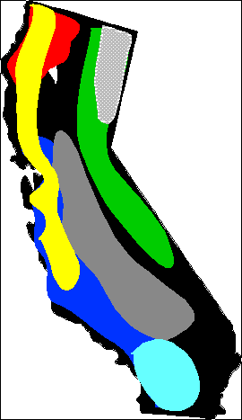
California invaded: 1849 A.D.
Xylella scorch of maples 2000s
Port Orford Cedar Root Disease
1950s
Expansion of root pathogens
Post 1880s
Root canker of Pacific Madrone and Bay laurel (70s)
Manzanita die-back 2004
Sudden Oak Death
1990s
White pine blister rust
1930s
Cypress canker 20s
Dutch Elm Disease
1960s
Colored canker of sycamore 70s
Pitch canker disease
1980s
Oak root canker
2000
1000 canker disease of walnuts 2001

Slide 2
Port Orford Cedar root disease; exotic agent= Phytophthora lateralis (East Asia); first found in a nursery in Oregon
Sudden Oak Death; exotic agent Phytophthora ramorum (origin unknown) introduced late ‘80s multiple times by infected ornamental plants
Colored canker of sycamore, exotic agent Ceratocystsis platani from East coast, introduced through wood packaging or untreated wood
Pine pitch canker, exotic agent Fusarium circinatum introduced in the 80s on pine seed and pine seedlings, origin: Mexico
Oak root canker caused by exotic Phytophthora cinnamomi introduced from Papua New Guinea via orchard stock prbably after World War II. Same pathogen causes manzanita die-offs (Sierra Nevada Foothills) and decline of Bay Laurel and Pacific Madrone (greater bay area)
Cypress canker outbreaks caused by native Seiridium cardinale on trees planted off site or on artificial crosses
Dutch Elm Disease first caused by exotic Ophiostoma ulmi then replaced by more aggressive O. novo-ulmi in the 60s’s. From Asia via Europe via infected wood and vectoring insects (one European and one North American)
1000 canker disease caused by fungus Geosmithia morbida (exotic to Ca) vectored by native walnut twig beetle (post 2003)
White pine blister rust caused by Cronartium ribicola introduced from Asia via France on infected western white pine in 1914 in Vancouver island
Native Heterobasidion on pines, junipers, sequoias and true firs increased by change in tree species composition, logging and fire exclusion
Xylella= Pierce’s disease via Mexico/Southern California

Slide 3
White pine blister rust:
An emergent disease caused by an introduced pathogen

Slide 4
The tree host: white pines
Genus Pinus
Hapoxylon subgroup
Five-needled
Eastern and western white pines, whitebark, sugar, limber, southwestern white, foxtail, bristlecone pines
Whitebark is closely related to European stone pines, where rust is endemic (but there are questions on whether it is the same species)

Slide 5
In Western North America
Nine species of white pines
Eight are infected (P. longaeva is the only one without a report)
Incidence of disease is not same across all species. E. g.: western white pine less resistant than Sugar pine. SP require wave years for infection to occur, that is years where Fall conditions have mild temperatures and rainfall

Slide 6
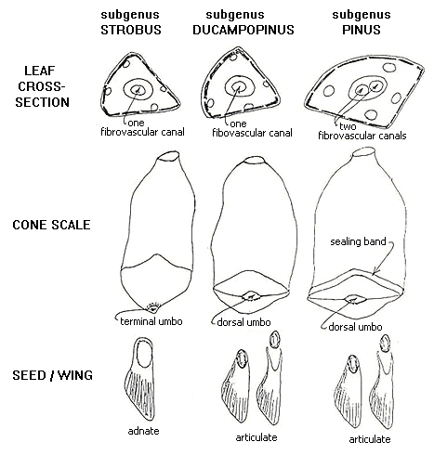
Some details on Pinus

Slide 7
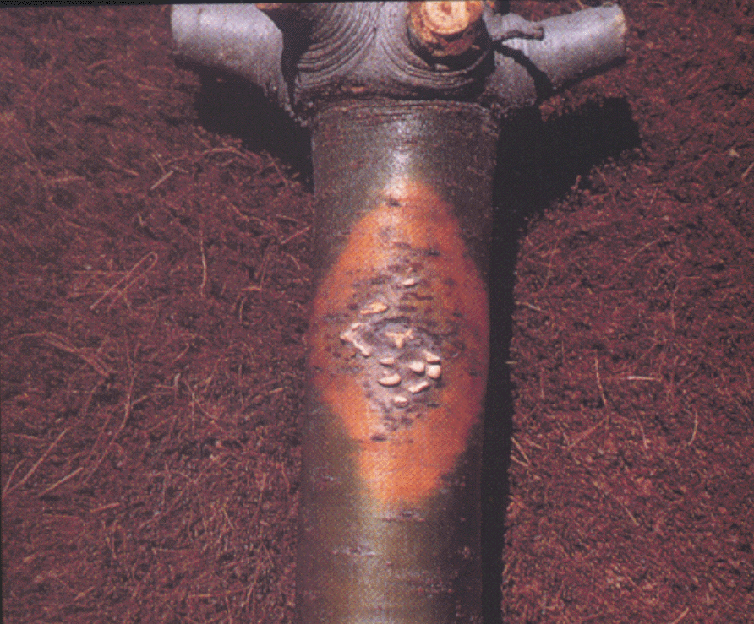
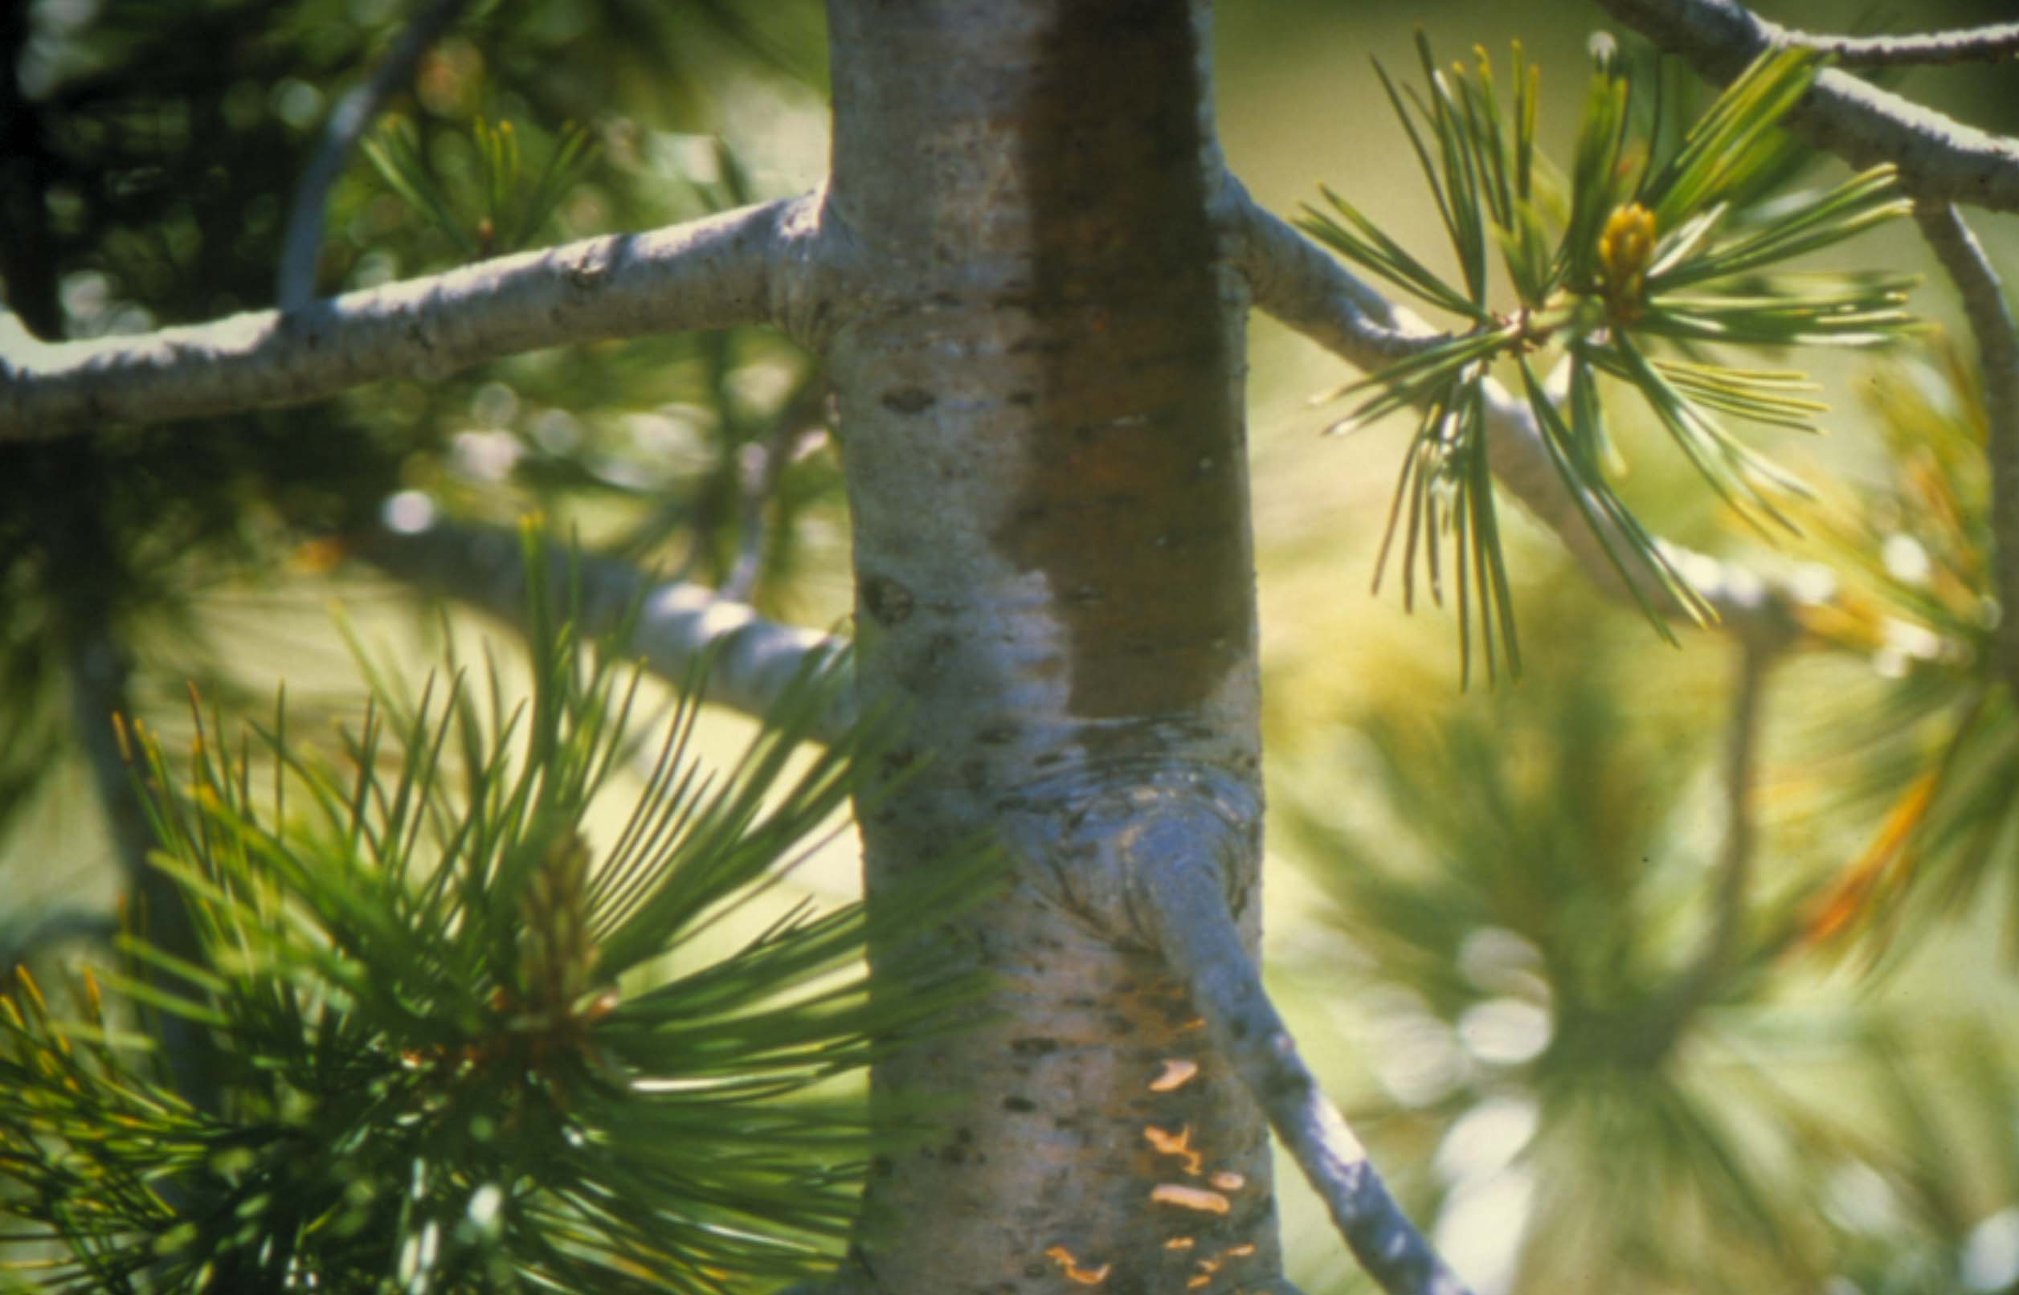
Blister rust cankers: sugar pine whitebark pine

Slide 8
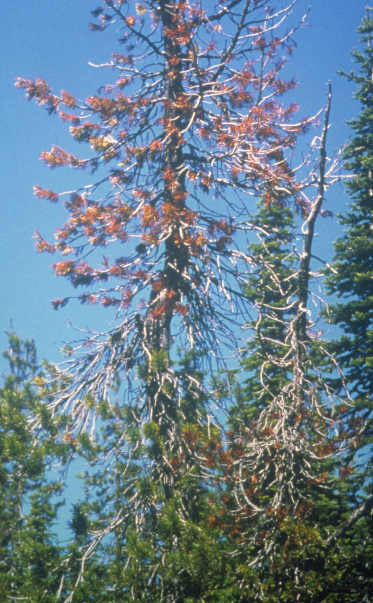
Top kill in whitebark pine

Slide 9
Cronartium ribicola: the causal agent
Complex system involving 5 spore stages and two hosts
  Pinus and Ribes
Introduced into North America around 1900 on infected eastern white pine stock; separate introductions on east and west coasts
Native to Asia

Slide 10
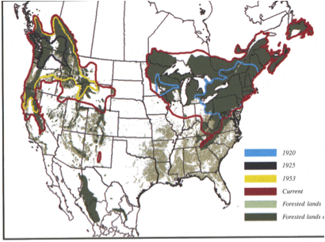

Slide 11
Some details about introduction
1906 on East Coast, but there are records of many shipments from Germany and Holland, in multiple locations including the midwest
1910, Vancouver BC, One shipment documented from France but most reconstructions suggest more than a single introduction occurred
Ribes also imported from Europe, but most ribes loose their foliage in fall, Introduction most likley to have happened through pines

Slide 12
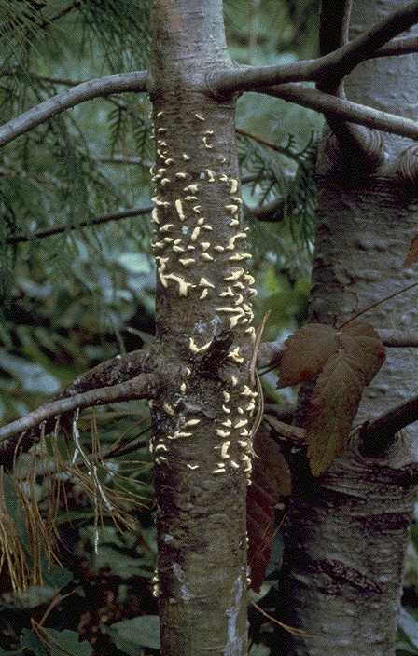
Methods
4 collection sites of a single aecidia in West
  2 coastal sites (Manning Park, BC; Sacramento, NM)
  2 interior sites (Smallwood, BC; Shelter Bay, BC)
4 collection sites in the East
  Ste-Camille, Quebec; Minden, Ontario; Little Grand Lake, NFLD; Moncton, New Brunswick

Slide 13
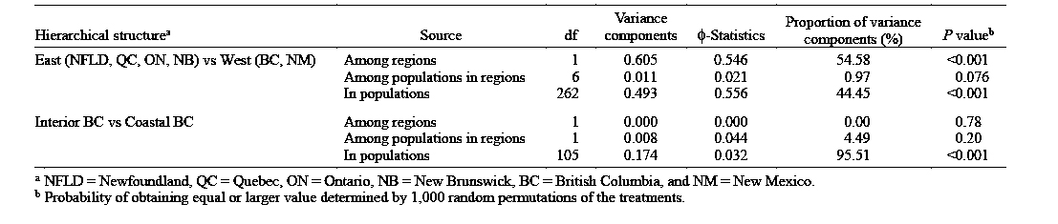
Results
Among regions: West v. East (0.605)
  Migration between east and west extremely low, less than 1 migrant per generation
Among populations in regions (but markers were imperfect and fail to detect differences among western populations)
  East (0.00 – 0.02)
  West (0.00- 0.02)
In Populations (0.493), a lot of sexual reproduction> No surprise because of rust cycle

Slide 14
Shelter Bay = interior BC
Manning Park = interior BC
Smallwood = coastal BC

Slide 15
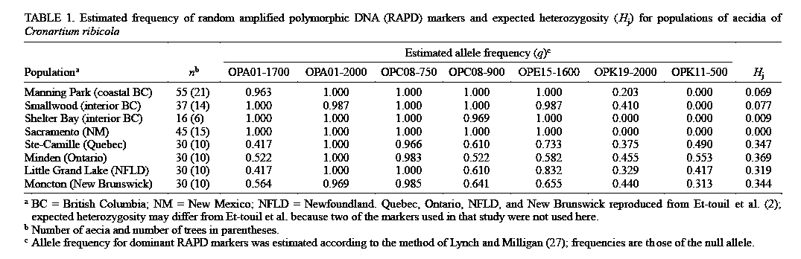
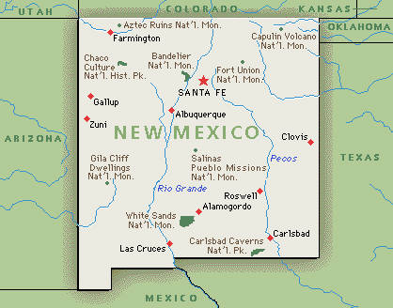
New Mexico Revisted
Sacramento, NM
All fixed loci, absence of heterozygots
Founder’s effect
Low genetic differentiation = genetic bottleneck

Slide 16
Conclusions
Eastern and western populations are not panmictic
Barrier to gene flow between eastern and western populations
  Great Plains – intense agriculture
  100 km absence of aecial and telial hosts

Slide 17
Factors affecting spread
Founder population of pathogen (Germany vs. France)
Number of introductions
Species of white pines
Amount of obligate alternate host Ribes and their distance from pines
Climate: as it gets colder infection less successful (for instance moving inland and east in Easter North America)
Weather: pine infection requires rainfall and moderate temperature in Fall, as we move South in the West these conditions happen only rarely, when they do we speak of WAVE YEAR
Topography: the more rugged the more difficult the spread. Although while basidiospores only travel a few hundred yards or a few km in the presence of currents induced by lakes in mountainous areas, aeciopsores may be able to travel over 1000km
Amount of resistance within species For instance in Sugar pine resistance is 1% in North and 8% in South CA, maybe due to resistance to C . occidentale, a rust of pinyon pines

Slide 18
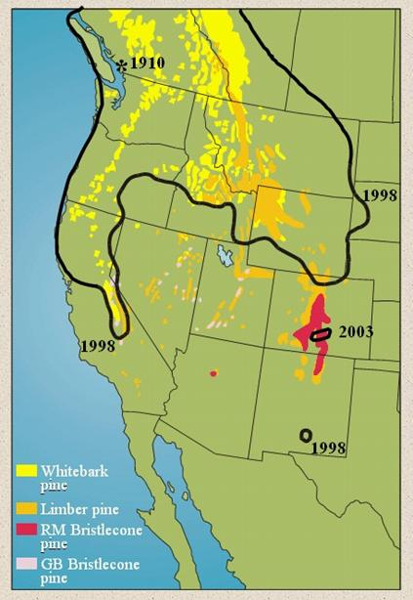
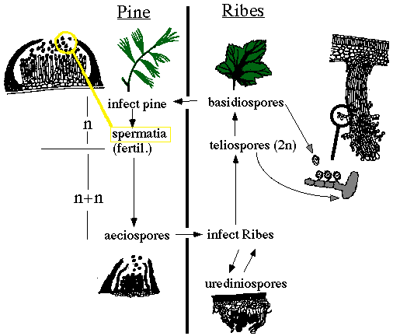

Slide 19
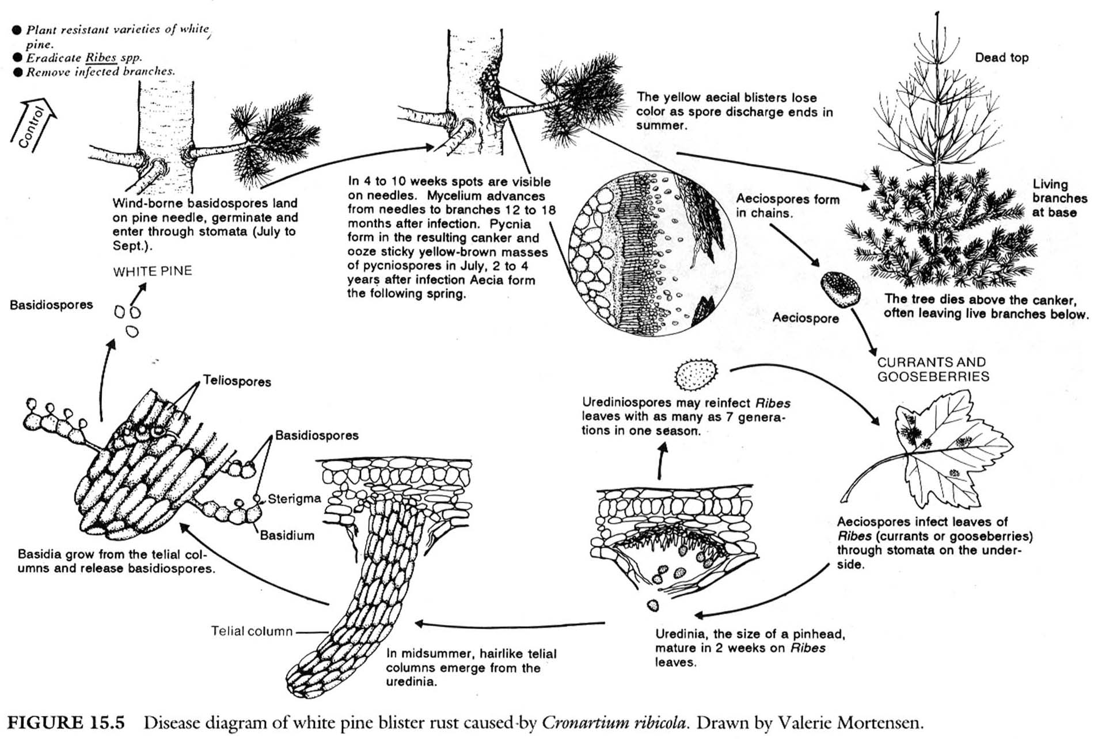
C. ribicola life cycle

Slide 20
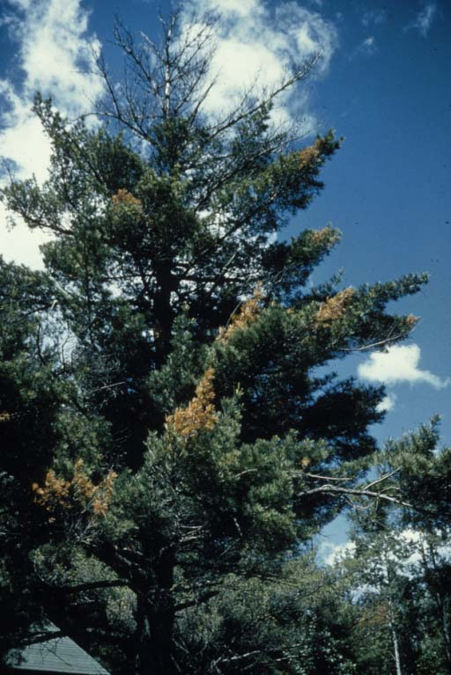

Slide 21
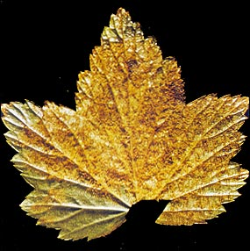

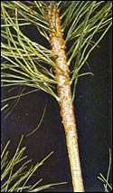
Cronartium ribicola—Causal Agent of White Pine Blister Rust
WPBR is an exotic disease from EU
Leaves above the canker die, causing branch/stem to break
Opens site for decay fungus
Next Spring: spores cause blisters and thus cankers
Fall: fungus attacks needles
Two Years Later: Fungus spreads to branches and trunk
Spore produced to transmit disease
Notes:
All species of white pine (or five needle pines) in North America are susceptible to the pathogen. As is common with many other rust fungi, two different host species are required for this fungus to complete its life cycle. Ribesspecies (currant and gooseberry) serve as the alternate host.
-In summer, telia are produced, which are rough hairs. Wet conditions, teliospores germinate, form basidium to produce basidiospores. Basidiospores disperse by air and these infect pine.

Slide 22
A Few Pathogen Details
Infection occurs through stomata of needles of all age, if needle is on stem then infection directly leads to tree girdling. If needle on branch, it will cause branch death and then if it moves into stem it will cause stem girdling, if stem does not die before pathogen gets to stem…
Because pathogen is obligate biotroph
Overall Low genetic diversity in N.A. Sign of introduced disease
  Diversity between subpopulations is greater in West because of rugged topography
  Indicative of frequent founder events and little gene flow
Genetic center: Asia
To infect white pines: 48 hours <68 F, 100% relative humidity

Slide 23
Attempts to control WPBR
Ribes eradication
  More successful in East than West
Use of Risk Zones for planting and management
  potential pitfalls: must also account for airflow patterns
Pruning
  Can be successful if infection caught 12 inches from main stem; costly; may need repeated entries; probably would not work in whitebark
Genetics: probably most successful method
  Sugar and western white pines
  Whitebark pine work in progress

Slide 24
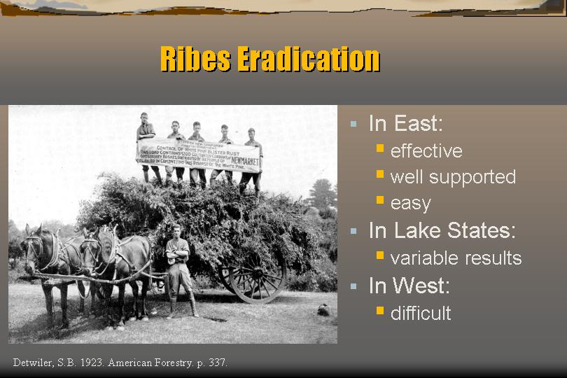

Slide 25
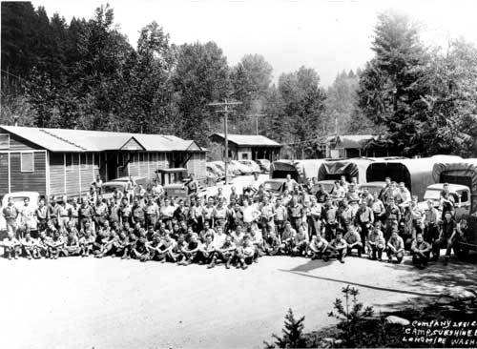
Civilian Conservation Camps during the Depression,

Slide 26
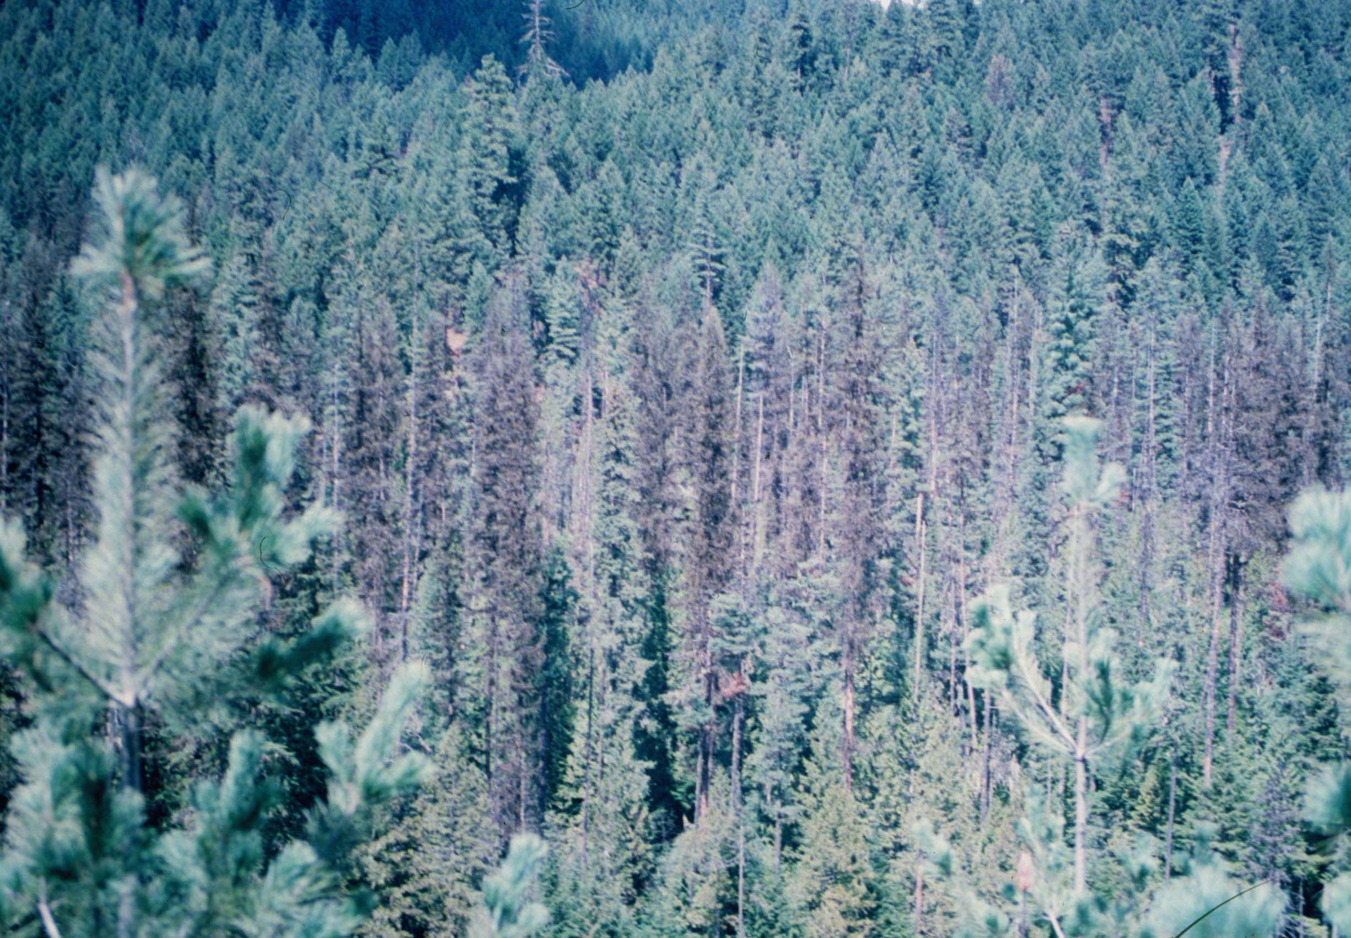
Widespread mortality in western white pine

Slide 27
Why mortality appears in clusters if pine to pine infection does not occur ?
1- Threshold of inoculum necessary for infections low in western white pine, so a single source can infect trees at various distance because dilution effects with distance are less pronounced
2- Resistance very infrequent (1 in a thousand)
3- Compounding effect of Mountain Pine Beetle

Slide 28
Pruning research in sugar pine
before...

Slide 29
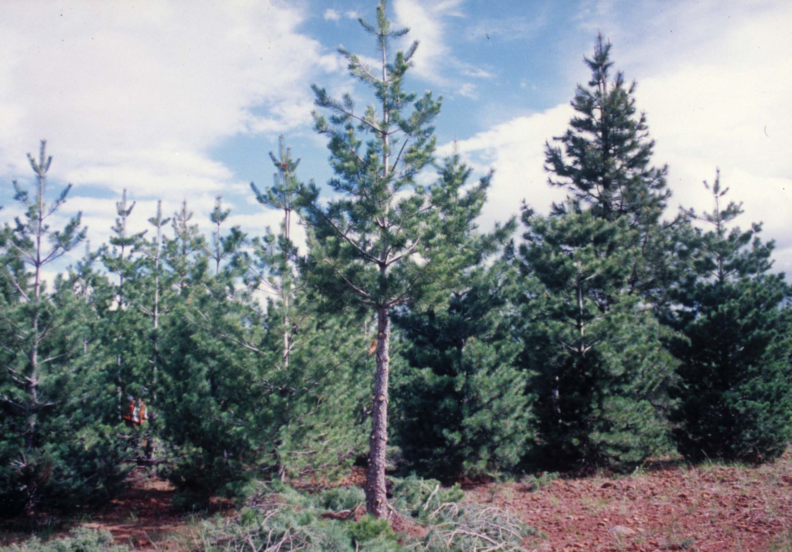
Pruning research in sugar pine
...after

Slide 30
Eastern white pine (P. strobus)
Largely cut over prior to rust, so loss due to rust minimal, but regenerating difficult
Only tree where Ribes control was mildly successful
Most land managers won’t risk it in high risk zones

Slide 31

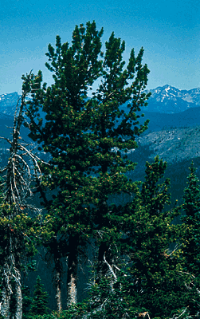
Whitebark pine (P. albicaulis)
High elevations in the western US and Canada
Keystone species; slow growth
Mutualistic relationship
with Clark’s nutcracker
Wildlife dependence on nuts
Restoration treatments: a helping hand for a tree with a bleak future

Slide 32
Western white pine (P. monticola)
Largely disappeared from the Inland Northwest, where it was once most valuable timber species
Like eastern wp, avoided in plantings
Changing species comp. and structure made forest more susceptible to fire, insects and other pathogens

Slide 33
Sugar pine (P. lambertiana)
CA and PNW
Tree of largest stature in mixed-conifer forests
Few native pests, none causing such widespread mortality
Also avoided in some planted settings
Resistance 1% to 8%

Slide 34
Tree resistance
Major gene for resistance
Found in sugar, western white, and southwestern white so far
  Thought to be gene-for-gene (because virulent race of pathogen neutralizes this gene)
  Gene-for-gene typically indicates a pathosystem in which the host and pathogen have evolved over long time periods- so what is going on in this system?

Slide 35
A quick review of gene-for-gene resistance

Slide 36
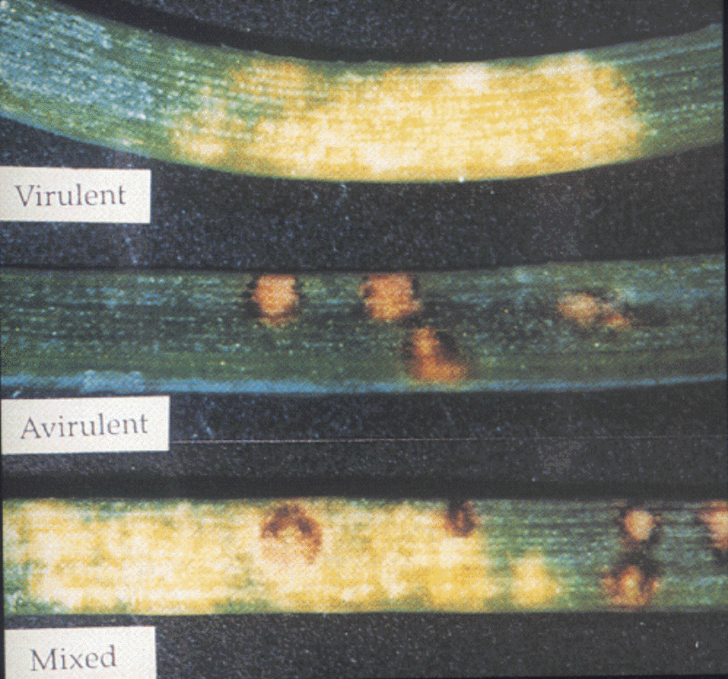
Lesion types: sugar pine

Slide 37
Additional types of tree resistance
Sugar pine
  Slow rusting resistance - many components of resistance combined into a single phenotypic expression, exhibited as amount and type of infection with moderately strong inheritance and independently inherited expressions (low infection # and high infection abortion)
  Ontogenetic resistance - another phenotypic expression that develops as the tree ages; under genetic controls; offspring may be fully susceptible

Slide 38
Additional types of tree resistance, cont’d
Western white pine
  Slow canker growth - non race specific trait; produces abnormally small cankers; may reduce pruning necessity (due to success)
  Reduced needle lesion frequency - also non race specific trait; few individual infection sites per seedling; may only be juvenile trait (seen in cotyledons)

Slide 39
Evaluation of longevity of control practices
Race of pathogen able to overcome major gene resistance in Sugar pine already present. Slow resistance or combination of two may be more durable approach

Slide 40
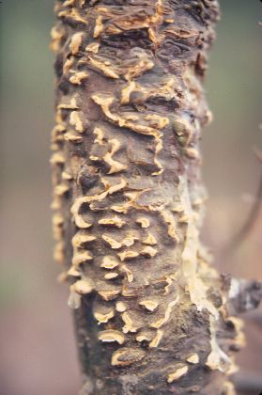
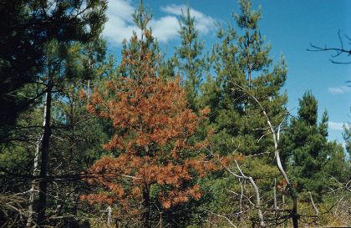
Influence of Host Resistance on the Genetic Structure of White Pine Blister Rust Fungus in the Western United States
Richardson, Klopfenstein, Zambino, McDonald, Geils, Carris

Slide 41
Purpose
Examine genetic diversity within and among population of western N.America
Effects of host resistance on C. ribicola
Identify loci that behave as if linked to loci undergoing environmental selection

Slide 42
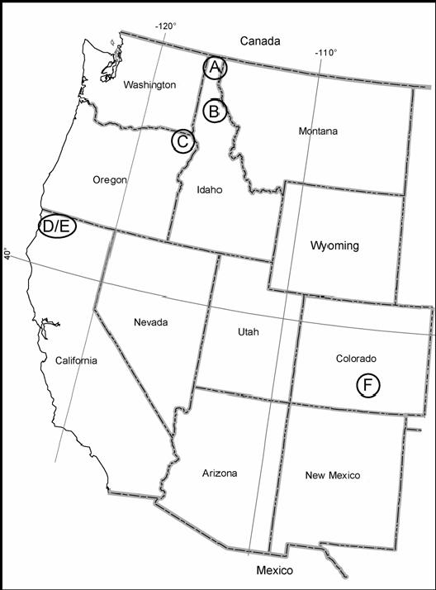
Material + Methods
Sampling of isolates from 6 sites
B= merry creek: multigenic resistant, D= happy camp : major gene resistant

Slide 43
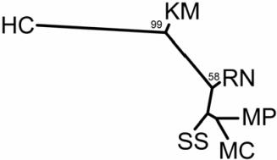
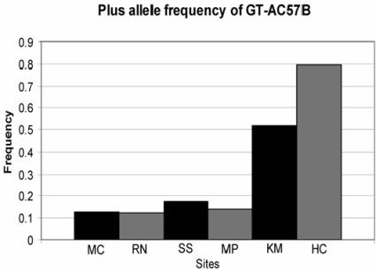
Results
Low number of polymorphic loci among 148 C. ribicola isolates
Heterozygosity
  Highest at MC
  Lowest at HC
Fst= 0.082 among sites, significant

Slide 44
Discussion
Effects of host resistance on C. ribicola
Merry Creek (multigenic resistant trees): had highest heterozygosity
Happy Camp (major gene resistant trees): had
lower heterozygosity
- Selection for rust isolates carrying vc1 because all trees have cr1.
Notes:
Genetic background of MC: composite host population from various lcoations,
HC: composite of field collected major gene resistant trees
Seems as though both have higher heterozygosity than local stands.
2 HC isolates closer to population 1 and 2 instead of 3. Perhaps hybrids or non vcr1?

Slide 45
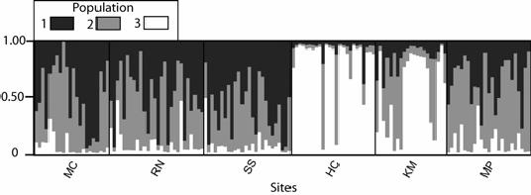
Results
Possibly 3 populations of C. Ribicola in Western US
Loci GFAC57B had very high Fst among different sites.
Notes:
HC in population 3.

Slide 46
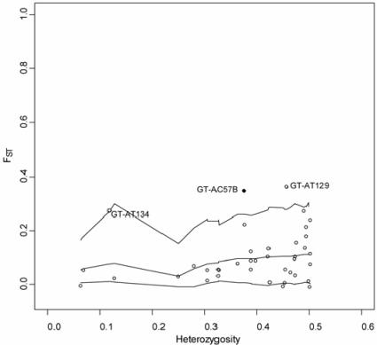
Discussion
Identify loci undergoing environmental selection
GTAC57B could be linked to genes under selection.

Slide 47
Mortality and decline of white pine not only due to WPBR
Fire suppression: most wp species like open spaces created by fire and are fire-adapted. With lack of fire, site are encroached by shade tolerant species and white pine regeneration is limited
Insect (mountain pine beetle ) outbreaks. When populations of this insect become large they attack healthy trees as well. Effect of WPBT and mountain pine beetle is more than the sum of the two
Dothistroma needle blight can cause outbreaks, however both Dothistroma and insect outbreaks may be cyclical and natural
Global warming

Slide 48
Consequences of wp mortality
Group of species that is extremely adaptable, and that in western North America, depending on latitude, goes from sea level to tree-line
High market value: white pines timber is king. In past times it was the best timber to build ships’ masts. One of the reasons for the secession of American territories
It includes the oldest living organism on earth (Bristlecone pine)
In the Rockies it is essential for survival of Clark’s nutcracker and Grizzly bears. In the West, white pines are diversity hotspots

Slide 49
"In North America, white pine blister rust has caused more damage and costs more to control than any other conifer disease. Since the 1920's, millions of dollars have been spent on the eradication of the alternate host, Ribes, and thousands of white pine stands have been severely damaged. In the western United States and Canada, some stands have been completely destroyed. When the main stem of a tree is invaded, death is only a question of time.“
Robert F. Sharpf, U.S. Department of Agriculture Handbook 521 (p.85)

Slide 50
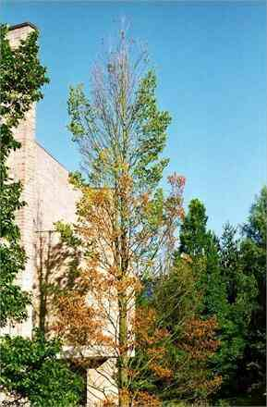
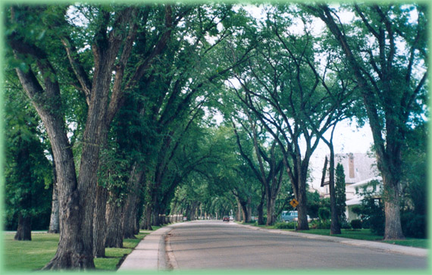
Dutch Elm Disease
Notes:
Foliage symptoms: Symptoms of DED begin as wilting of leaves and proceed to yellowing and browning. The pattern of symptom progression within the crown varies depending on where the fungus is introduced to the tree. If the fungus enters the tree through roots grafted to infected trees (see disease cycle section), the symptoms may begin in the lower crown on the side nearest the graft and the entire crown may be affected very rapidly. If infection begins in the upper crown, symptoms often first appear at the end of an individual branch (called "flagging") and progress downward in the crown (cover photo).
Multiple branches may be individually infected, resulting in symptom development at several locations in the crown (figure 2). Symptoms begin in late spring or any time later during the growing season. However, if the tree was infected the previous year (and not detected), symptoms may first be observed in early spring. Symptoms may progress throughout the whole tree in a single season, or may take two or more years.
Vascular symptoms: Branches and stems of elms infected by the DED fungus typically develop dark streaks of discoloration. To detect discoloration, cut through and peel off the bark of a dying branch to expose the outer rings of wood. In newly infected branches, brown streaks characteristically appear in the sapwood of the current year (figure 3). It is important to cut deeply into the wood or look at the branch in cross section for two reasons: (1) As the season progresses, the staining may be overlaid by unstained wood, and (2) if infection occurred in the previous year, the current sapwood may not be discolored.

Slide 51
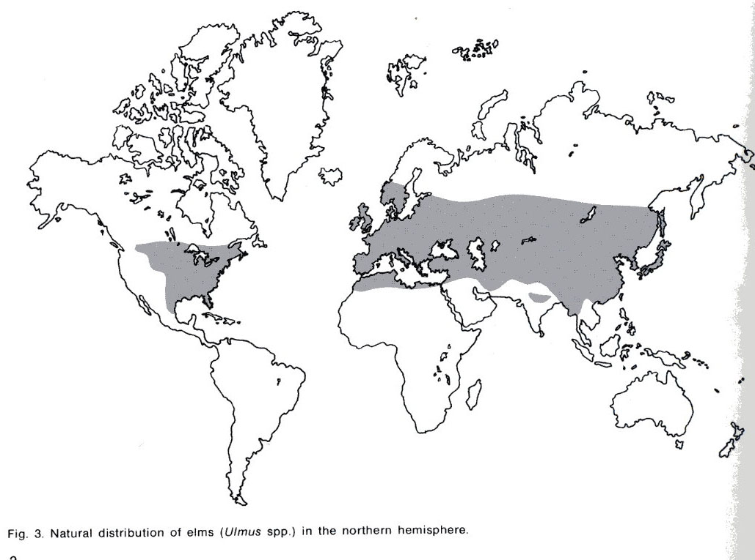
Host: the Elms (genus Ulmus)
>30 species in genus. Europe has 5; N. America 8; Asia has 23 or more
6 species native to the northeastern U.S., including Ulmus americana, the American elm
New species are still being found in China, the center of diversity
Notes:
The elm host. Native species of North American elms vary in their susceptibility to DED, even within species. American elm (Ulmus americana L.) is generally highly susceptible. Winged elm (U. alata Michx.), September elm (U. serotina Sarg.), slippery elm (U. rubra Muhl.), rock elm (U. thomasii Sarg.), and cedar elm (U. crassifolia Nutt.) range from susceptible to somewhat resistant. No native elms are immune to DED, but some individuals or cultivars have a higher tolerance (and thus may recover from or survive with infection) or resistance to DED. Many European and Asiatic elms are less susceptible than American elm.
In addition to genetic factors present in some cultivars and species, physical factors affect tree susceptibility. These factors include time of year, climatic conditions (such as drought) and vitality of the tree. Water conducting elements are most susceptible to infection as they are being produced in the spring, thus elms are most susceptible to infection after earliest leafing out to midsummer. Trees are less susceptible under drought conditions. Vigorously growing trees are generally more susceptible than slower growing trees.

Slide 52
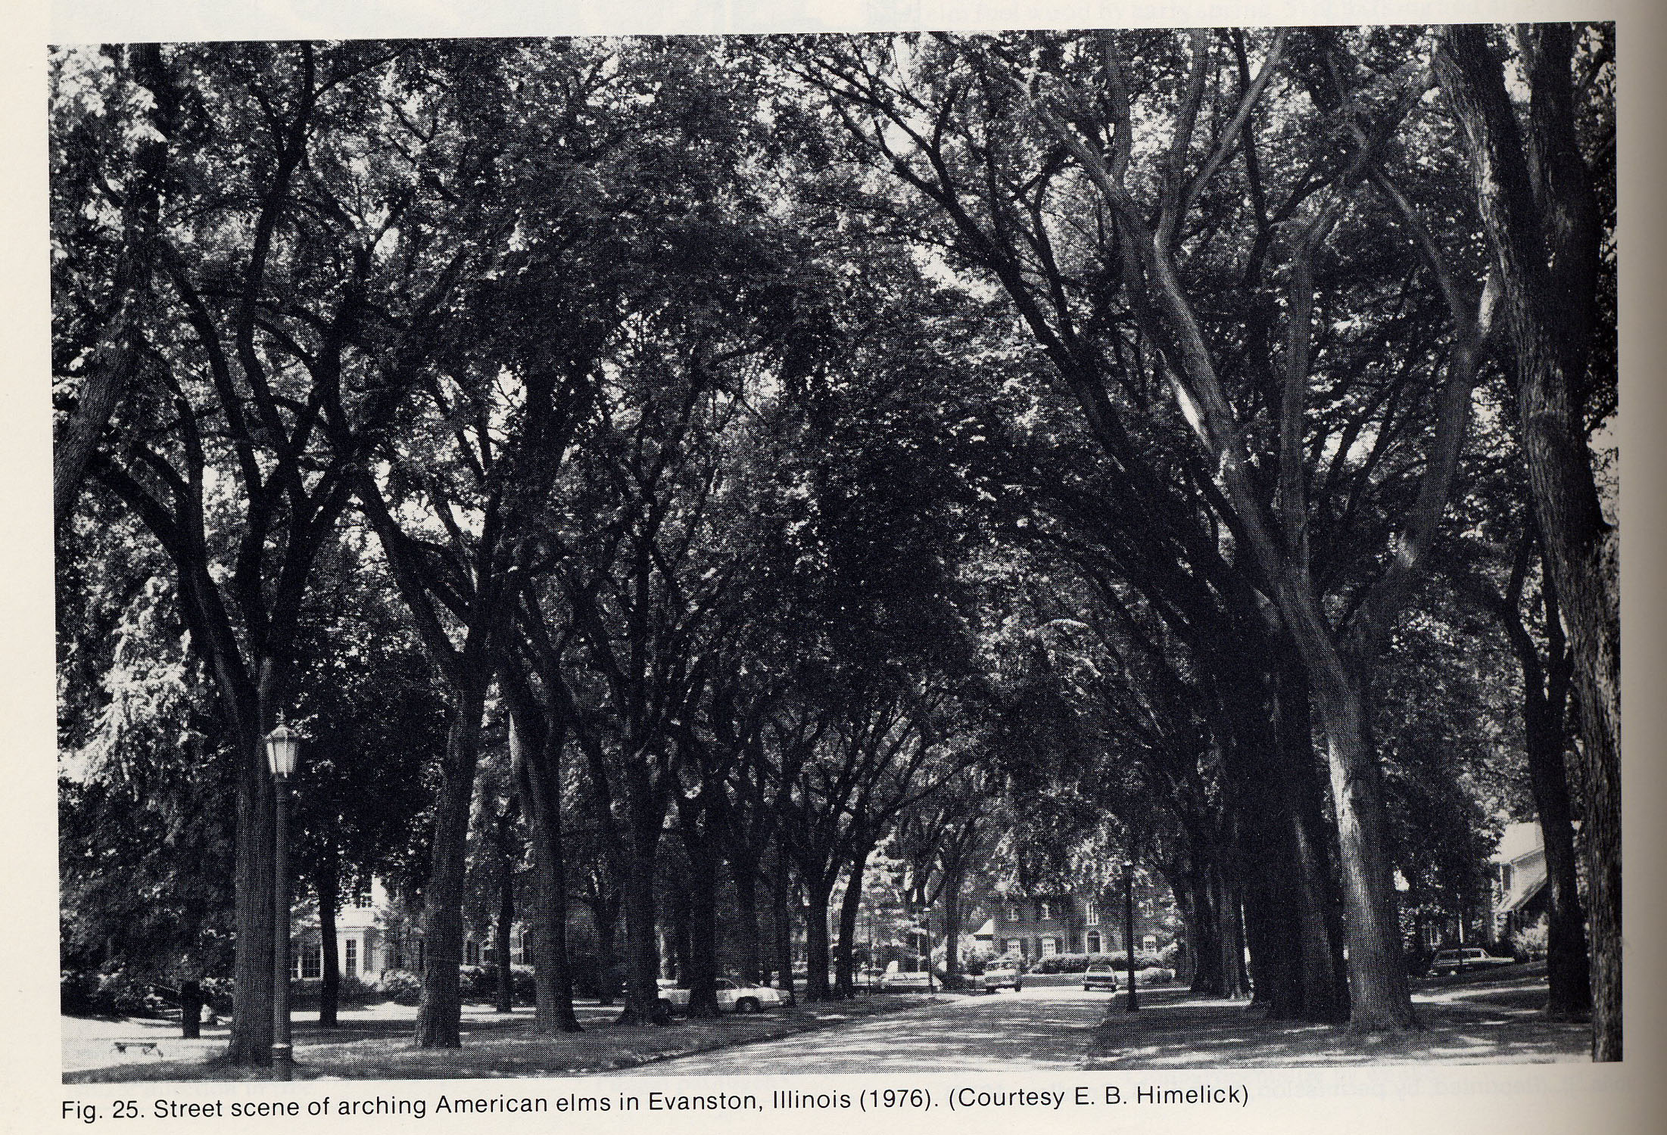
Elms: the perfect shade tree
Used as street-liners
Fast-growing,
easily transported, tolerant
of soil compaction and
different soil types
Shade trees, with branches borne high above ground. When
planted in rows, they
overhang the street
forming a Gothic-style arch. Good for windbreaks
#1 urban tree in U.S east of the Rockies, and in large parts of Europe and Asia (Heybroek, 1993)

Slide 53
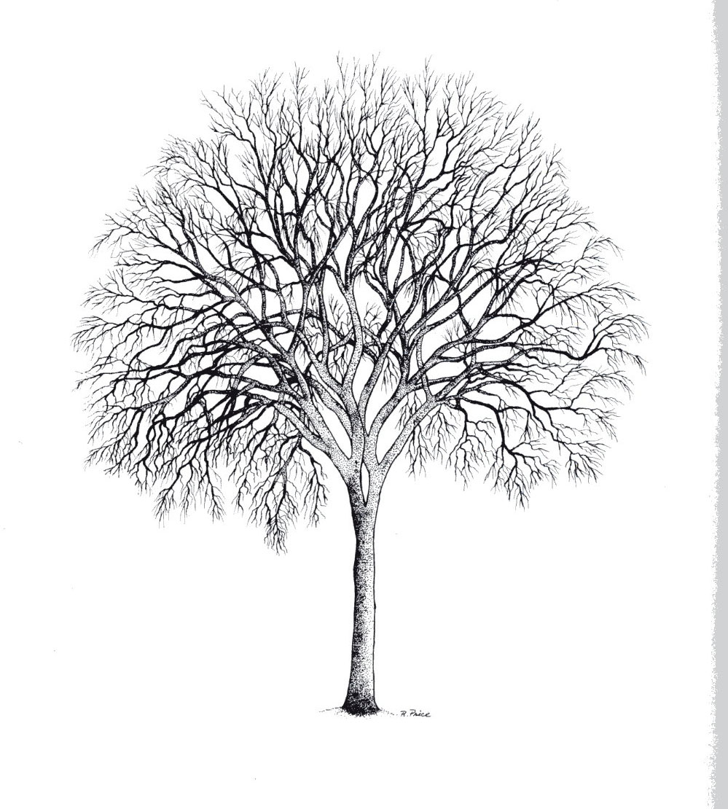
Elms: rural and natural Settings
In rural settings:
In coastal western Europe, used as windbreaks
The Siberian Elm was planted as “shelterbelts” to prevent erosion during the Dustbowl in the 30’s in the U.S.
In Natural Settings:
A generally riparian, river bottom group that can survive periods of anoxia, explaining tolerance to over-watering and soil compaction

Slide 54
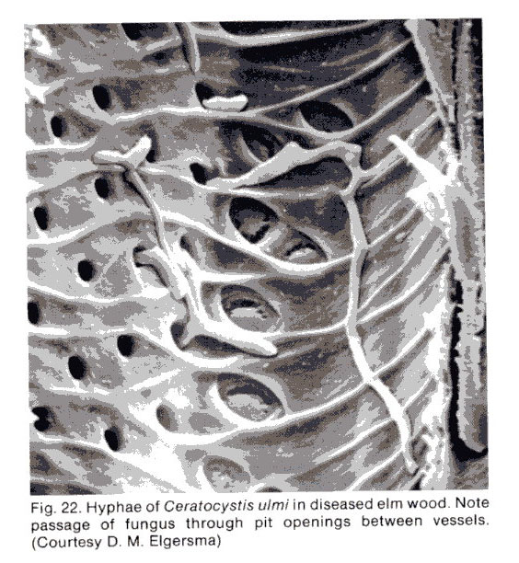
Overview: Dutch Elm Disease
Why “Dutch”? First isolated in 1920 by a Dr. Schwarz in the Netherlands
Wilt disease that attacks elm (Ulmus ssp) and spreads through the vascular system
Caused by ascomycete fungi (genus Ophiostoma)
Vectored by beetles (family Scolytidae) and root graft
Notes:
Frequently, by the time first symptoms are noted, the fungus has already reached scaffold branches or the main trunk of the tree. Once the fungus is established within a tree, it spreads rapidly via the water-conducting vessels. The tree forms gums within these vessels in response to the presence of the fungus, causing the tree to wilt and eventually die. Trees infected through root grafts wilt and die rapidly; this frequently occurs in the spring soon after the trees have leafed out and progresses from the base of the tree upward.
Vascular wilt diseases
Vascular wilt diseases are caused by pathogenic fungi or bacteria that enter the water-conducting xylem vessels of a plant, then proliferate within the vessels, causing water blockage. The typical symptoms include wilting and death of the leaves, followed often by death or serious impairment of the whole plant. As a group, therefore, the vascular wilts are among the most devastating plant diseases.
There are several interesting features of these diseases. For example, the blockage of the xylem vessels is not necessarily caused by the pathogens themselves but often by the host reactions to invasion - the production of gel-like materials which serve as potential barriers to spread of the pathogens in the vessels. In addition, some of the symptoms, such as the common yellowing of the leaves and the loss of control of stomatal function, may are caused by toxins produced by the pathogens. But perhaps the most interesting point is that the pathogens have only a weak ability to invade living plant tissues; instead, they grow in the nutrient-poor conditions of the water-conducting vessels, and they only grow into the rest of the plant when it has been weakened or killed by water stress.
DED symptoms are the result of a fungus infecting the vascular (water conducting) system of the tree. Infection by the fungus results in clogging of vascular tissues, preventing water movement to the crown and causing visual symptoms as the tree wilts and dies.
Foliage symptoms: Symptoms of DED begin as wilting of leaves and proceed to yellowing and browning. The pattern of symptom progression within the crown varies depending on where the fungus is introduced to the tree. If the fungus enters the tree through roots grafted to infected trees (see disease cycle section), the symptoms may begin in the lower crown on the side nearest the graft and the entire crown may be affected very rapidly. If infection begins in the upper crown, symptoms often first appear at the end of an individual branch (called "flagging") and progress downward in the crown (cover photo).
Multiple branches may be individually infected, resulting in symptom development at several locations in the crown (figure 2). Symptoms begin in late spring or any time later during the growing season. However, if the tree was infected the previous year (and not detected), symptoms may first be observed in early spring. Symptoms may progress throughout the whole tree in a single season, or may take two or more years.
Vascular symptoms: Branches and stems of elms infected by the DED fungus typically develop dark streaks of discoloration. To detect discoloration, cut through and peel off the bark of a dying branch to expose the outer rings of wood. In newly infected branches, brown streaks characteristically appear in the sapwood of the current year (figure 3). It is important to cut deeply into the wood or look at the branch in cross section for two reasons: (1) As the season progresses, the staining may be overlaid by unstained wood, and (2) if infection occurred in the previous year, the current sapwood may not be discolored.

Slide 55
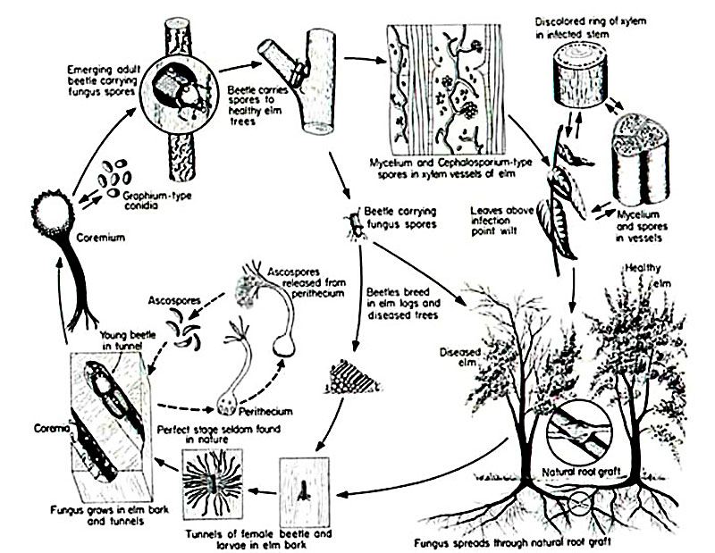
Life Cycle of Ophiostoma ulmi
Notes:
From the point of inoculation, the fungus moves upward and downward by two modes: in the liquid within xylem vessels and the growth of fungal hyphae between xylem vessels after germination. Ophiostoma novo-ulmi reaches the roots within one season of infection where it continues to grow. The fungus grows in the roots and ascends the trunk in a wave of infection that kills the entire tree or a major part of it. Where elms are planted close together and there is a possibility of root grafting, Ophiostoma novo-ulmi may move from one tree into the next through the roots. The fungus can also survive as a saprophyte in dead plant tissue.
According to Partridge (1997), O. ulmi s.l. is a rather complex fungus. It has four spore types: conidia produced on mycelium, conidia borne on a mycelial stalk (synnema), yeast like spores that are variable in size, and ascospores, which are produced in a black fruiting body (perithecium) which ooze through the long neck of the perithecium, and accumulate at the tip in sticky mass.

Slide 56
Vectors of disease
Insects: 1) the native elm beetle 2) the smaller European elm beetle. The beetles can fly for several miles, allowing the disease to spread over a wide area
Root grafts: when elms are within 50 feet of one another, their roots can grow together and disease passes easily along. Important in urban settings
Infected logs: Often transferred long distances

Slide 57
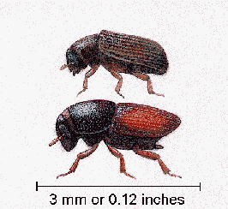
Beetles: key disease vector
1) Native elm bark beetle (Hylurgopinus rufipes) (above) is the primary vector in parts of the northern United States, New England, and all of Canada.
However, temperatures below -6F kill the larvae.
2) European elm bark beetle (Scolytus multistriatus Marsh.) (below) is the major vector of the disease.

Slide 58
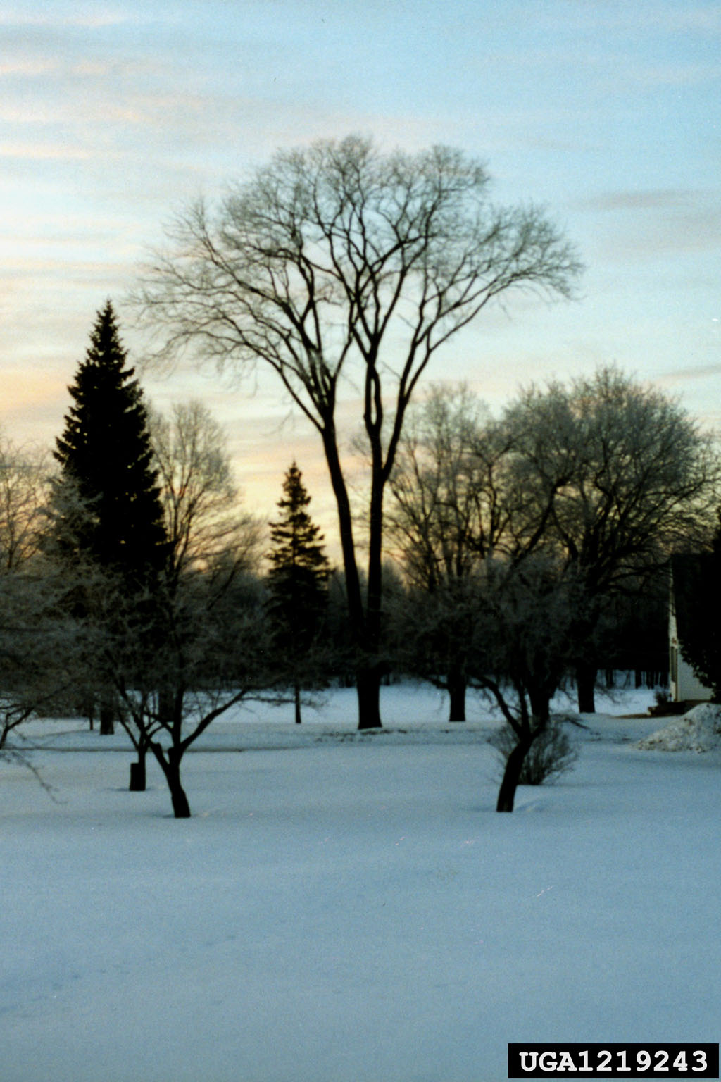

Slide 59
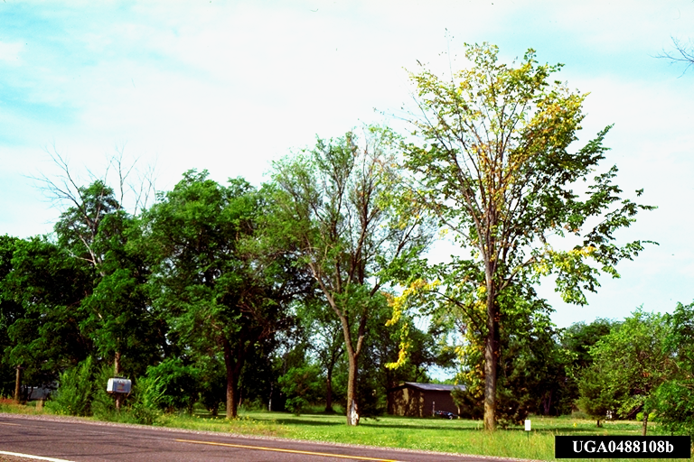
Dutch elm disease – crown symptoms

Slide 60
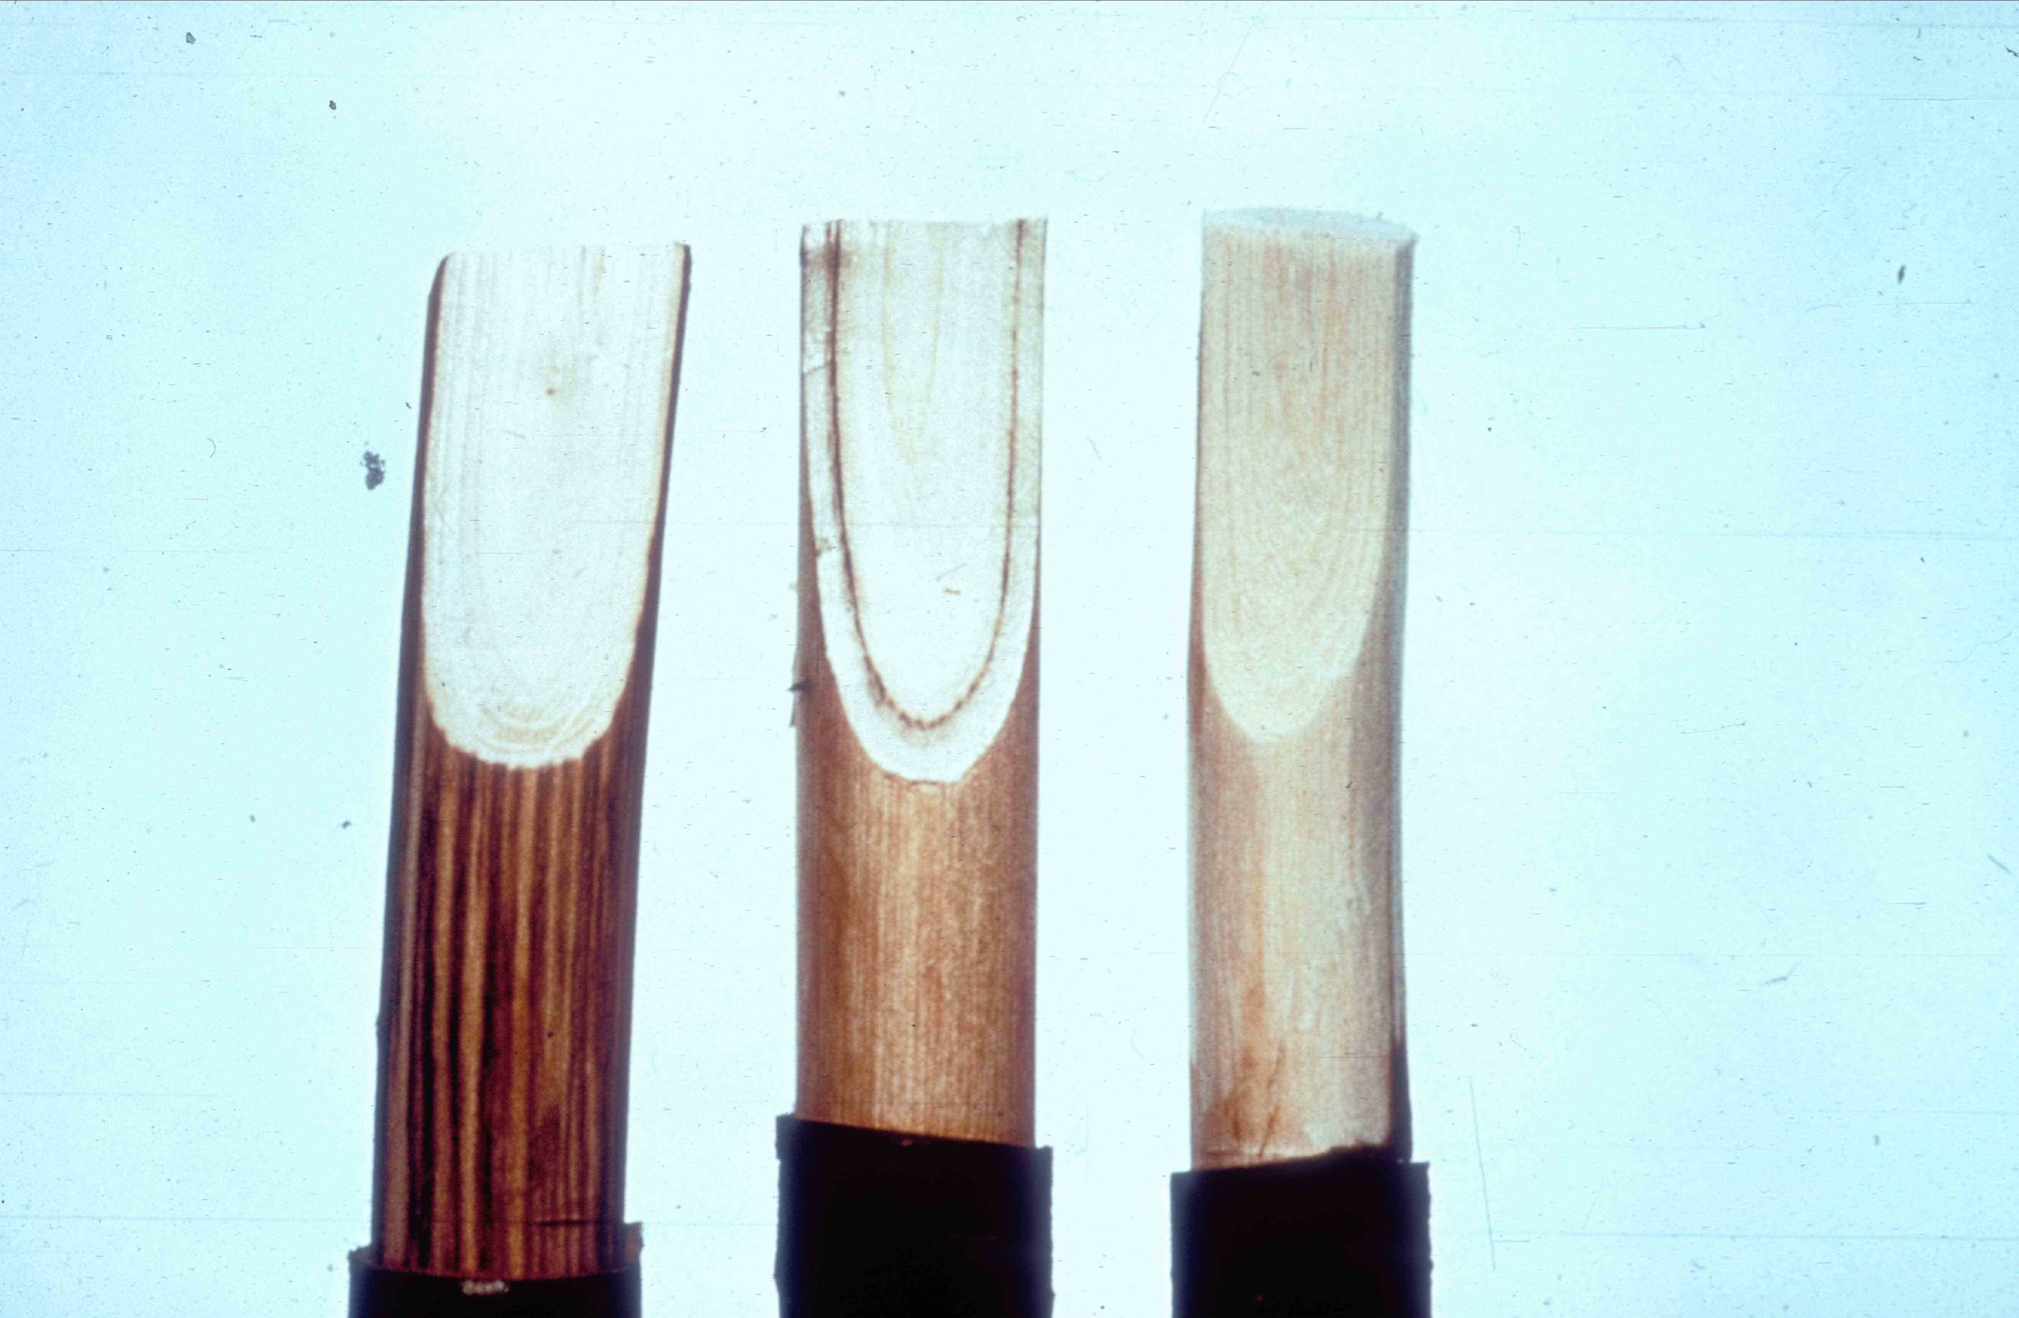
Dutch elm disease – vascular discoloration

Slide 61
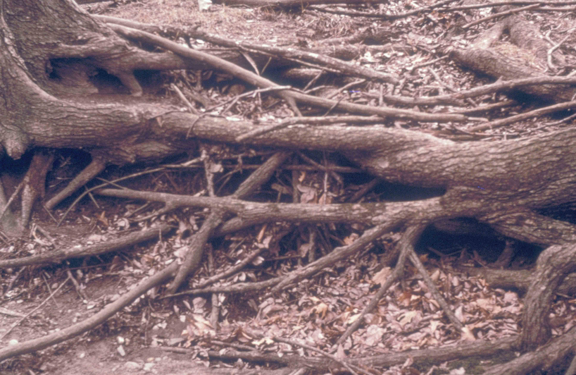
Elm root grafts

Slide 62
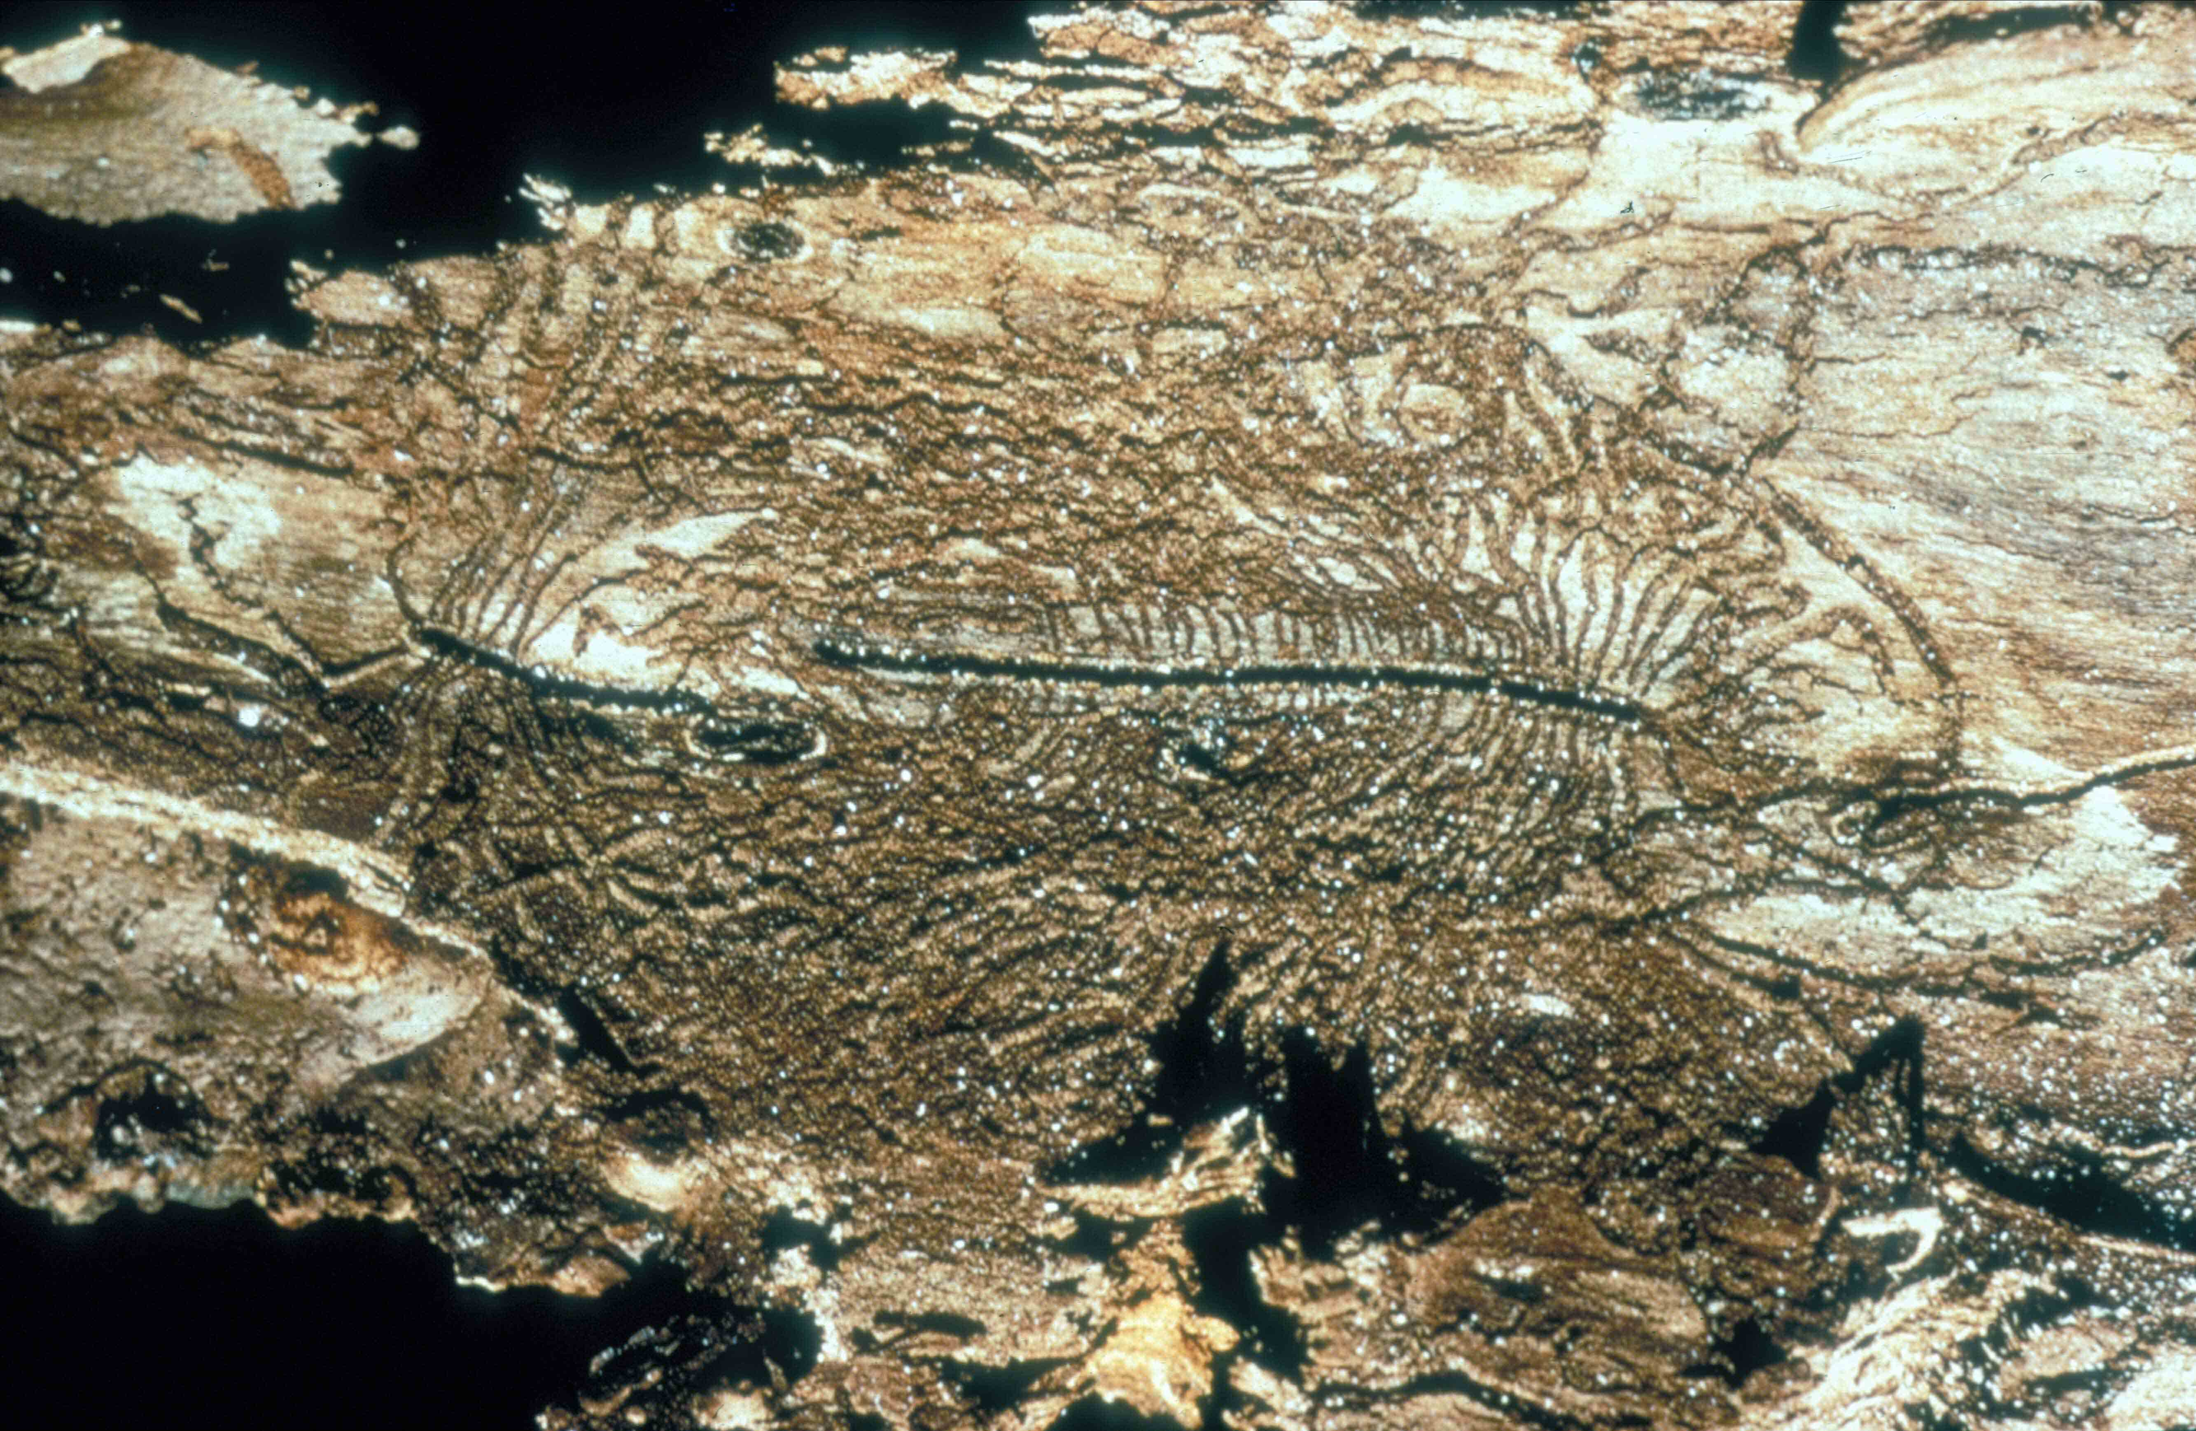
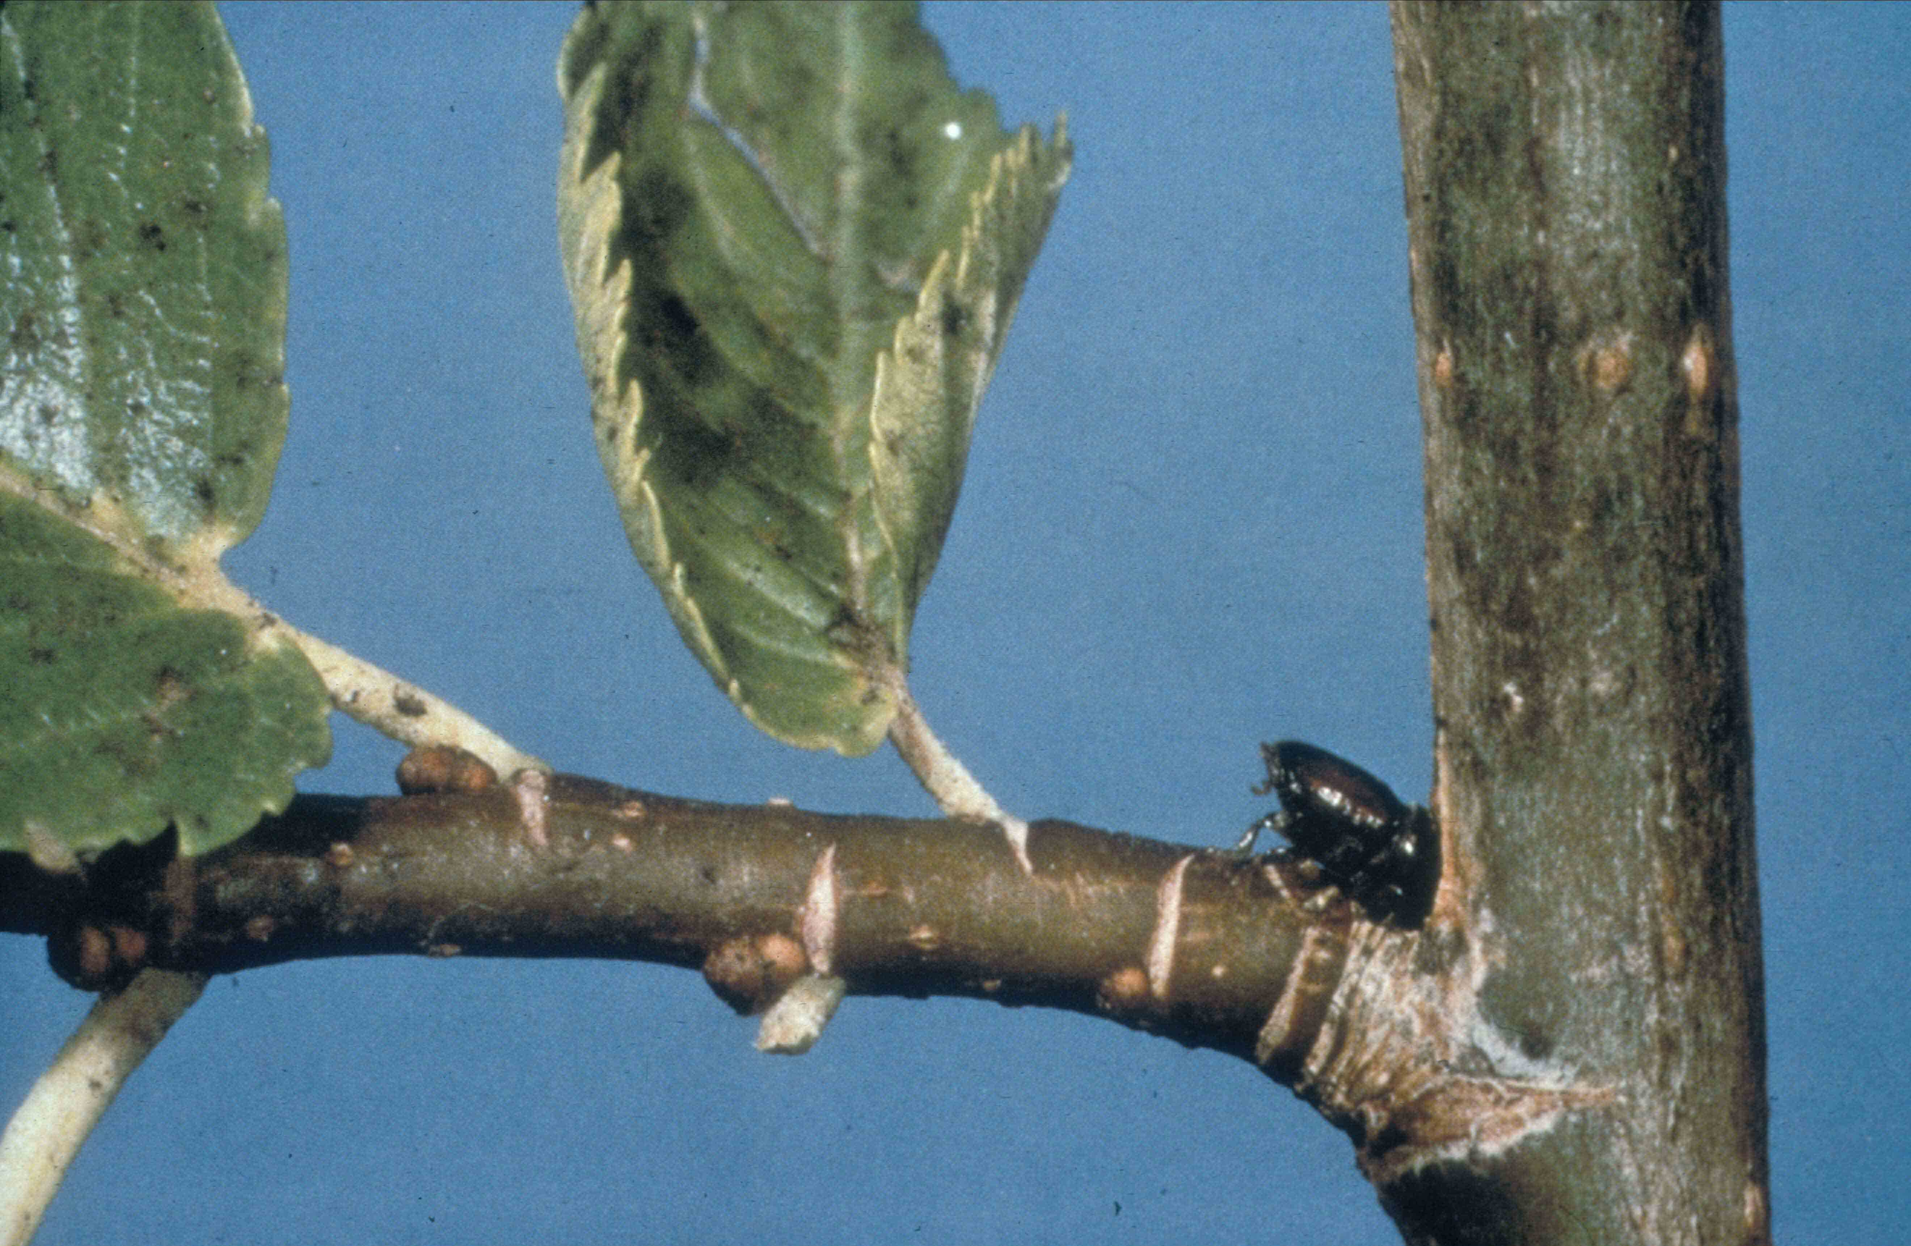
Elm bark beetle galleries
Maturation feeding

Slide 63
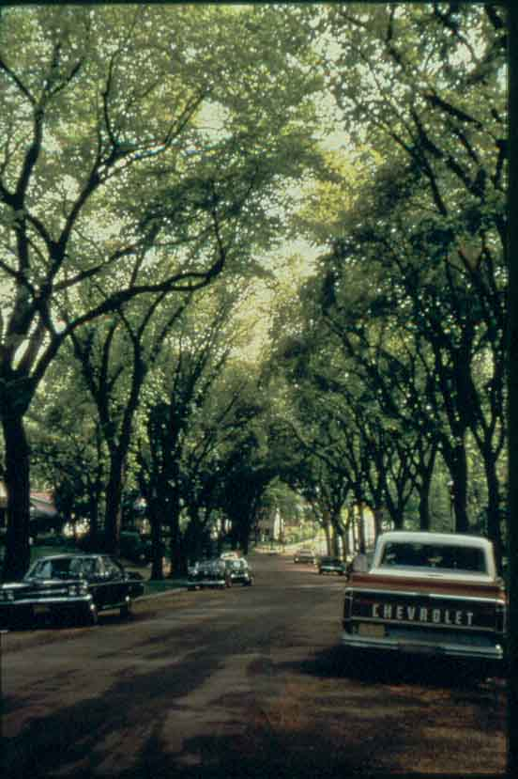
1970

Slide 64
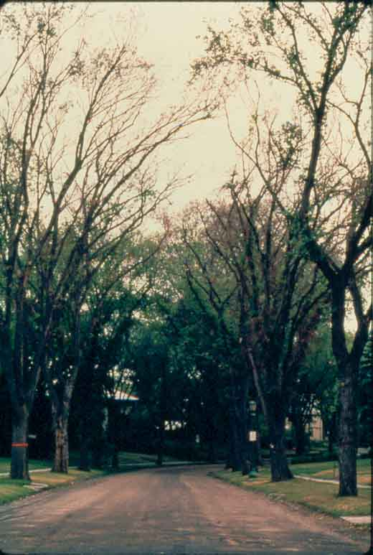
1976

Slide 65
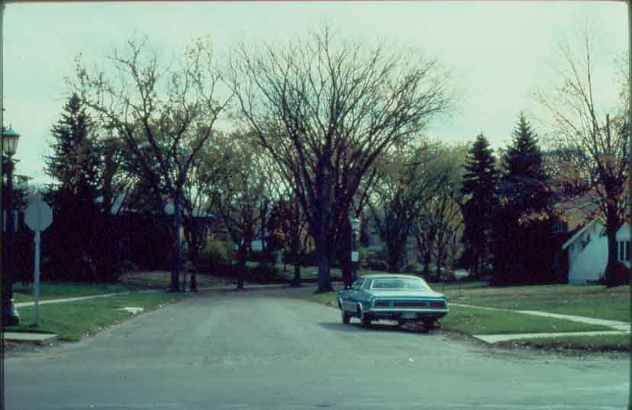
1977

Slide 66
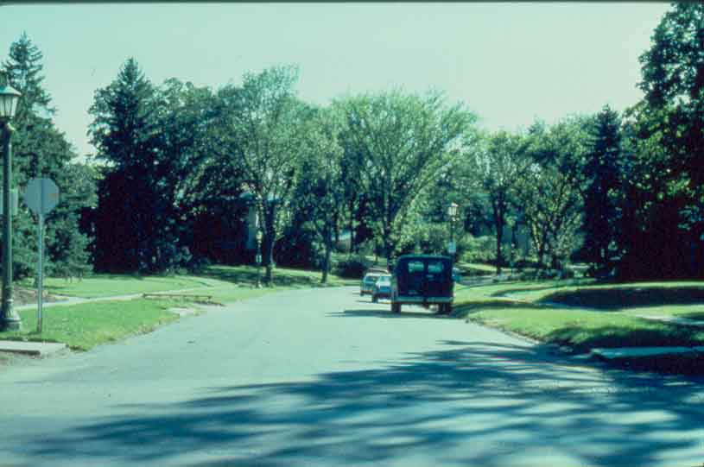
1978

Slide 67
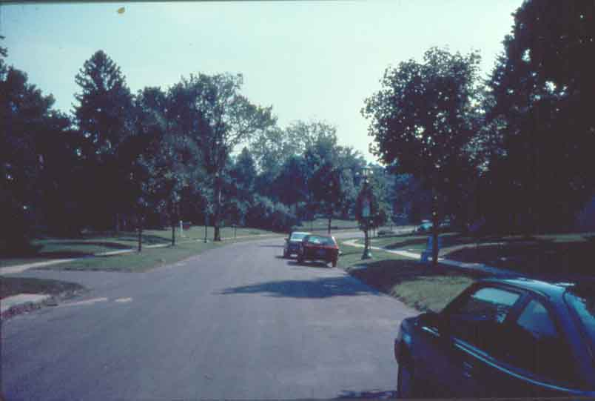
1991

Slide 68
History of the Disease
Disease was unknown in Europe and N. America before 1900
Since 1910, two pandemics
Pandemics caused by two different species:
  1) Ophiostoma ulm
  2) Ophiostoma novo-ulmi
In both cases, geographic origins are still unknown (probably Asia)
Notes:
Appears in France, Belgium, Germany 1918-1921/ arrival in E. US in late 20’s, established in NY and effecting 5500 sq miles by 1940/ strain transported to Ohio in 1928 via diseased logs. New epidemic in Europe, aggressive strains recognized in Europe in 1971.

Slide 69
Management: Sanitation
Includes removing bark from elm logs which are being stored for use as fuel and/or covering or burning all downed wood (so that beetles can’t get in it). AND, removing dead or diseased branches of standing trees (again because of the beetles).
Needs to be community-wide, and coupled w/fungicide use.
Thought of as the most effective way of curbing DED.

Slide 70
Management: injections
Systemic fungicides labeled for preventative control, injected into root flares. Effective on trees showing < 5-10% crown symptoms.
Need new injections every 3 years, expensive.

Slide 71
Management: Spraying
Best when coupled w/sanitation methods.
Timing of spraying is important

Slide 72
Other Management Methods
Development of resistant hybrid elms
Additional treatments: breaking up root grafts is commonly used and efffective.
Timing of pruning: wounded trees attract the bark beetle vectors of DED (Byers et al., 1980), so routine pruning should be done in the dormant season or during periods of beetle inactivity.

Slide 73
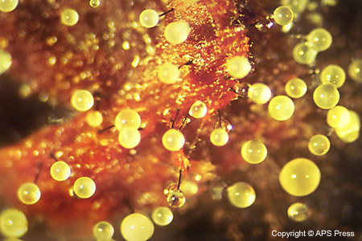
Dutch Elm Disease
Wilt disease caused by ascomycete fungus in the genus Ophiostoma

Slide 74
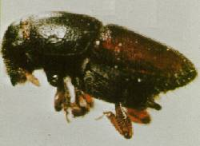


Transmitted by Scolytus bark beetle
  Beetle carves larval galleries in sapwood and carries fungus from tree to tree

Slide 75


Spreads through trees vascular system
Tree tries to slow fungus by plugging its own xylem tissue with tyloses
Plugged xylem causes branch dieback

Slide 76


Toxins force stomata to open
Increased evapotranspiration causes desiccation and rapid death of tree

Slide 77

Life cycle with beetle vector

Slide 78


Slide 79


Two separate pandemics caused by two different species
Ophiostomata ulmi
Ophiostomata nova-ulmi
Origins still unknown

Slide 80
Two Pandemics
O. ulmi arrives in Europe and expands outward on infected timber, kills 10-40% elms then stops…Virus!
O. novo-ulmi strains introduced in both Europe and N. America-radiates further
Now both species overlap in Europe
Notes:
Said hey we got it already…don’t regulate elm timber trade…get new species.

Slide 82

Two species differ in…
Optimal growing temp
  O. ulmi 28 C subtropical origins
  O. novo-ulmi 22 C temperate origins
Colony morphology
Molecular fingerprint
Pathogenicity to elms
  O. ulmi moderately aggressive
  O. novo-ulmi highly aggressive

Slide 83
Reproductively Isolated?
Not completely…
Both species have two mating types and crosses within species are fertile
Between species…
  O. ulmi can not fertilize O. novo-ulmi
  O. novo-ulmi CAN fertilize O.ulmi
Progeny include
  Sterile females
  Offspring with low vigor and fitness
    Basically out-competed by stronger parent species

Slide 84
When the two species meet…
O. ulmi usually present when O. novo-ulmi
arrives and is quickly replaced
Two species meet in bark surrounding beetle galleries
Chance for interspecific genetic exchange
Hybrids don’t survive or are transient BUT…
Act as GENETIC BRIDGE

Slide 85
Definitions
Interspecific hybrid
  Mating between two species of same genus produces a sterile or transient progeny to prevent movement of genes and thus keeps species separate
Introgression
  Backcrossing of an interspecific hybrid with one of it’s parents leading to movement of genes in between species

Slide 86
Methods of Detecting Gene Flow
DNA Fingerprinting
  Probed with cloned dna fragments to distinguish between two species
  Some O. novo-ulmi isolates had rare O. ulmi like polymorphisms
    Acquired through introgression
  15 of 50 O. novo-ulmi isolates had O. ulmi gene
  1 had altered phenotype
    Less aggressive
    AFLP showed gene was involved with pathogenicity

Slide 87
Gene flow? More clues…
Sudden increases of Vegetative Compatibiliy (VC) types
  Necessary to prevent spread of “cooties” (viral factors) between adjacent colonies
  Controlled by many genes with many alleles; only isolates that have the same alleles at all VC genes fuse their hyphae because they recognize each other as selves
  Viruses will spread through fused cells of same VC types

Slide 88
Europe
Single clones of VC types with single mating type introduced and spread through Europe
  High rate of viral spread through pop
After a few years population diversifies in VC type and mating type
  Spread of viruses declines
    Effect slower in North America due to less pressure from virus

Slide 89
Conclusions
O. novo-ulmi VC clones diversify only where O. ulmi was already present
Only when virus activity is high will clones diversify rapidly
Novel VC genes are acquired by O. novo-ulmi from O.ulmi
Selection pressure from viruses favors novel VC types

Slide 90
O. novo-ulmi with single VC type-black
As it changes to many VC types in grey

Slide 91
WOW!!!
O. novo-ulmi outcompeted O. ulmi in Europe
O. novo-ulmi caught virus from O. ulmi that would have killed it off BUT….
At the same time O. novo-ulmi acquired VC genes from O. ulmi that made it less susceptible to virus

Slide 92


O. Himal-ulmi
Found in Himalayas while searching for origins of pathogens in Asia
Appears to be in natural balance with elms and bark beetles
Very aggressive on European Elms
Importance of regulating timber trade

Slide 93

The End

Slide 94


Pitch canker disease of pines
Threat to native populations of Monterey pine
Threat to exotic plantations overseas

Slide 95

THE PRINCIPAL HOST TO
PITCH CANKER IN CALIFORNIA
PINUS RADIATA (MONTEREY PINE)

Slide 96


Just in case you were wondering why it is called pine pitch canker…

Slide 97
Where does it come from?
Maximum genetic diversity found in Mexico
East Coast of US has relatively high diversity, suggesting longer exposure
South Africa, California and Japan have very low diversity, with California and Japan being quite similar presumably because infestations have the same source

Slide 98
Careful when interpreting data:
Genetic similarity between two sites does not necessarily imply a source-sink relationship, but can indicate a third location was the source for both
Observational correlations, especially in new systems (like new host-pathogen combinations) may be misleading. The pathogen was found on many insect species but this was an accidental not a causal correlation, meaning that insects were not vectoring the disease, but rather they were accidentally contaminated in correlation with the significant outbreaks due to the novelty of the association between Monterey pine and Fusarium circinatum

Slide 99
DISEASE PROGRESS BY LANDSCAPE TYPE
= GOLF
= LT. URBAN
= URBAN
DISEASE SEVERITY
= WILDLAND
1996
1997
1998
1999
2000
2001
2002

Slide 100
DISEASE PROGRESS BY LOCATION
= INLAND
= COASTAL
DISEASE SEVERITY
1996
1997
1998
1999
2000
2001
2002
SURVEY DATE

Slide 101

HOW MANY TREES WILL DIE?

Slide 102
MORTALITY DUE TO PITCH CANKER IN
A PLANTED STAND OF MONTEREY PINE
1989: 8% OF TREES INFECTED (N =50)
1993: 96% OF TREES INFECTED
1999: 14 TREES WERE DEAD, NEARLY DEAD OR
HAD BEEN REMOVED
MORTALITY RATE = 28%

Slide 103
MORTALITY RECORDS FROM
MONTEREY PENINSULA PLOTS
TOTAL NUMBER OF TREES LOST SINCE 1996:
138
CONFIRMED PITCH CANKER DEATHS:
5
% MORTalITY DUE TO PITCH CANKER = 3.6%

Slide 104

LONG TERM IMPACTS

Slide 105
CHANGE IN DISEASE STATUS FROM 1996 TO 1999
28%
Diseased in 1996
Disease free in 1999
6%
NUMBER OF TREES
17%
1 = New Brighton State Beach, 2 = Sunset State Beach, 3 = DeLaveaga golf course

Slide 106
DISEASE REMISSION COULD BE DUE TO ELEVATED RESISTANCE RESULTING FROM REPEATED INFECTIONS
= INDUCED RESISTANCE

Slide 107
EFFECT OF REPEATED INOCULATIONS
ON SUSCEPTIBILITY
Lesion length (cm)
Lesion length (cm)
Mean of ten trees
Inoculation dates

Slide 108
PITCH CANKER IN OTHER SPECIES:
At this point significant only in Bishop pine: however, in order to understand impact we need to ensure exposure has been long enough, and in areas with significant host density. With time:
Mortality rates may decrease
Mortality rates may increase
BISHOP PINE
KNOBCONE PINE
DOUGLAS-FIR

Slide 109
Pitch canker disease of pines
Introduced in California
Spread around by Christmas tree trade
Regions in red are characterized by significant
presence of Monterey pine plantations

Slide 110

PITCH CANKER AS A SEEDLING DISEASE

Slide 111


Spreading of the disease
Vectors ?
Infected nursery material ?
Aerial spores ?
macro conidia
micro conidia

Slide 112


Fusarium sampling,

Slide 113


Real-time Quantification
Working Schema
suspend in
20 ml 4X TE 65ºC
DNA-extraction
Spore trap
with filter paper
Centrifugation
Spore concentration
Mating type
determination
Calculate spores/m²
Compare with Spore (DNA) standard
RT-PCR using
CIRC1A-4A

Slide 114
Seasonal differences
Dry season: May-October PCR+ : Wet:Dry = 3:1
Wet season: October-April

Slide 115
What do trapping results tell us:
Precipitation or high fog levels are both conducive to sporulation
Warmer temperatures seem to favor sporulation: rainfall in late spring generate the best spreading conditions. Places with rainy summers may be very conducive
When temperatures approach the zero, sporulation is completely interrupted (not a good Sierra pathogen). This insight was gained by comparing higher elevation and colder SC plots with lower elevation SF plots

Slide 116
Correlation between symptoms level and inoculum load
Early
Late
Infection stage

Slide 117
Epidemiology
Artificial movement through plant material
Spores are sticky and long lived (tools, insects), tools can be infectious even if they “look” clean
Insect vectoring (facultative), it seems to be particularly important in association with cone-insects on Monterey pines
Wounding? Insect feeding increases infection rates
Airborne relatively long distance, each year we see an advancing disease front in Northern California, North-South movement favored by frequency of hosts and by warmer temperatures, as opposed to East-West movement

Slide 118

CURRENT DISTRIBUTION OF PITCH CANKER IN CALIFORNIA

Slide 119
Inoculum dilution analysis

Slide 120
Surprising “late” findings:
Pathogen reported in roots of mature Aleppo pines in Southern California
Pathogen transported to New Zealand on Douglas fir seedlings from Placerville (CA)
Recently, second mating type introduced in California. How=?
Found as an endophyte of grasses

Slide 121
Canker stain of sycamore
Pathogen is a vascular fungus called Ceratocystis platani
Native to Eastern USA, moved to Italy and California via infected wood
In both places two serious epidemics started
Introduced in the Stockton area, it killed all sycamores there

Slide 122

Visible symptoms: die-back

Slide 123

Sunken lesions

Slide 124

Wood staining

Slide 125
Epidemiology and control
Infected wood and tools spread disease
Possible association with nititulidae beetles
Spreads through root grafts
Controlled by sanitation of tools and severing root grafts

Slide 126


Canker stain of plane trees by Ceratocystis platani
Tree death within 3-7 years (EPPO/CABI, 1997)

Slide 127



Symptoms
i cancri

Slide 128


Field diagnosis
EPPO PM 7/14(1)
Leaf chlorosis, dieback
Necrosis under the bark, cankers
Bark canker caused by Fomitiporia punctata
Lack of callus at the edges of the lesion

Slide 129

Field diagnosis

Slide 130



Field diagnosis

Slide 131


Slide 132


Field diagnosis

Slide 133




Diagnosis in the lab
Inspection for the presence of perithecia after incubation in a damp room
Isolation

Slide 134


10 μm
Diagnosis in the lab
10 μm
100 μm
10 μm

Slide 135


Infection biology and epidemiology

Slide 136


Slide 137


Slide 138


Slide 139



Slide 140



Slide 141
Thousand canker disease of walnuts
Geosmithia morbida: fungus
Pityophthorus juglandis: insect vector

Slide 142
Some facts about TCD
Insect is native
Fungus apparently is not native
Association between insect and fungus happened in the Southwest (1990s?)
Disease started in Southwest, moved to California, from California elsewhere in the USA
Insect of the genus Pityophthorus normally attack small sized portions of trees, not this one
Mortality is due to coalescence of large numbers of cankers, and not to spread of a single lesion
Black walnuts are the only hosts: J. californica, J. hindsii, and their hybrids with J. nigra (are all susceptible

Slide 143



Walnut twig beetle

Slide 144


Slide 145


WTB distribution in the USA
December 2014
1960
1959
1896/1928
from Rugman-Jones et al. (2015) PLoS ONE 10(2):e0118264
Notes:
Fig 1. USA county records of the walnut twig beetle, Pityophthorus juglandis Blackman: (A) historic distribution as of 1960 (Bright, 1981; Wood and Bright, 1992); and (B) current distribution (December 2014) based primarily on recent collections by the co-authors and various cooperators.
The origins of the fungal pathogen are not known, but P. juglandis is likely native to Arizona, California, New Mexico, and Mexico. In the last 10 to 20 years, apparently aided by the pathogen, P. juglandis has expanded its distribution into Colorado, Idaho, Oregon, Utah, and Washington. The hypothesis that P. juglandis is native to California is supported by:
(1) An analysis of the North American P. juglandis collection history (Bright 1981, Wood and Bright 1992, Seybold et al. in prep), which revealed only eight records from Arizona and New Mexico before the first collection in California in 1959
56 2010 USDA Research Forum on Invasive Species GTR-NRS-P-75
(2) The broad current distribution of P. juglandis in California
(3) The presence of P. juglandis at a remote California location (Lassen County) in 1974 before the relatively recent and noticeable increase in trees with symptoms of thousand cankers disease
(4) A relatively rich subcortical insect community, including natural enemies, associated with P. juglandis
(5) The presence of two native endemic species of Juglans in California

Slide 146




Genetic analyses of WTB mitochondrial haplotypes suggest migrations from southwest U.S. to other regions
Analysis by P. Rugman-Jones and
R. Stouthamer, Dept. Entomology,
UC-Riverside
Graphic by A.D. Graves,
USDA FS FHP, Albuquerque
Phylogram
Rugman-Jones et al. (2015) PLoS ONE 10(2):e0118264
Notes:
WTB Population Genetics and Similarity of Populations in the U.S. Mitochondrial Cytochrome Oxidase I Haplotypes of Walnut Twig Beetle 658 bp sequence of COI, 61 haplotypes from 825 specimens from 62 populations
Fig 6. Distribution of three most abundant Pityophthorus juglandis mitochondrial haplotypes (H1, H2, and H17) across 17 “topographical”
populations. See Fig. 2 for population labels. See Table 1 and S1 Table for sample sizes and detailed information about the distribution of the remaining L1 and L2 haplotypes.

Slide 147
WTB range expansion and spread of TCD?
native range of WTB
Zerillo et al. (2014) PLoS ONE 9(11):e112847
Rugman-Jones et al. (2015) PLoS ONE 10(2):e0118264
Notes:
The pathogen population is very diverse and there has already been considerable mixing of pathogen genotypes within the US.
Considering the substrate specificity of bark beetles and Geosmithia associates to their respective plant hosts [56], and the highly diverse and complex genetic structure in G. morbida that we and others [10,26,27] have observed, it is unlikely that the current TCD epidemic was a result of a new association between the WTB and G. morbida.The scattered distribution of the genetic clusters indicated that G. morbida was likely disseminated to different regions at several times and from several sources. The large number of haplotypes observed and the genetic complexity of G. morbida indicate that it evolved in association with at least one Juglans spp. and the walnut twig beetle long before the first reports of the disease.
Introduction WTB and associated G. morbida to new areas very likely on beetle-infested logs into regions they would not have reached naturally. There is considerable trade in walnut wood prized in wood working, gunstocks, and musical instruments, and spread probably facilitated by tourists and campers carrying small amounts of wood. We know that two introductions (Ohio and Pennsylvania) came from logs imported from California, and the others most likely came from California or possibly Colorado.
While Geosmithia spp. are generally regarded as asexual (though see [69]), perhaps the respective fungal partners of the two WTB lineages also underwent some kind of parasexual genetic exchange, for example via hyphal fusion [70], or wholesale transfer of fungal genotypes (genotype flow) from one lineage to another [71,72]. Under this scenario, the subsequent invasive success ofWTB is attributed not to pre-adapted beetle and/or fungal genotypes (i.e., in the native range), but to novel genotypes that arose after an invasion. If this is the case, we might expect to see increased levels of fungal genetic variation and/or unique fungal genotypes in those populations where the
WTB lineages are sympatric [24].

Slide 148

Distribution of TCD in the United States
October, 2015
http://www.thousandcankers.com/quarantines.php
Notes:
Highly desired Claro walnut (J. hindsii) by woodworkers

Slide 149

Natural distribution of some native Juglans species in the USA
J. hindsii
J. nigra
J. californica
J. major
Zerillo et al. (2014) PLoS ONE 9(11):e112847
Notes:
As I mentioned, TCD was first characterized in J. nigra introduced as a landscape and city tree in Colorado, Utah and other western states. There is great concern about its introduction to the eastern U.S. and its native range, where it is a highly valued forest species as well as in plantations for production of nuts and wood products.

Slide 150




Comparative TCD Symptoms
Wolfskill NCGR
Solano Co., CA
Photo by Stacy Hishinuma
Juglans major
(southern NM)
Sporadic cankers, minimal staining on bark surface
Juglans californica
(in northern CA)
Numerous cankers, prolific staining on bark surface

Slide 151




Juglans species show differences in susceptibility to Geosmithia morbida
A
B
BC
BC
CD
CD
CD
D
D
D
(P = 0.05)
Notes:
Susceptibility of Juglans species and Pterocarya stenoptera to G. morbida. Intact branches were inoculated with G. morbida (GM-1 and GM-3). After six weeks, branches were cut and bark was removed for measurement of the lesion at the site of inoculation. Means and SE of data collected from 2010 to 2013 are indicated. Statistical grouping was calculated using the Tukey-Kramer HSD and indicated by the letter above each bar. Column means not marked by the same letter are significantly different (P=0.05) by Tukey-Kramer HSD.
Note Paradox.

Slide 152
Landing rate of WTB on branches of six species of Juglans
and one Pterocarya species
Juglans species effect :
F 7,138 = 21.17; P<0.001
(PROC GLIMMIX in SAS; Multiple
means separation by Tukey-Kramer )
a
4
3.5
3
2.5
No. WTB/branch/7 d (mean ± SE)
2
1.5
b
1
c
c
c
c
c
c
0.5
0
J. ailantifolia
J. californica
J. cinerea
J. hindsii
J. major
J. microcarpa
J. regia
P. stenoptera
Juglans
species
from Stacy Hishinuma

Slide 153
Hypotheses on spread
The most likely pathway for movement is raw wood (logs, burls, stumps, firewood, wood packaging material(WPM)). Other potential pathways include nursery stock, scion wood for grafting, and natural spread. The beetle/pathogen complex is likely to enter the east with each entrance event, as follows:
- Movement of untreated walnut (logs, burls, stumps, firewood) across the country from the west into eastern states appears limited but it does occur and it is rarely documented. Low grade walnut maybe utilized if bark is attached this could be an important pathway. Raw wood is the most critical pathway.
- Campsites and sawmills in the Great Plains states may facilitate the eastern movement of Thousand Canker Disease.
- To date there have been no reports of infected trees in walnut production nurseries; however, if nurseries do become infected, this could become an important pathway.
- Natural spread along riparian corridors is likely to occur.

Slide 154


Symptoms from a distance
Early=flagging Late=dead canopy with resprouting

Slide 155

Close-up symptoms
Pinhead sized entry hole of beetle

Slide 156

Close-up symptoms
Larvae tunnels produced along the grain, and so do the lesions

Slide 157

Close-up symptoms
Mortality caused by coalescence of multiple cankers

Slide 158


Colonies of Gm on both sides

Slide 159


Fungus sporulating on beetle and in beetle gallery

Slide 160



The vector
+ the fungus
WTB carries
the spores of the
fungus on its surface
(no specialized structures)
Photos by Andrew Graves & Steve Seybold, USDA Forest Service

Slide 161
WTB is believed to have 2 to 3 generations a year in California. Adults emerge for an initial flight period in April and May followed by a longer second generation flight period in mid-July to mid-September. After flying, male beetles initiate brood galleries on branches often near leaf scars or lenticels.
Males produce a pheromone and attract 2 to 3 females, which attract additional beetles to the tree. Females deposit eggs in galleries (tunnels) that are directed against the grain and constructed in the phloem and xylem (wood) surfaces. The gallery imprint is left on the wood surface. Small white C-shaped larvae hatch and create feeding mines that extend from the egg galleries. These mines are contained in the phloem and filled with dark brown to black-colored boring dust.
Larvae complete development in the mines and subsequently pupate within a single pupal cell. Adults emerge and either remain at the original tree or fly to other trees to mate and reproduce. WTB does not appear to be attracted to stressed or injured branches or trees.
Beetles are believed to inoculate the Geosmithia sp. fungus into the phloem during construction of feeding or reproductive galleries. The fungal pathogen colonizes and kills the phloem. Dead tissue is limited to the phloem and cambium and the fungus does not penetrate woody tissues. Secondary saprophytic fungi may opportunistically colonize the wood beneath cankers

Slide 162
Control?
Bark application and drenches with insecticides apparently not effective
Prevention is the best option
Some efficacy reported with injections of insecticides, fungicides, and fertilizers

