Slide 1
WHAT IS A SOD-BLITZ?
In the tradition of bio-blitzes , a SOD-blitz involves the public into surveying a natural ecosystem and determine the presence of target organisms.
Collections normally are performed in a short time by volunteers
Matteo Garbelotto
UCB Forest Pathology and Mycology Lab

Slide 2
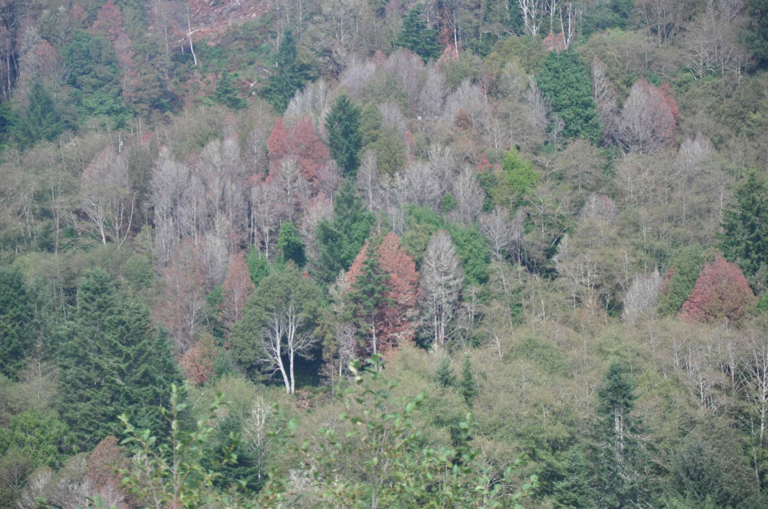
2013 SOD damage, Broookings, OR

Slide 3
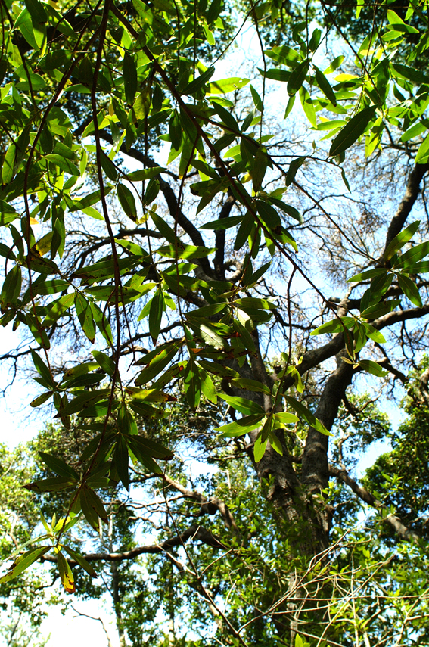
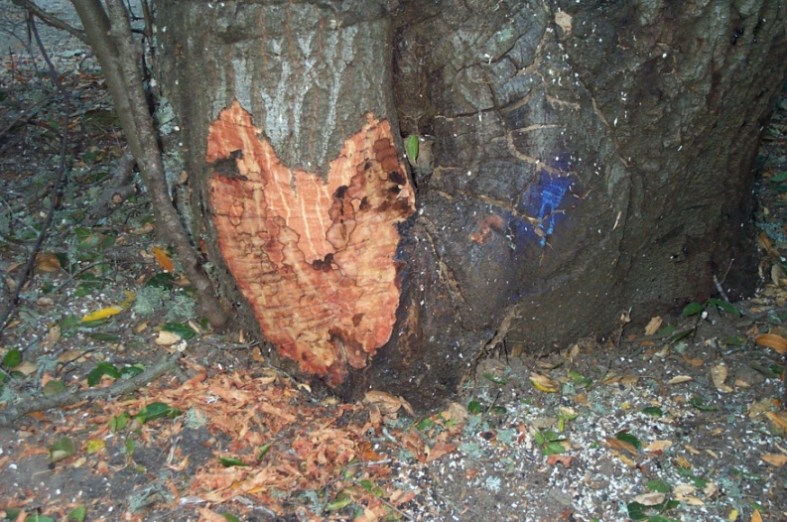
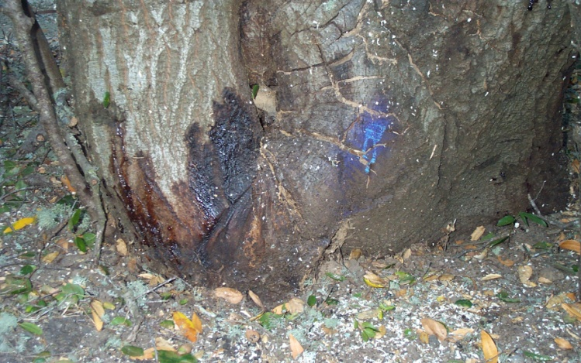
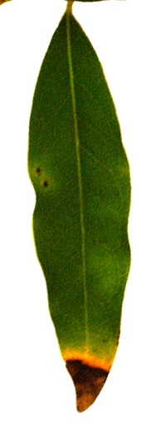
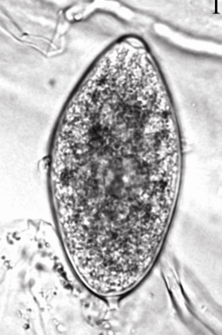
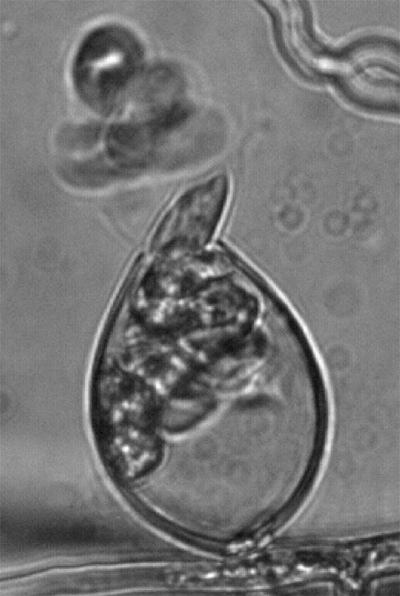
Bay/Oak association
Bay
Yearly
Coast Live Oak (no sporulation)
Canker margin in phloem
Wave years
Bleeding canker
Sporangia
Soil
Notes:
Oaks important component of the CAL ecosystem
Main source of inoculum is from bay
Oaks much more likely to get infected if adjacent to a bay tree

Slide 4

Diseased bay leaves, main BLITZ target
Active season
SOD spore catches in water: April to June is
consistent and indicates best period to diagnose SOD

Slide 5
What is unique about SOD-blitzes?
Volunteer data is all analyzed by the UCB Forest Pathology and Mycology Laboratory
Lab phase ensures output is of the highest standard
Data is made public in real time
Estimated 1 million people accessed the data in 2013
Blitz data gets fed into disease distribution together with new data from researchers and government to generate an updated disease distribution map (SODmap)
SODmap data provides the basis for the two SODmap mobile apps (iPhone and Droid) that allow to:
  Determine SOD distribution in the field
  Determine infection risk for oak

Slide 6
Involvement of citizens through community-based organizations is critical
SOD blitzes advertized through the media and Internet, but..
Organized exclusively through cooperation with local organizers, environmentalist, grass-root activists, in order to foster a community-based response
Only a community-based response can provide the effort level necessary to achieve good local coverage and to organize concerted action to control SOD
SOD is an infectious disease (not unlike many human and animal diseases) and requires a community wide effort, in order to be effectively controlled

Slide 7
Education on biology and epidemiology
Create a community-based
active disease management
approach
SOD-blitz
Provide disease distribution info for decision-making & research
Training sessions to allow
homeowners to implement
active disease management

Slide 8
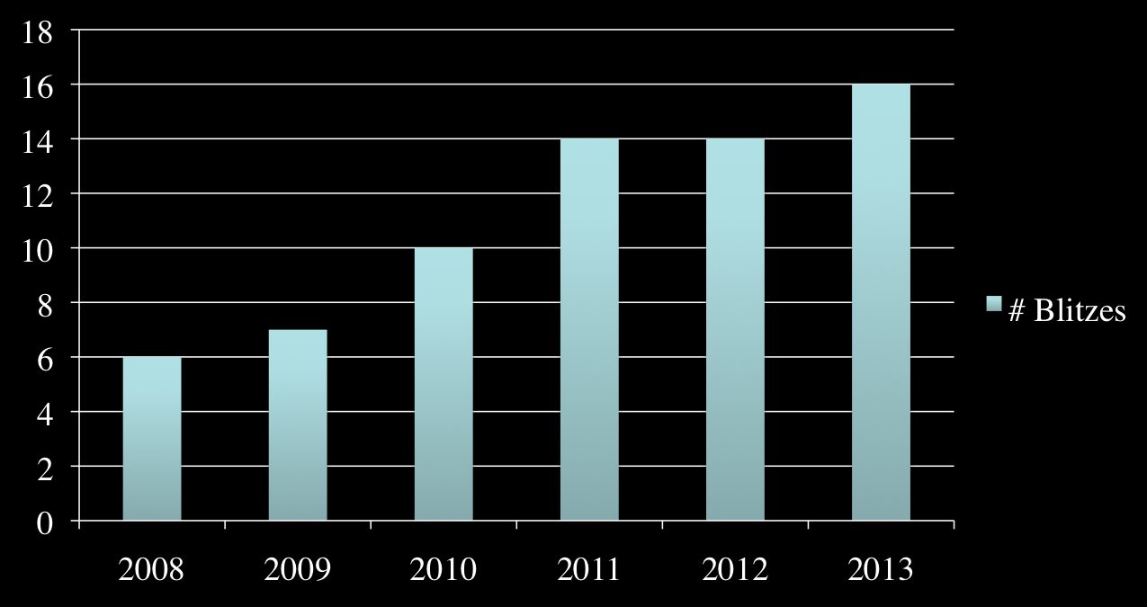
Number of local blitzes per year
2008-2013: six years of Blitzes

Slide 9
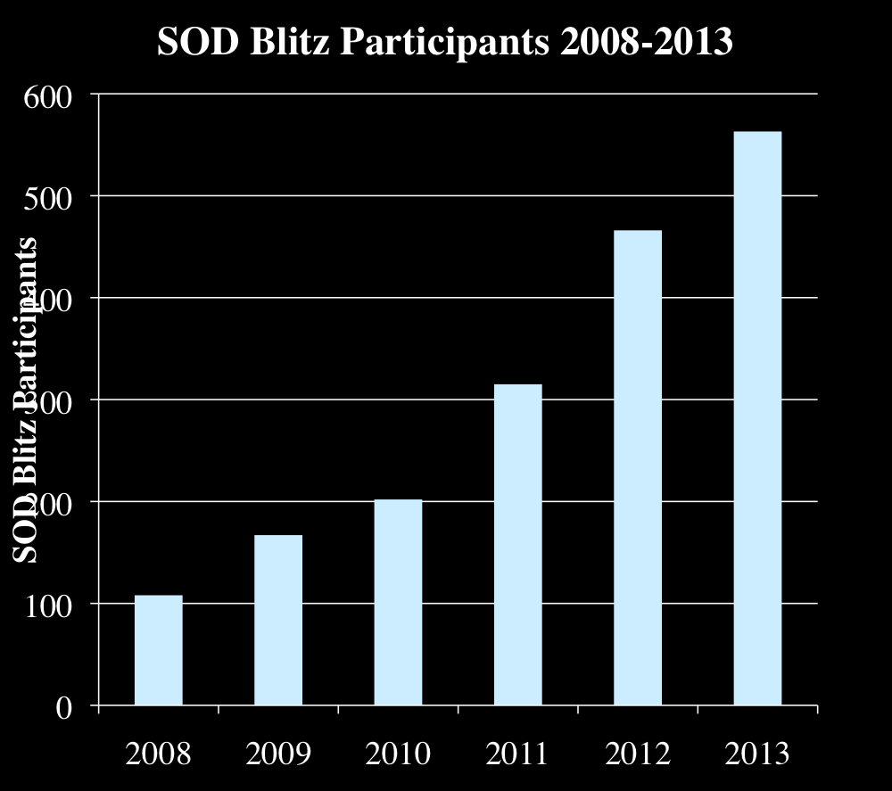

Slide 10
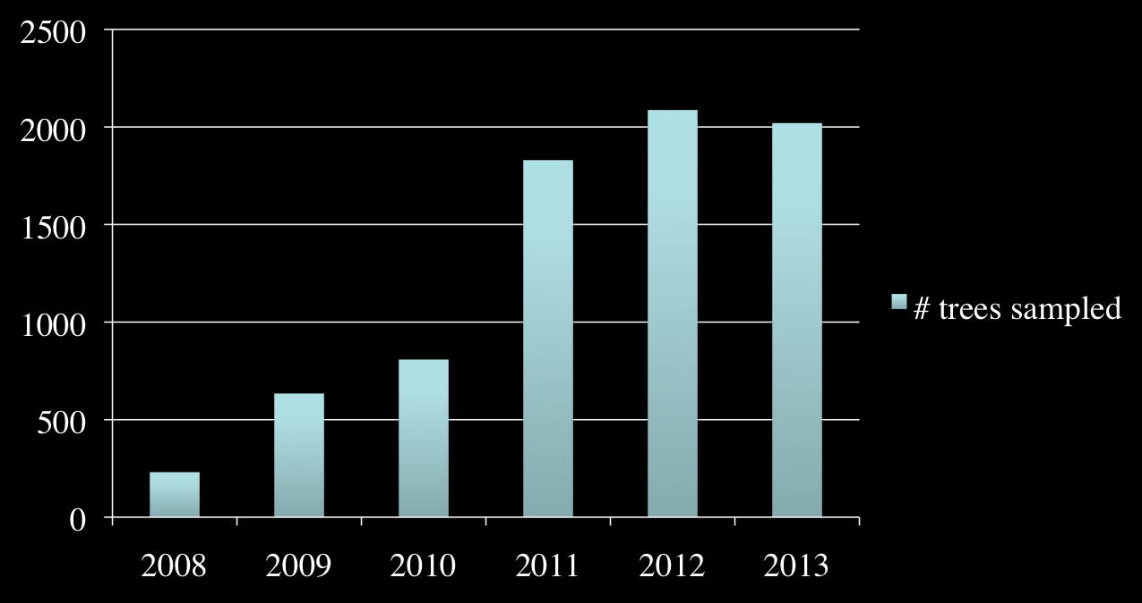
Symptomatic trees sampled per year (cumulative total=7610)

Slide 11
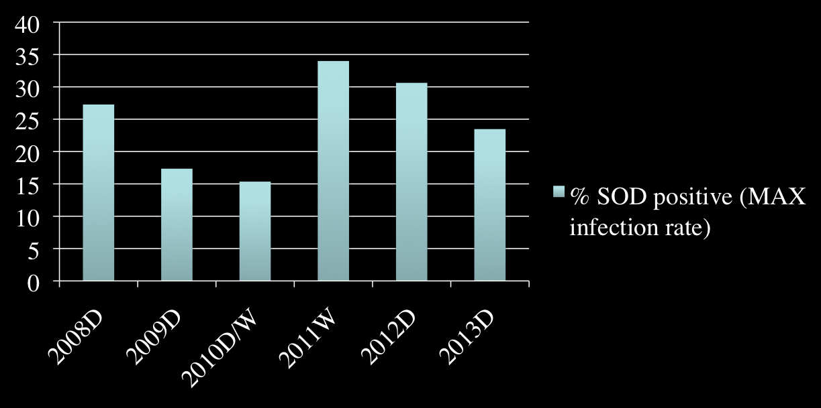
Rainfall and % SOD positives are correlated
Note that decrease is gradual during dry spells,
but increase is rapid at the onsite of rainfall

Slide 12
Limitations of Blitzes
Surveys are haphazard, as pool of participants changes and areas sampled shift, hence between-years comparisons are hard to make for individual areas, while overall comparisons are feasible
Some level of error in determining tree location, hence it is hard to determine whether the same tree has been re-sampled in different years
To save on costs, participants are requested to make sure 80% of collections are symptomatic, hence true infection rate cannot be calculated

Slide 13
Adaptation of protocols and analyses to increase power of blitzes
Include number of trees surveyed when sampling, and split them in two categories: healthy or symptomatic

Slide 14
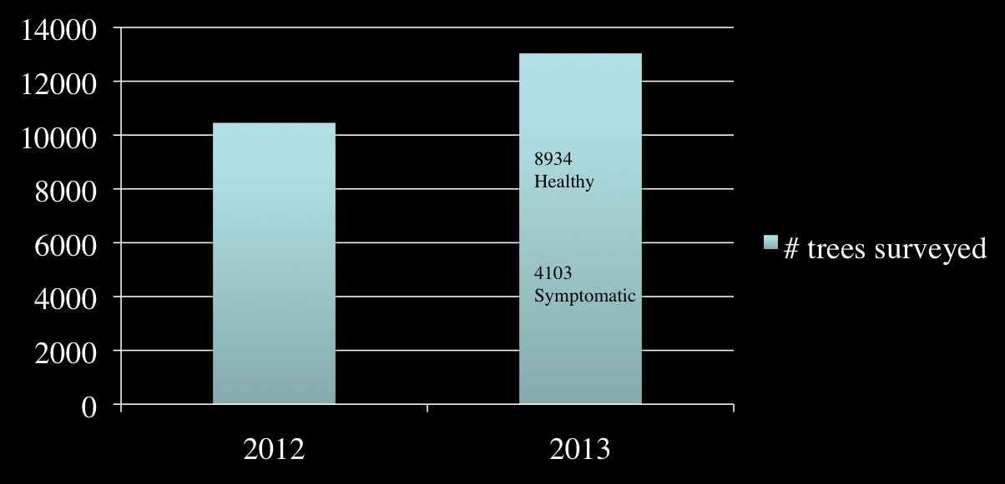
Number tree surveyed (2012-2013)
?
This information is necessary to calculate
true infection rate

Slide 15
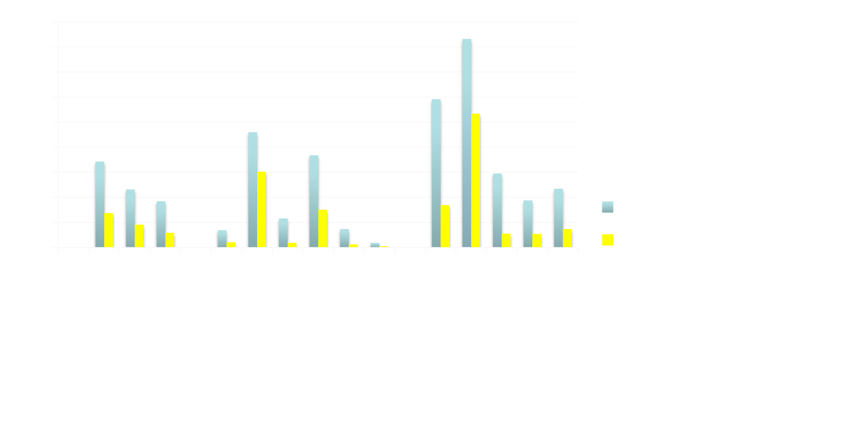
First large scale picture of true bay infection rates across the state (SOD blitz 2013)

Slide 16
Are % SOD positives and true infection rates correlated ?
Correlation Coefficient is 0.922, meaning the two are strongly correlated
This indicates % SOD positives is a good proxy
Will confirm this analysis in future blitzes

Slide 17
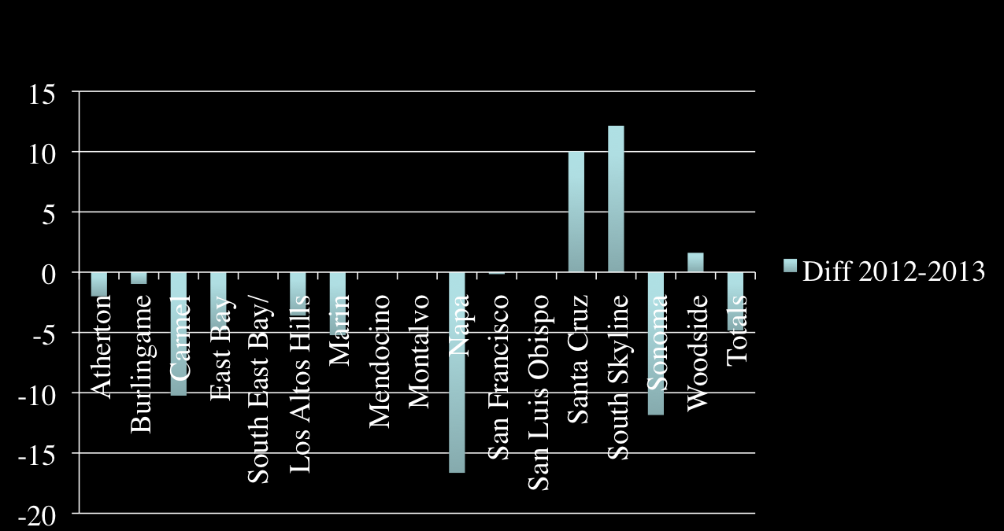
Variation in infection rates between 2012-2013

Slide 18
Variation in infection rates between 2012-2013
With a dry 2013, overall infection rates decreased (-5%) as expected
Two sites had a significant increase: South Skyline and Santa Cruz. A significant decrease instead was noticed in Napa
Although the difference may be due to sampling error, it is interesting to note that increases were in two colder areas and decrease in a hotter area
This observation matches conclusions from last year that epidemiology of disease is different between the coastal forests and the forest that are somewhat inland

Slide 19
Epidemiology different=oak infection risk will be different
Truly Coastal
Somewhat Inland
Mendocino, West Sonoma, Marin County, San Francisco, North Peninsula, South Skyline, Santa Cruz, Big Sur, West of the Berkeley-Oakland hills
Wet-dry cycles do affect populations of the pathogen: dry spells lower populations of the pathogen but levels remain high even during drought: much longer epidemic phase, short periods of rain (3 months) will bring the numbers up
Central and East Sonoma, most of Napa, East of Oakland Berkeley Hills, South peninsula
During dry spells (1 year or longer), populations of the pathogen decrease significantly and disease enters chronic phase, with very limited risk for oak infection. It may take over a year for pathogen populations to climb up to the epidemic phase, in which oaks can be infected

Slide 20
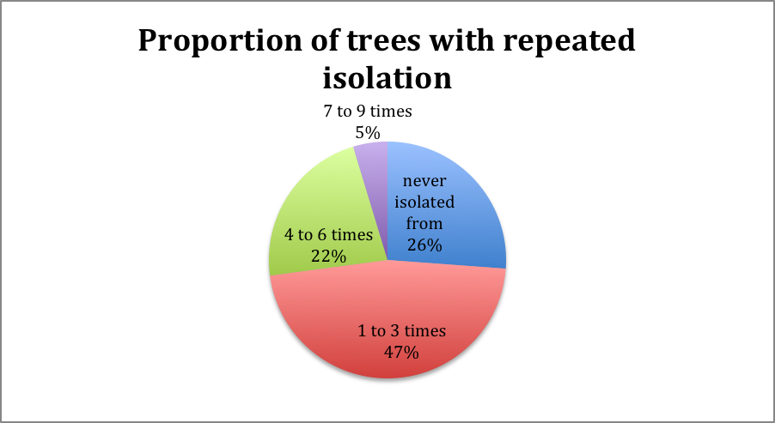
Trees that are continuously infected (5%), especially in dry years, are the source of infection, and their elimination may be extremely beneficial
Notes:
All of 7-9x repeat growers are in CS drainage but one
Look at enviro effects
Regression

Slide 21
2013 Blitzes offered the opportunity to permanently tag trees, so that their infection status can be followed in time

Slide 22
We paired with Ross Meentemeyer lab in North Carolina to perform robust analyses on blitz data:
  Were the trained volunteers performing well in their duties, was their work reliable
  Does temperature really have an effect on infection rates (IR)
  Is rainfall correlated with % positives
  Is there a correlation between IRs of consecutive years
  Were there any other factors that improved our ability to predict further spread of the disease

Slide 23


Professionals vs. laypeople
2011
2012
Conclusion: In 2011, laypeople performed better than professionals, in 2012, the two groups performed equally well

Slide 24
Taken together, our data suggest that the SOD Blitz informational sessions and training efforts were highly effective and citizen science produces useful data for understanding locations at risk of disease spread.

Slide 25
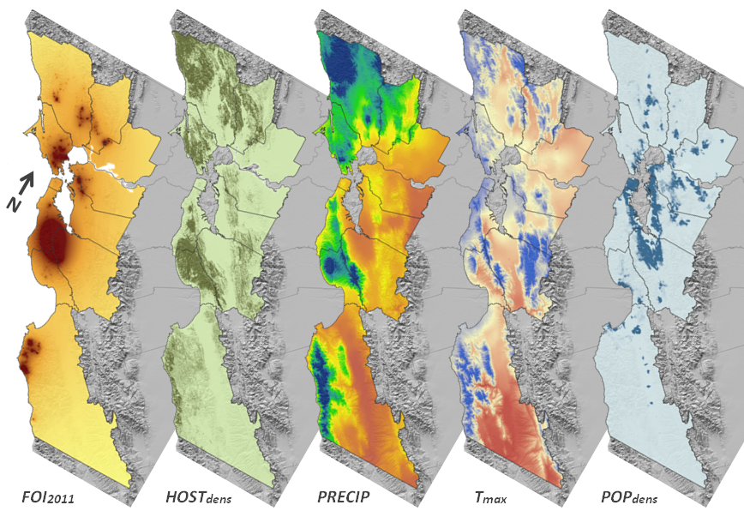
Correlation type
+ + + - +
P value < 0.0001 for all

Slide 26
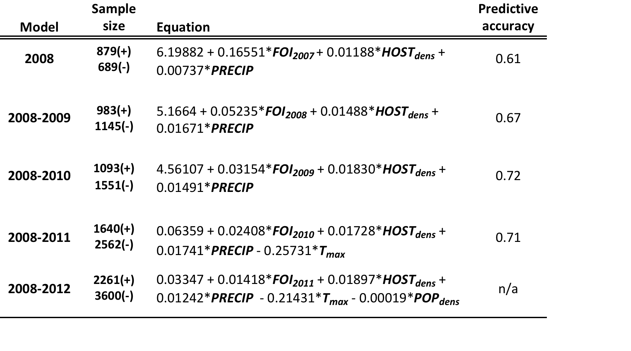
Our infection predictive ability based on generalized linear logistic regressions increases as we perform more blitzes
Increase from
0.61 to 0.71
FOI, HOSTdens, PRECIP are all positively correlated with predictive accuracy (PA) and relatively important
T_{max} is the mean monthly maximum temperature during the December-May wet season, it is negatively correlated with PA and is very important
POPdens is negatively correlated and marginally important

Slide 27
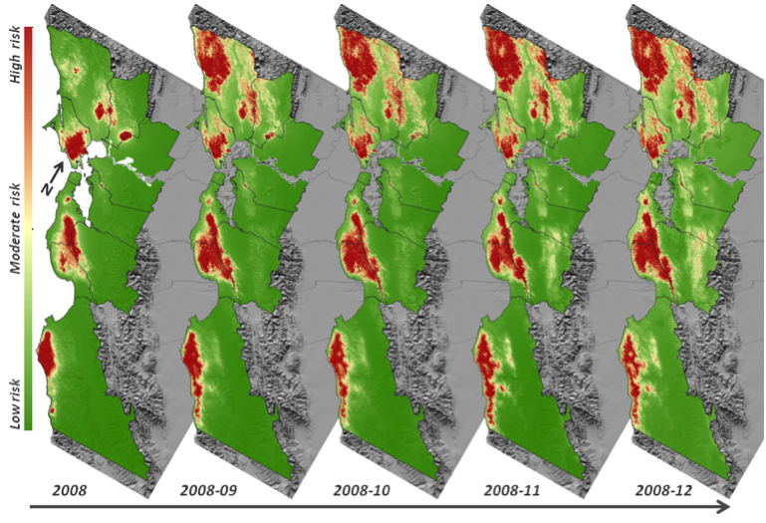
Predicted spatial distribution of disease risk through time (2008 – 2012).

Slide 28
Continued Blitz effort generated a larger and more powerful set of data, increasing predictive accuracy. Value in continuing the program
The analysis has generated an accurate risk map
Risk is significantly lower where mean monthly temperature of December-May is higher. This confirms our initial observation of a dual epidemiological pattern between the warmer interior and the cooler coastal areas
Risk is lower in highly populated areas
Risk is higher where infection the previous year was higher: this confirms the importance of yearly blitzes
Risk is higher with increased precipitation and higher bay laurel density

Slide 29
Theoretical risk and actual risk: how did the blitzes help
I live in a colder area 5
I live in a mild area 3
I live in a warmer area 1
I live in a very rainy area 3
I live in a moderate rainfall area 2
I live in a drier area 1
Bay laurel density is high 3
Bay laurel density intermediate 2
Bay laurel density low 1
I live in a residential/urban area 1
I live in a rural area 2
In the previous year SODmap,
  More than 4 positive trees in a 1Km2 3
  1 to 4 positive trees in a 1km2 2
  0 positive trees in a 1km2 1
Total 5-8=low risk/9-12= intermed./ 13-16=high
Use the SODmap mobile App for iPhone or Droid (free!!!)

Slide 30
2008-2012 Blitzes have uncovered new infestations, unexpected disease patterns, and have provided fine scale distribution for many areas
Provided evidence of an epidemic outbreak Statewide in 2011
First reports of infestations in Carmel Valley Village, Atherton, City of Napa, West side of the Oakland-Berkeley hills, Presidio National Park, Golden Gate Park (SF)
Quantified infestations across the SF peninsula
SOD-free surveys of Atherton after 2009 SOD eradication effort
Provided evidence that spread rate accelerates as weather gets cooler (e.g. movement westward of pathogen in East Bay), and viceversa (e.g. movement northeast in the Carmel Valley, and East in the lower peninsula)

Slide 31
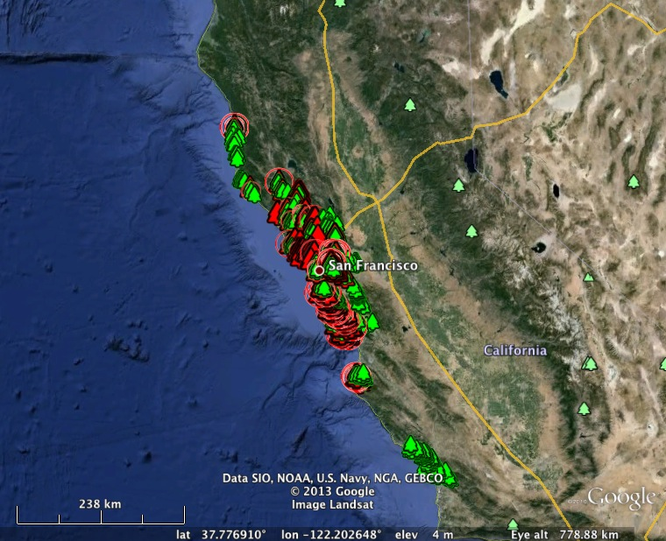
SOD Blitzes 2013 (www.sodblitz.org)
Highlights of findings
San Luis
Obispo
View of entire 2013 SOD-Blitz survey, showing intensive San Luis Obispo BLITZ with all negatives

Slide 32
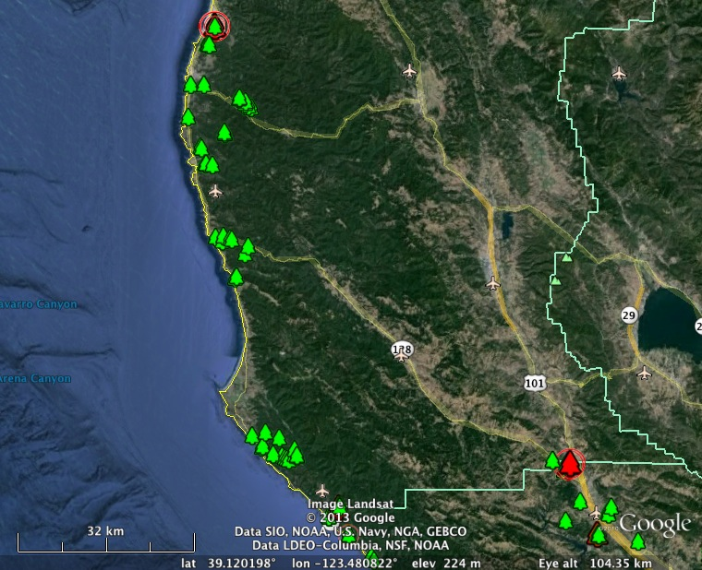
Mendocino & Northern Sonoma
1
3
2

Slide 33
1= Significant infestation NorthEast of McKerricher State Park (already known)
2 = New report of confirmed infestation (>1 tree) immediately North of the Sonoma-Mendocino border, near Highway 1
3= Confirmed infestation, apparently expanding, in Cloverdale. In 2012, only one positive tree had been found. With possible oaks infection

Slide 34
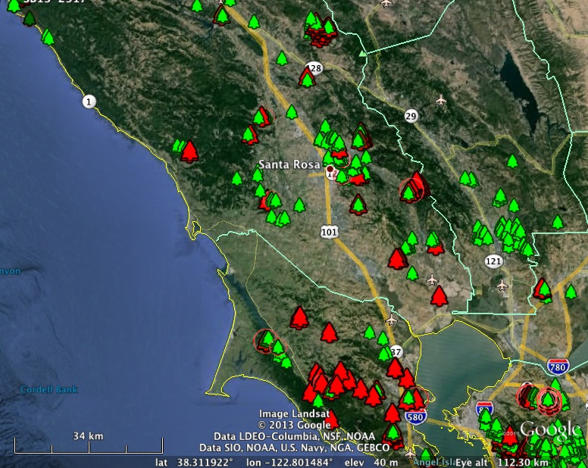
North bay
1
2
3
4
5

Slide 35
1-SOD establishing itself firmly in North County: West of Geyserville, Chalk Hill, and Sonoma Preserve
2- As in previous surveys, SOD abundant in hills around Santa Rosa
3- Large outbreaks on the slopes of the Valley of the Moon, similar to those seen in 2006-2007. Positives in the Sonoma residential neighborhoods. First report from the Carneros area
4- Despite good coverage on the Napa Valley floor, no positives were found, suggesting that-although pathogen was found there in conjunction with heavy rainfall of 2011, it is not firmly established. Outbreak along 12 between Napa and Fairfield
5- Marin remains one of the most widely colonized counties. With interesting positives from Point Reyes, Bolinas, San Rafael, Mill Valley, the Belvedere peninsula and Sausalito

Slide 36
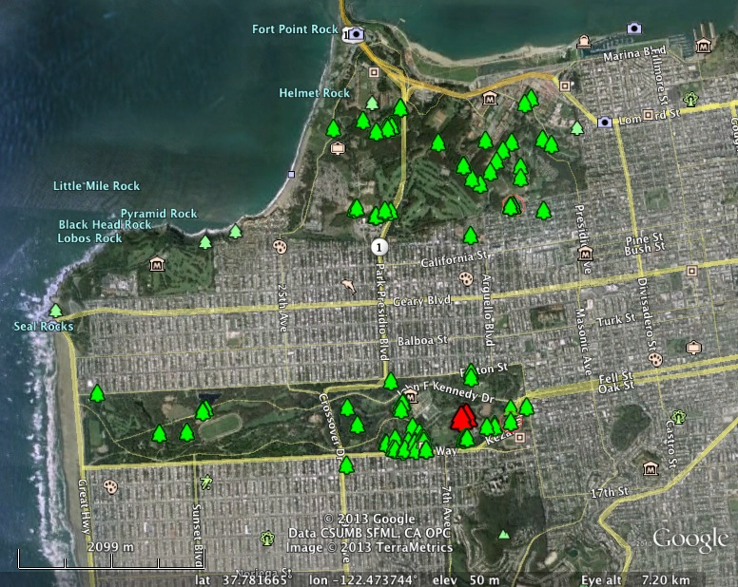
San Francisco
1
2

Slide 37
1-Presidio NP continues to be SOD-free. Lack of bays and planting scheme seem not to offer opportunity for SOD establishment
2-New positives in Golden Gate Park, in completely different location than the outbreak on 3 bays detected last year. Positives were camellias in the nursery, at the edges of the AIDS memorial grove, where SOD infected oaks were found 8 years ago. Plants from the nursery were suspected at that time, but positives not found then. Risk of spreading the disease by planting infected plants

Slide 38
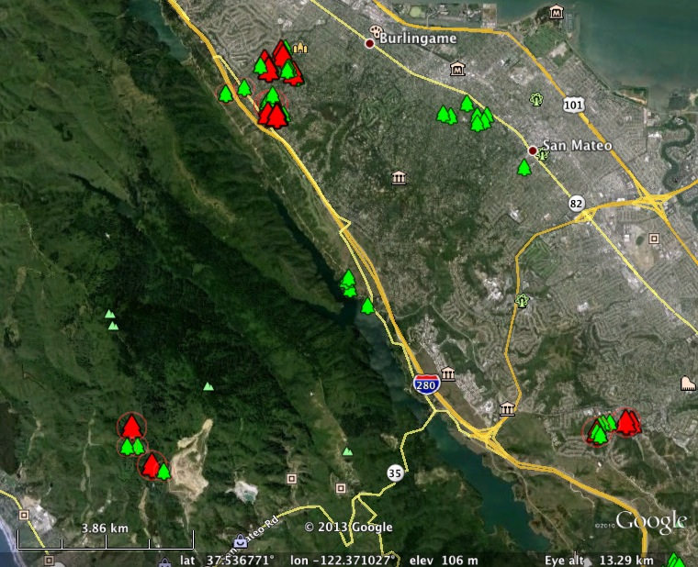
North peninsula
1
3
2

Slide 39
1- Outbreak in Burlingame Hills remains significant and probably larger than expected
2- First report in West San Mateo County, NorhEast of Half-Moon-Bay. Potential issue for nurseries if too close
3- First report South of Ralston Avenue, associated with apparent oak infection

Slide 40
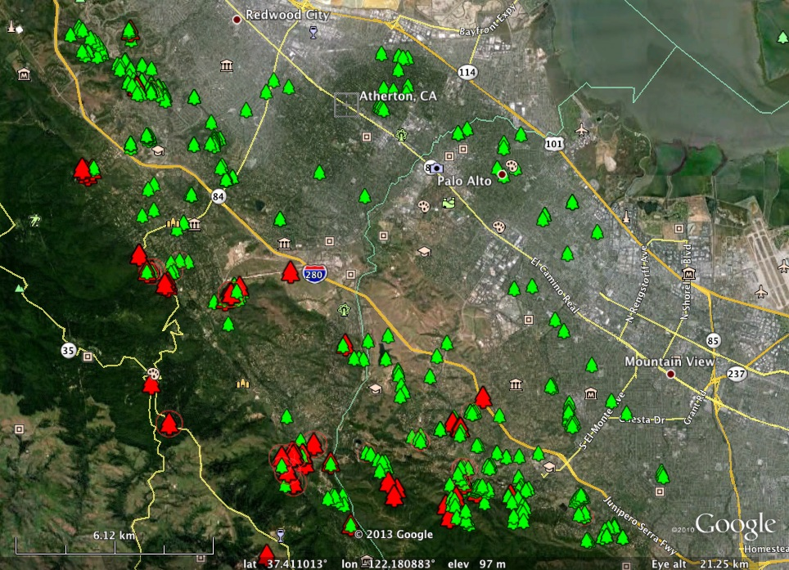
Mid peninsula
2
1
3

Slide 41
1- SOD North of Woodside, both West and East of 280, but with higher frequency on the mountain slopes West of 280. Increase of frequency East of 280, may require wet years
2- No SOD in the residential areas from Atherton to Mountain view. Eradication in Atherton appears to have been effective but need to keep monitoring
Los Altos Hills: not an apparent increase in infection frequency (not expected due to dry weather in an areas where arrival of SOD has been more recent), but an apparent movement Eastward

Slide 42
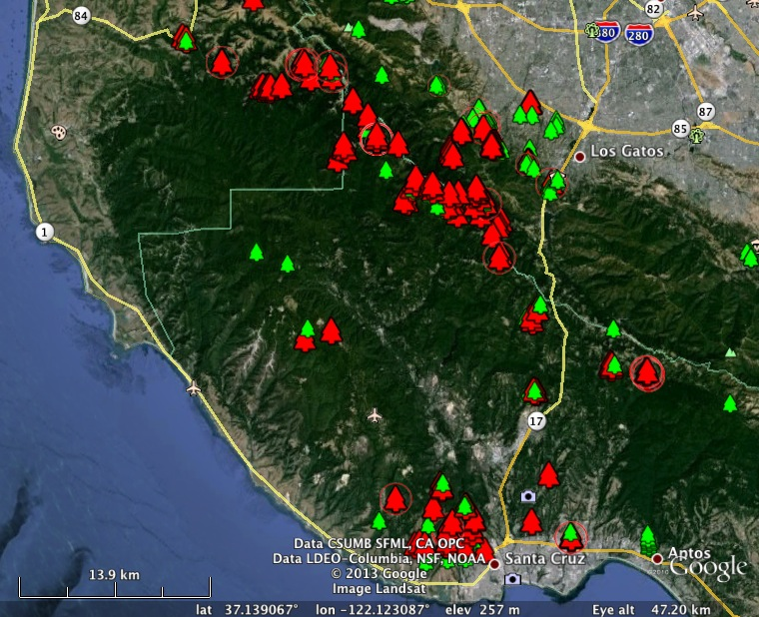
South Peninsula and Santa Cruz
2
1
3
4

Slide 43
The star indicates original introduction site of SOD (1987?). Its spread was very effective South (Santa Cruz), North (Boulder Creek-Skyline), and East (Soquel) but not West (lack of bays, mostly upwind)
1- A second significant outbreak in West San Mateo County West of La Honda
2- New findings East and South of Saratoga, one outbreak just north of 85
3- Positives close to Big Basin, indicating a slow advancement westward
4- Positives along Summit Road

Slide 44
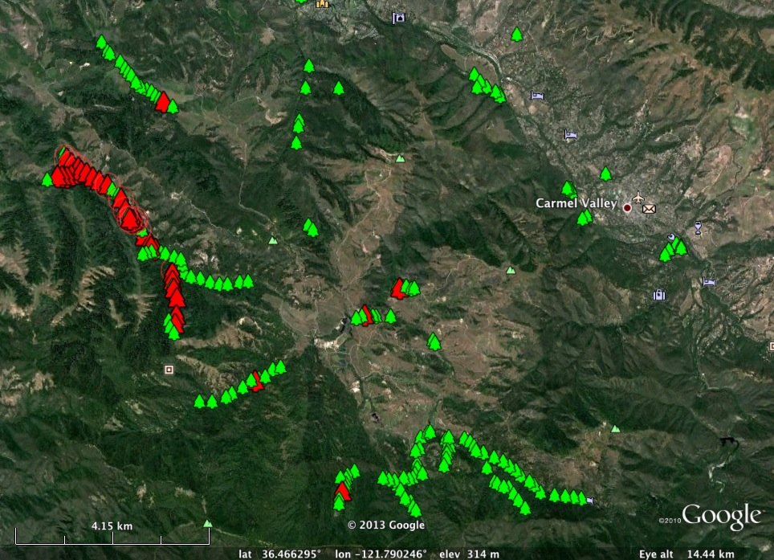
Carmel Valley
1
2

Slide 45
Hotspots away from the continuous forest of the Santa Lucia Range
Lack of positives in Carmel Valley Village:
  Very limited sampling, need to ramp up
  Highlights the dynamic aspect of disease establishment in areas that are less than optimal, possibly strongly affected by weather conditions. Need to be cautious because a series of wet years can change the game for a pathogen like P. ramorum with huge reproductive potential

Slide 46
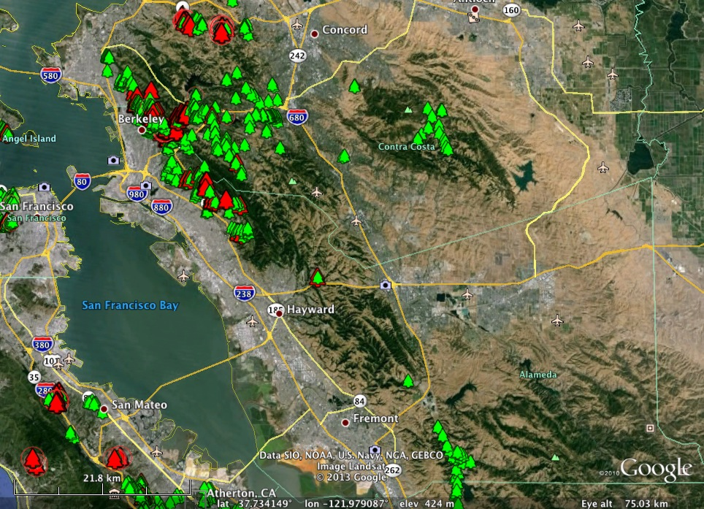
East Bay
1
4
2
3

Slide 47
1- First information on SOD distribution in John Muir Heritage Trust Land
2- First extensive survey of Mount Diablo, shows SOD still not there
3- Although previously detected once around Sunol, SOD not detected in 2013 blitz. Lack of detection does not equate to absence, but it does indicate the disease is not well established.
4- Although originally introduced in the East Side of the Berkeley Hills, SOD is present there and causing Oak infection, but it seems to be strongly negatively affected by weather patterns, in particular by drier weather
5- Since its arrival on the Western side of the Berkeley-Oakland Hills, disease spread has increased noticeably. Last year we reported epidemic conditions on bay laurel that theoretically can lead to oak infection. The 2013 blitzes documented oak infections in Berkeley, and outbreaks on bays in Kensington, North Berkeley, Berkeley, Claremont and Montclair

Slide 48
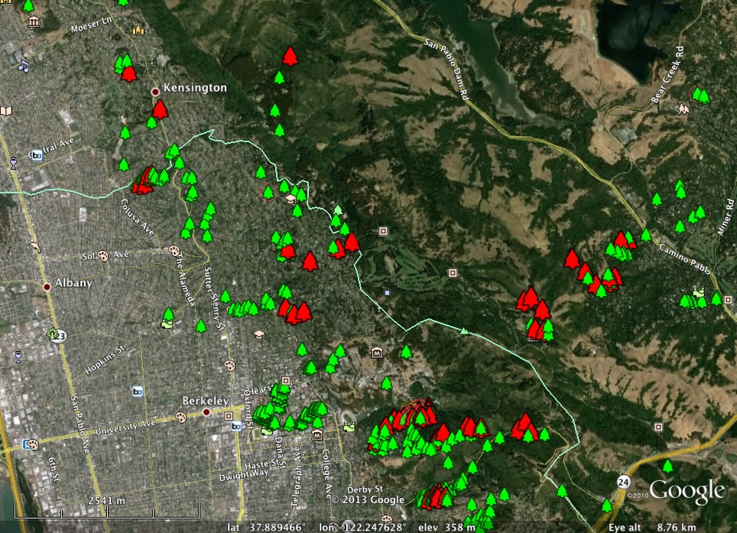

Slide 49
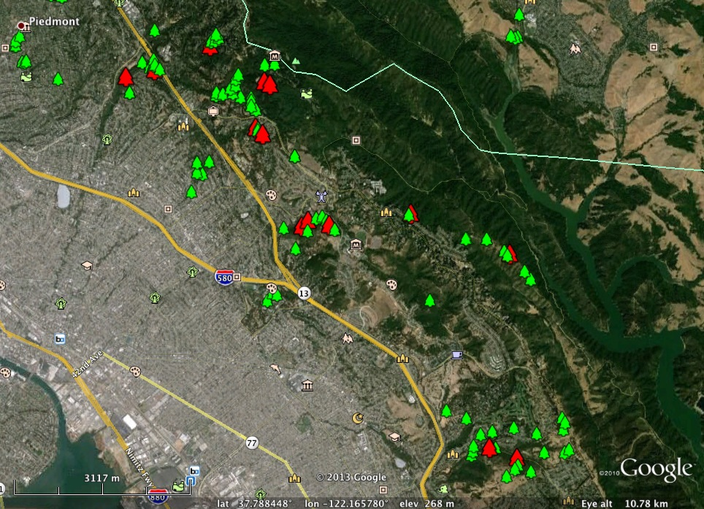

Slide 50
SODMAP database
The SODMAP is the result of a partnership of scientists and citizens, working together to create the most complete distribution map of a forest disease ever produced in the world.
BLITZ data more than 50% of SODMAP data

Slide 51
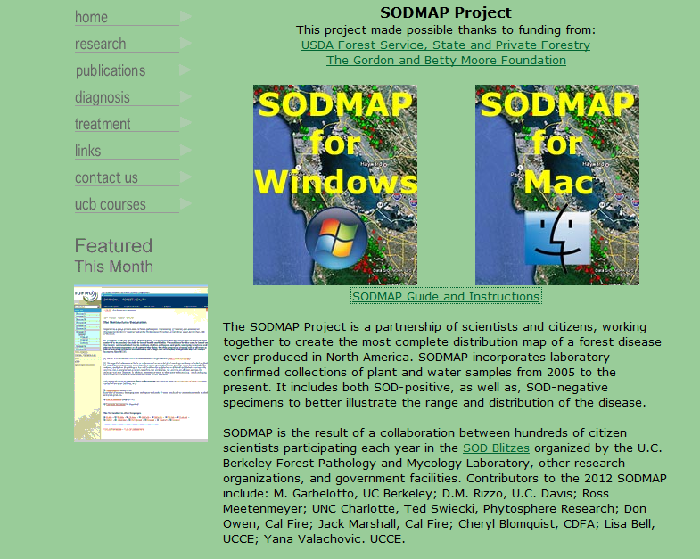
Sodmap.org

Slide 52
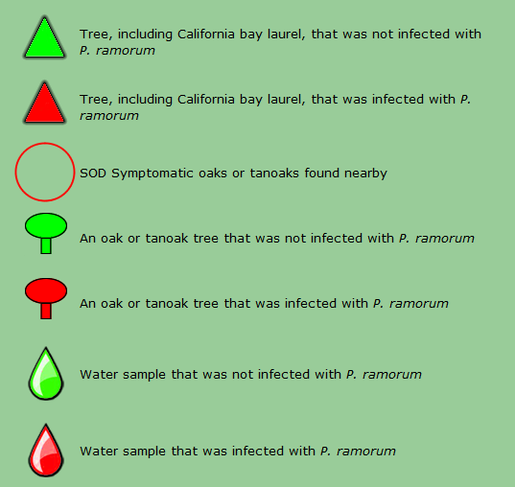
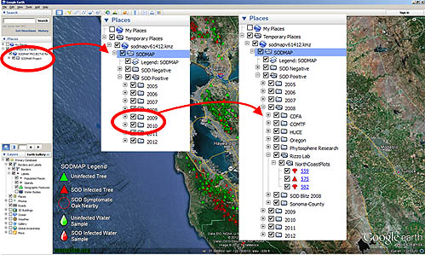
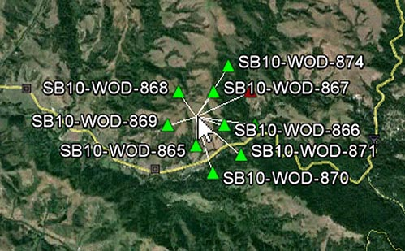
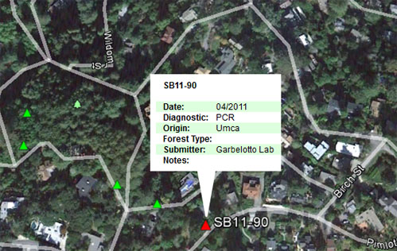
Using SODMAP

Slide 53
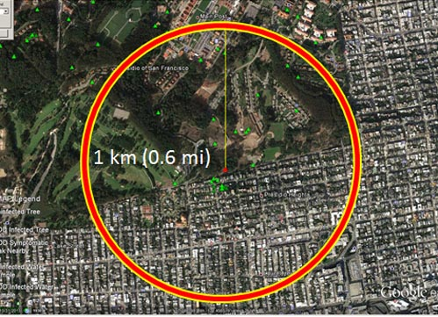
Using SODMAP to Assess Risk of
oak infection
Positives within 200 m, risk is high
Positives within 1km, but further than 200 m, risk moderate
Multiple positives within 200 m, risk very high

Slide 54
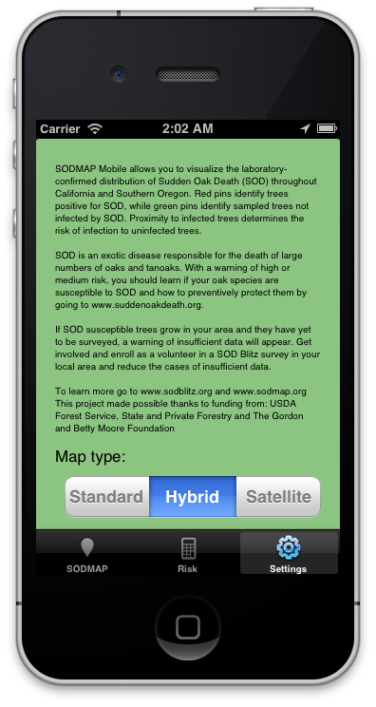
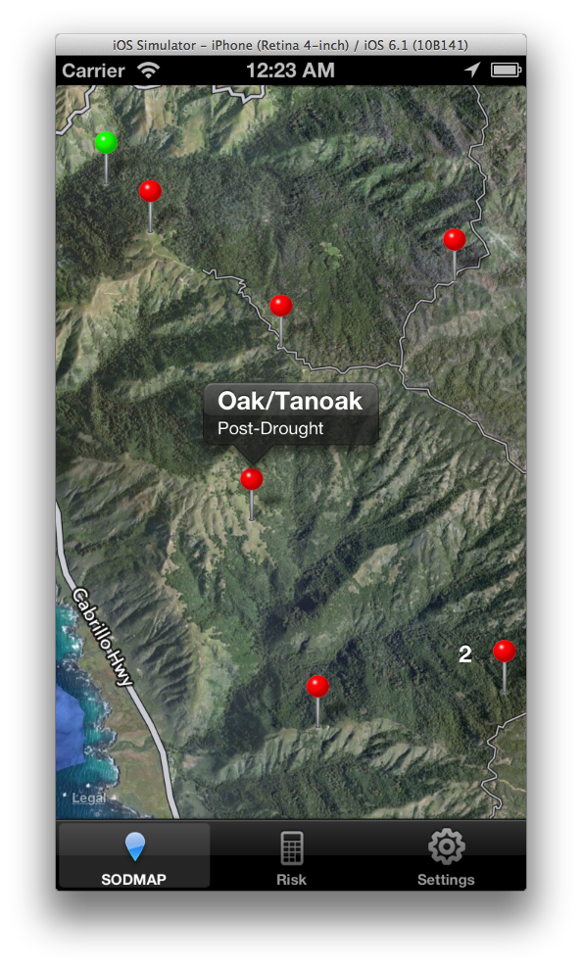
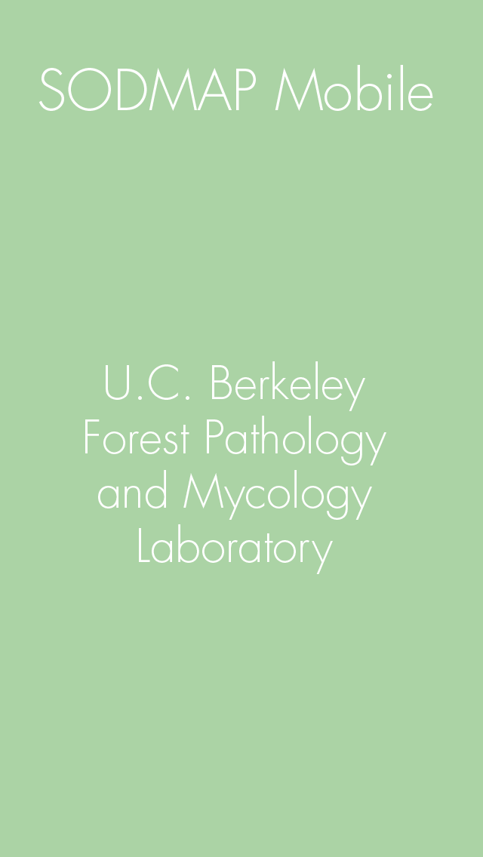
Smartphone technology: SODmap mobile (iPhone & Droid), allows you to locate positive and negative trees in the field

Slide 55
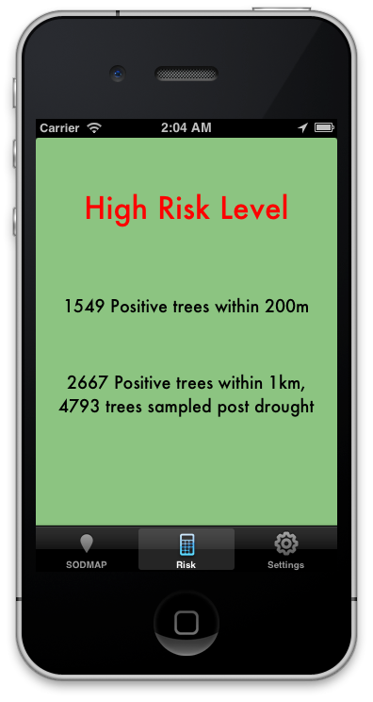
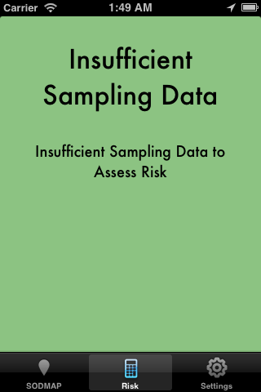
SODmap mobile is free and allows you to determine risk of oak infection at any given site
Insufficient data
Risk nil or low
Moderate Risk
High Risk

Slide 56
www.sodblitz.org
www.sodmap.org
www.matteolab.org
( go there to find out dates and locations of all meetings to learn how to use SODmap mobile and novel findings on disease management)

Slide 57
Conclusions
The continuous and increasing volunteer effort has allowed to increase our prediction accuracy for the spread of SOD, and to determine which factors most affect its spread
SODblitzes continue to identify new outbreaks: in 2013 Southern Mendocino, Northern Sonoma, and Golden Gate Park (AIDS memorial grove). On the other hand it provides good baseline data for uninfected areas such as San Luis Obispo and Mount Diablo
The large blitz database has allowed to generate the otherwise unimaginable SODmap: a very detailed map of distribution of the disease
SODmap is the basis for SODmap mobile: a smart App that allows to identify infected trees in the field and to determine risk of oak infection
We have shown volunteer work is of high quality and continuing the effort will allow us to improve our prediction ability, to determine which trees may be carriers of the disease in between wet cycles, and to identify new outbreaks

