Slide 2
White pine blister rust:
An emergent disease caused by the introduced basidiomycete
Cronartium ribicola

Slide 3
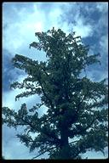
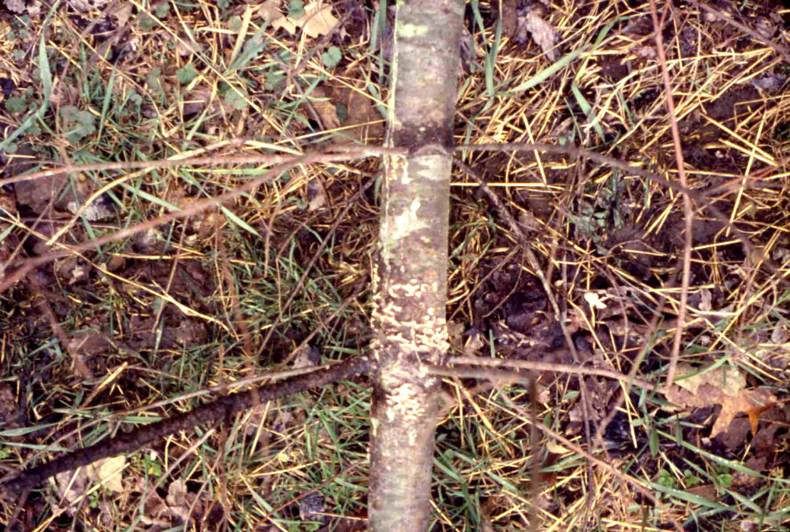
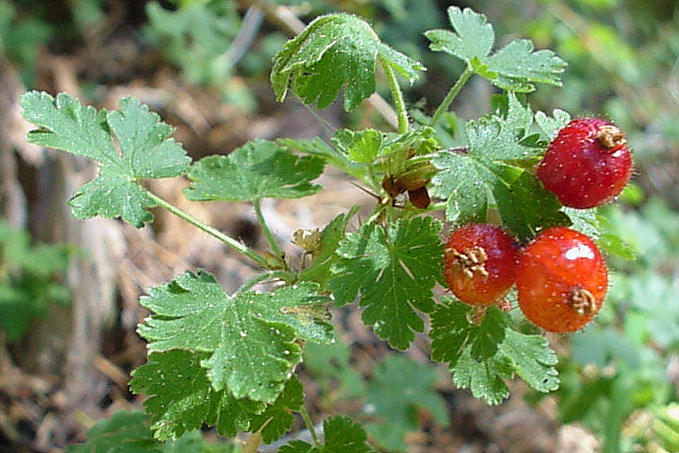
White pine blister rust
Introduced in the West Coast on seedlings
Efficiently airborne
Needs alternate host: gooseberry
Genetic resistance program
Spring
Fall

Slide 4
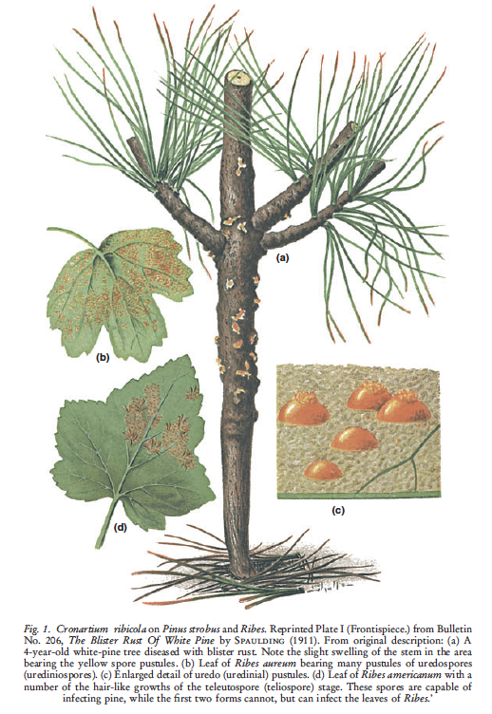

Slide 5
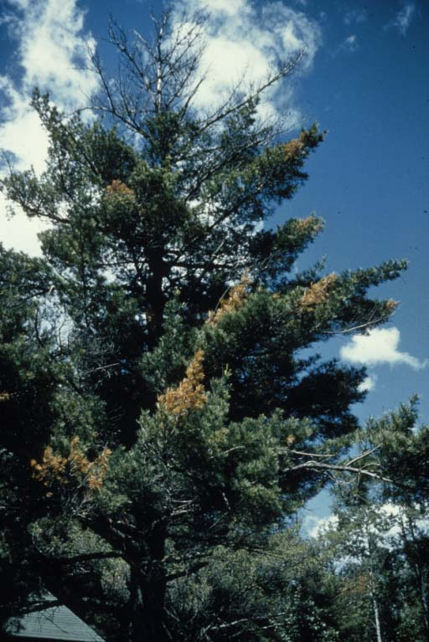
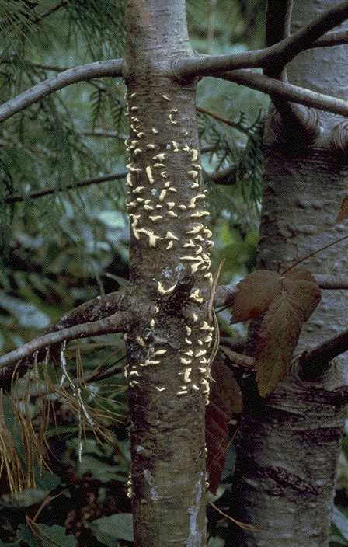

Slide 6
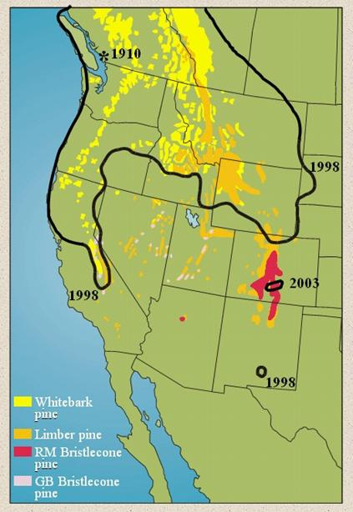
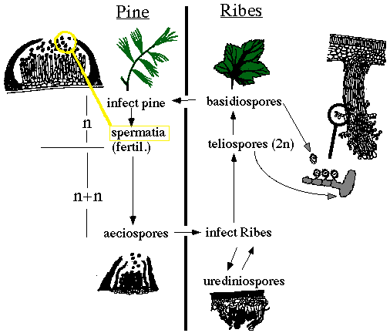

Slide 7
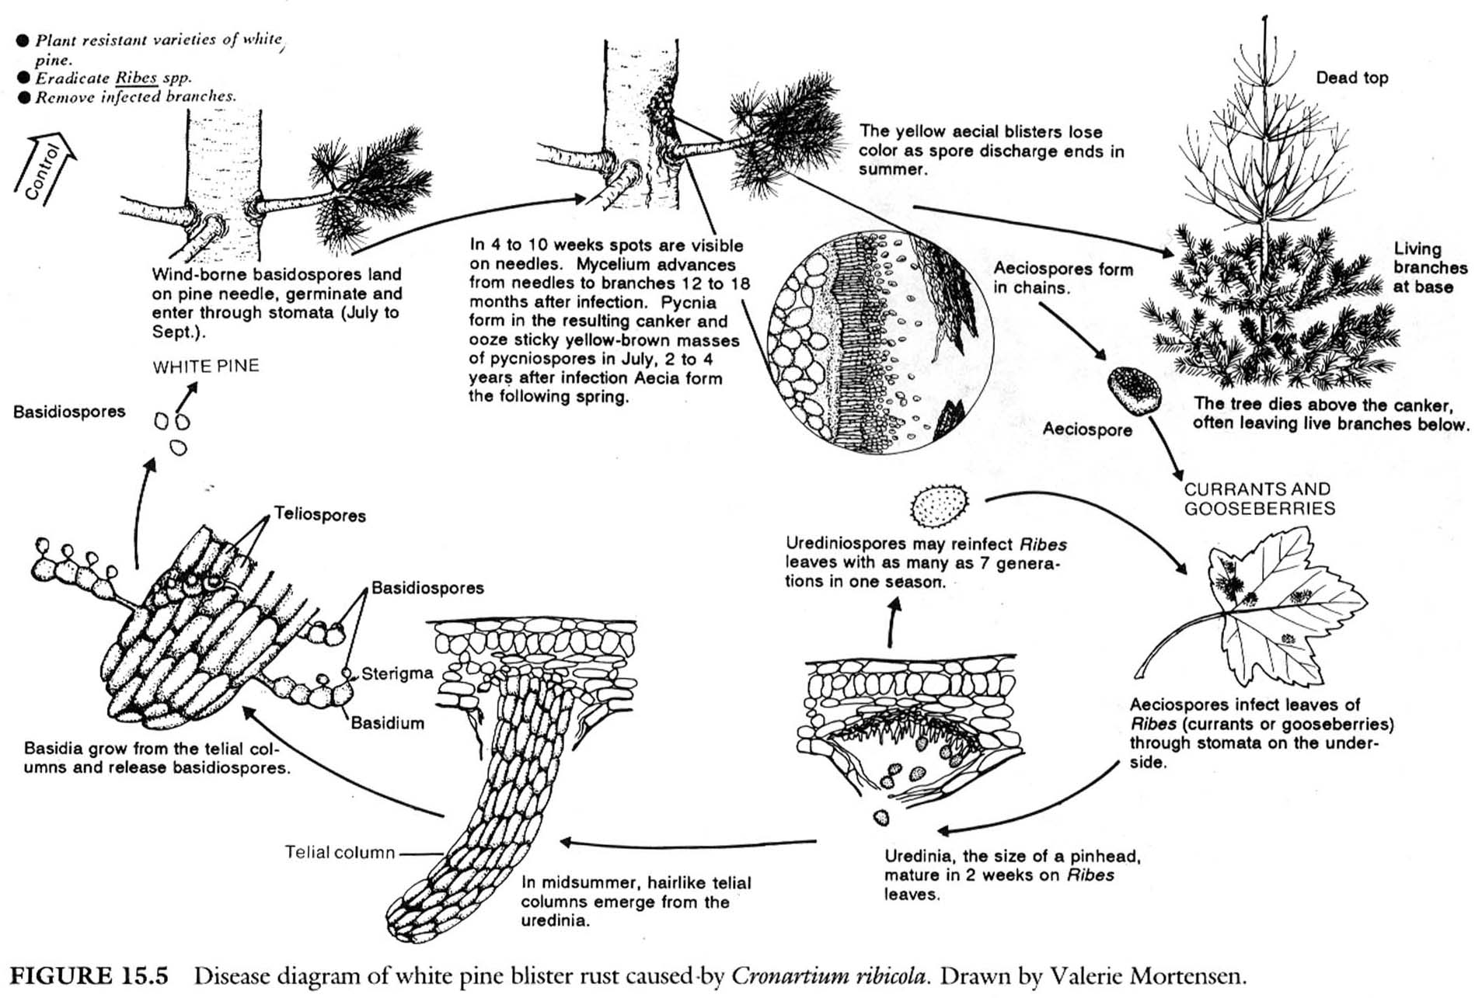
C. ribicola life cycle

Slide 8
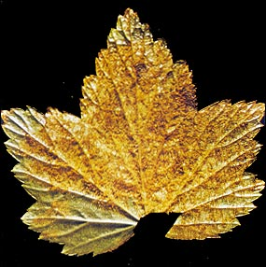

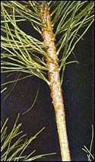
Cronartium ribicola—Causal Agent of White Pine Blister Rust
Leaves above the canker die, causing branch/stem to break
Opens site for decay fungus
Next Spring: spores cause blisters and thus cankers
Fall: fungus attacks needles
Two Years Later: Fungus spreads to branches and trunk
Spore produced to transmit disease
Notes:
All species of white pine (or five needle pines) in North America are susceptible to the pathogen. As is common with many other rust fungi, two different host species are required for this fungus to complete its life cycle. Ribesspecies (currant and gooseberry) serve as the alternate host.
-In summer, telia are produced, which are rough hairs. Wet conditions, teliospores germinate, form basidium to produce basidiospores. Basidiospores disperse by air and these infect pine.

Slide 9
A Few Pathogen Details
Infection occurs through stomata of needles, if needle is on stem then infection directly leads to tree girdling. If needle on branch, it will cause branch death and then if it moves into stem it will cause stem girdling, if stem does not die before pathogen gets to stem…
Overall Low genetic diversity in N.A. Sign of introduced disease
  Diversity between subpopulations is greater in West because of rugged topography
  Indicative of frequent founder events and little gene flow
Genetic center: Asia
To infect white pines: 48 hours <68 F, 100% relative humidity

Slide 10
Attempts to control WPBR
Ribes eradication
  More successful in East than West
Use of Risk Zones for planting and management
  potential pitfalls: must also account for airflow patterns
Pruning
  Can be successful if infection caught 12 inches from main stem; costly; may need repeated entries; probably would not work in whitebark
Genetics: probably most successful method
  Sugar and western white pines
  Whitebark pine work in progress

Slide 11
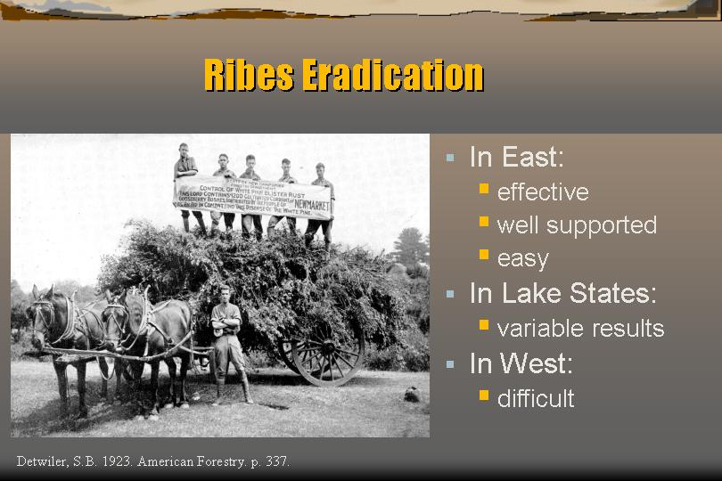

Slide 12
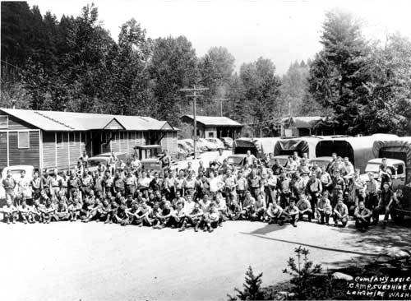
Civilian Conservation Camps during the Depression

Slide 13
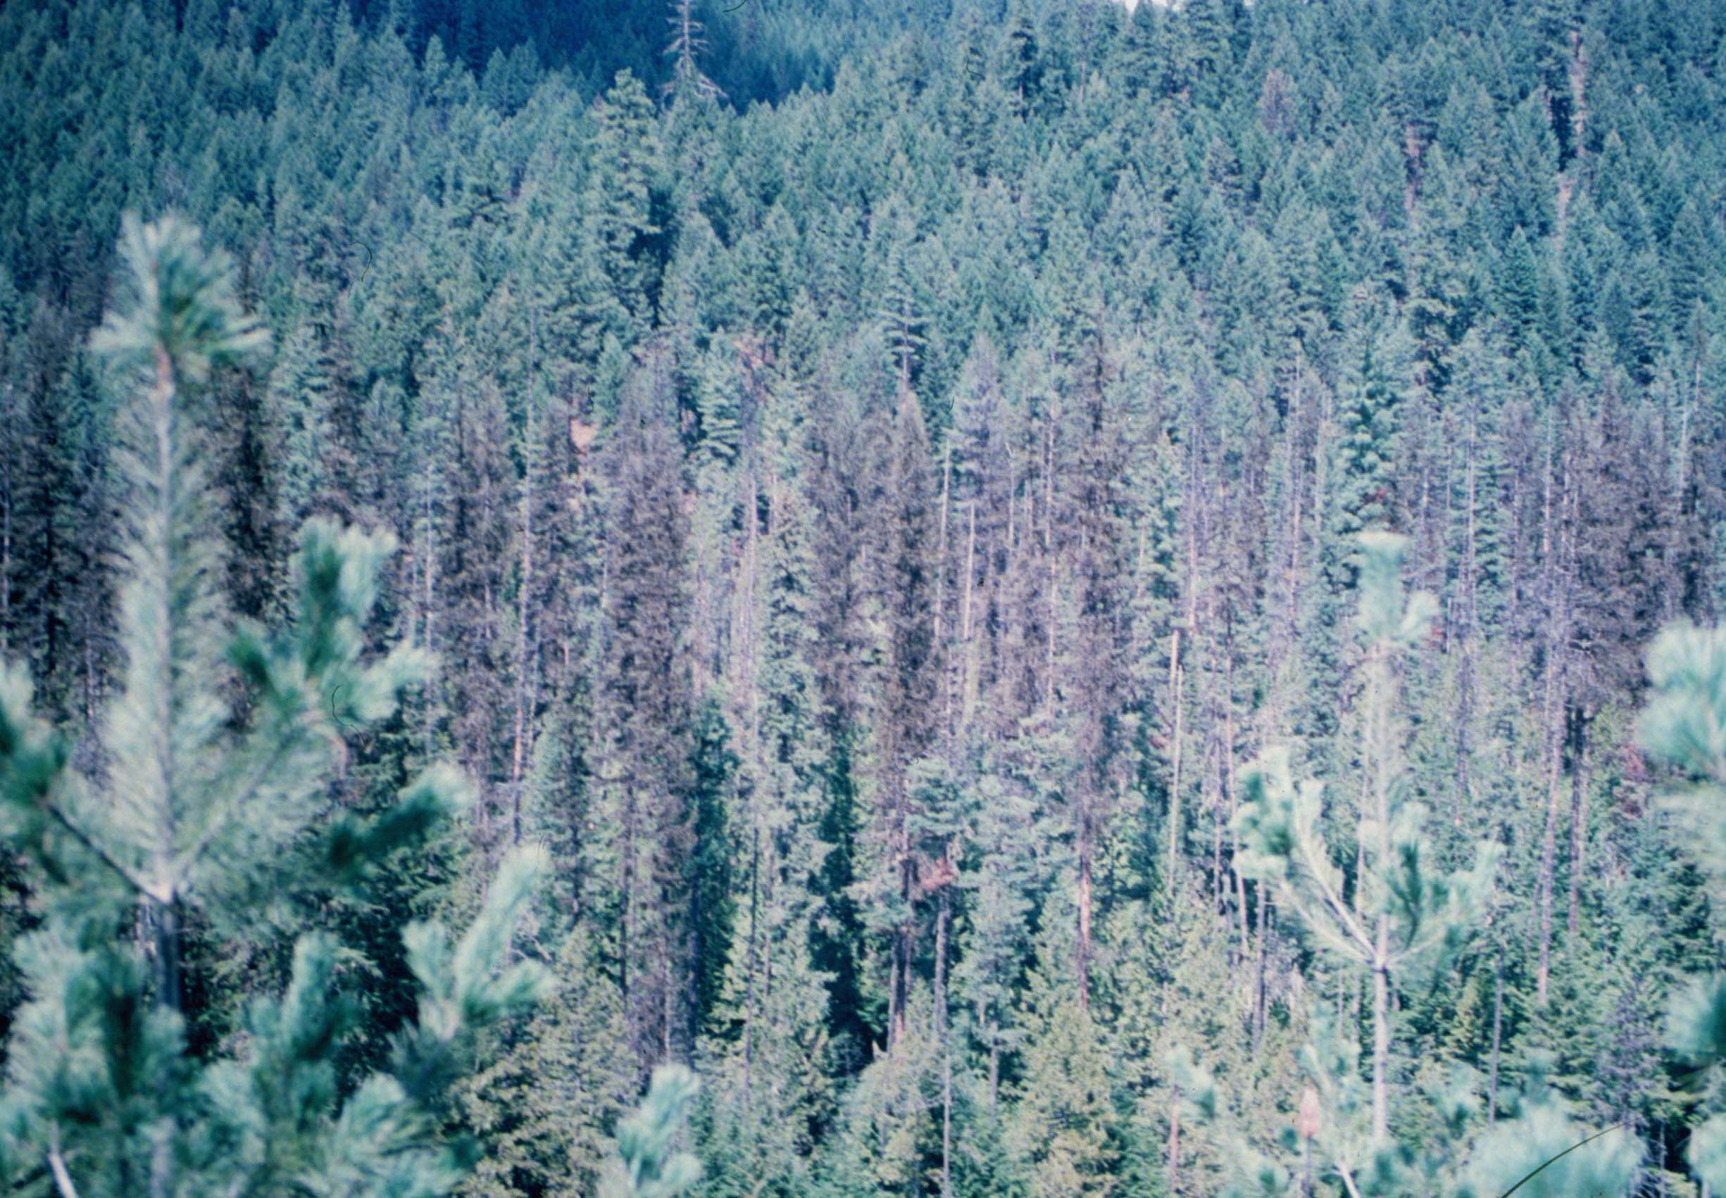
Widespread mortality in western white pine

Slide 14
Why mortality appears in clusters if pine to pine infection does not occur ?
1- Threshold of inoculum necessary for infections low in western white pine, so a single source can infect trees at various distance because dilution effects with distance are less pronounced
2- Resistance very infrequent (1 in a thousand)
3- Compounding effect of Mountain Pine Beetle

Slide 15
Pruning research in sugar pine
before...

Slide 16
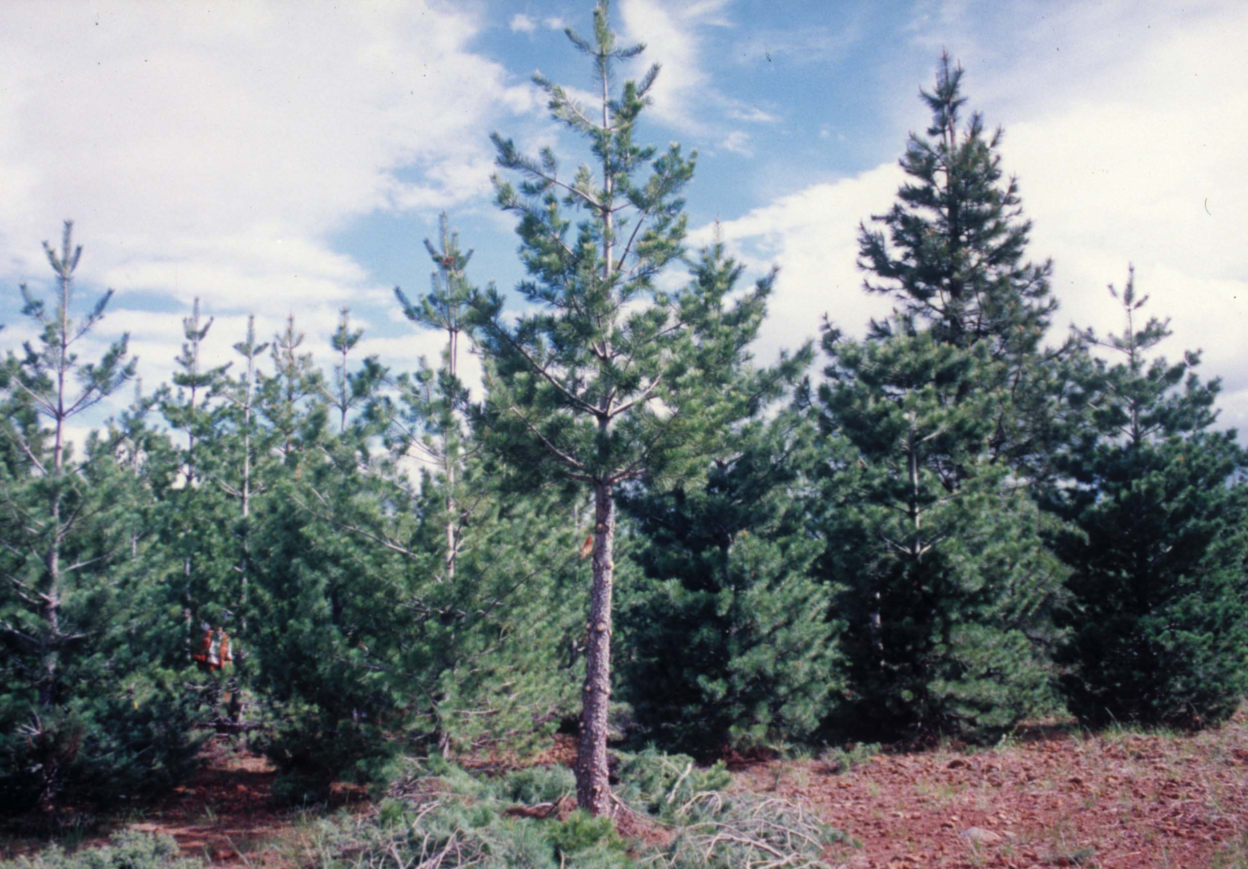
Pruning research in sugar pine
...after

Slide 17
Eastern white pine (P. strobus)
Largely cut over prior to rust, so loss due to rust minimal, but regenerating difficult
Only tree where Ribes control was mildly successful
Most land managers won’t risk it in high risk zones

Slide 18

Whitebark pine (P. albicaulis)
High elevations in the western US and Canada
Keystone species; slow growth
Mutualistic relationship
with Clark’s nutcracker
Wildlife (Grizzlies) dependence on nuts

Slide 19
Western white pine (P. monticola)
Largely disappeared from the Inland Northwest, where it was once most valuable timber species
Like Eastern wp avoided in plantings
Changing species comp. and structure made forest more susceptible to fire, insects and other pathogens

Slide 20
Sugar pine (P. lambertiana)
CA and PNW
Tree of largest stature in mixed-conifer forests
Few native pests, none causing such widespread mortality
Also avoided in some planted settings
Resistance 1% to 8%

Slide 21
Tree resistance
Major gene for resistance
Found in sugar, western white, and southwestern white so far
  Thought to be gene-for-gene (because virulent race of pathogen neutralizes this gene)
  Gene-for-gene typically indicates a pathosystem in which the host and pathogen have evolved over long time periods- so what is going on in this system?

Slide 22
A quick review of gene-for-gene resistance

Slide 23
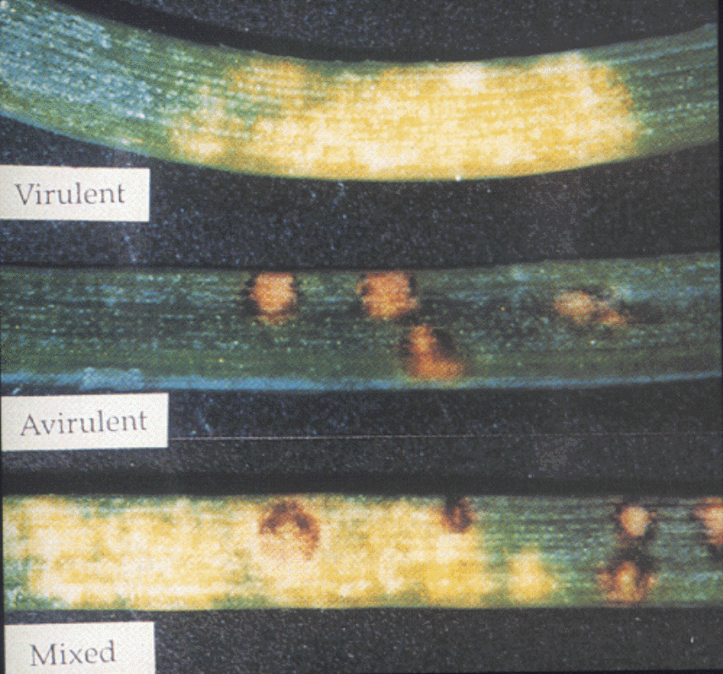
Lesion types: sugar pine

Slide 24
Additional types of tree resistance
Sugar pine
  Slow rusting resistance - many components of resistance combined into a single phenotypic expression, exhibited as amount and type of infection with moderately strong inheritance and independently inherited expressions (low infection # and high infection abortion)
  Ontogenetic resistance - another phenotypic expression that develops as the tree ages; under genetic controls; offspring may be fully susceptible

Slide 25
Additional types of tree resistance, cont’d
Western white pine
  Slow canker growth - non race specific trait; produces abnormally small cankers; may reduce pruning necessity (due to success)
  Reduced needle lesion frequency - also non race specific trait; few individual infection sites per seedling; may only be juvenile trait (seen in cotyledons)

Slide 26
Evaluation of longevity of control practices
Race of pathogen able to overcome major gene resistance in Sugar pine already present. Slow resistance or combination of two may be more durable approach

Slide 27
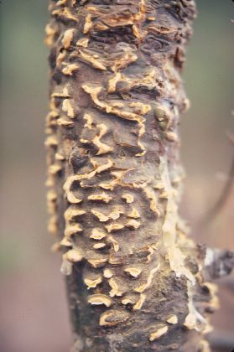
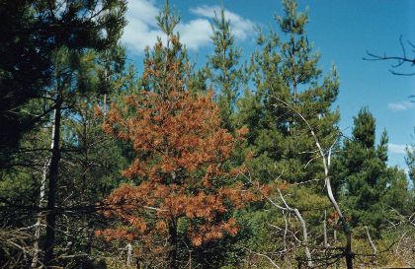
Influence of Host Resistance on the Genetic Structure of White Pine Blister Rust Fungus in the Western United States
Richardson, Klopfenstein, Zambino, McDonald, Geils, Carris

Slide 28
Purpose
Examine genetic diversity within and among population of western N.America
Effects of host resistance on C. ribicola

Slide 29
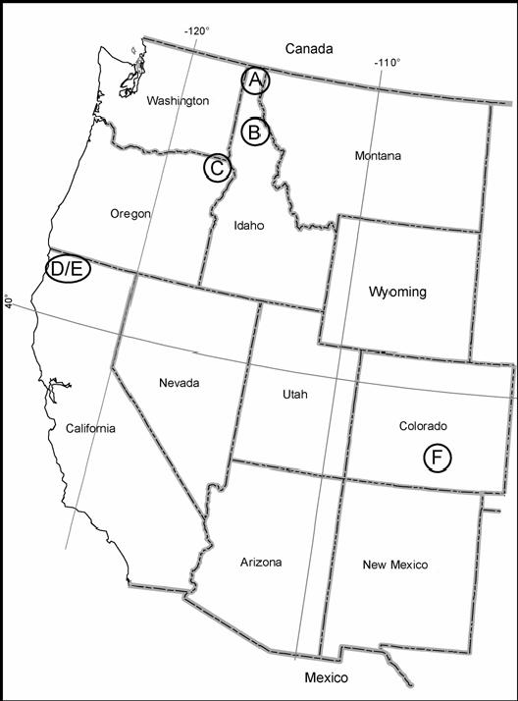
Materials + Methods
Sampling of isolates from 6 sites
B= merry creek: multigenic resistant, D= happy camp : major gene resistant

Slide 30
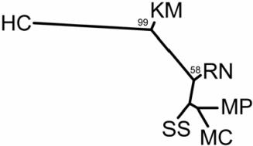
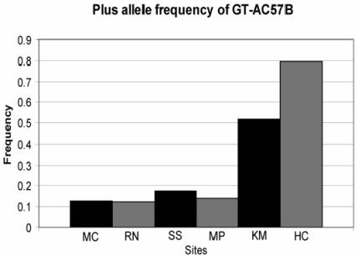
Results
Low number of polymorphic loci among 148 C. ribicola isolates
Heterozygosity
  Highest at MC
  Lowest at HC
Fst= 0.082 among sites, significant

Slide 31
Discussion
Effects of host resistance on C. ribicola
Merry Creek (multigenic resistant trees): had highest heterozygosity
Happy Camp (major gene resistant trees): had
lower heterozygosity
- Selection for rust isolates carrying vc1 because all trees have cr1.
Notes:
Genetic background of MC: composite host population from various lcoations,
HC: composite of field collected major gene resistant trees
Seems as though both have higher heterozygosity than local stands.
2 HC isolates closer to population 1 and 2 instead of 3. Perhaps hybrids or non vcr1?

Slide 32
Mortality and decline of white pine not only due to WPBR
Fire suppression: most wp species like open spaces created by fire and are fire-adapted. With lack of fire, site are encroached by shade tolerant species and white pine regeneration is limited
Insect (mountain pine beetle ) outbreaks. When populations of this insect become large they attack healthy trees as well. Effect of WPBT and mountain pine beetle is more than the sum of the two
Dothistroma needle blight can cause outbreaks, however both Dothistroma and insect outbreaks may be cyclical and natural
Global warming

Slide 33
Consequences of wp mortality
Group of species that is extremely adaptable, and that in western North America, depending on latitude, goes from sea level to tree-line
High market value: white pines timber is king. In past times it was the best timber to build ships’ masts. One of the reasons for the secession of American territories
It includes the oldest living organism on earth (Bristlecone pine)
In the Rockies it is essential for survival of Clark’s nutcracker and Grizzly bears. In the West, white pines are diversity hotspots

Slide 34
"In North America, white pine blister rust has caused more damage and costs more to control than any other conifer disease. Since the 1920's, millions of dollars have been spent on the eradication of the alternate host, Ribes, and thousands of white pine stands have been severely damaged. In the western United States and Canada, some stands have been completely destroyed. When the main stem of a tree is invaded, death is only a question of time.“
Robert F. Sharpf, U.S. Department of Agriculture Handbook 521 (p.85)

Slide 35
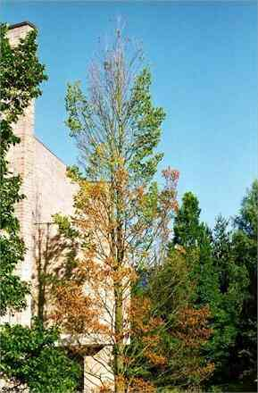
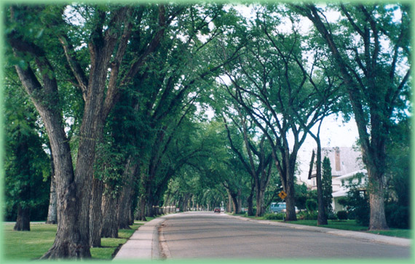
Dutch Elm Disease
Notes:
Foliage symptoms: Symptoms of DED begin as wilting of leaves and proceed to yellowing and browning. The pattern of symptom progression within the crown varies depending on where the fungus is introduced to the tree. If the fungus enters the tree through roots grafted to infected trees (see disease cycle section), the symptoms may begin in the lower crown on the side nearest the graft and the entire crown may be affected very rapidly. If infection begins in the upper crown, symptoms often first appear at the end of an individual branch (called "flagging") and progress downward in the crown (cover photo).
Multiple branches may be individually infected, resulting in symptom development at several locations in the crown (figure 2). Symptoms begin in late spring or any time later during the growing season. However, if the tree was infected the previous year (and not detected), symptoms may first be observed in early spring. Symptoms may progress throughout the whole tree in a single season, or may take two or more years.
Vascular symptoms: Branches and stems of elms infected by the DED fungus typically develop dark streaks of discoloration. To detect discoloration, cut through and peel off the bark of a dying branch to expose the outer rings of wood. In newly infected branches, brown streaks characteristically appear in the sapwood of the current year (figure 3). It is important to cut deeply into the wood or look at the branch in cross section for two reasons: (1) As the season progresses, the staining may be overlaid by unstained wood, and (2) if infection occurred in the previous year, the current sapwood may not be discolored.

Slide 36
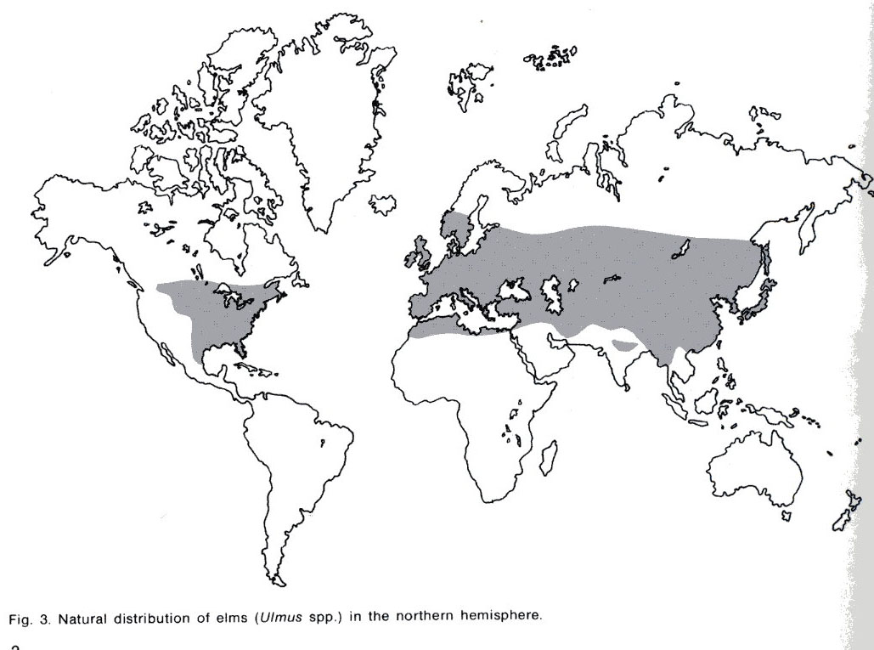
Host: the Elms (genus Ulmus)
>30 species in genus. Europe has 5; N. America 8; Asia has 23 or more
6 species native to the northeastern U.S., including Ulmus americana, the American elm
New species are still being found in China, the center of diversity
Notes:
The elm host. Native species of North American elms vary in their susceptibility to DED, even within species. American elm (Ulmus americana L.) is generally highly susceptible. Winged elm (U. alata Michx.), September elm (U. serotina Sarg.), slippery elm (U. rubra Muhl.), rock elm (U. thomasii Sarg.), and cedar elm (U. crassifolia Nutt.) range from susceptible to somewhat resistant. No native elms are immune to DED, but some individuals or cultivars have a higher tolerance (and thus may recover from or survive with infection) or resistance to DED. Many European and Asiatic elms are less susceptible than American elm.
In addition to genetic factors present in some cultivars and species, physical factors affect tree susceptibility. These factors include time of year, climatic conditions (such as drought) and vitality of the tree. Water conducting elements are most susceptible to infection as they are being produced in the spring, thus elms are most susceptible to infection after earliest leafing out to midsummer. Trees are less susceptible under drought conditions. Vigorously growing trees are generally more susceptible than slower growing trees.

Slide 37
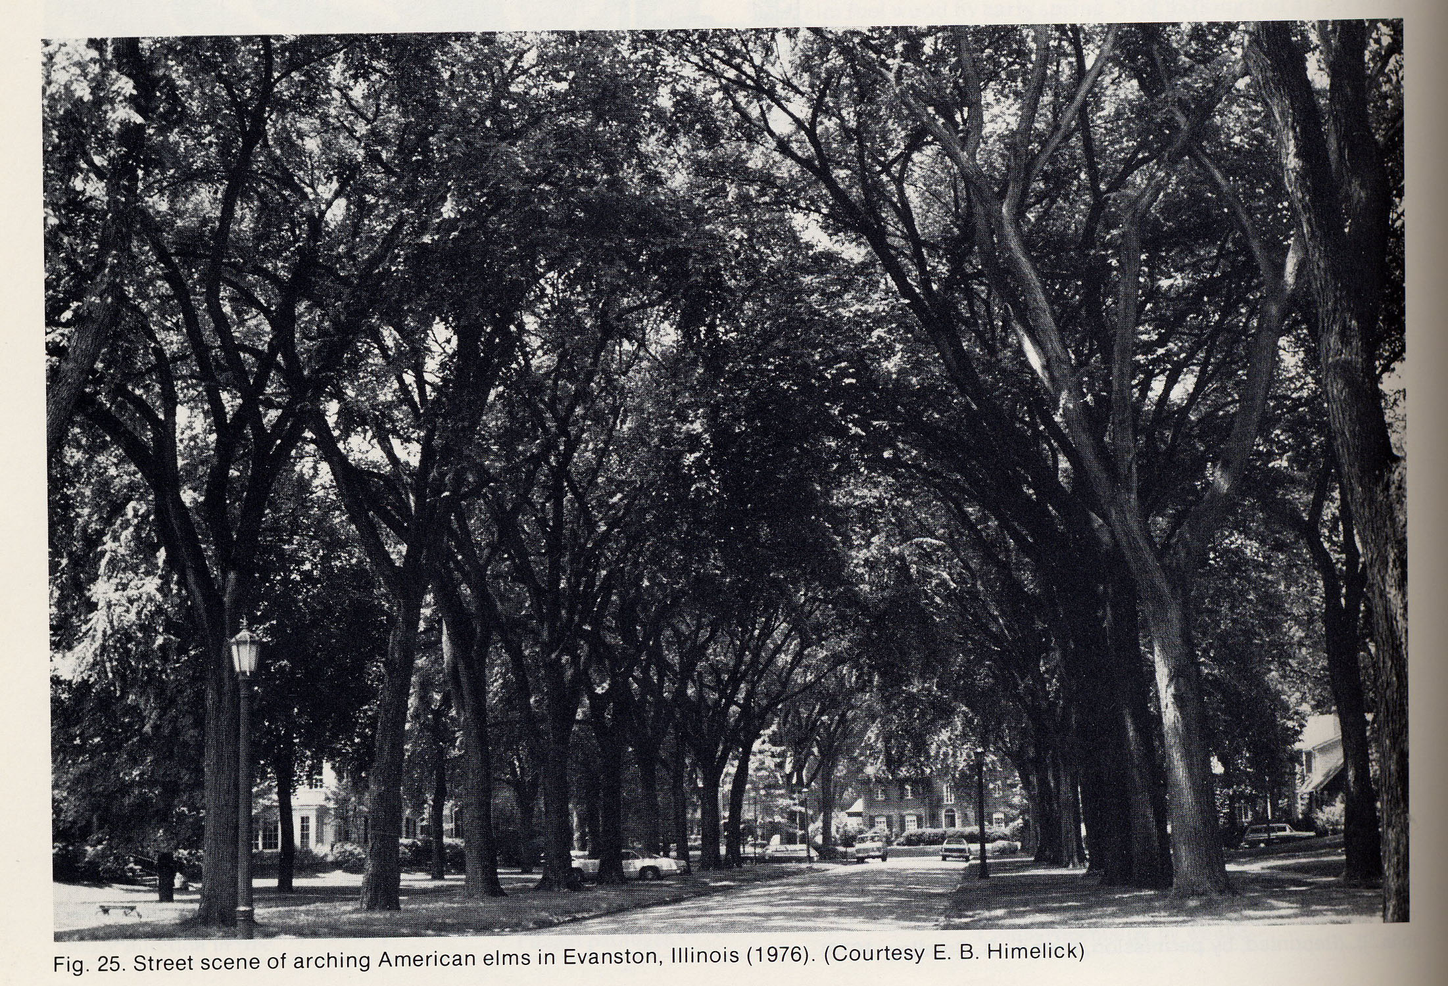
Elms: the perfect shade tree
Used as street-liners
Fast-growing,
easily transported, tolerant
of soil compaction and
different soil types
Shade trees, with branches borne high above ground. When
planted in rows, they
overhang the street
forming a Gothic-style arch. Good for windbreaks
#1 urban tree in U.S east of the Rockies, and in large parts of Europe and Asia (Heybroek, 1993)

Slide 38
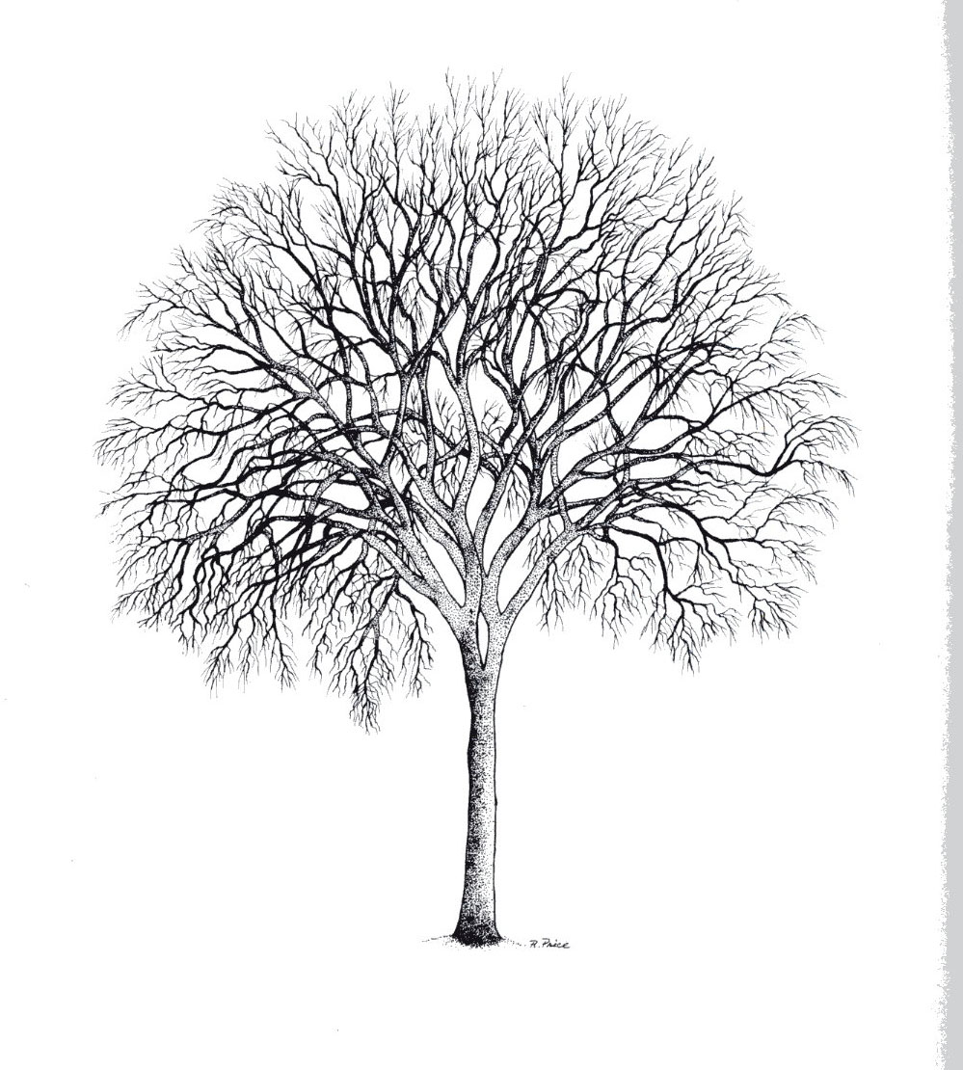
Elms: rural and natural Settings
In rural settings:
In coastal western Europe, used as windbreaks
The Siberian Elm was planted as “shelterbelts” to prevent erosion during the Dustbowl in the 30’s in the U.S.
In Natural Settings:
A generally riparian, river bottom group that can survive periods of anoxia, explaining tolerance to over-watering and soil compaction

Slide 39
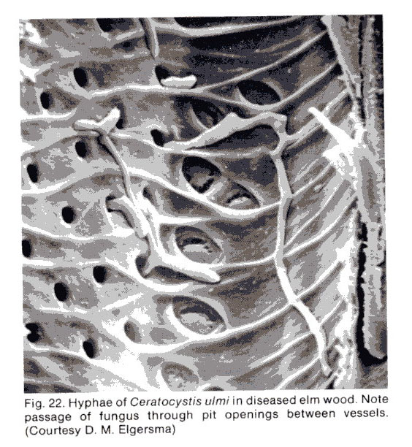
Overview: Dutch Elm Disease
Why “Dutch”? First isolated in 1920 by a Dr. Schwarz in the Netherlands
Wilt disease that attacks elm (Ulmus ssp) and spreads through the vascular system
Caused by ascomycete fungi (genus Ophiostoma)
Vectored by beetles (family Scolytidae) and root graft
Notes:
Frequently, by the time first symptoms are noted, the fungus has already reached scaffold branches or the main trunk of the tree. Once the fungus is established within a tree, it spreads rapidly via the water-conducting vessels. The tree forms gums within these vessels in response to the presence of the fungus, causing the tree to wilt and eventually die. Trees infected through root grafts wilt and die rapidly; this frequently occurs in the spring soon after the trees have leafed out and progresses from the base of the tree upward.
Vascular wilt diseases
Vascular wilt diseases are caused by pathogenic fungi or bacteria that enter the water-conducting xylem vessels of a plant, then proliferate within the vessels, causing water blockage. The typical symptoms include wilting and death of the leaves, followed often by death or serious impairment of the whole plant. As a group, therefore, the vascular wilts are among the most devastating plant diseases.
There are several interesting features of these diseases. For example, the blockage of the xylem vessels is not necessarily caused by the pathogens themselves but often by the host reactions to invasion - the production of gel-like materials which serve as potential barriers to spread of the pathogens in the vessels. In addition, some of the symptoms, such as the common yellowing of the leaves and the loss of control of stomatal function, may are caused by toxins produced by the pathogens. But perhaps the most interesting point is that the pathogens have only a weak ability to invade living plant tissues; instead, they grow in the nutrient-poor conditions of the water-conducting vessels, and they only grow into the rest of the plant when it has been weakened or killed by water stress.
DED symptoms are the result of a fungus infecting the vascular (water conducting) system of the tree. Infection by the fungus results in clogging of vascular tissues, preventing water movement to the crown and causing visual symptoms as the tree wilts and dies.
Foliage symptoms: Symptoms of DED begin as wilting of leaves and proceed to yellowing and browning. The pattern of symptom progression within the crown varies depending on where the fungus is introduced to the tree. If the fungus enters the tree through roots grafted to infected trees (see disease cycle section), the symptoms may begin in the lower crown on the side nearest the graft and the entire crown may be affected very rapidly. If infection begins in the upper crown, symptoms often first appear at the end of an individual branch (called "flagging") and progress downward in the crown (cover photo).
Multiple branches may be individually infected, resulting in symptom development at several locations in the crown (figure 2). Symptoms begin in late spring or any time later during the growing season. However, if the tree was infected the previous year (and not detected), symptoms may first be observed in early spring. Symptoms may progress throughout the whole tree in a single season, or may take two or more years.
Vascular symptoms: Branches and stems of elms infected by the DED fungus typically develop dark streaks of discoloration. To detect discoloration, cut through and peel off the bark of a dying branch to expose the outer rings of wood. In newly infected branches, brown streaks characteristically appear in the sapwood of the current year (figure 3). It is important to cut deeply into the wood or look at the branch in cross section for two reasons: (1) As the season progresses, the staining may be overlaid by unstained wood, and (2) if infection occurred in the previous year, the current sapwood may not be discolored.

Slide 40
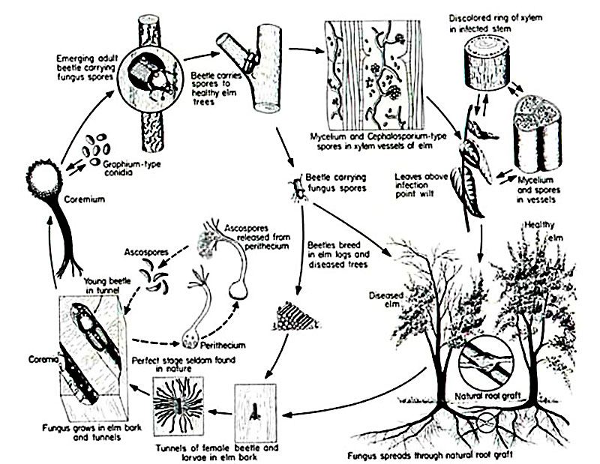
Life Cycle of Ophiostoma ulmi
Notes:
From the point of inoculation, the fungus moves upward and downward by two modes: in the liquid within xylem vessels and the growth of fungal hyphae between xylem vessels after germination. Ophiostoma novo-ulmi reaches the roots within one season of infection where it continues to grow. The fungus grows in the roots and ascends the trunk in a wave of infection that kills the entire tree or a major part of it. Where elms are planted close together and there is a possibility of root grafting, Ophiostoma novo-ulmi may move from one tree into the next through the roots. The fungus can also survive as a saprophyte in dead plant tissue.
According to Partridge (1997), O. ulmi s.l. is a rather complex fungus. It has four spore types: conidia produced on mycelium, conidia borne on a mycelial stalk (synnema), yeast like spores that are variable in size, and ascospores, which are produced in a black fruiting body (perithecium) which ooze through the long neck of the perithecium, and accumulate at the tip in sticky mass.

Slide 41
Vectors of disease
Insects: 1) the native elm beetle 2) the smaller European elm beetle. The beetles can fly for several miles, allowing the disease to spread over a wide area
Root grafts: when elms are within 50 feet of one another, their roots can grow together and disease passes easily along. Important in urban settings
Infected logs: Often transferred long distances

Slide 42
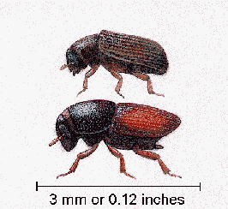
Beetles: key disease vector
1) Native elm bark beetle (Hylurgopinus rufipes) (above) is the primary vector in parts of the northern United States, New England, and all of Canada.
However, temperatures below -6F kill the larvae.
2) European elm bark beetle (Scolytus multistriatus Marsh.) (below) is the major vector of the disease.

Slide 43
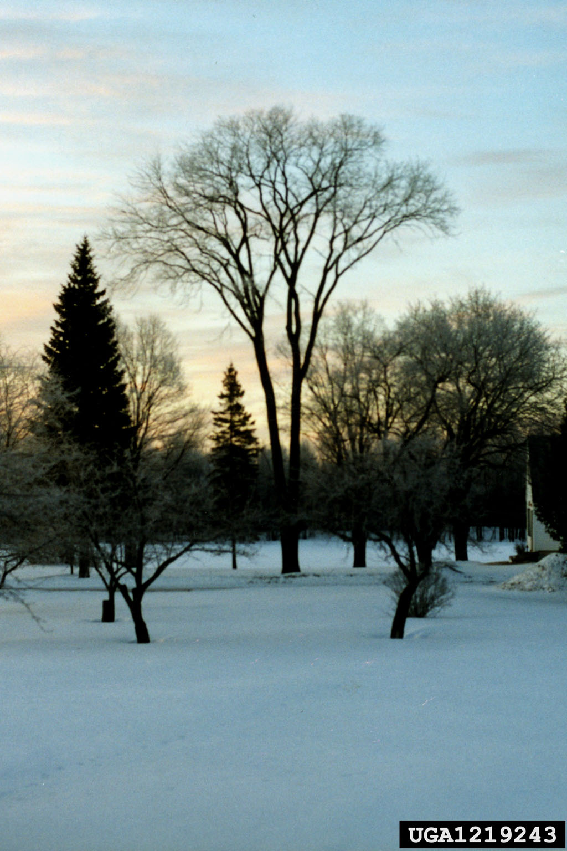

Slide 44
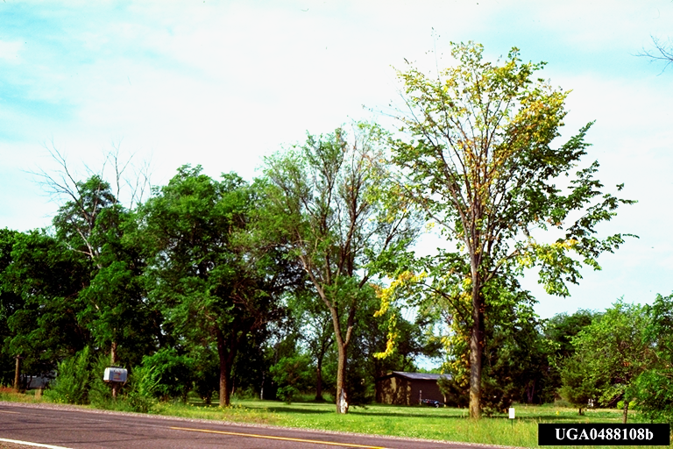
Dutch elm disease – crown symptoms

Slide 45
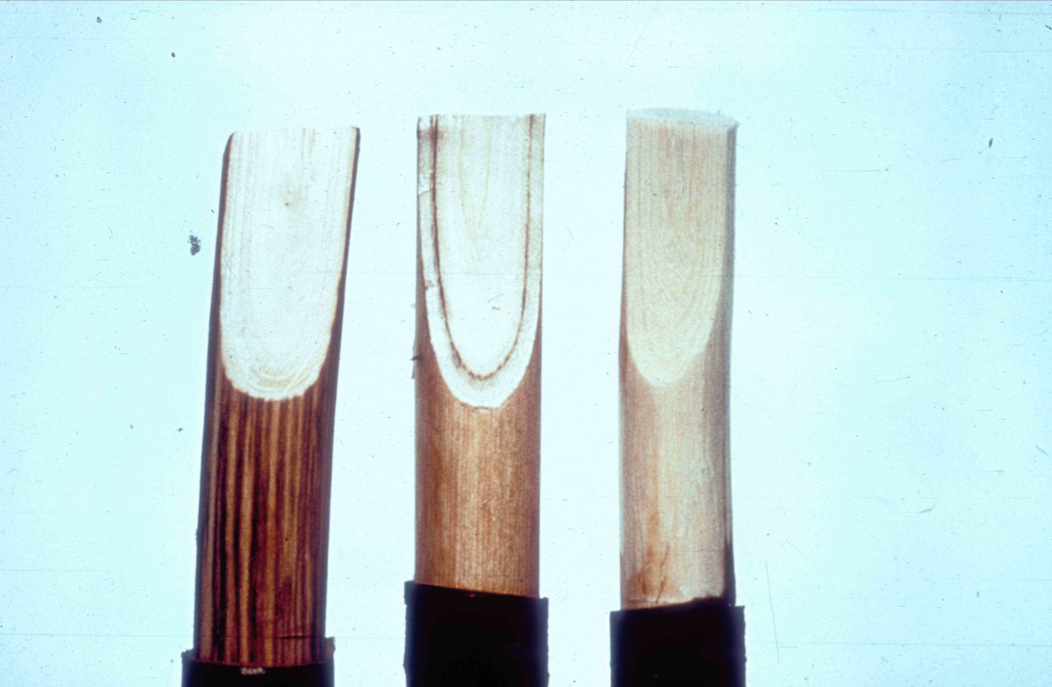
Dutch elm disease – vascular discoloration

Slide 46
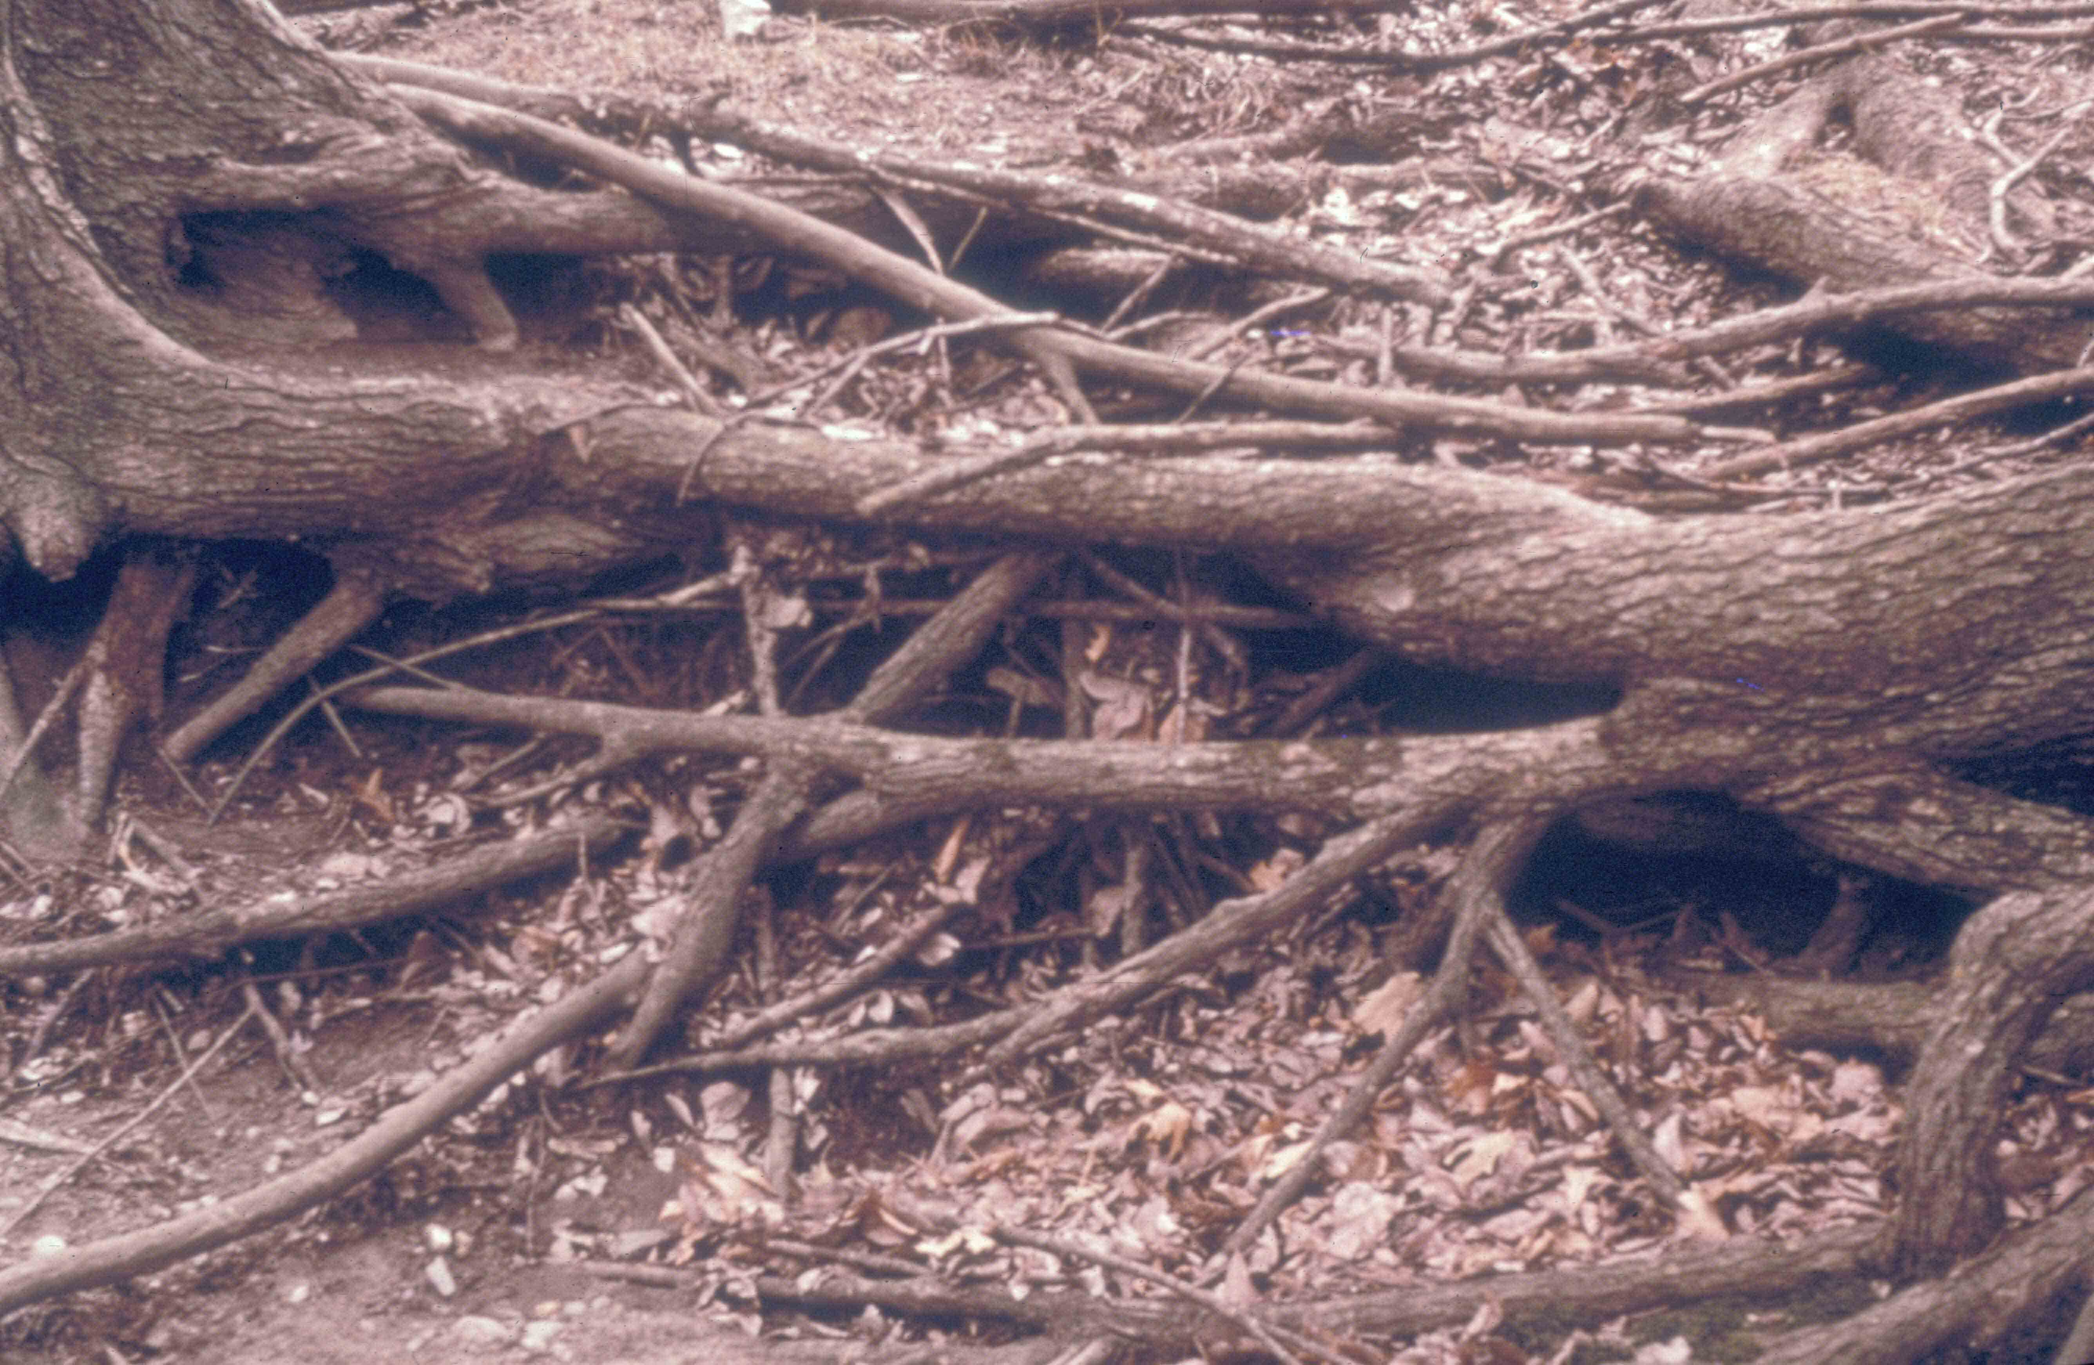
Elm root grafts

Slide 47
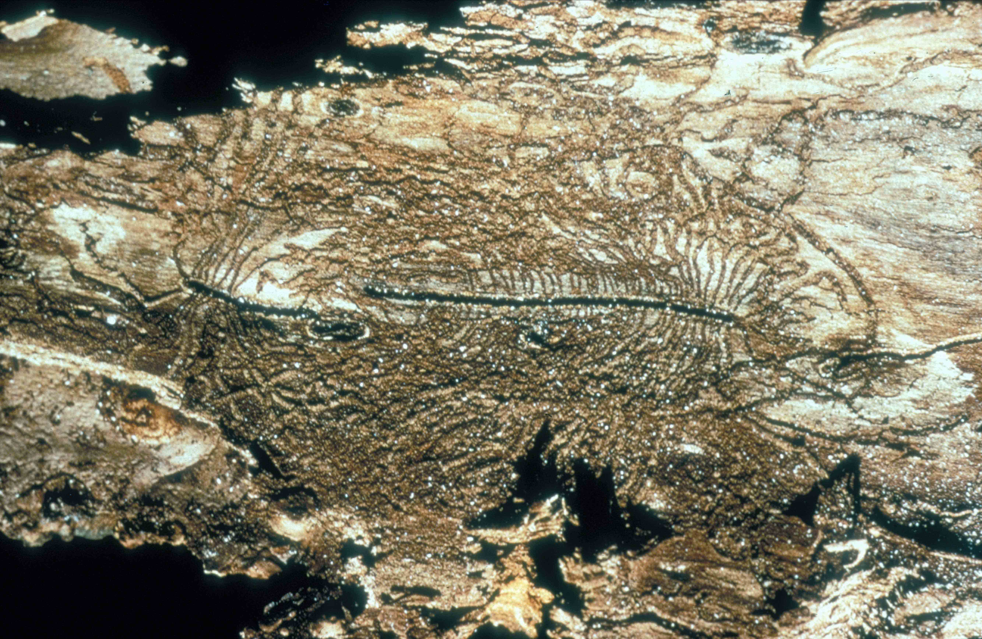
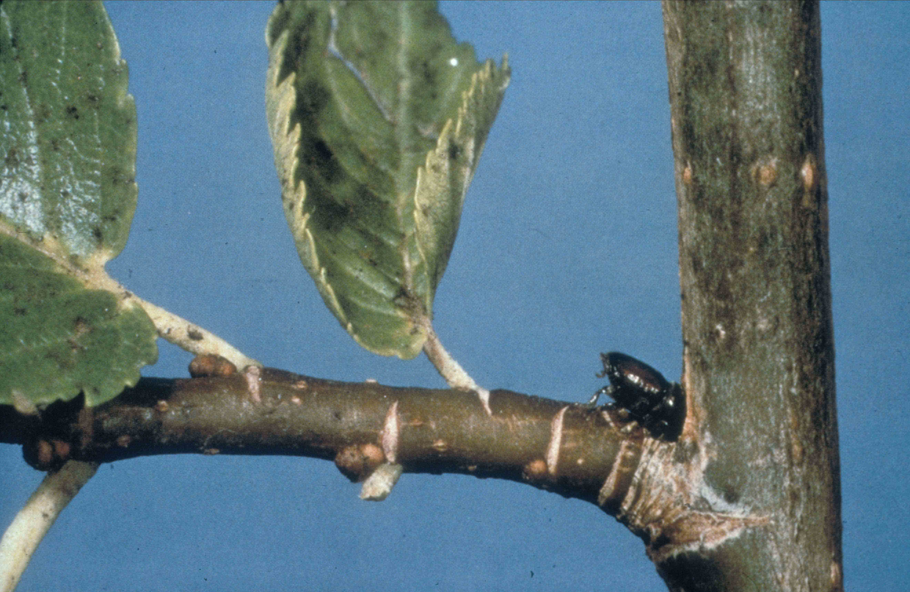
Elm bark beetle galleries
Maturation feeding

Slide 48
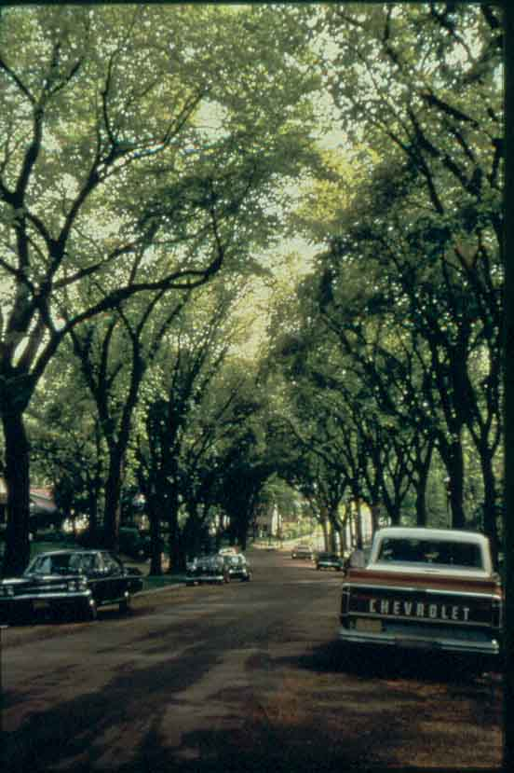
1970

Slide 49
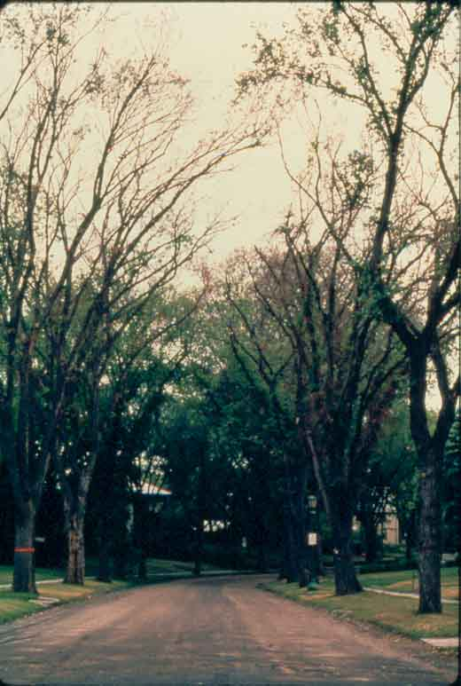
1976

Slide 50
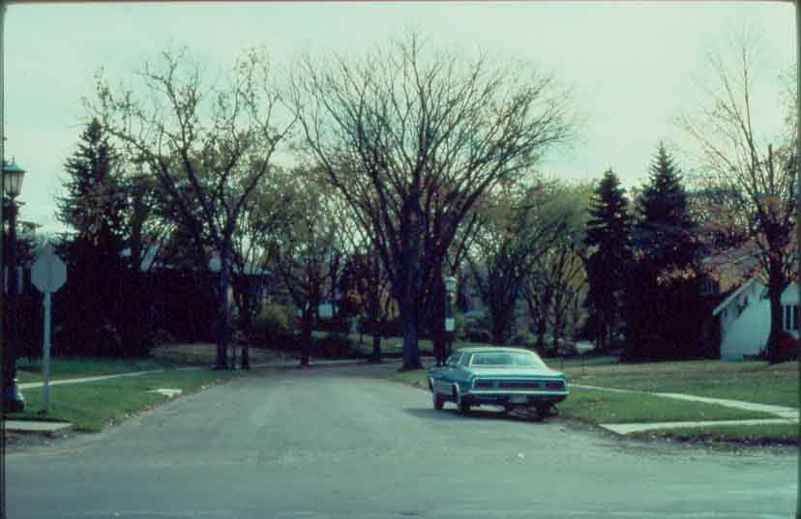
1977

Slide 51
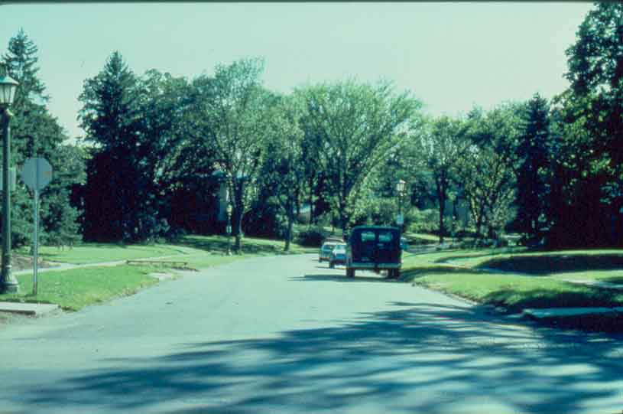
1978

Slide 52
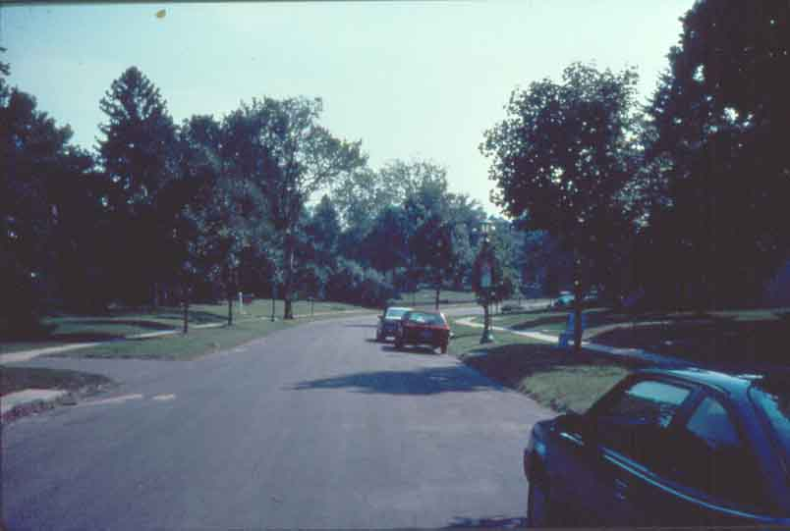
1991

Slide 53
History of the Disease
Disease was unknown in Europe and N. America before 1900
Since 1910, two pandemics
Pandemics caused by two different species:
  1) Ophiostoma ulm
  2) Ophiostoma novo-ulmi
In both cases, geographic origins are still unknown (probably Asia)
Notes:
Appears in France, Belgium, Germany 1918-1921/ arrival in E. US in late 20’s, established in NY and effecting 5500 sq miles by 1940/ strain transported to Ohio in 1928 via diseased logs. New epidemic in Europe, aggressive strains recognized in Europe in 1971.

Slide 54
Management: Sanitation
Includes removing bark from elm logs which are being stored for use as fuel and/or covering or burning all downed wood (so that beetles can’t get in it). AND, removing dead or diseased branches of standing trees (again because of the beetles).
Needs to be community-wide, and coupled w/fungicide use.
Thought of as the most effective way of curbing DED.

Slide 55
Management: injections
Systemic fungicides labeled for preventative control, injected into root flares. Effective on trees showing < 5-10% crown symptoms.
Need new injections every 3 years, expensive.

Slide 56
Management: Spraying
Best when coupled w/sanitation methods.
Timing of spraying is important

Slide 57
Other Management Methods
Development of resistant hybrid elms
Additional treatments: breaking up root grafts is commonly used and efffective.
Timing of pruning: wounded trees attract the bark beetle vectors of DED (Byers et al., 1980), so routine pruning should be done in the dormant season or during periods of beetle inactivity.

Slide 58
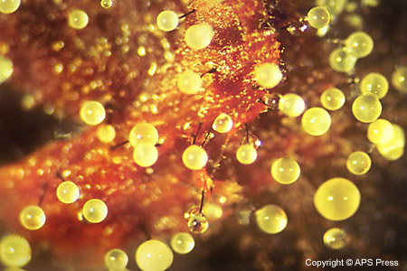
Dutch Elm Disease
Wilt disease caused by ascomycete fungus in the genus Ophiostoma

Slide 59
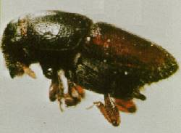
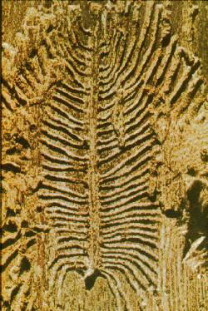
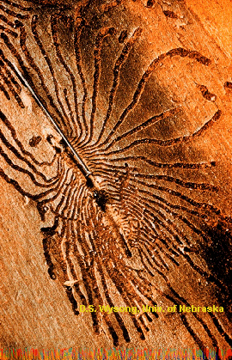
Transmitted by Scolytus bark beetle
  Beetle carves larval galleries in sapwood and carries fungus from tree to tree

Slide 60
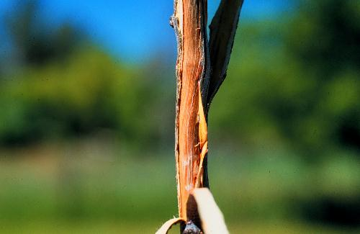
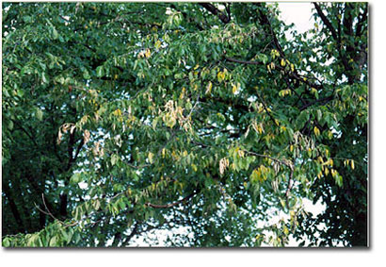
Spreads through trees vascular system
Tree tries to slow fungus by plugging its own xylem tissue with tyloses
Plugged xylem causes branch dieback

Slide 61
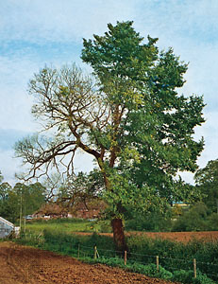
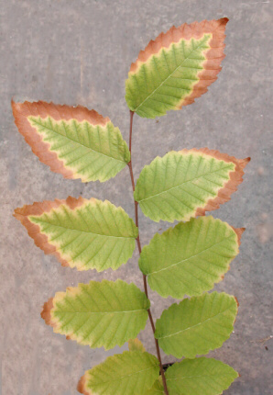
Toxins force stomata to open
Increased evapotranspiration causes desiccation and rapid death of tree

Slide 62
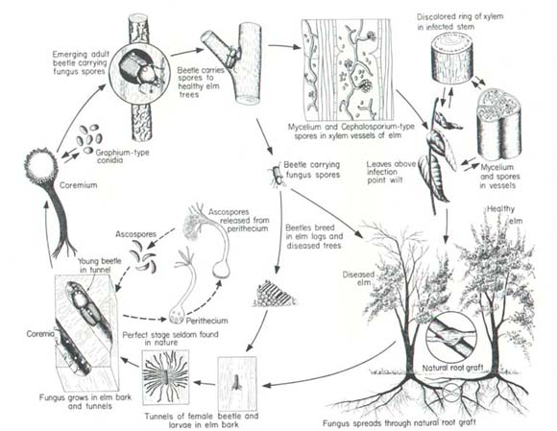
Life cycle with beetle vector

Slide 63
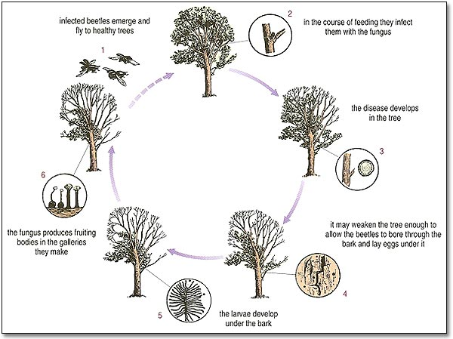

Slide 64


Two separate pandemics caused by two different species
Ophiostomata ulmi
Ophiostomata nova-ulmi
Origins still unknown

Slide 65
Two Pandemics
O. ulmi arrives in Europe and expands outward on infected timber, kills 10-40% elms then stops…Virus!
O. novo-ulmi strains introduced in both Europe and N. America-radiates further
Now both species overlap in Europe
Notes:
Said hey we got it already…don’t regulate elm timber trade…get new species.

Slide 67

Two species differ in…
Optimal growing temp
  O. ulmi 28 C subtropical origins
  O. novo-ulmi 22 C temperate origins
Colony morphology
Molecular fingerprint
Pathogenicity to elms
  O. ulmi moderately aggressive
  O. novo-ulmi highly aggressive

Slide 68
Reproductively Isolated?
Not completely…
Both species have two mating types and crosses within species are fertile
Between species…
  O. ulmi can not fertilize O. novo-ulmi
  O. novo-ulmi CAN fertilize O.ulmi
Progeny include
  Sterile females
  Offspring with low vigor and fitness
    Basically out-competed by stronger parent species

Slide 69
When the two species meet…
O. ulmi usually present when O. novo-ulmi
arrives and is quickly replaced
Two species meet in bark surrounding beetle galleries
Chance for interspecific genetic exchange
Hybrids don’t survive or are transient BUT…
Act as GENETIC BRIDGE

Slide 70
Definitions
Interspecific hybrid
  Mating between two species of same genus produces a sterile or transient progeny to prevent movement of genes and thus keeps species separate
Introgression
  Backcrossing of an interspecific hybrid with one of it’s parents leading to movement of genes in between species

Slide 71
Methods of Detecting Gene Flow
DNA Fingerprinting
  Probed with cloned dna fragments to distinguish between two species
  Some O. novo-ulmi isolates had rare O. ulmi like polymorphisms
    Acquired through introgression
  15 of 50 O. novo-ulmi isolates had O. ulmi gene
  1 had altered phenotype
    Less aggressive
    AFLP showed gene was involved with pathogenicity

Slide 72
Gene flow? More clues…
Sudden increases of Vegetative Compatibiliy (VC) types
  Necessary to prevent spread of “cooties” (viral factors) between adjacent colonies
  Controlled by many genes with many alleles; only isolates that have the same alleles at all VC genes fuse their hyphae because they recognize each other as selves
  Viruses will spread through fused cells of same VC types

Slide 73
Europe
Single clones of VC types with single mating type introduced and spread through Europe
  High rate of viral spread through pop
After a few years population diversifies in VC type and mating type
  Spread of viruses declines
    Effect slower in North America due to less pressure from virus

Slide 74
Conclusions
O. novo-ulmi VC clones diversify only where O. ulmi was already present
Only when virus activity is high will clones diversify rapidly
Novel VC genes are acquired by O. novo-ulmi from O.ulmi
Selection pressure from viruses favors novel VC types

Slide 75
O. novo-ulmi with single VC type-black
As it changes to many VC types in grey

Slide 76
WOW!!!
O. novo-ulmi outcompeted O. ulmi in Europe
O. novo-ulmi caught virus from O. ulmi that would have killed it off BUT….
At the same time O. novo-ulmi acquired VC genes from O. ulmi that made it less susceptible to virus

Slide 77


O. Himal-ulmi
Found in Himalayas while searching for origins of pathogens in Asia
Appears to be in natural balance with elms and bark beetles
Very aggressive on European Elms
Importance of regulating timber trade

Slide 78

The End

