Slide 1
Biological Invasions: a threat to California Ecosystems
Taught by Dr. Matteo Garbelotto
  Matteog@berkeley.edu
  Office: Third floor Hilgard Hall
  Office hours: by appointment

Slide 2
Course info
One two hour lecture per week
One quiz every week on previous lecture
Tainter and Baker Forest Pathology book
Some readings will be posted on the Lab’s Web site: www.matteolab.org
        Link to UCB course
        POWERPOINT LECTURES, assigned readings
        Posted on Fridays

Slide 3
Course info
One final quiz (3 questions out of 9)
One short Powerpoint presentation
Possibility to improve grade by writing paper (5 pages) on same topic as oral presentation
One computer lab: use of software for genetic analyses (Dr. Osmundson)
One field activity Saturday April 27th: participation in UCB SODBLITZ (www.sodblitz.org)

Slide 4
GRADING
25% class and field activity participation
25% weekly quizzes
25% final quiz
25% oral presentation

Slide 5
EMERGENT FOREST DISEASES: ARE THEY A THREAT TO NATIVE ECOSYSTEMS?
Intro to Disease
Native Diseases
Invasive fungi and emergent disease I
Invasive fungi and emergent disease II
Exotic CA pathogens (EPCA): White Pine Blister rust
EPCA:Dutch Elm Disease
EPCA: Pine Pitch Canker, Colored Canker of Sycamore
EPCA: Sudden Oak Death
Genetic Analyses of Invasive spp
EPCA: Other invasive Phytophthoras
Habitat change: Annosum root rot
Host change: Cypress canker; Armillaria root Rot
Newly introduced disease and US introduced: Xylella, 1000 canker, Phragmidium violaceum, Chestnut blight
Finals

Slide 6
EMERGENT FOREST DISEASES: ARE THEY A THREAT TO NATIVE ECOSYSTEMS?
Matteo Garbelotto
U.C.Berkeley

Slide 7
Disease: injurious physiological activity caused by the continuous irritation by a primary causal factor and expressed in characteristic pathological conditions called symptoms
Disease: any disturbance of a plant that interferes with its normal, structure, function or economic value

Slide 8
Primary causal factor=agent
ABIOTIC
BIOTIC (incl. VIRUSES)

Slide 9
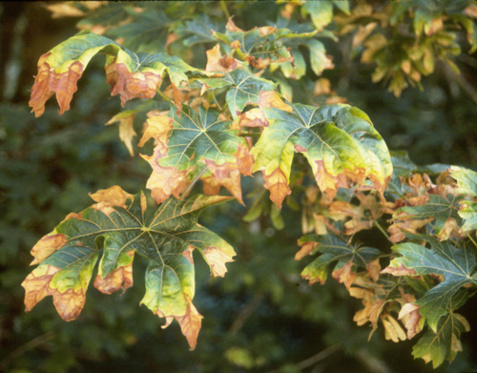
Maple scorch

Slide 10
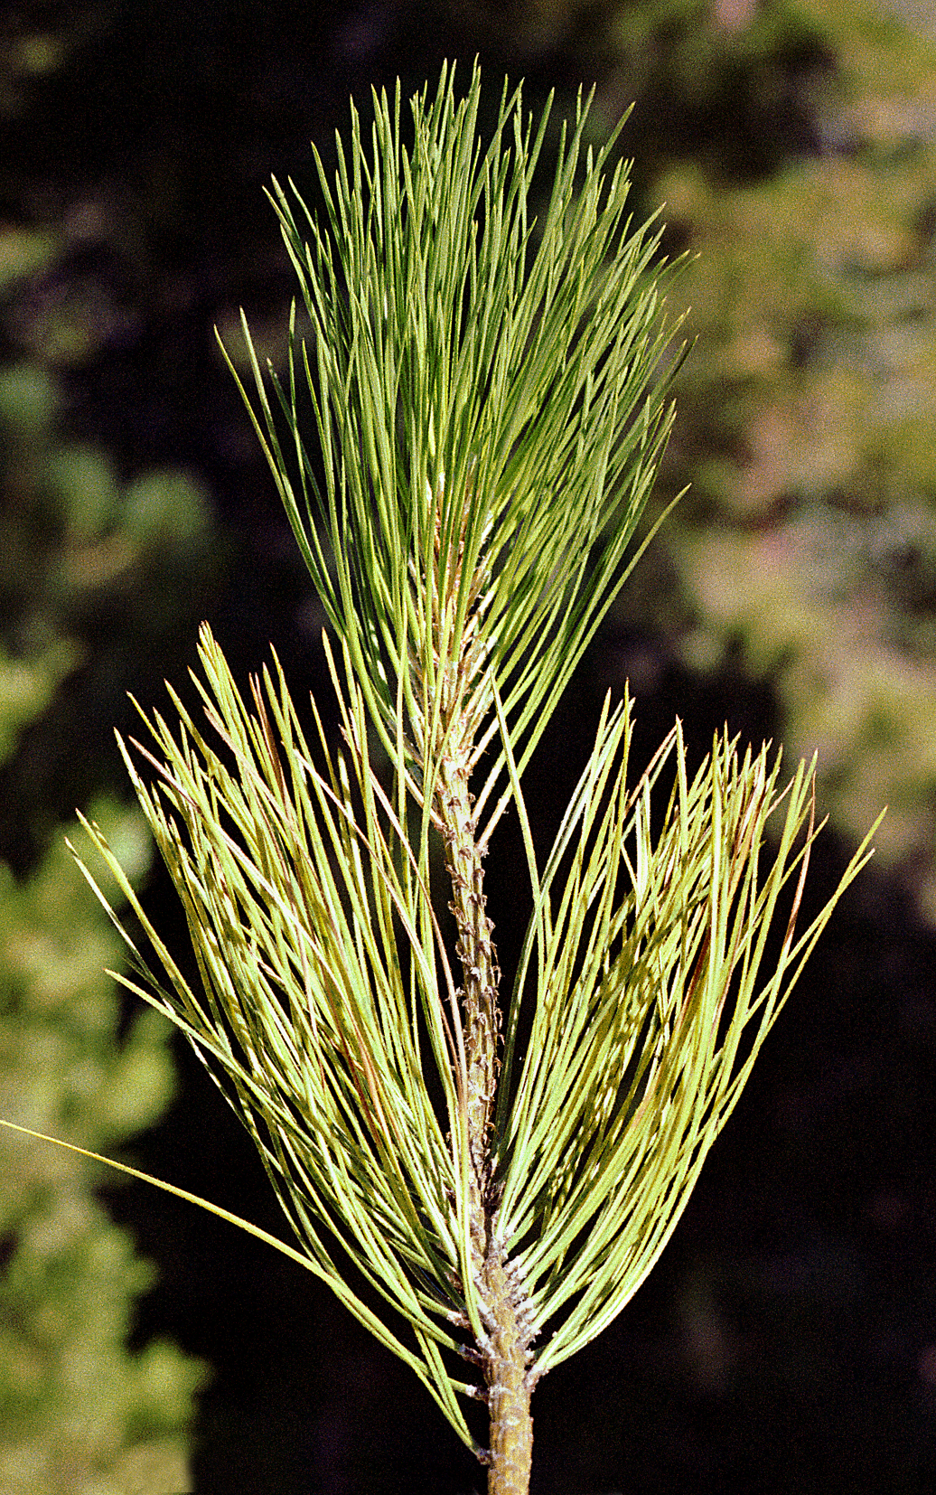
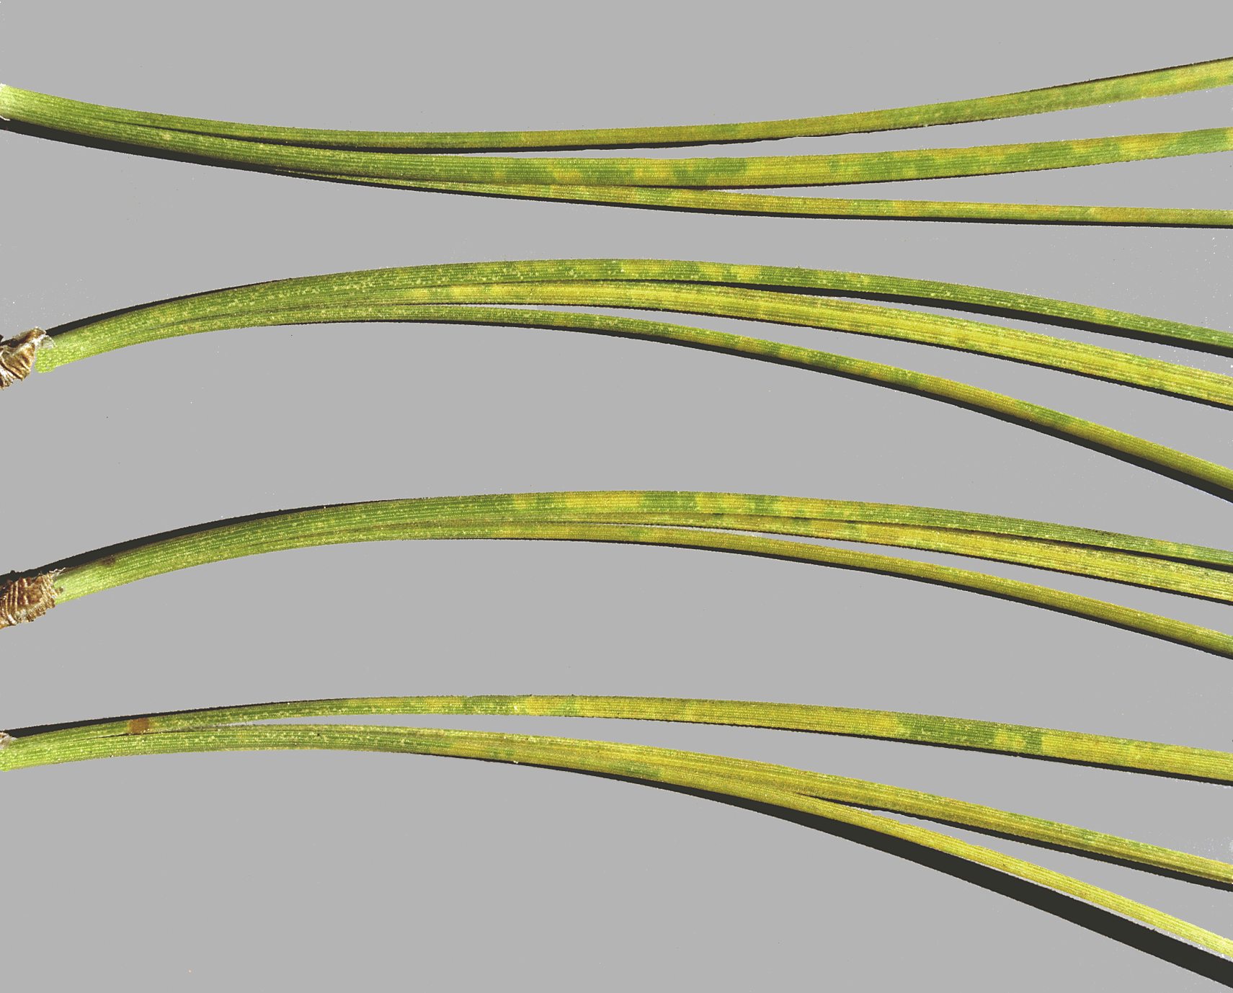
Premature needle yellowing
and loss on ponderosa pine
Ozone mottle

Slide 11
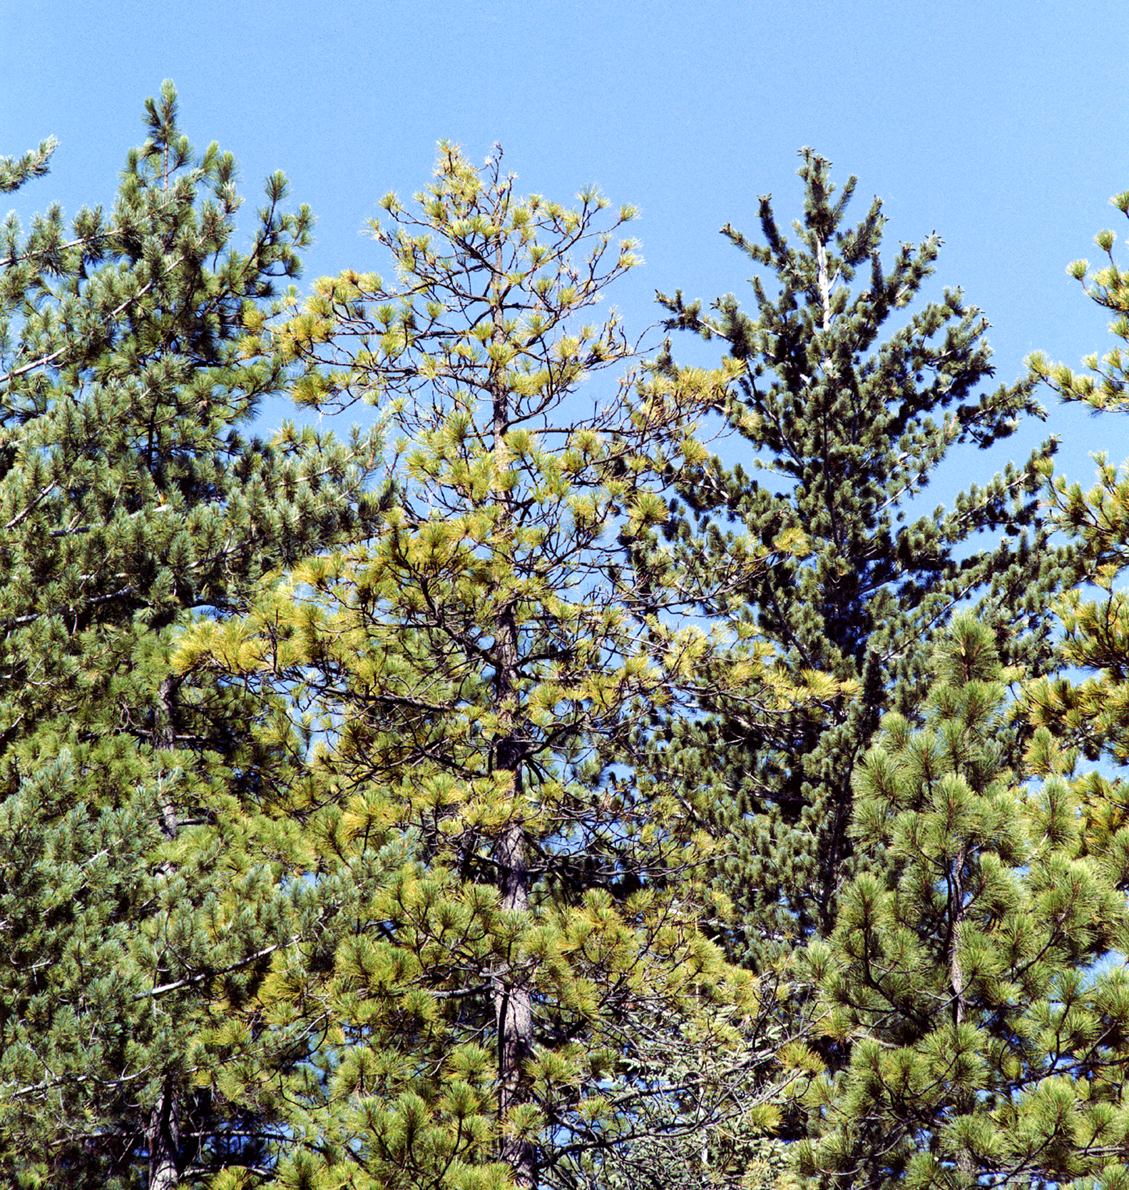
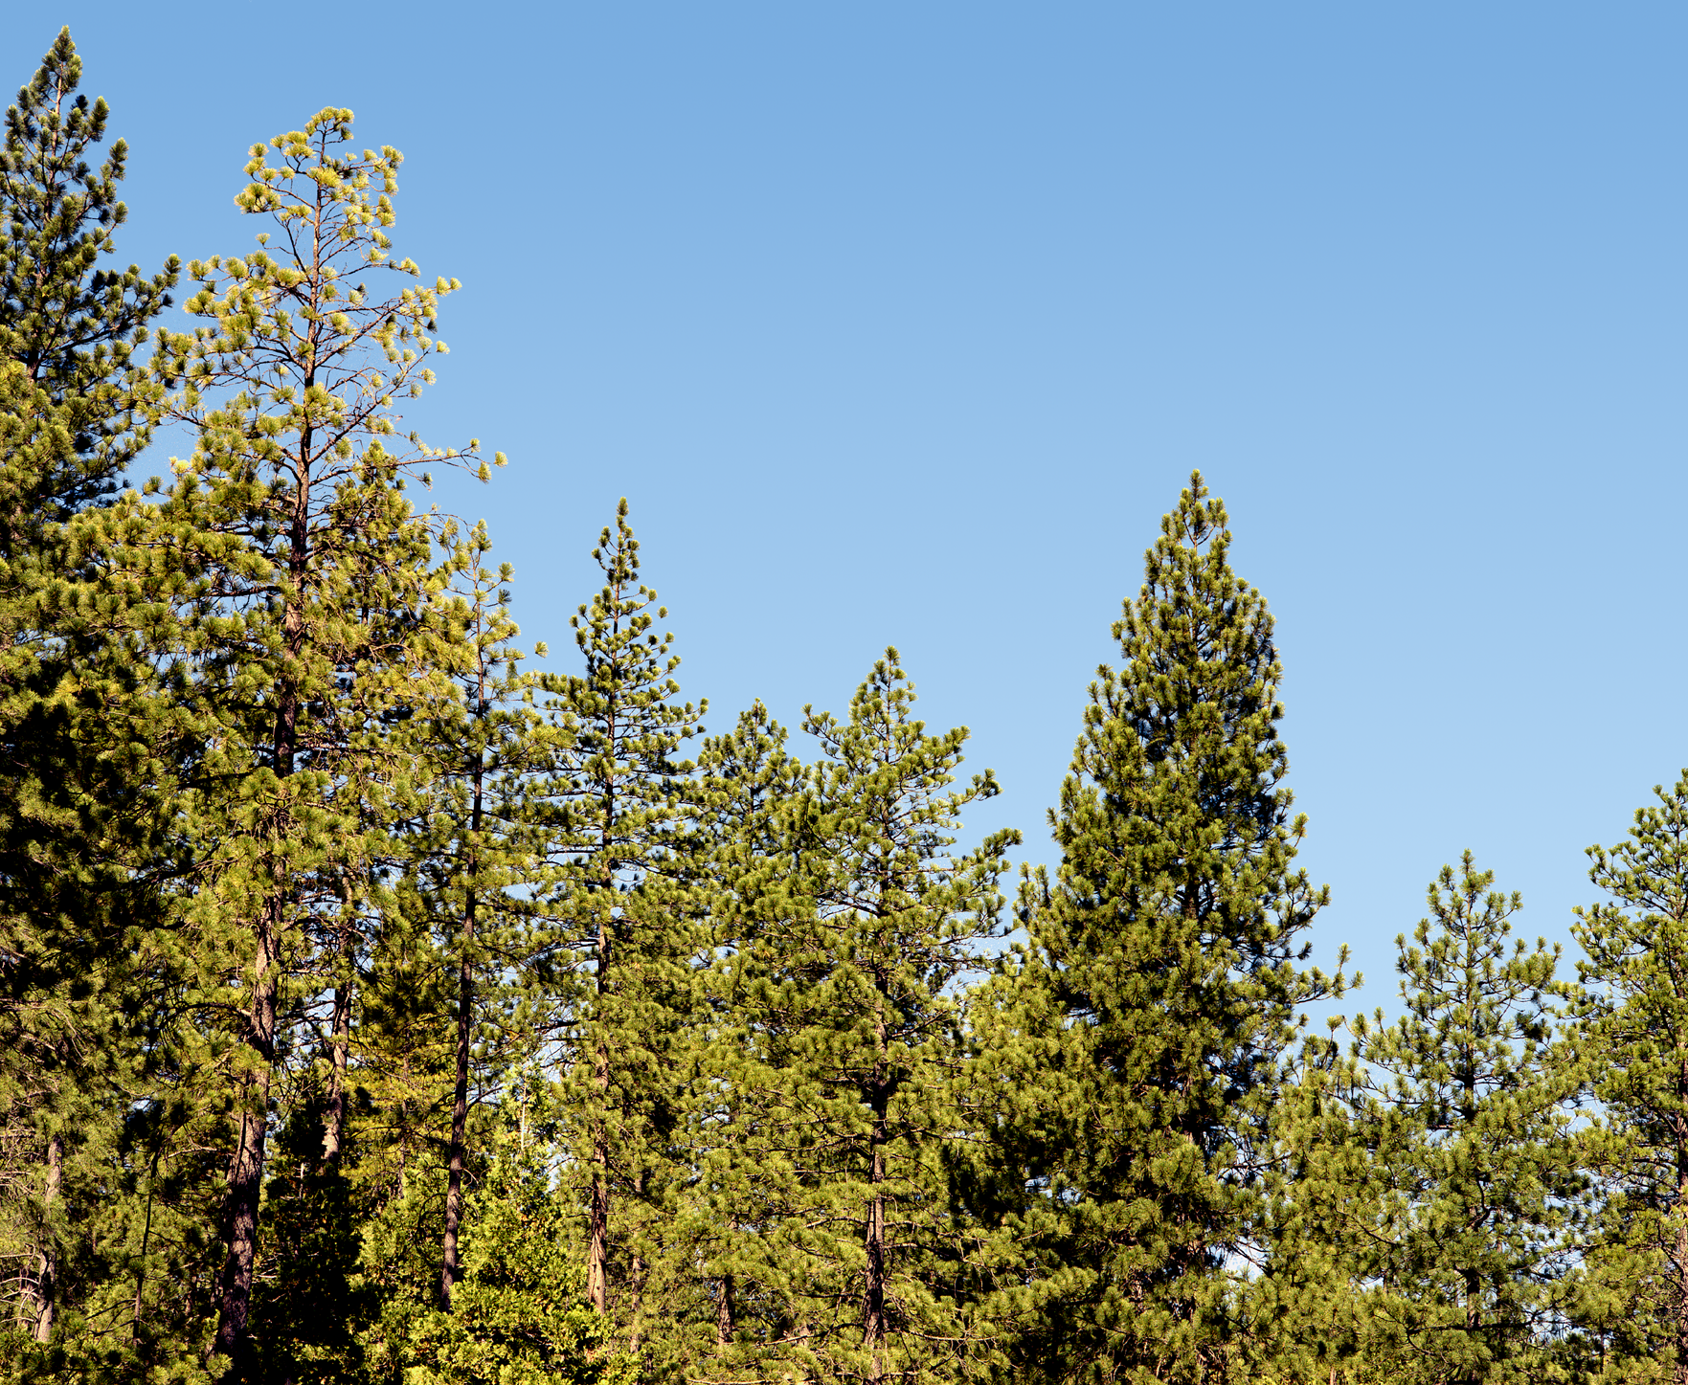
Loss of vigor in ponderosa
pine exposed to ozone

Slide 12
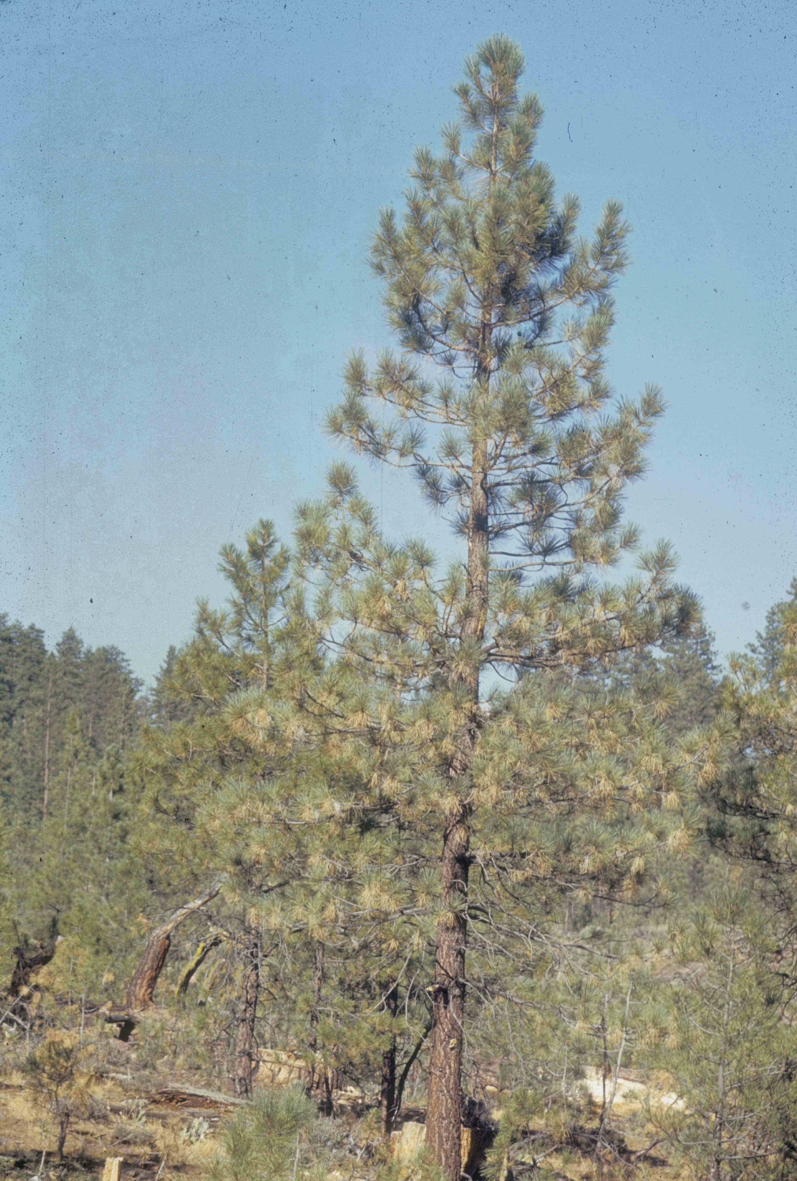
Smog symptoms on
ponderosa pine in
southern California

Slide 13
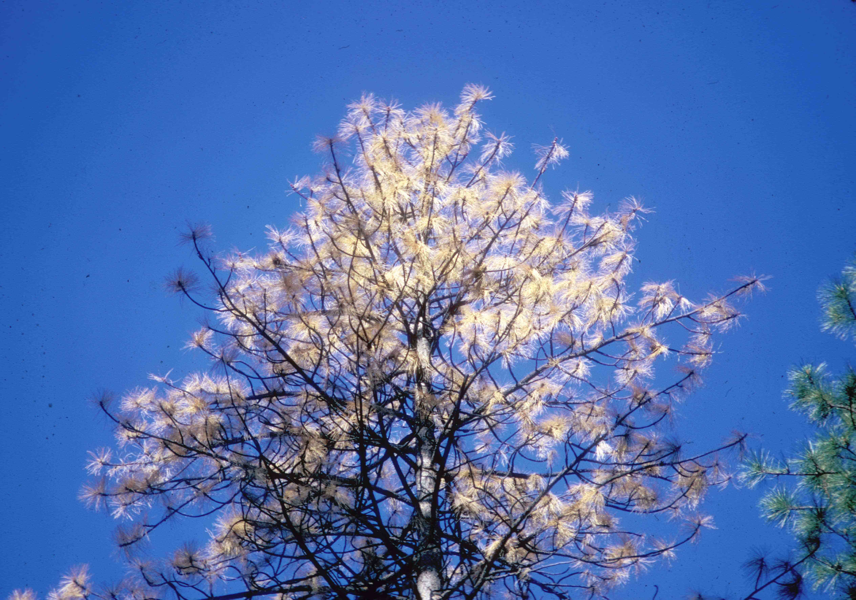
Advanced smog symptoms on ponderosa pine

Slide 14
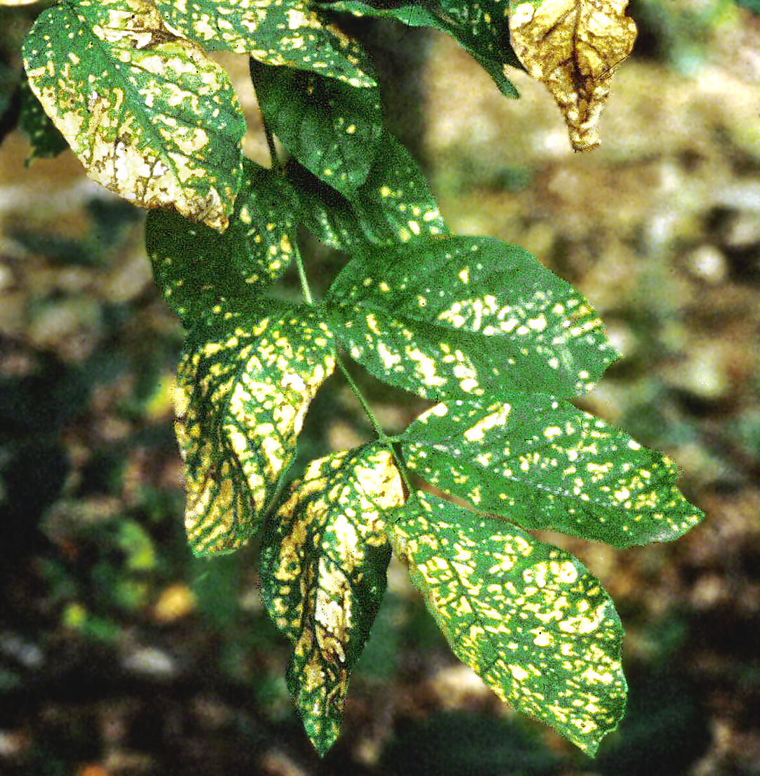
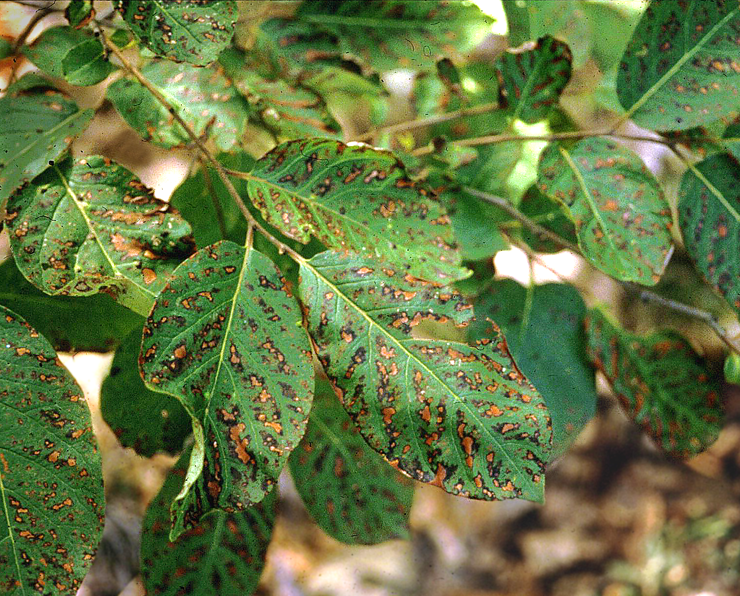
Acute SO₂ injury
Ash
Persimmon

Slide 15
BIOTIC DISEASES caused by:
Parasitic plants
Bacteria
Fungi
Oomycetes
Viruses
Nematodes

Slide 16
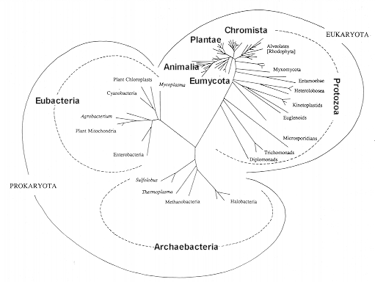
Tree of Life, from Patterson & Sogin, 1992

Slide 17
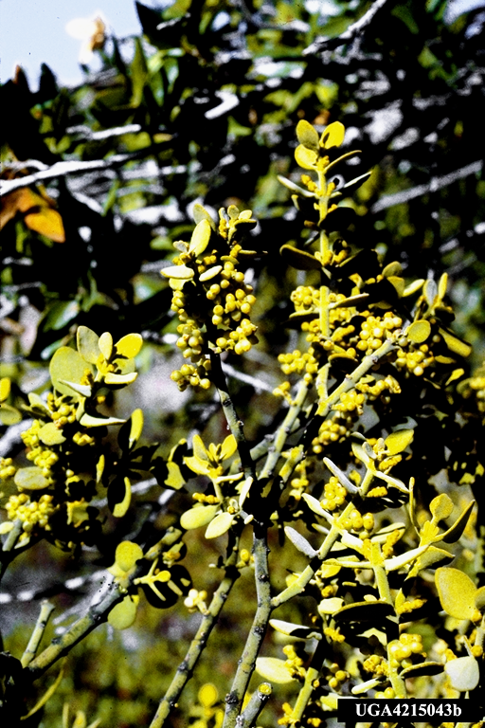
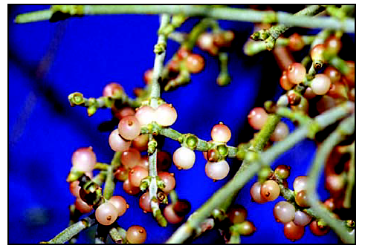
Phorodenron villosum on oak
Leafy mistletoe

Slide 18
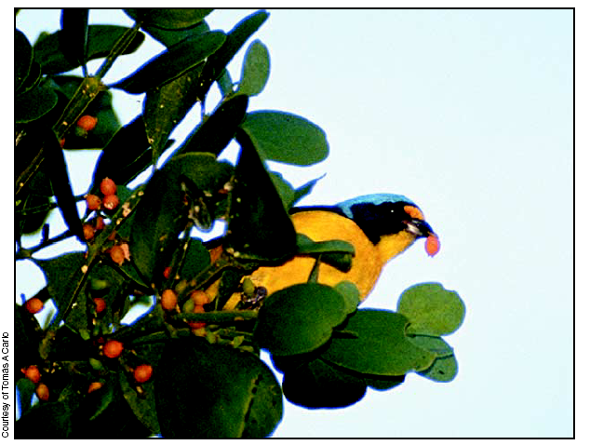
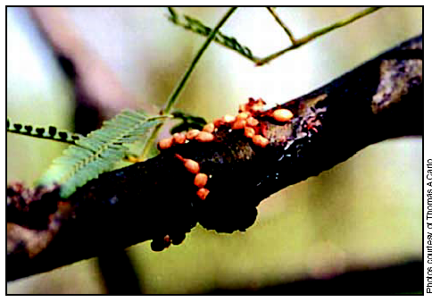

Slide 19
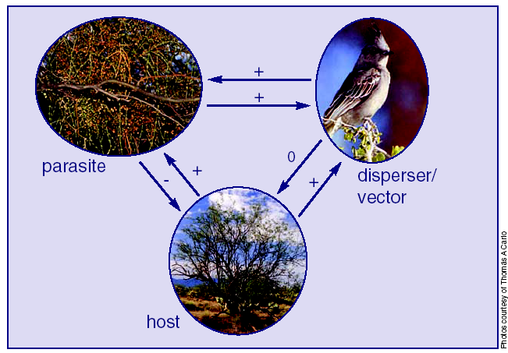

Slide 20
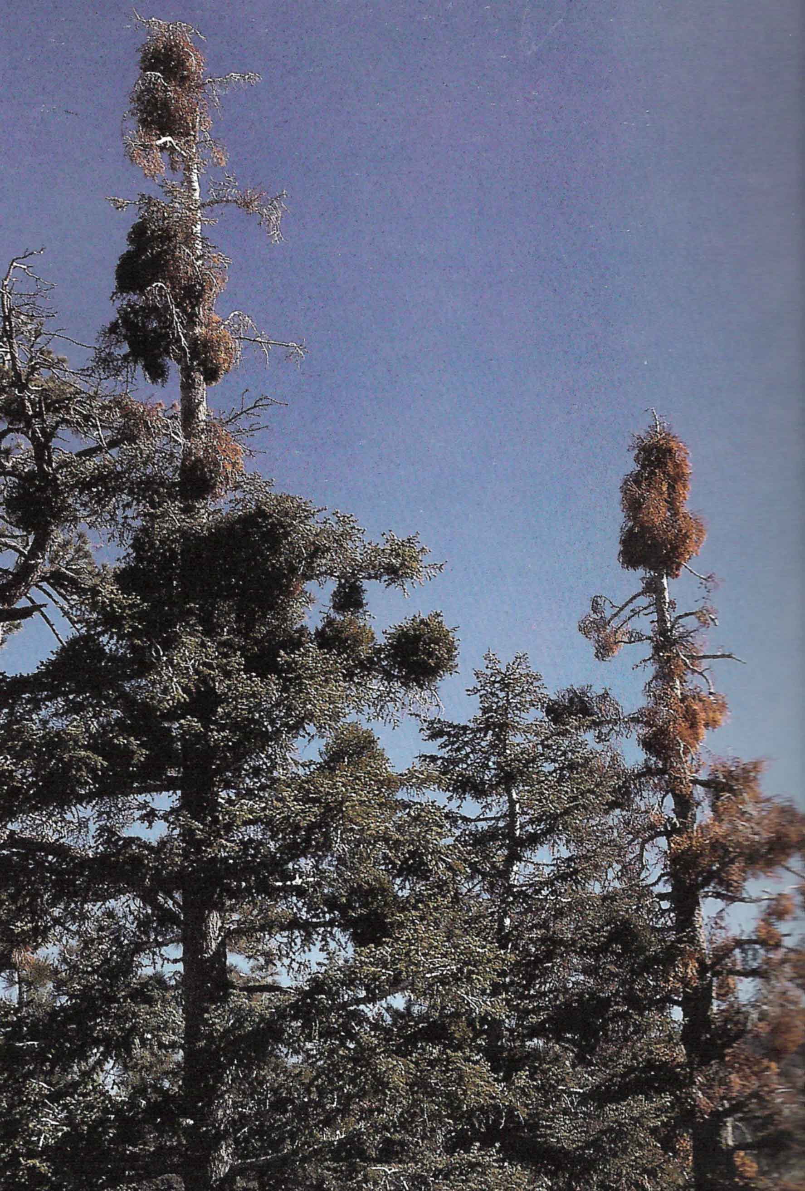
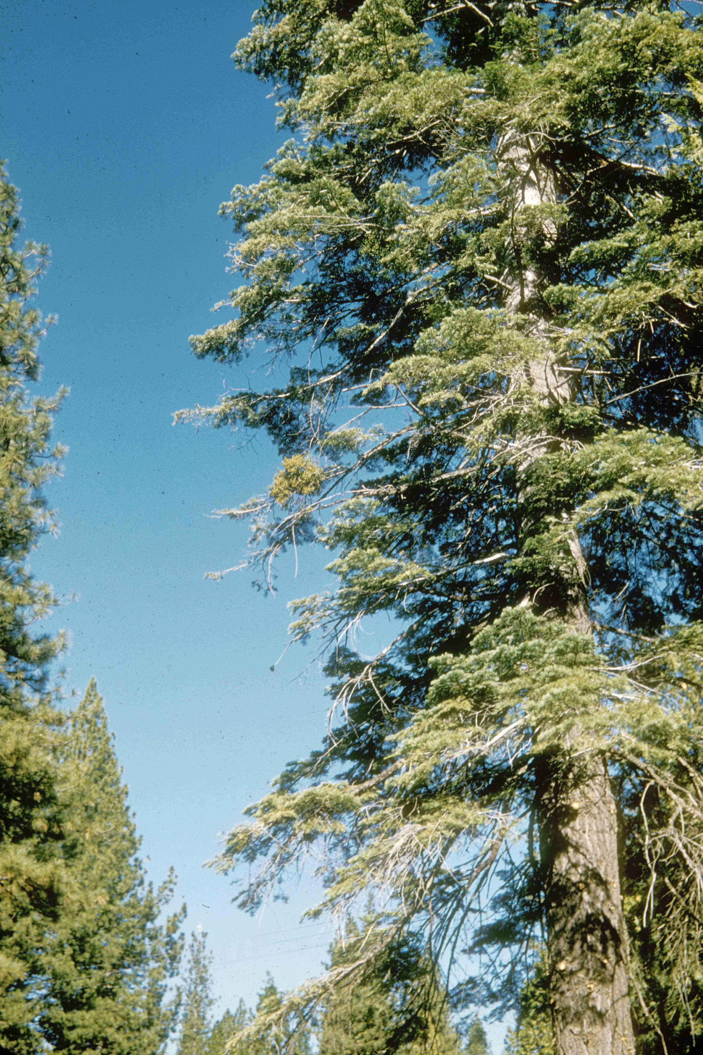
Phoradendron pauciflorum
on white fir

Slide 21
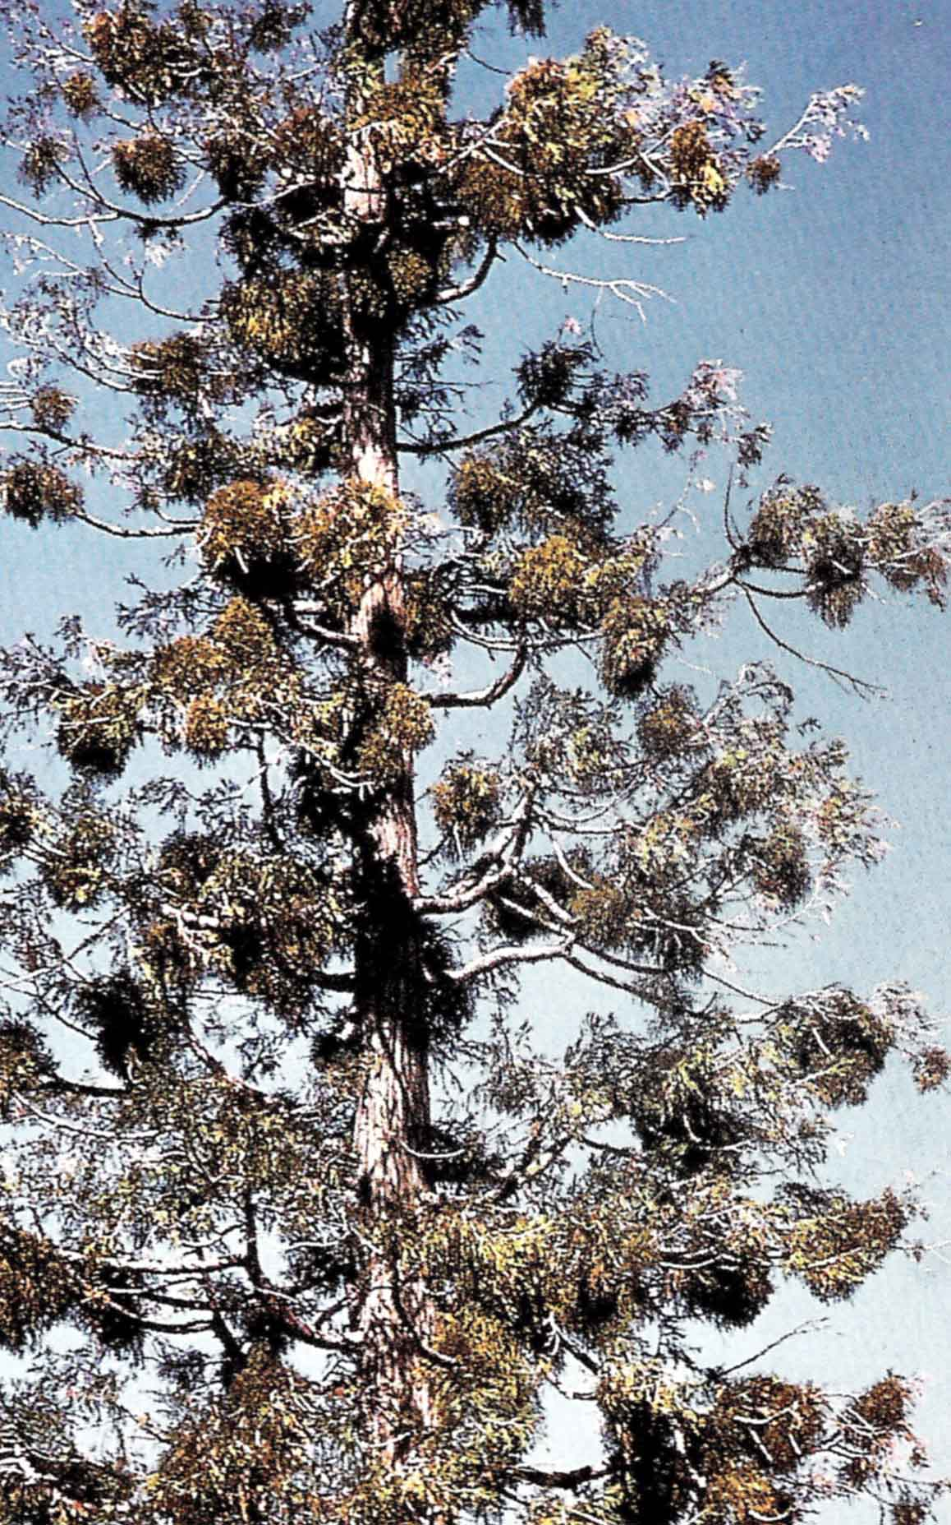
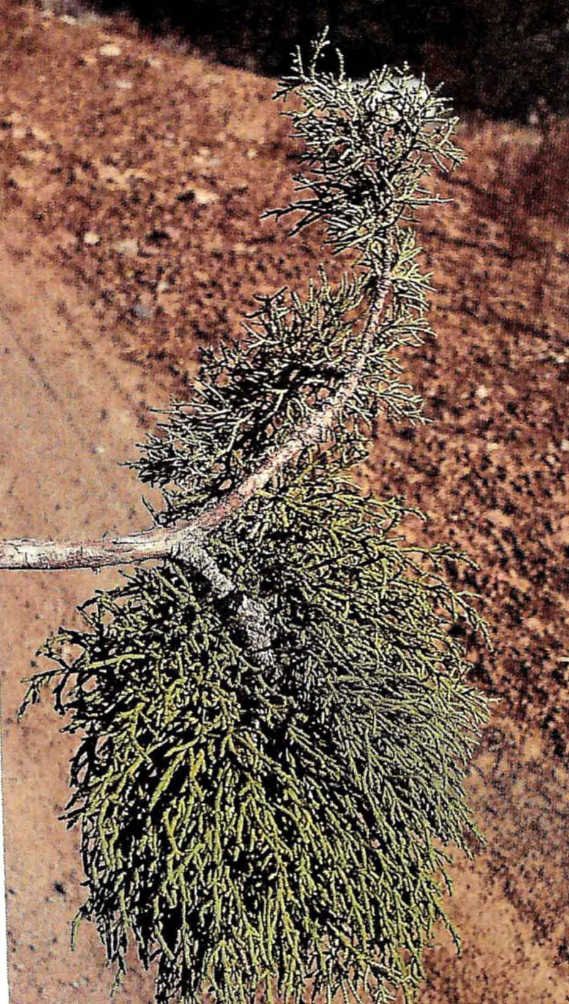
Phorodendron libocedri
on incence cedar

Slide 22
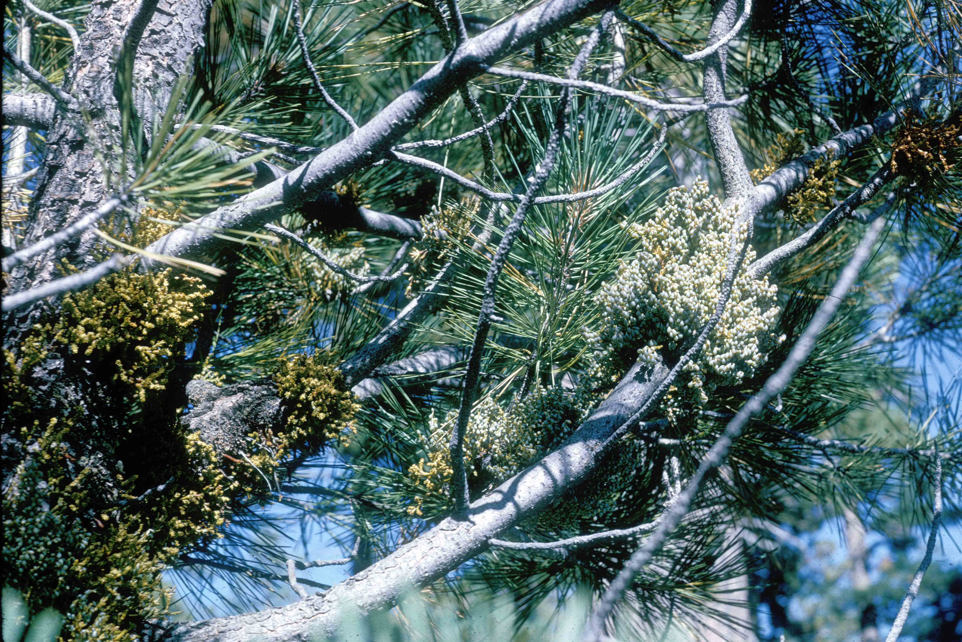

Slide 23
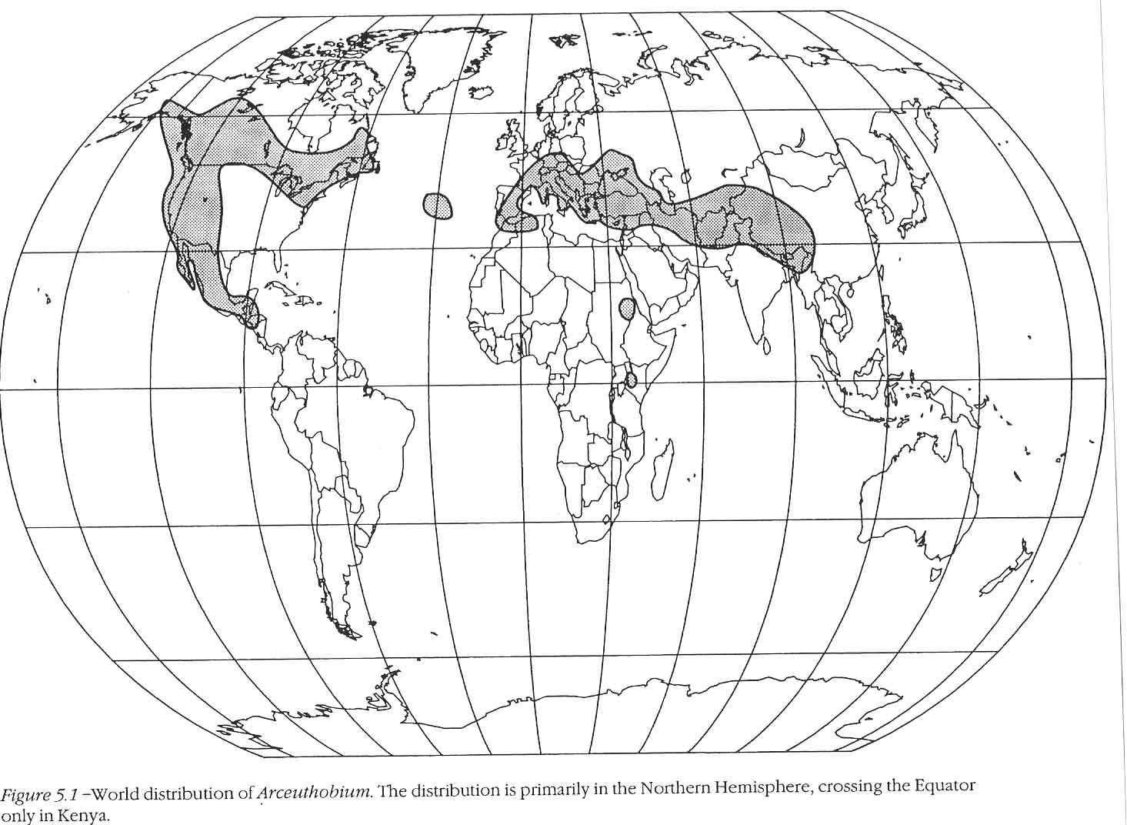

Slide 24
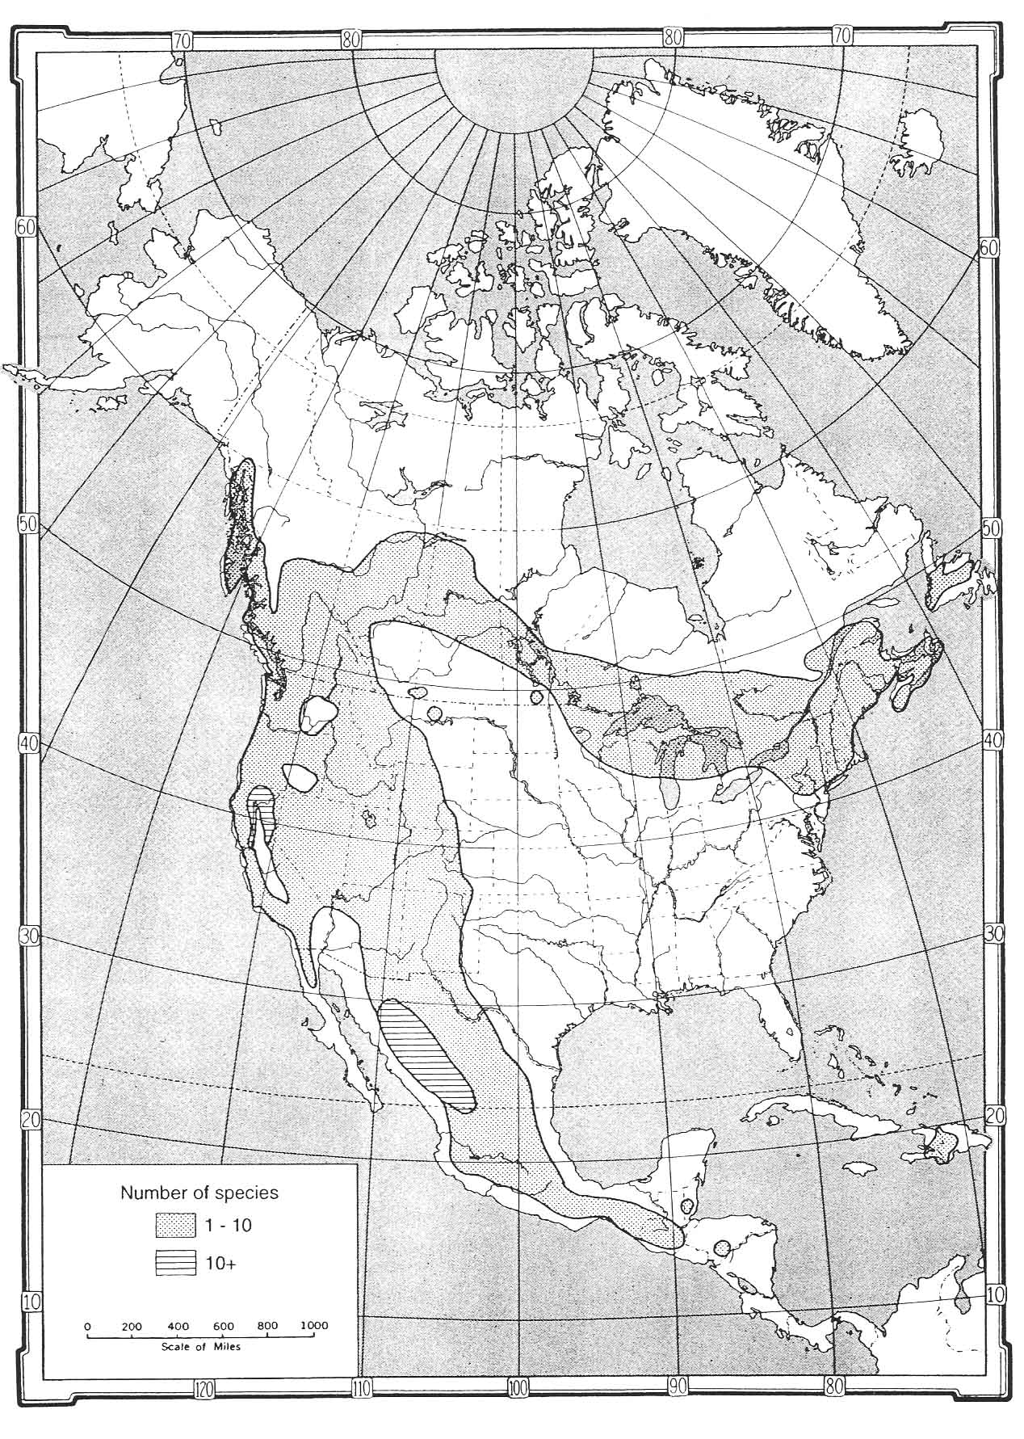
Large number of
species because of
high host specificity

Slide 25
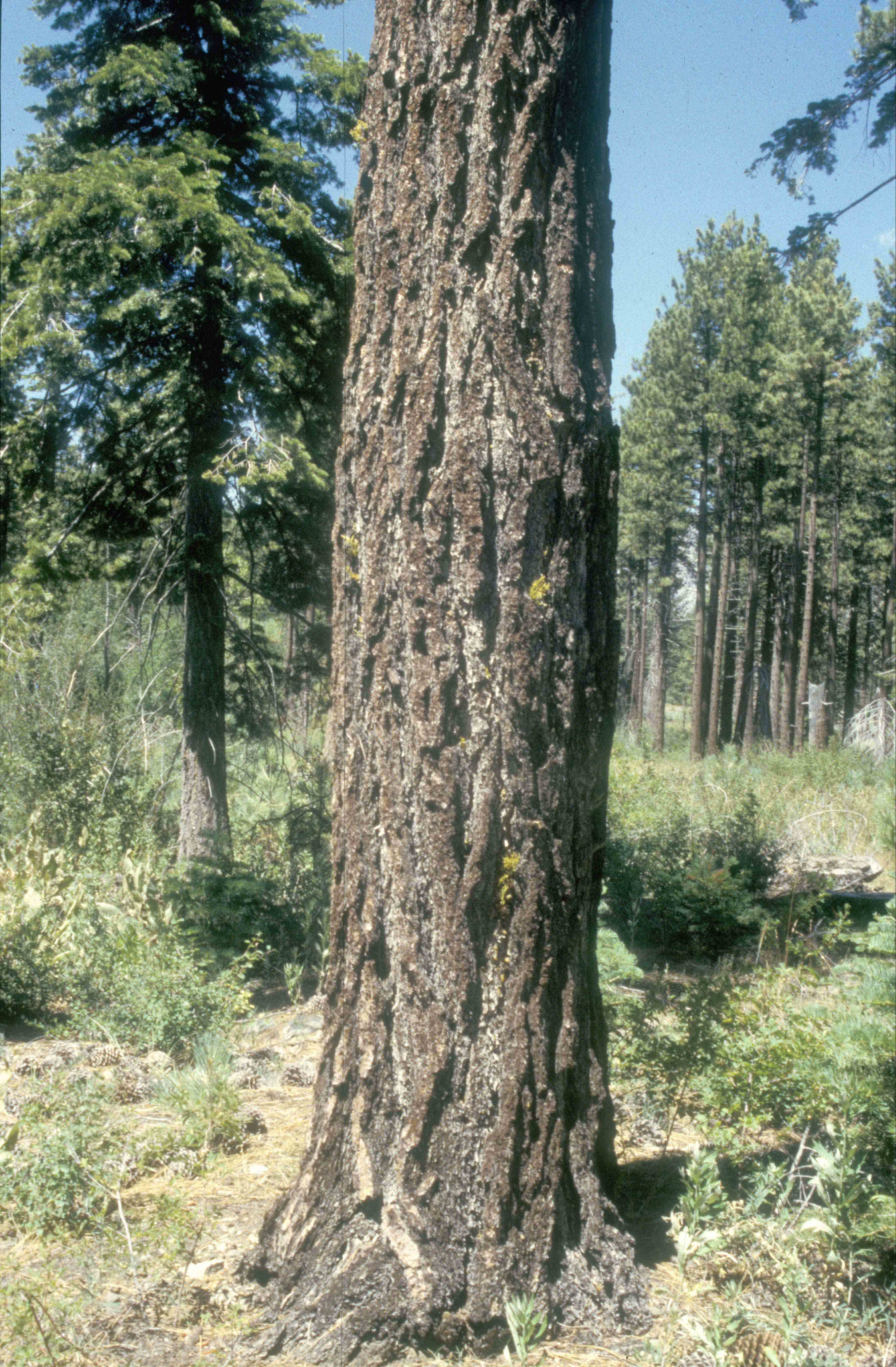
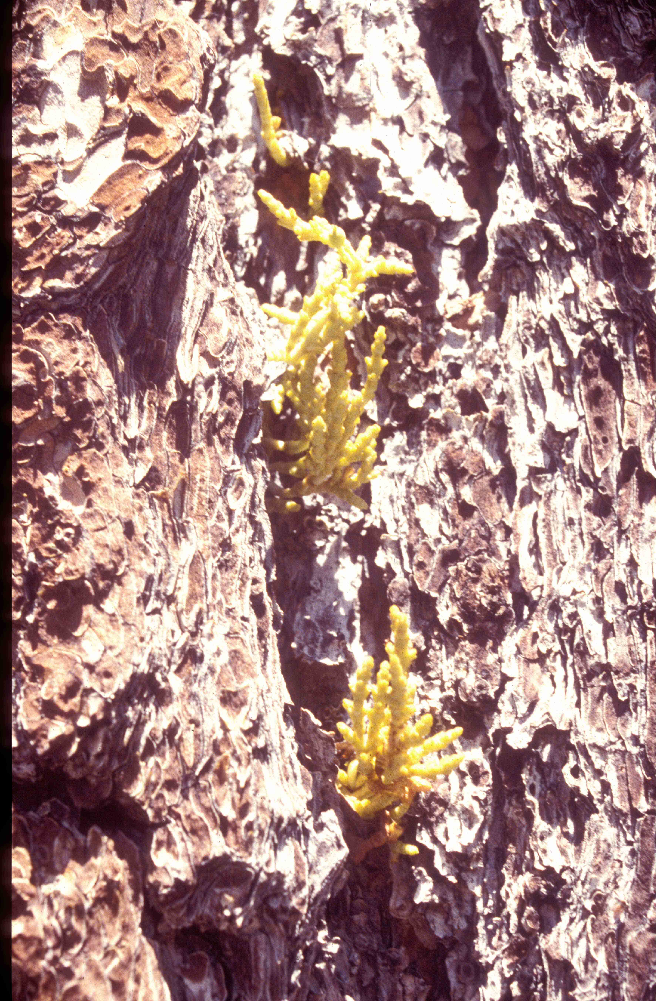
Arceuthobium campylopodum
on Jeffrey pine

Slide 26
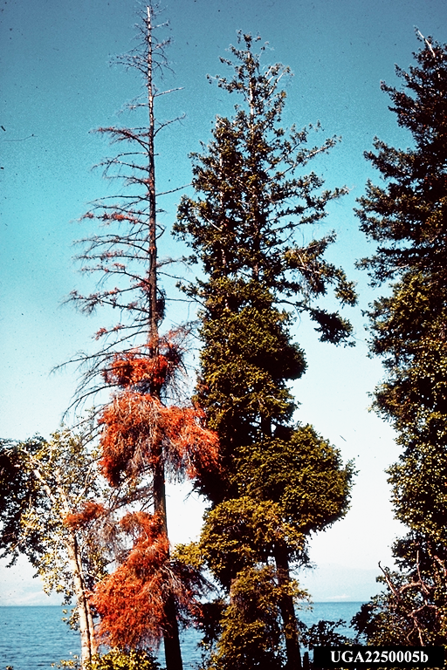
Arceuthobium douglasii
on Douglas-fir

Slide 27
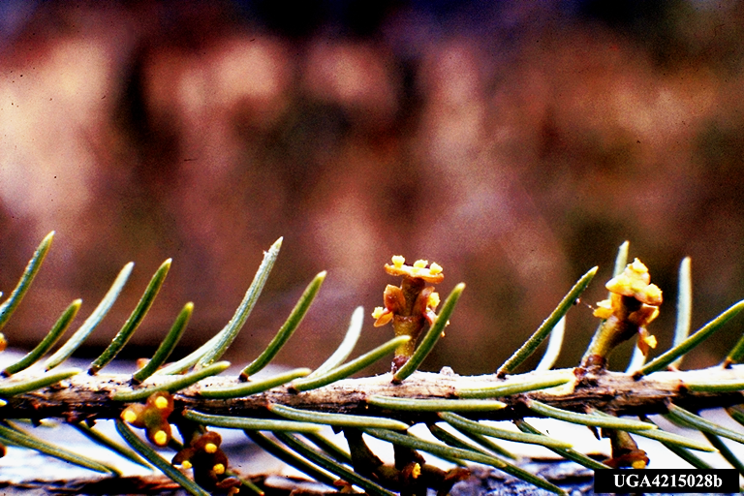
Male flowers

Slide 28
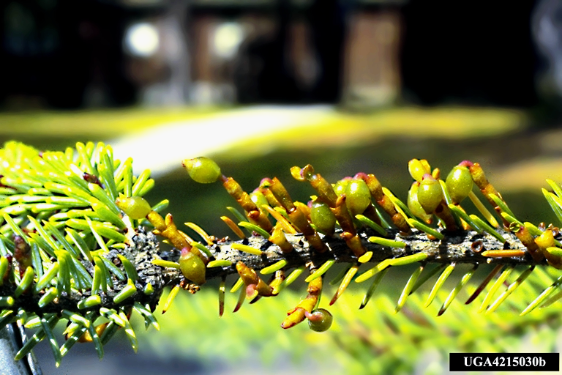
Mature female shoots - seeds

Slide 29
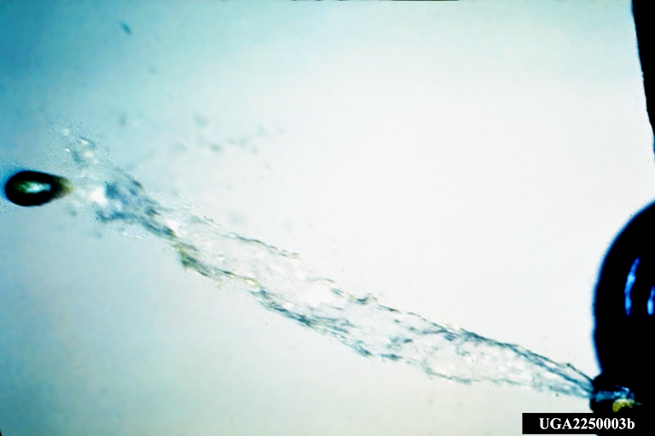
Explosive seed dispersal of Arceuthobium

Slide 30
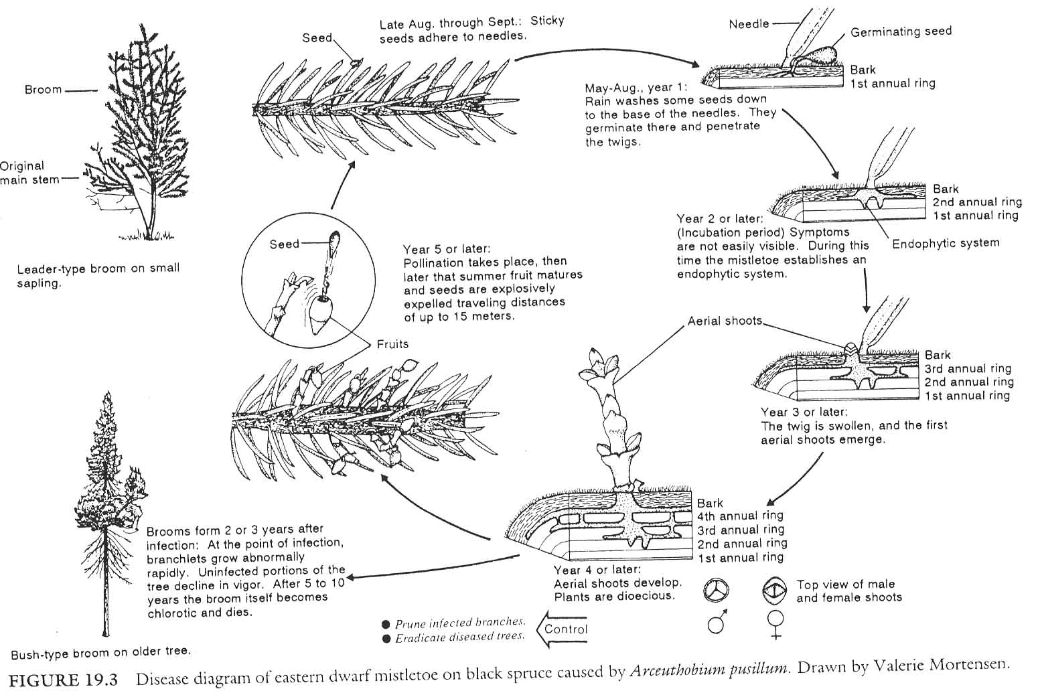

Slide 31
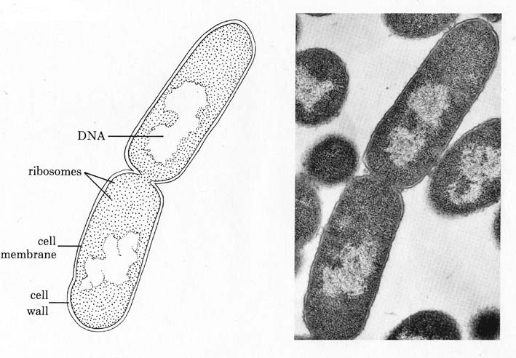
BACTERIA
Prokaryotes
Unicellular
Variously shaped
Do not produce spores
Reproduce by binary fission
*
Richiami sulle entità biotiche

Slide 32
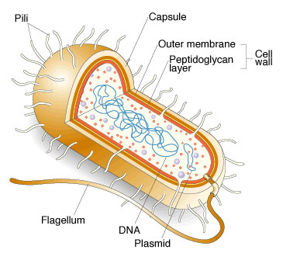

Slide 33
Genetic elements
Chromosome (single one, circular)
Plasmids
Primary mechanisms of variation
Mutations
Loss/acquisition of plasmids and transposons
Recombination through: transformation (incorporation in
Chromosome of plasmid DNA; conjugation (incorporation of
DNA from another bacterium); transduction (incorporation
through bacterial viruses called bacteriophages)

Slide 34
Phytoplasma
Prokaryotes lacking a cell wall (MLOs - Mollicutes)
Usually vascular pathogens
Generally vectored by insects

Slide 35
VIRUSES and VIROIDS
Submicroscopic parricles always intracellular when in the host, infectious and pathogenic
They comprise
Nucleic Acids (RNA or DNA) and a capsid protein
Viroids instead are simply constituted by a single RNA molecule, they do not code for or possess proteins

Slide 36
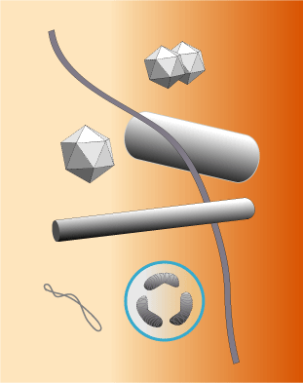
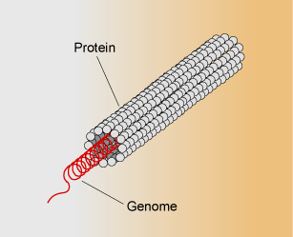
Nucleic acid: ssRNA, dsRNA, ssDNA, dsDNA
Protein capsid: protects virus during transport
*
*

Slide 37
VIRAL REPLICATION
The genome of the virus codes for:
1- capsid protein;
2- polymerase;
3- protein for intracellular movement;
4- proteins involved in transmission and relationship with vectors

Slide 38
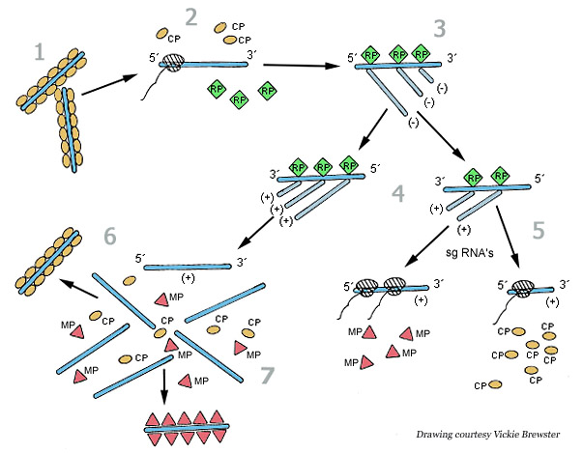
ssRNA+
Notes:
TMV enters a wounded plant cell to begin the replication cycle [1]. As the cost protein (CP) molecules are stripped away from the RNA [2], host ribosomes begin to translate the two replicase-associated proteins. The replicase proteins (RP) are used to generate a negative-sense (- sense) RNA template from the virus RNA [3]. This - sense RNA is, in turn, used to generate both full-length positive-sense (+ sense) TMV RNA [4] and the + sense subgenomic RNAs (sgRNAs) [5] that are used to express the movement protein (MP) and CP. The + sense TMV RNA is either encapsidated by the CP to form new TMV particles [6] or wrapped with MP [7] to allow it to move to an adjacent cell for another round of replication. For details on cell-to-cell and long distance movement, see Figure 10. (Courtesy Vickie Brewster)

Slide 39
Some examples of bacteria, phytoplasmas and viruses present in forests
Bacterial leaf scorch: Xylella fastidiosa
Crown Gall: Agrobacterium tumefaciens
Ash and elm yellows: Ca. Phytoplasma alni and P. ulmi
Bacterial wetwood (Enterobacter, Klebsiella, Erwinia and Pseudomonas)
Poplar mosaic virus, poplar potyvirus
Cherry leaf roll virus (elms, dogwood)
Tobacco Mosaic Virus (tanoak, oaks elders)

Slide 40
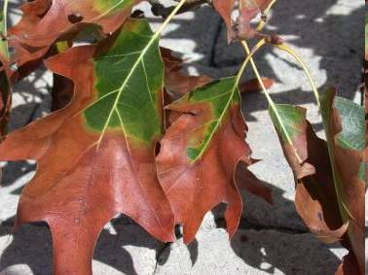
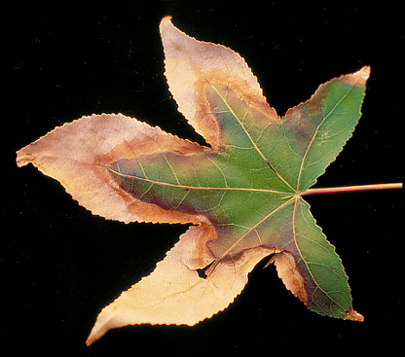
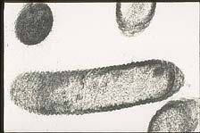
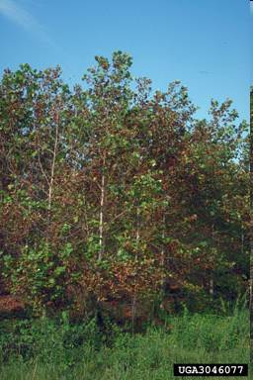
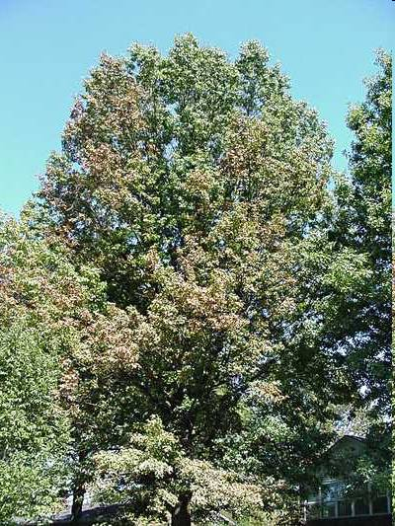
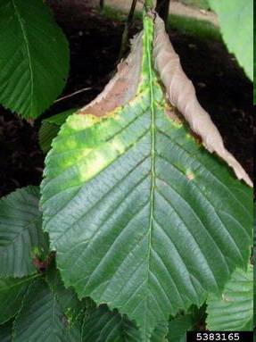
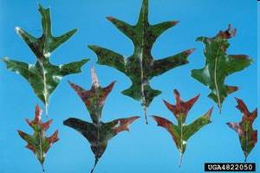
Bacterial Leaf Scorch
Xylella fastidiosa

Slide 41
Hosts
Scientific Common
Acer sp.
A. Rubrum Red maple
A. negundo Boxelder
A. saccharum Sugar maple
C. florida Flowering dogwood
C. occidentalis Hackberry
L. stryraciflua Sweet gum
Morus alba Whitemulberry
Platanus sp.
P. occidentalis American sycamore
P. x acerifolia London plane
Ulmus americana American elm
Scientific Common
Quercus sp.
Q. velutina Black oak
Q. incana Bluejack oak
Q. macrocarpa Bur oak
Q. prinus Chestnut oak
Q. laurifolia Laurel oak
Q. virginiana Live oak
Q. rubra Northern red oak
Q. palustris Pin oak
Q. stellata Post oak
Q. coccinea Scarlet oak
Q. imbricaria Shingle oak
Q. shumardii Shumard oak
Q. falcata Southern red oak
Q. bicolor Swamp white oak
Q. laevis Turkey oak
Q. nigra Water oak
Q. alba White oak
Q. phellos Willow oak

Slide 42
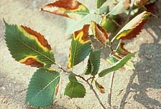
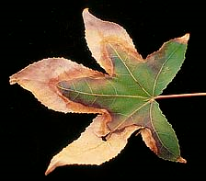
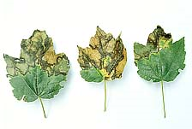
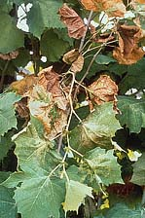
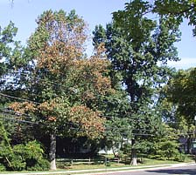
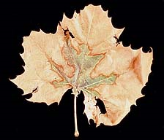
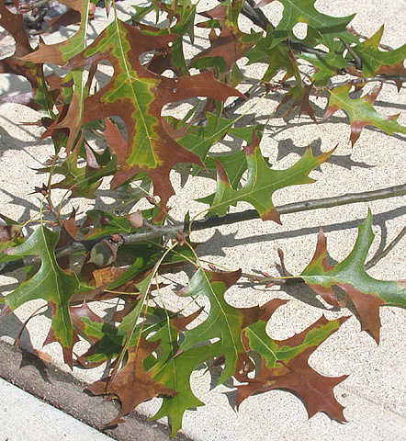
Symptoms
First appear in late summer /early fall
Leaf scorching
Limb death

Slide 43
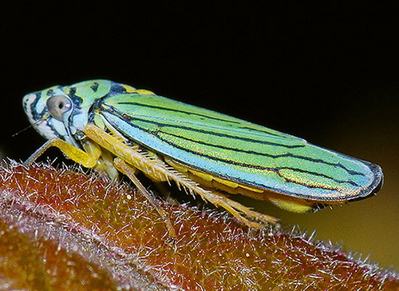
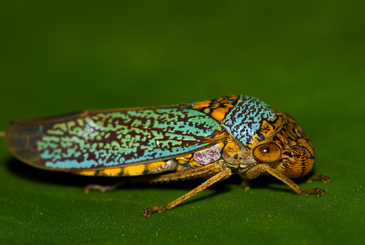

Vector
Not determined for each tree species yet
Most likely Graphocephala, Oncometopia and Homalodisca species.
Graphocephala atropunctata
Oncometopia orbona
Homalodisca vitripennis

Slide 45





A. tumefaciens
Elm yellows
Ash yellows
Bacterial wetwood
Cherry Leaf Roll virus

Slide 46



NEMATODES
*
*
*

Slide 47
Fungi
Eukaryotic organisms, heterotrophs, characterized by chitin and B-glucans in the cell wall, feeding through absorption, reproducing by spores and producing a vegetative structure made up of tubular structures,branched, irregular, and indefinite in growth (modified from B. Kendric 1992)

Slide 48

Fungal hyphae and mycelium

Slide 49



There are no differentiated structures in fungi, but hyphae can generate…
compatibile
compatibile
compatibile
mycelia
stroma
rhizomorphs

Slide 50



