Slide 1
Emergent diseases threatening California ecosytems
Taught by Dr. Matteo Garbelotto
  Matteog@berkeley.edu

Slide 2
Disease: injurious physiological activity caused by the continuous irritation by a primary causal factor and expressed in characteristic pathological conditions called symptoms
Disease: any disturbance of a plant that interferes with its normal, structure, function or economic value

Slide 3
Primary causal factor=agent
ABIOTIC
BIOTIC (incl. VIRUSES)

Slide 4
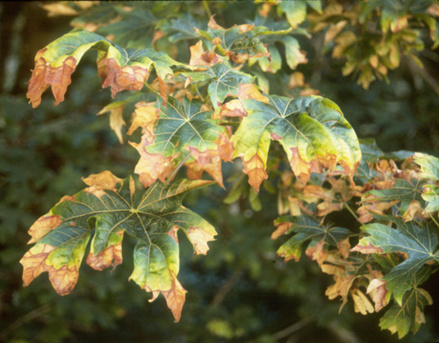
Maple scorch

Slide 5
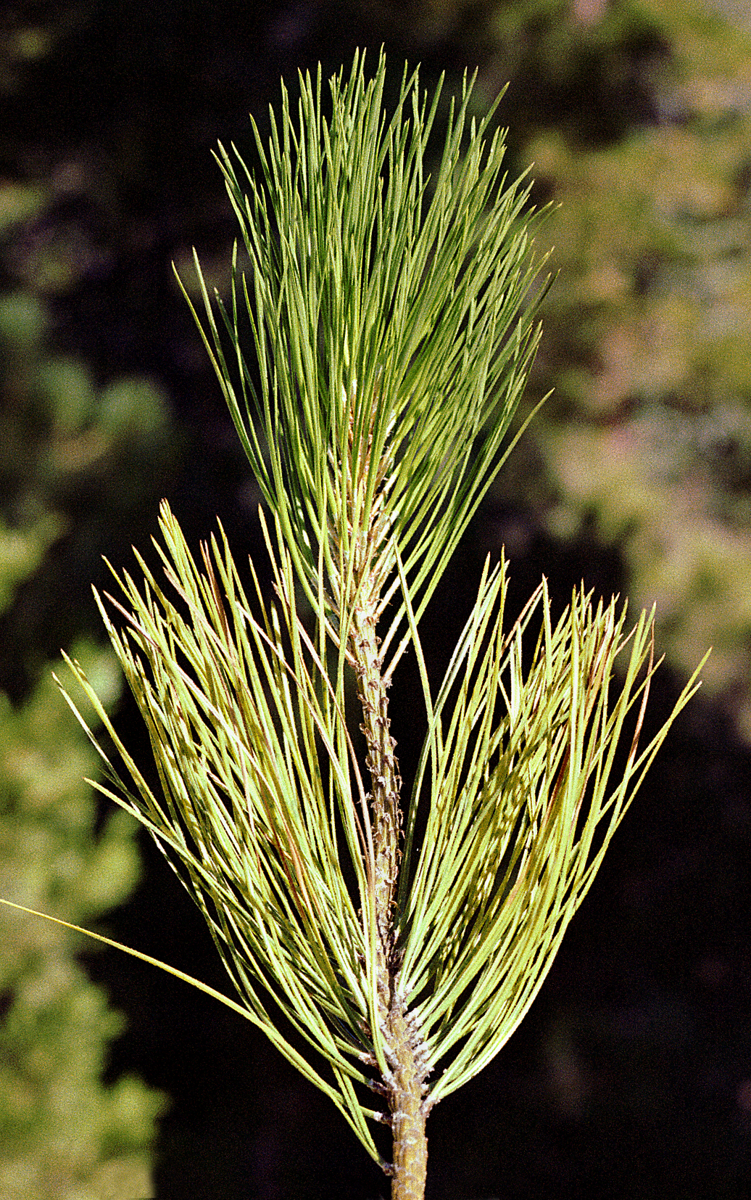
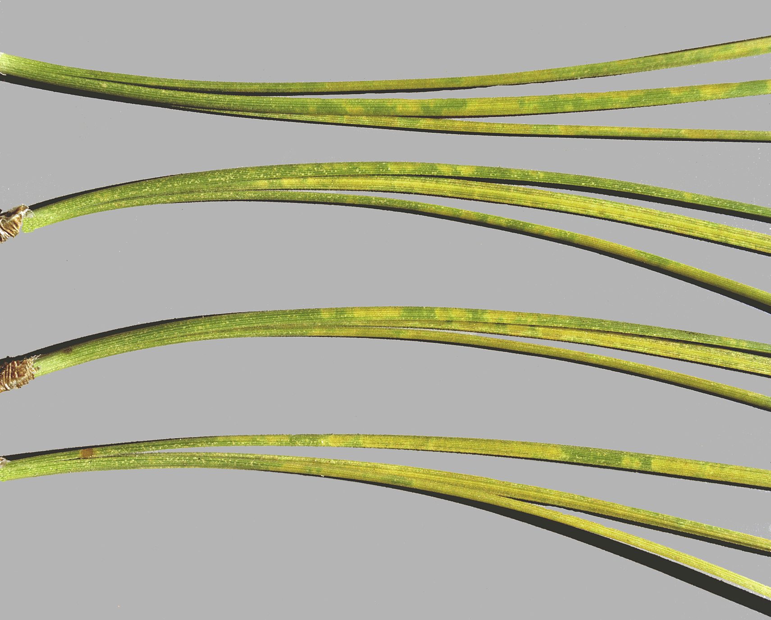
Premature needle yellowing
and loss on ponderosa pine
Ozone mottle

Slide 6
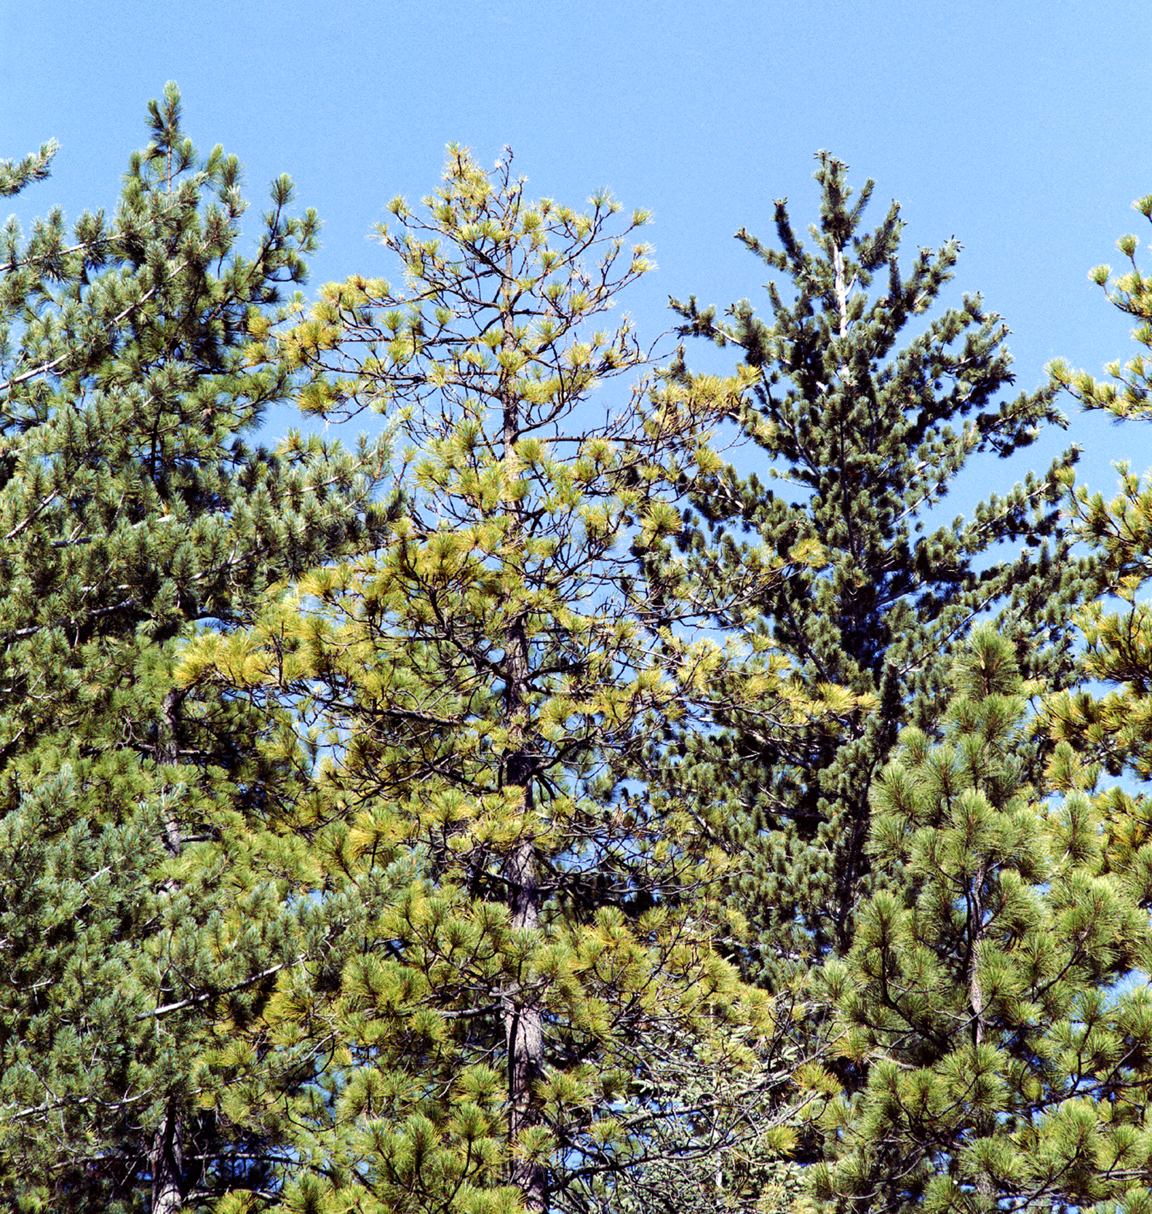
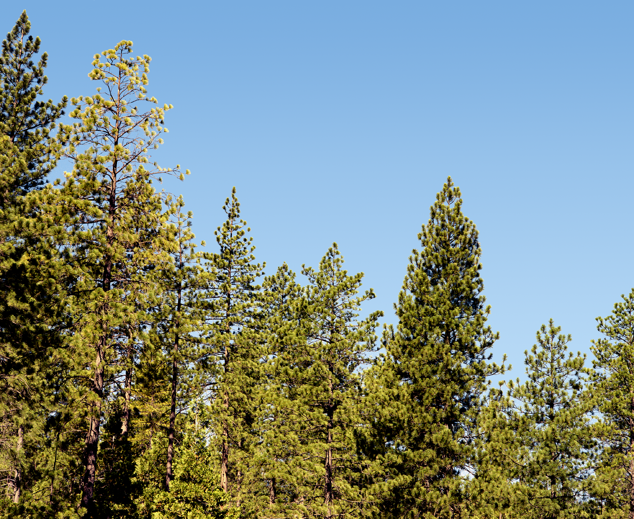
Loss of vigor in ponderosa
pine exposed to ozone

Slide 7
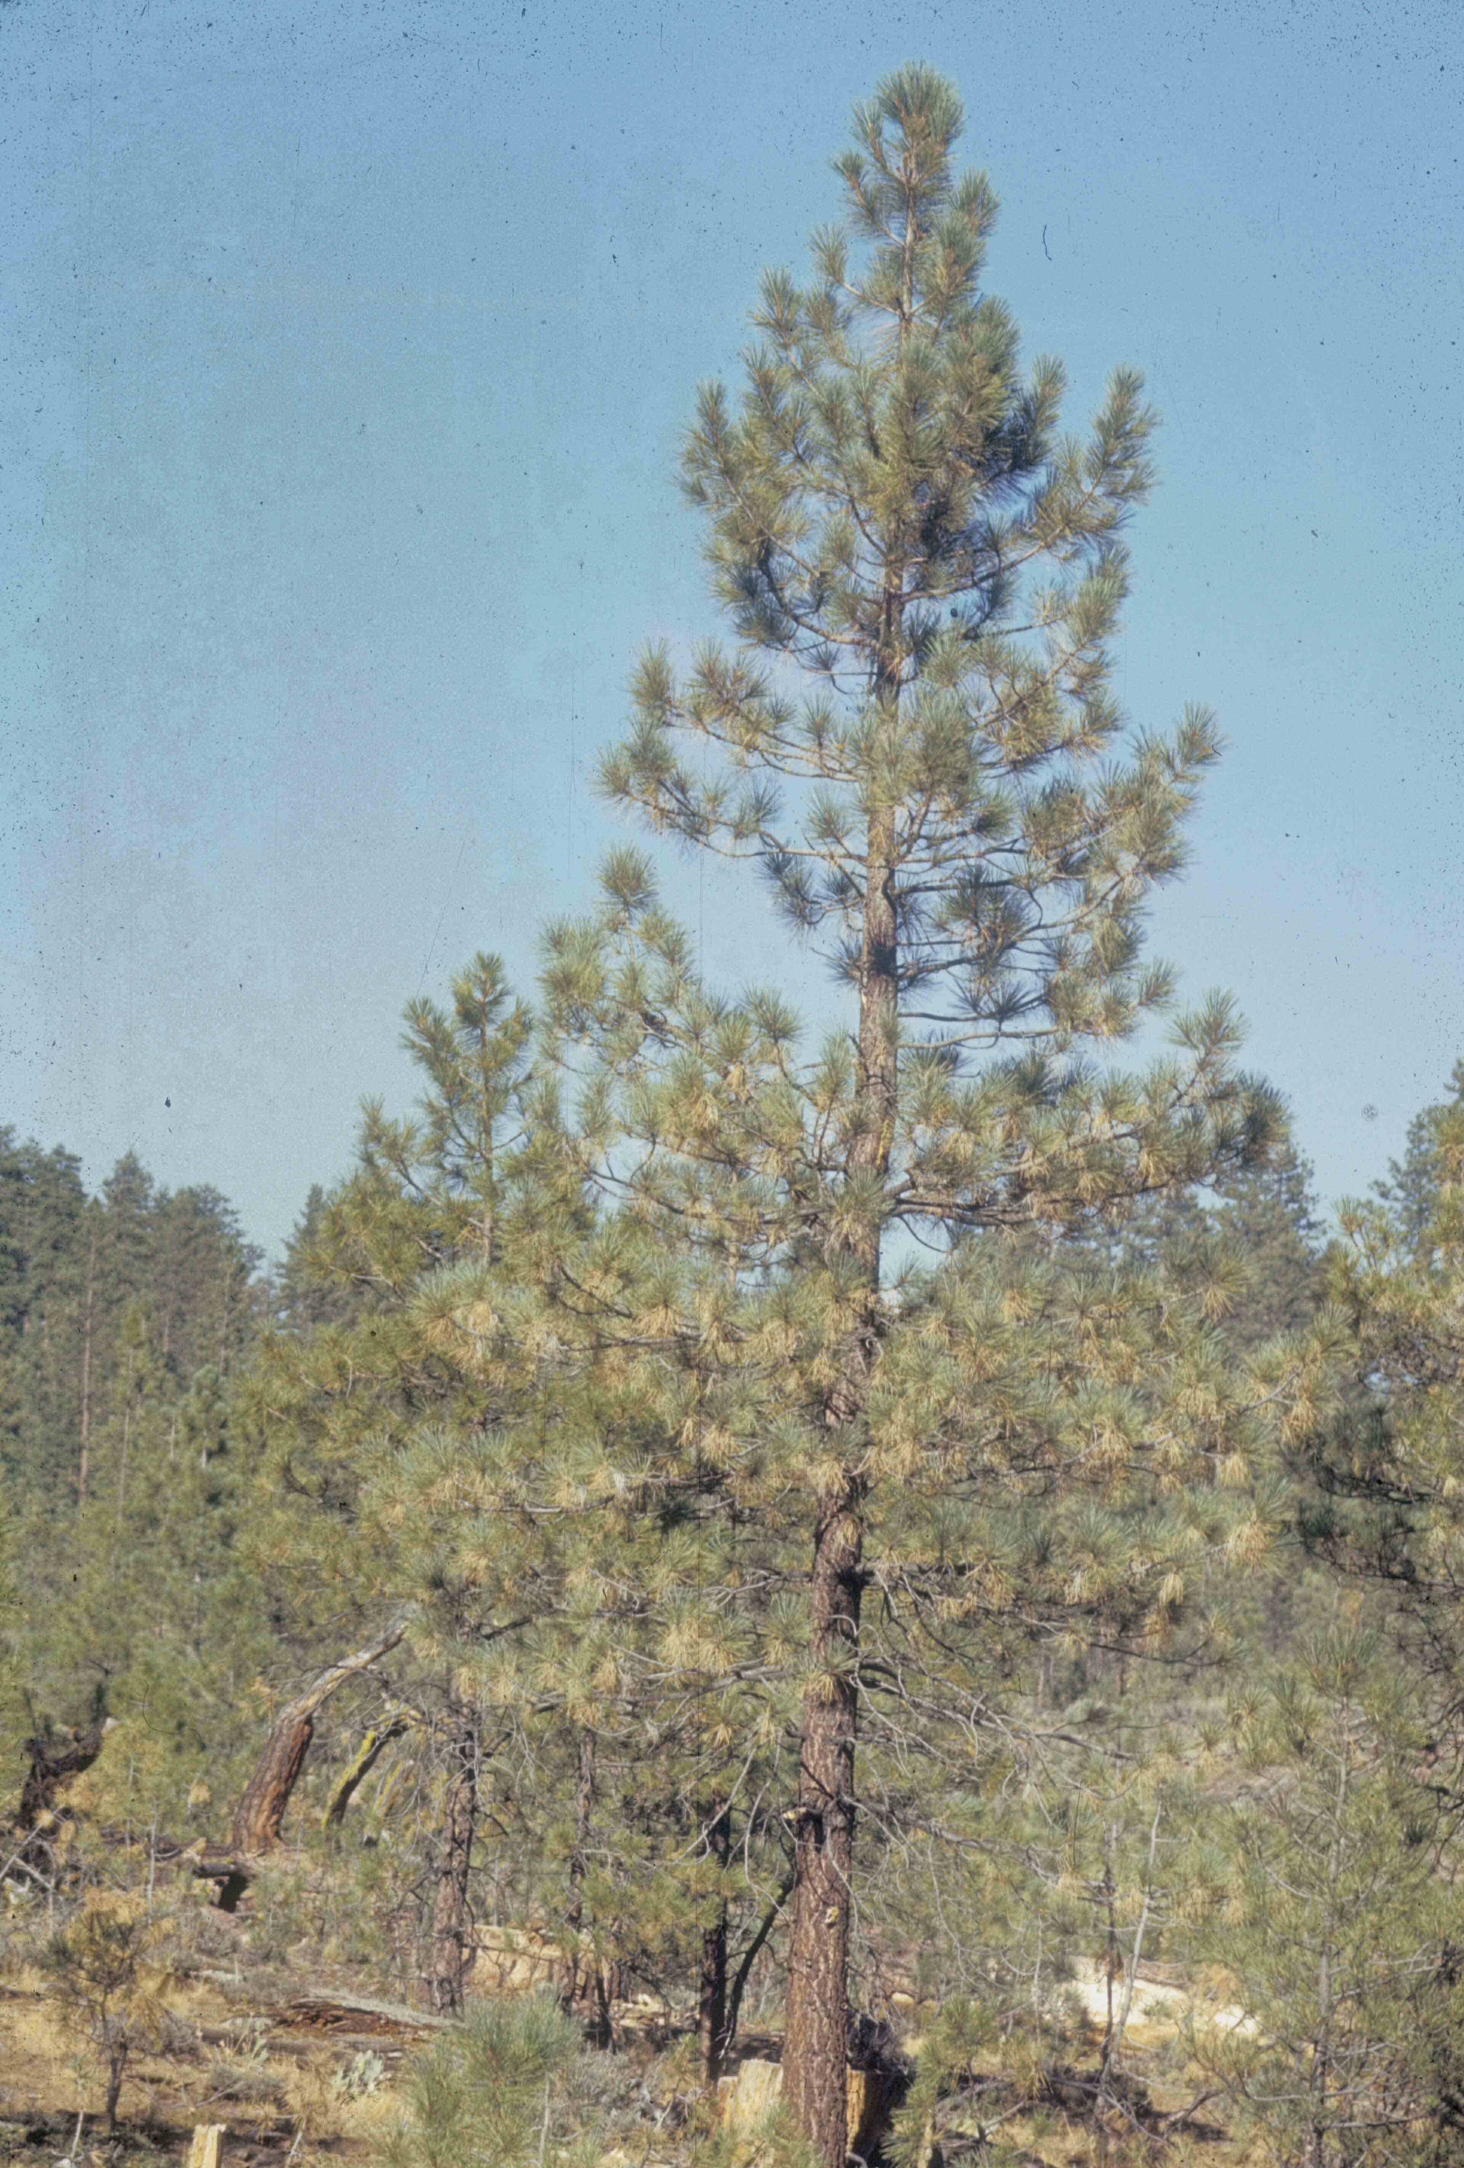
Smog symptoms on
ponderosa pine in
southern California

Slide 8
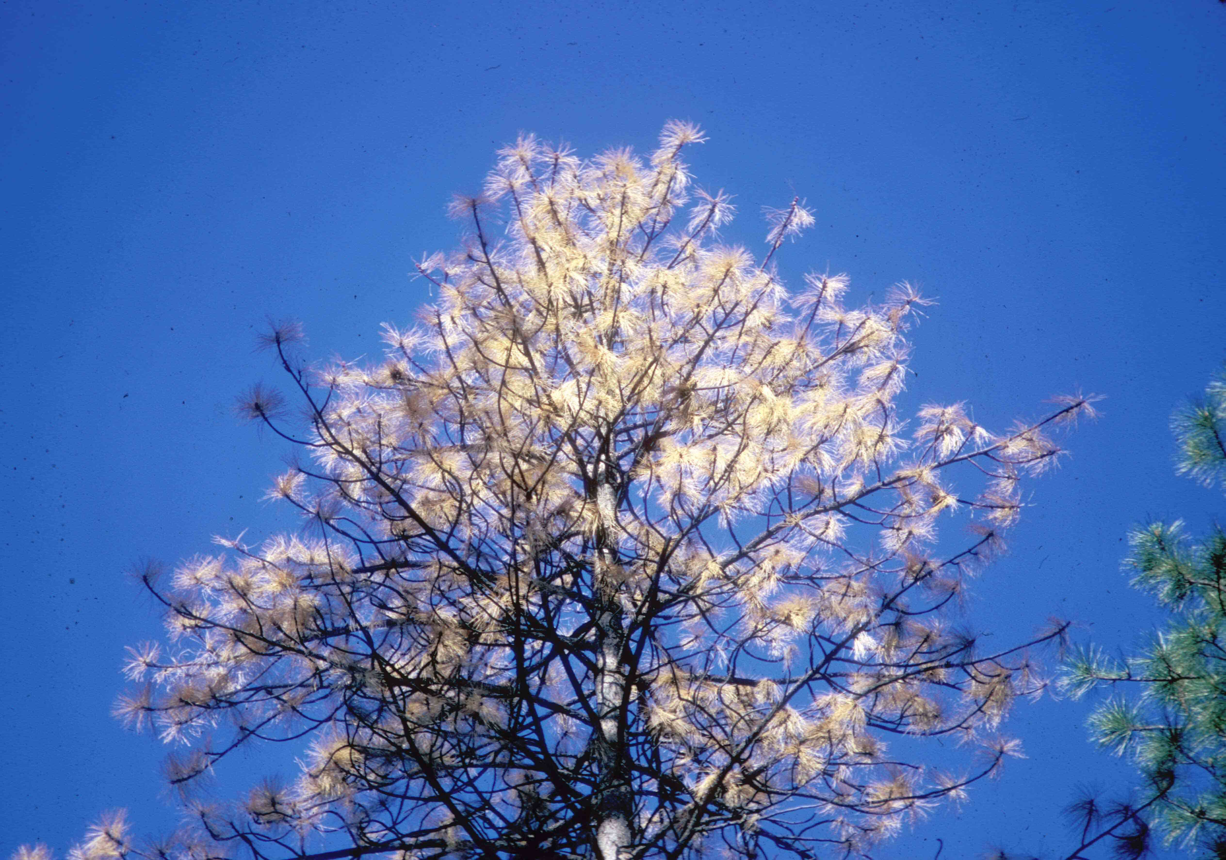
Advanced smog symptoms on ponderosa pine

Slide 9
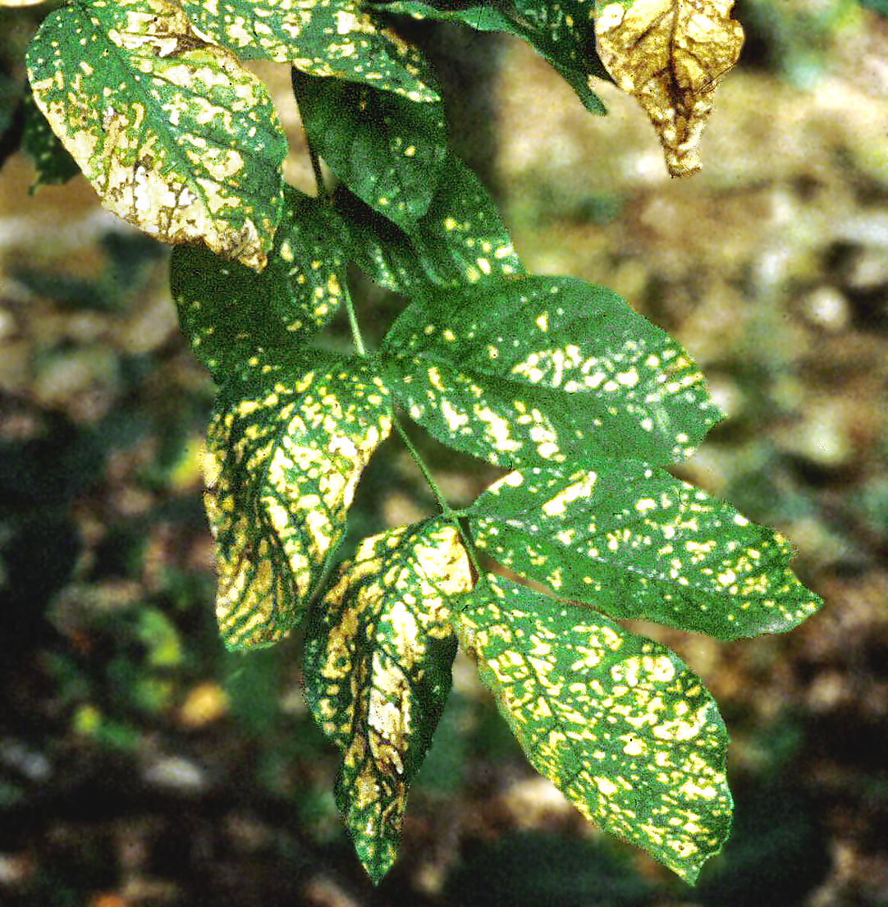
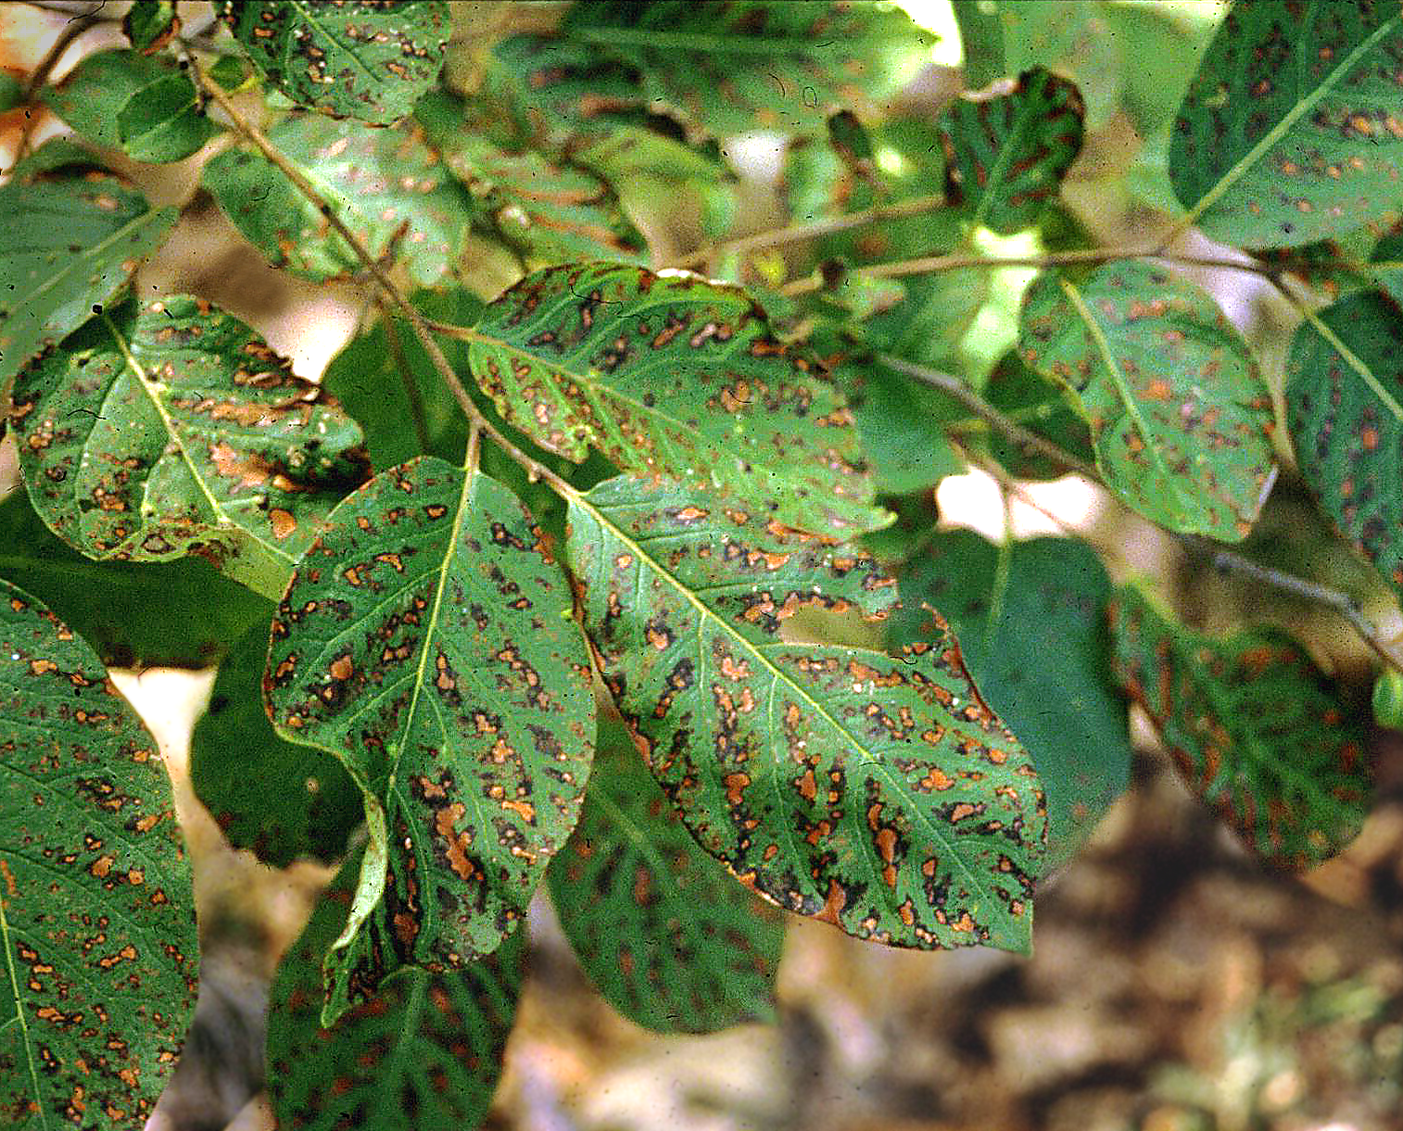
Acute SO₂ injury
Ash
Persimmon

Slide 10
BIOTIC DISEASES caused by:
Parasitic plants
Bacteria
Fungi
Oomycetes
Viruses
Nematodes

Slide 11
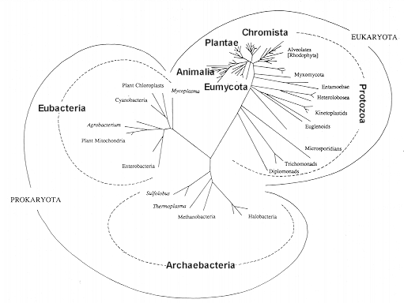
Tree of Life, from Patterson & Sogin, 1992

Slide 12
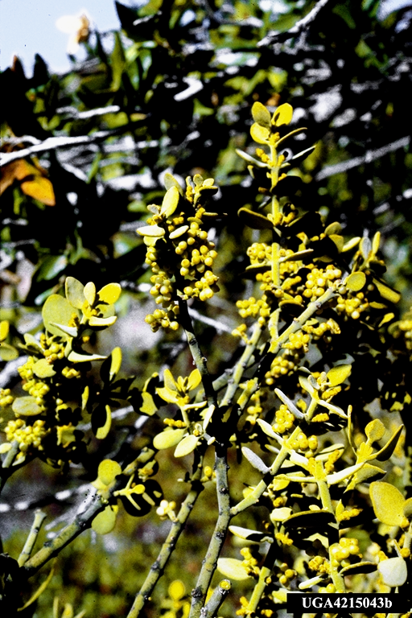
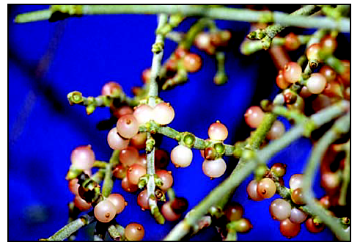
Phorodenron villosum on oak
Leafy mistletoe

Slide 13
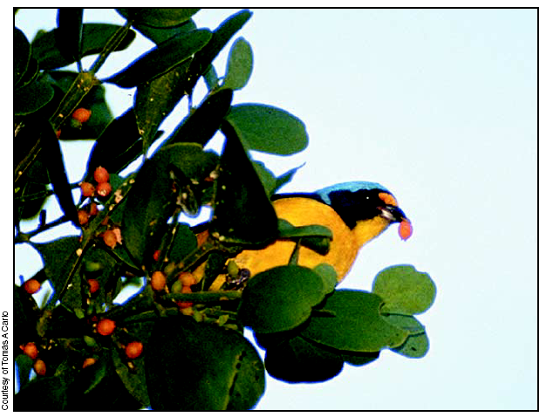
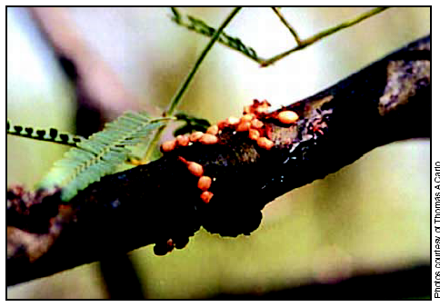

Slide 14
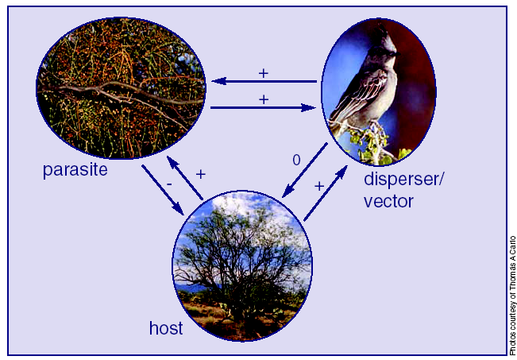

Slide 15
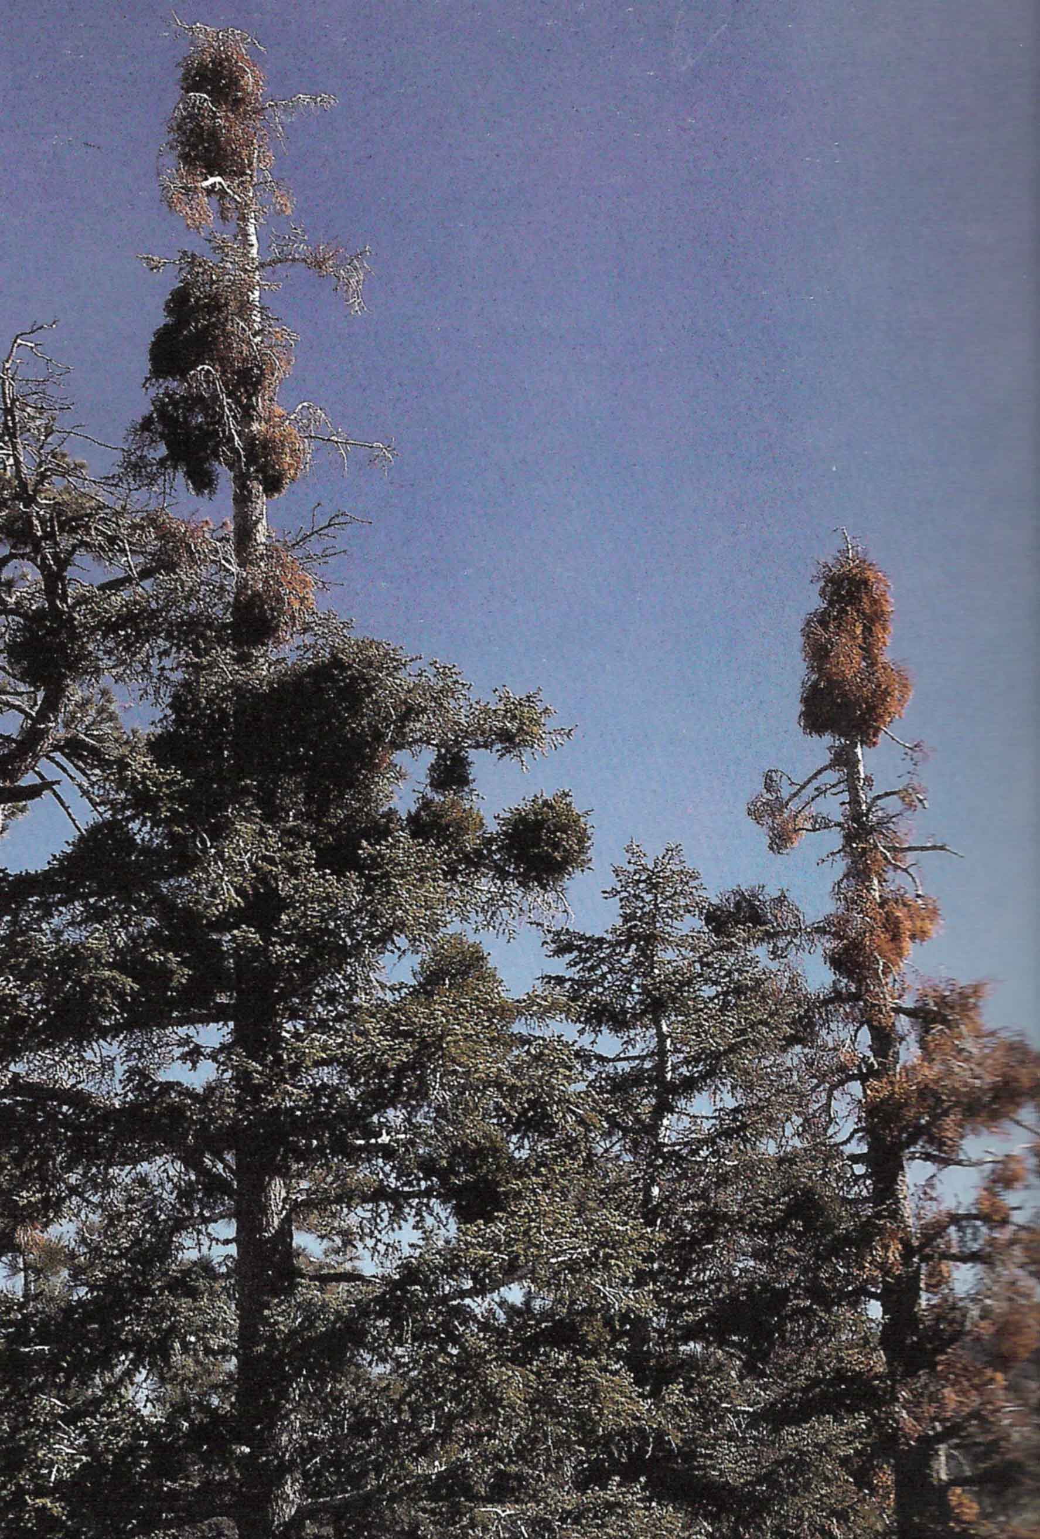
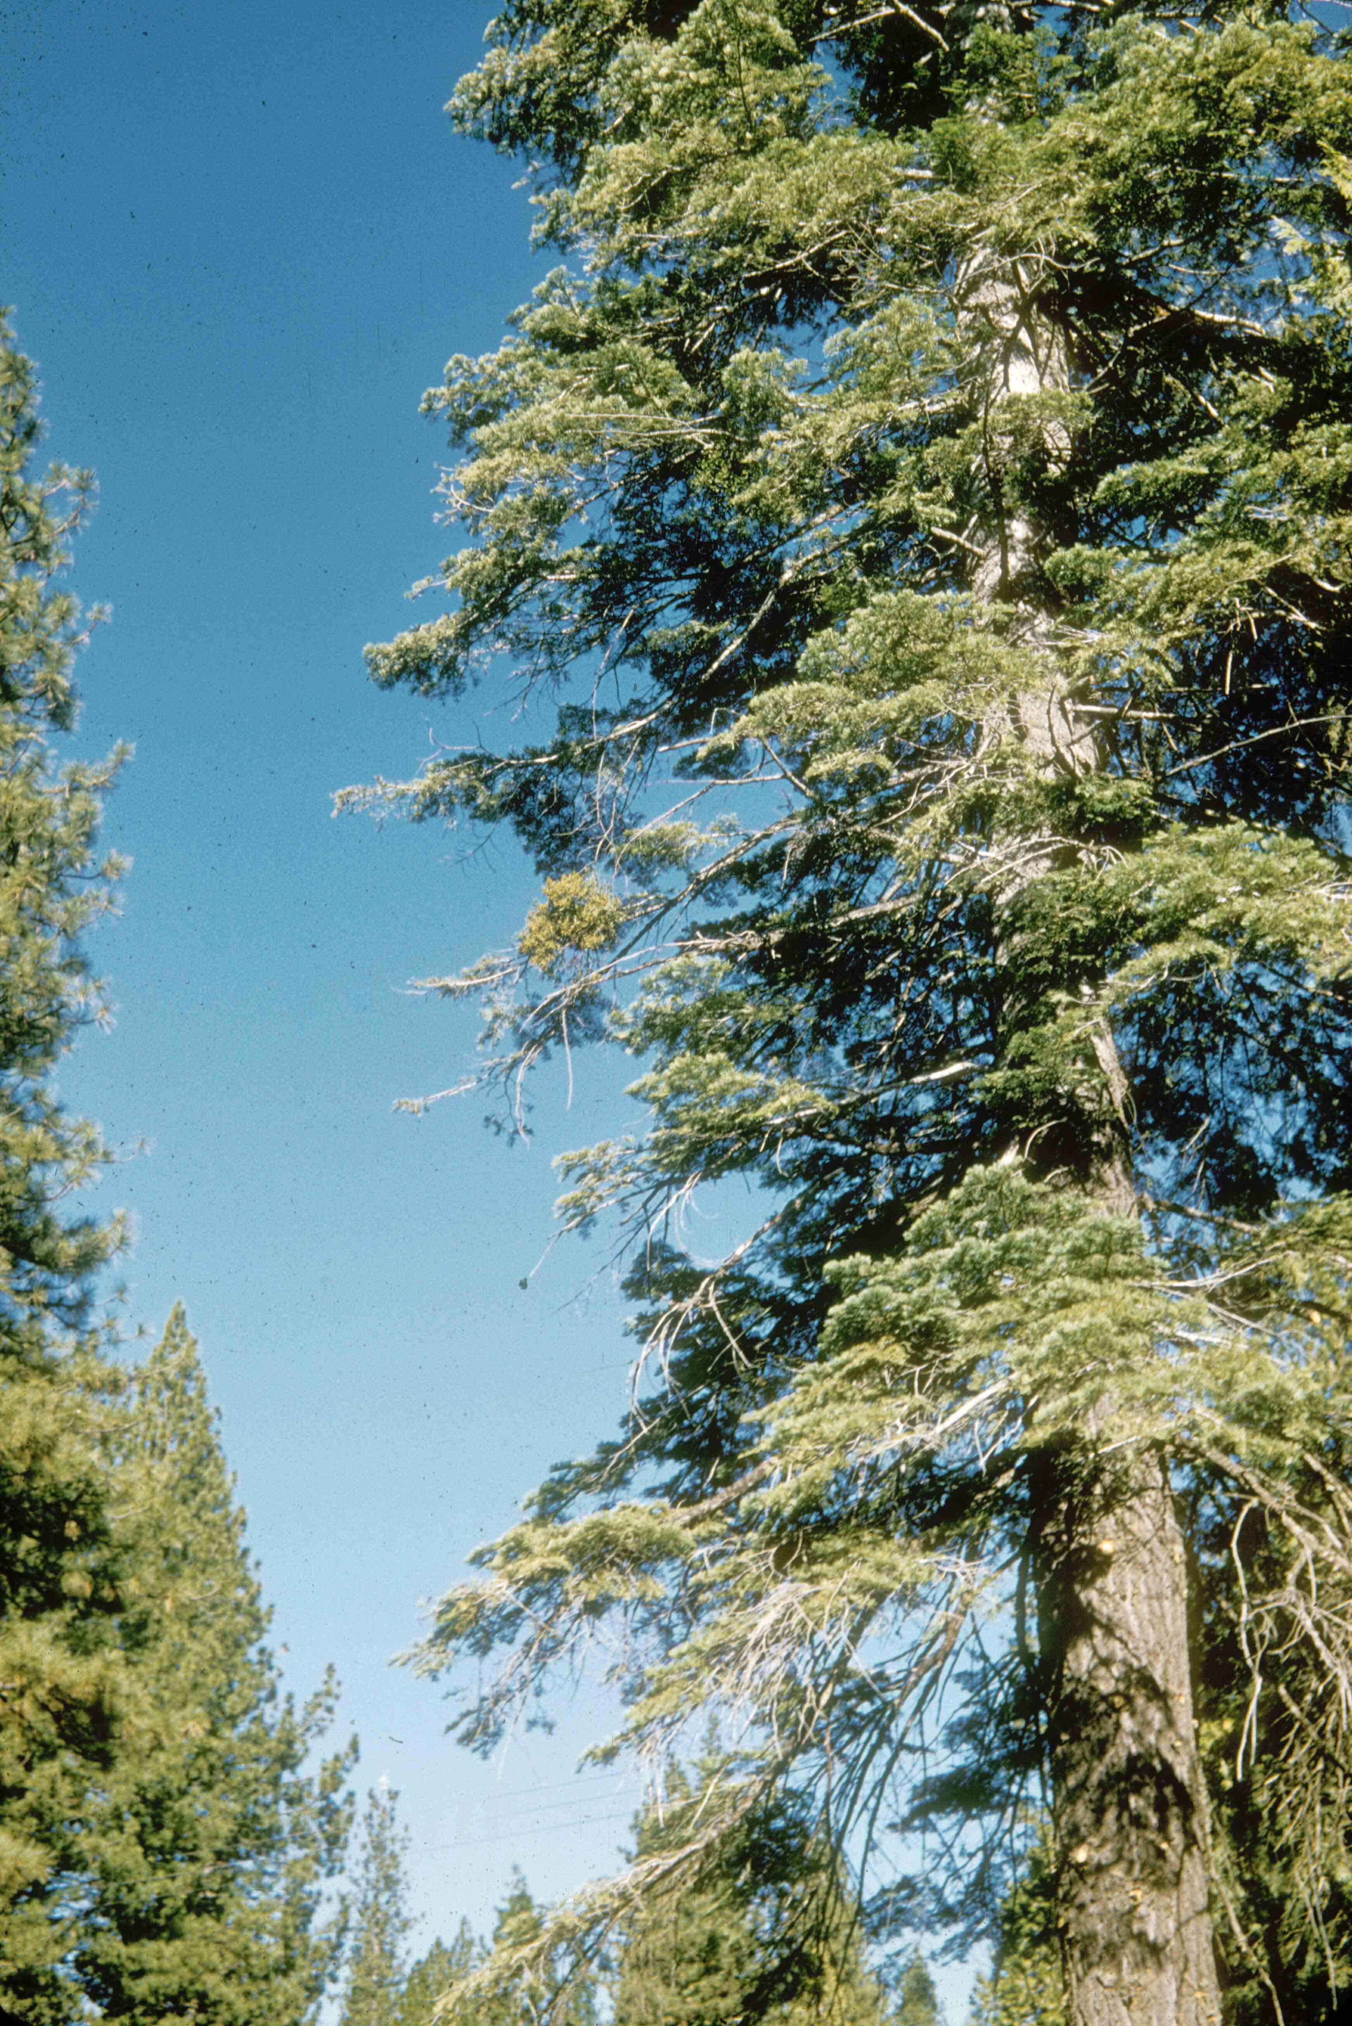
Phoradendron pauciflorum
on white fir

Slide 16
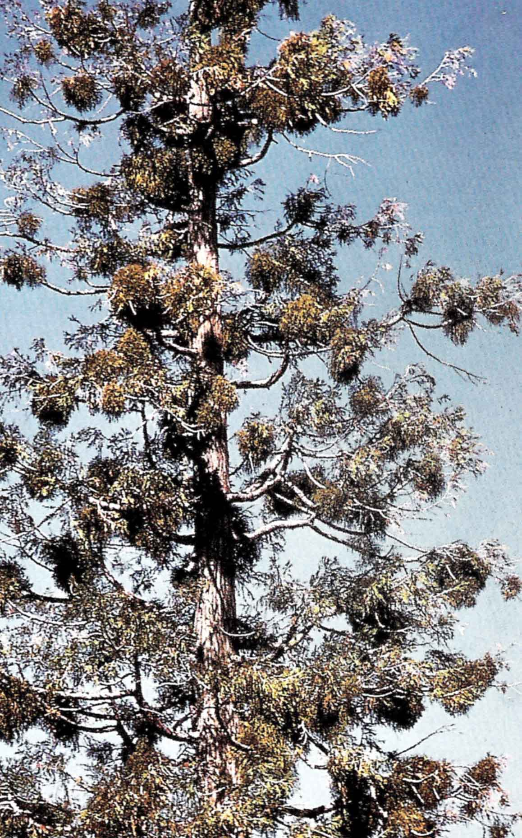
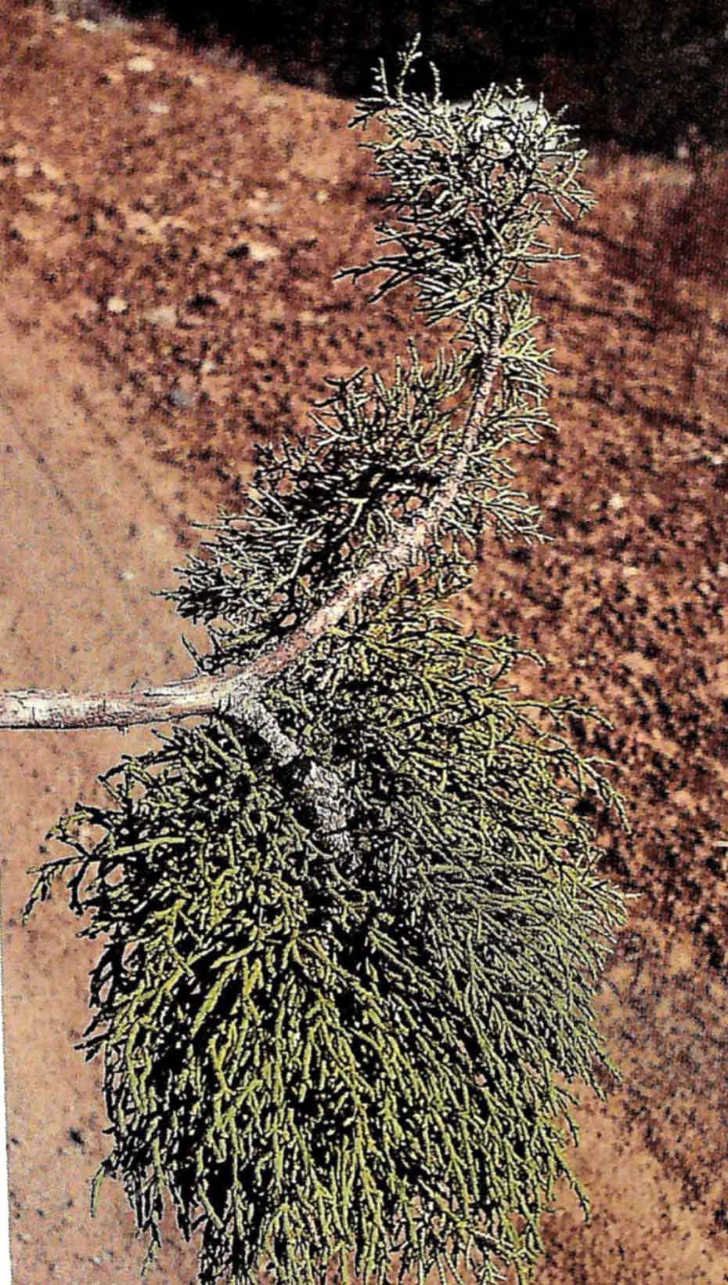
Phorodendron libocedri
on incence cedar

Slide 17
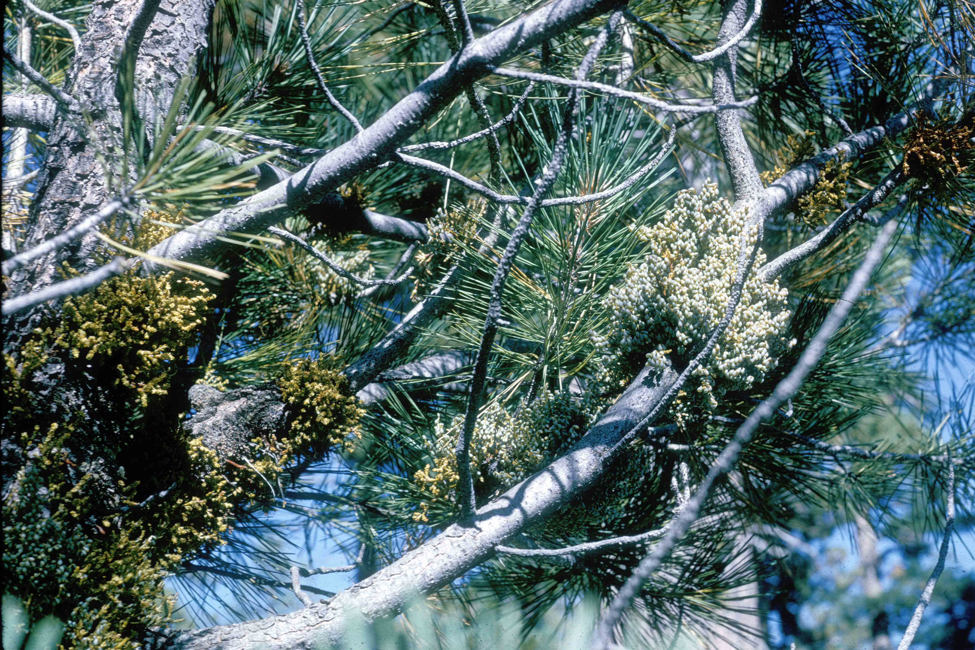

Slide 18
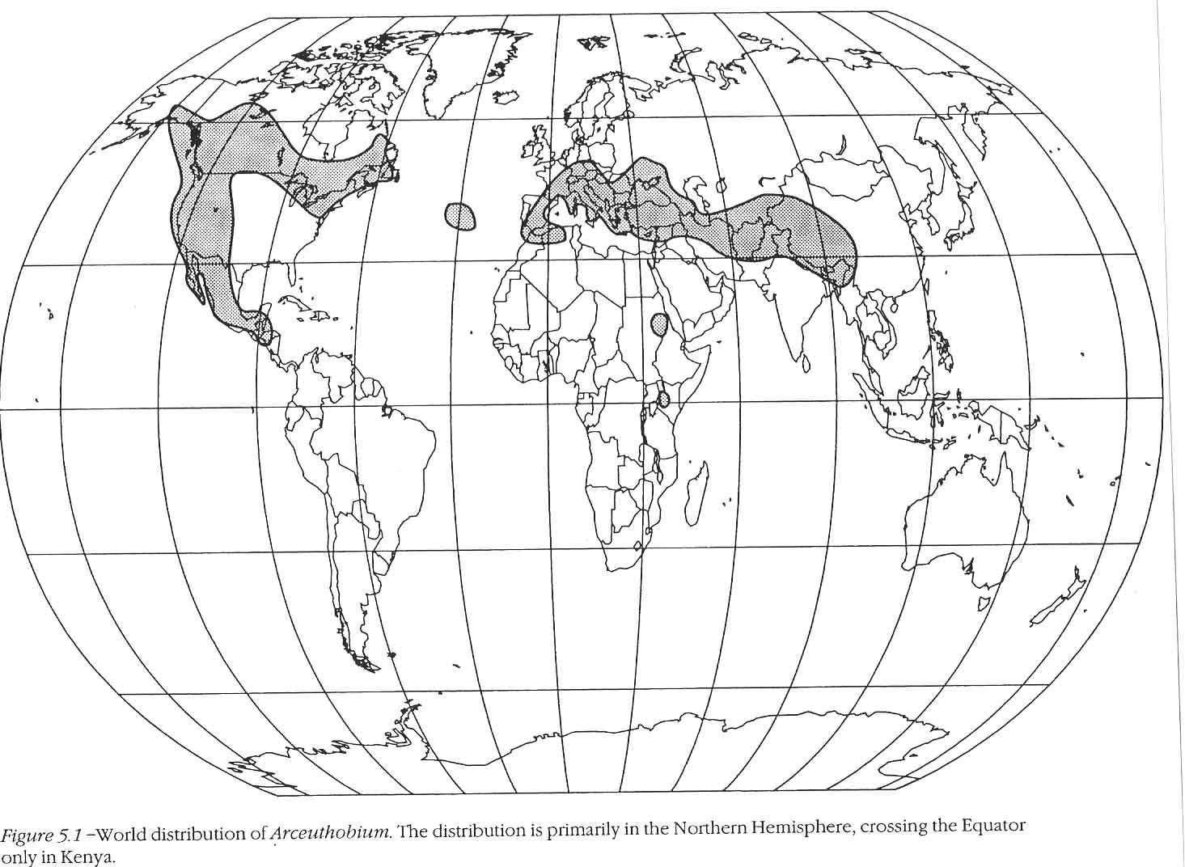

Slide 19
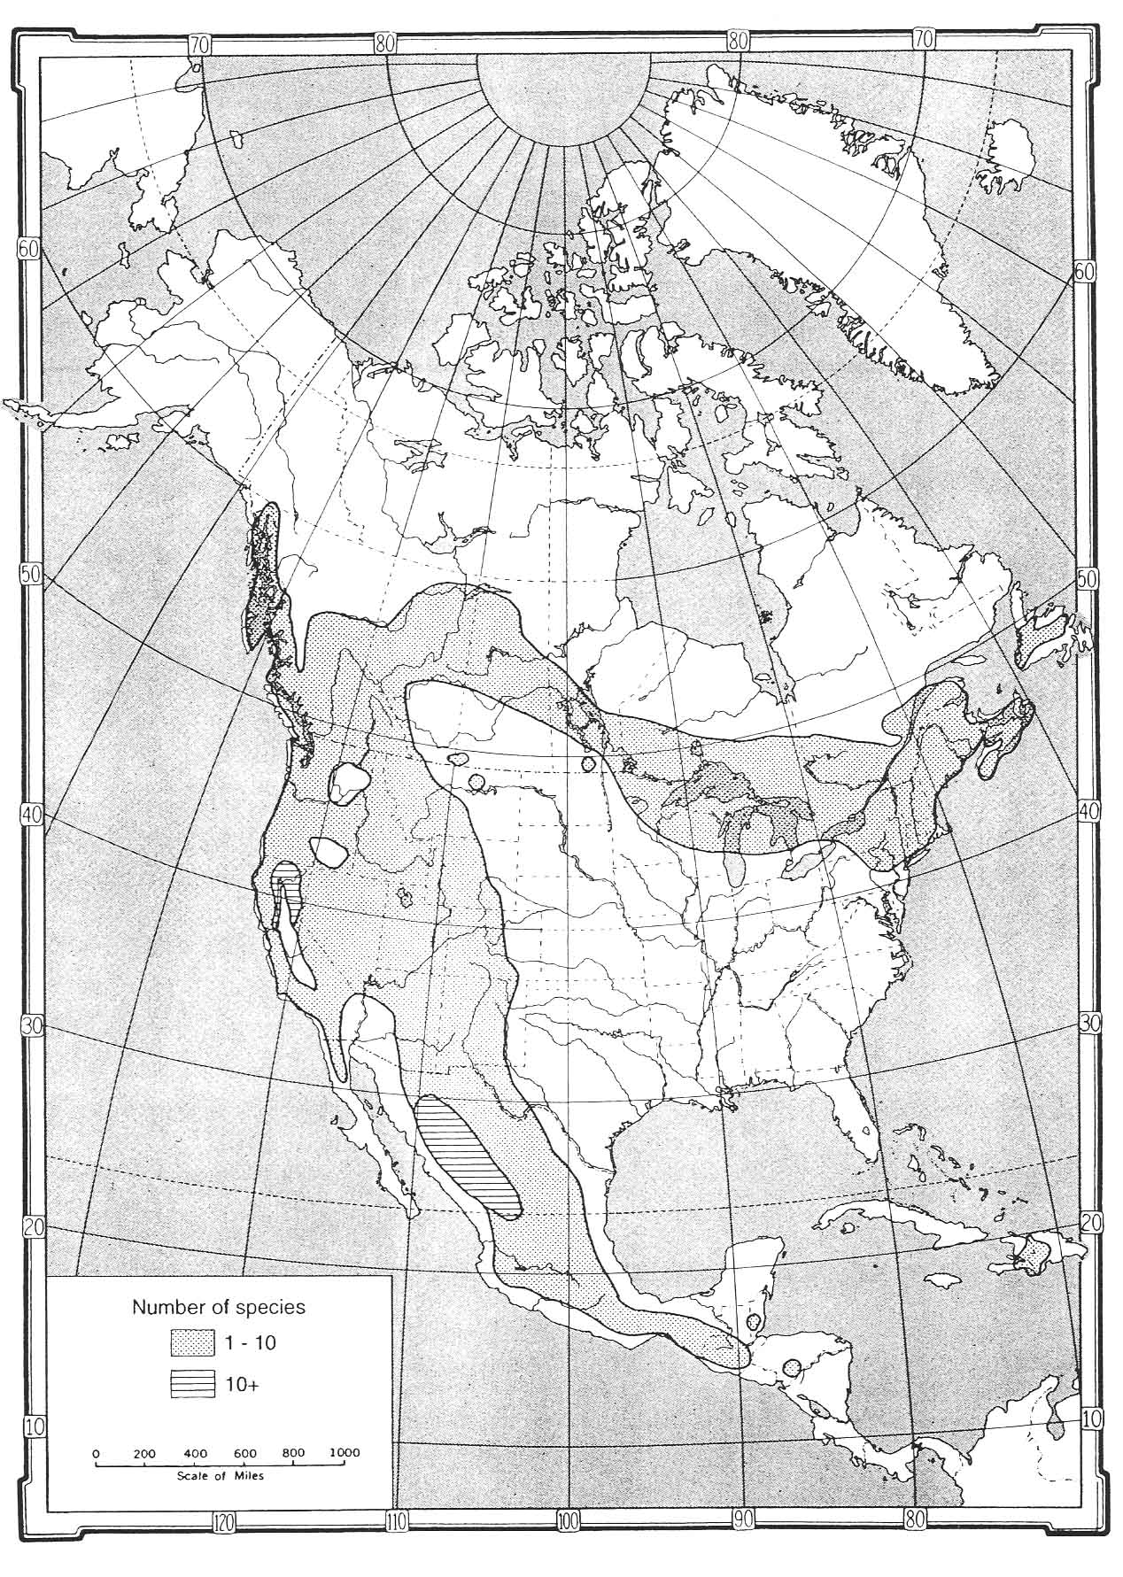
Large number of
species because of
high host specificity

Slide 20
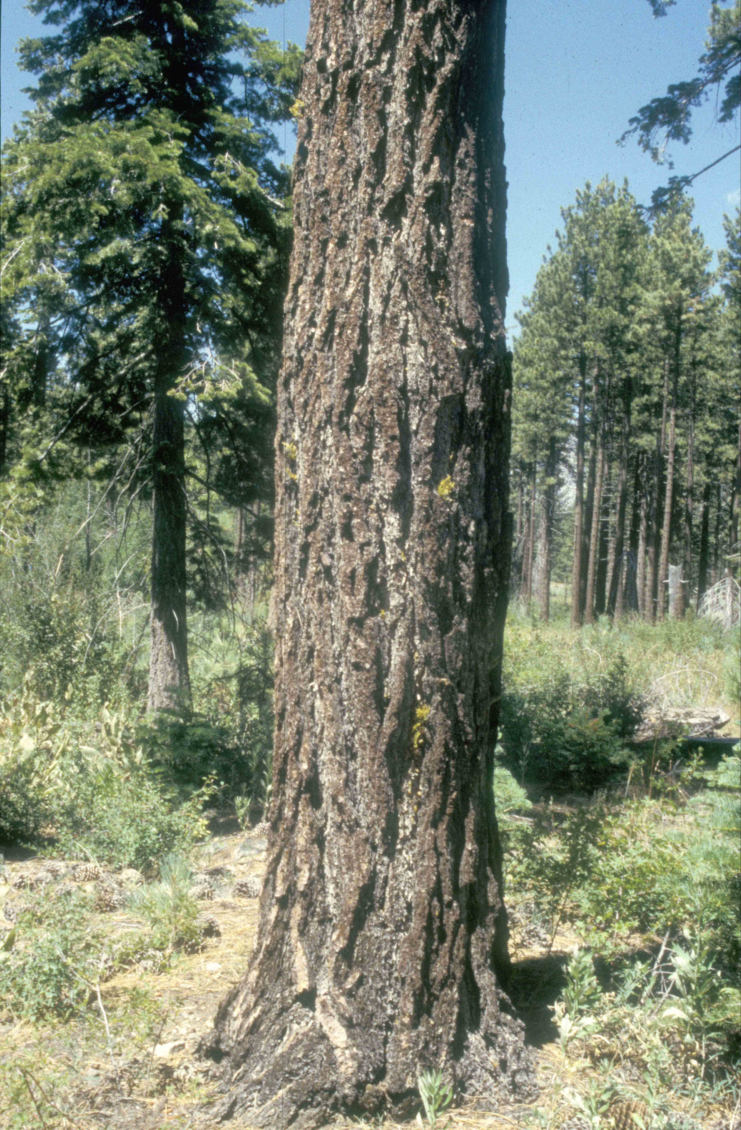
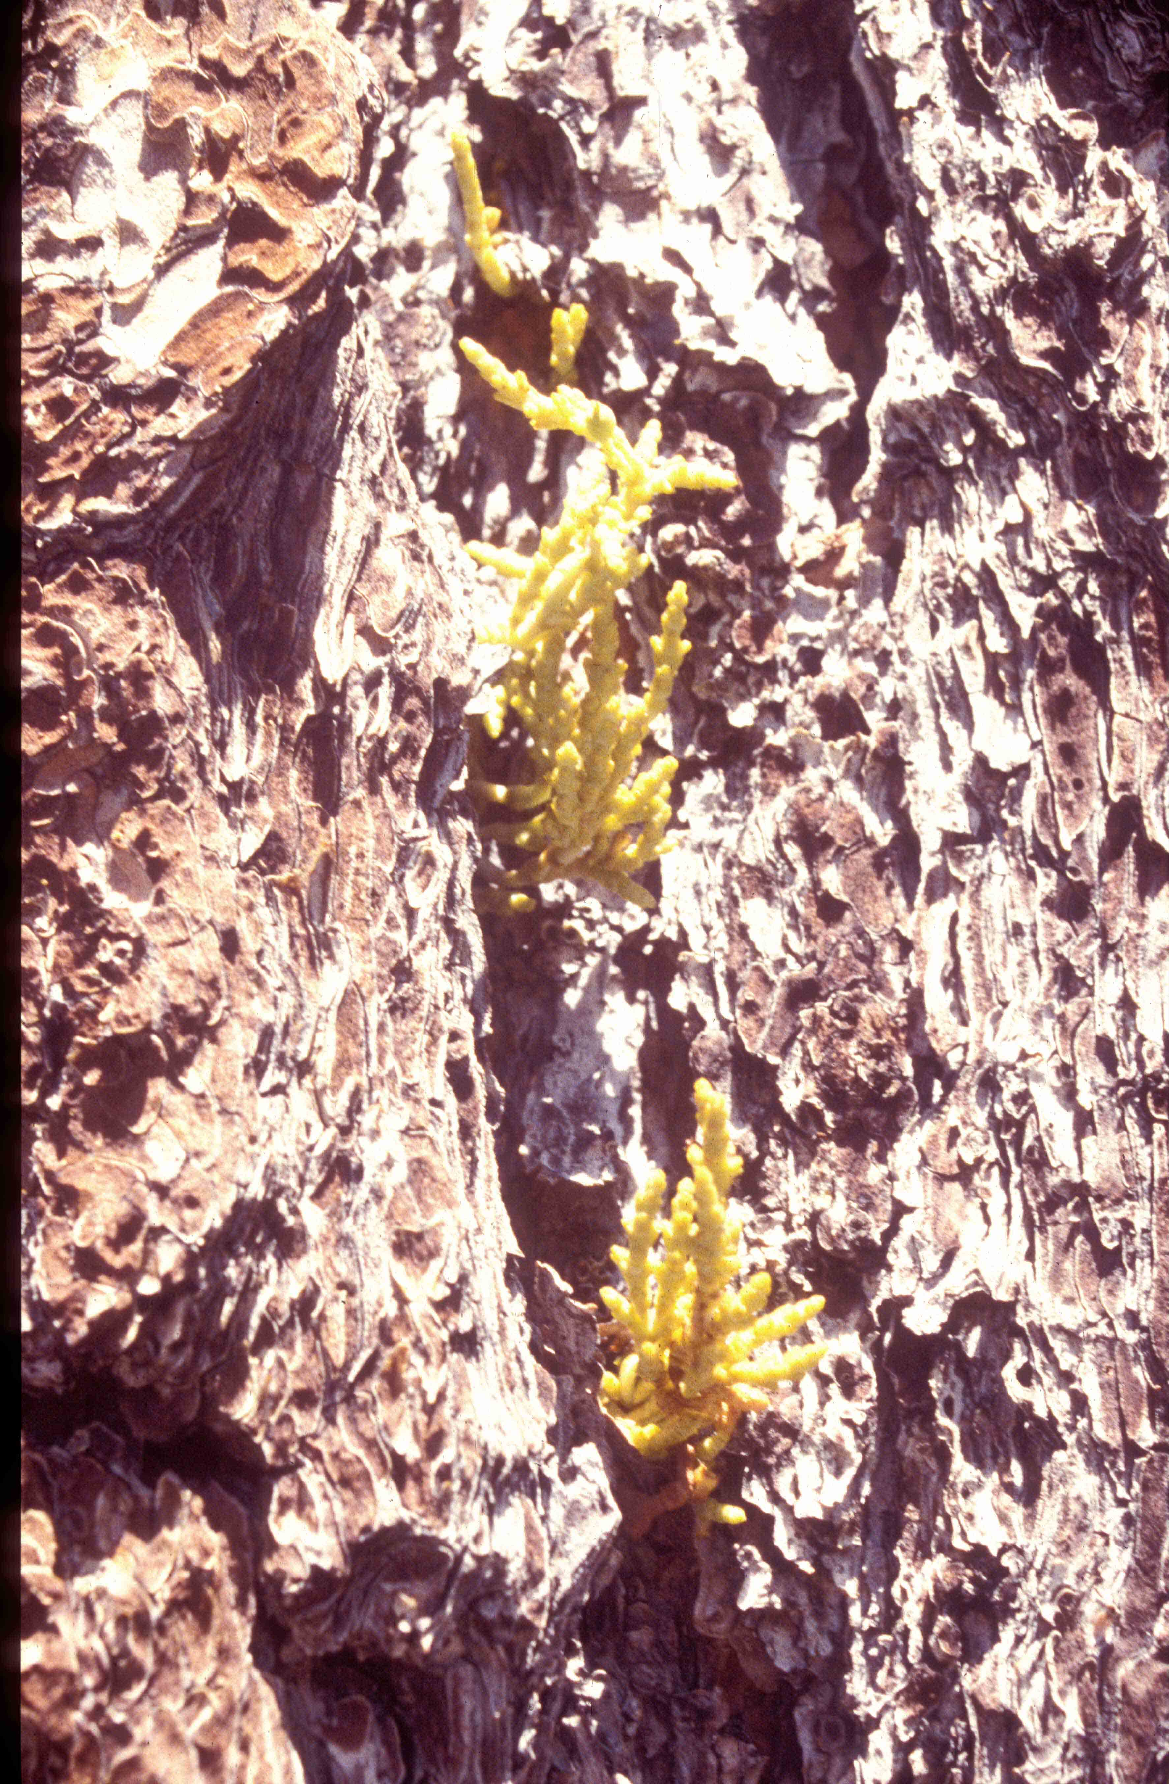
Arceuthobium campylopodum
on Jeffrey pine

Slide 21
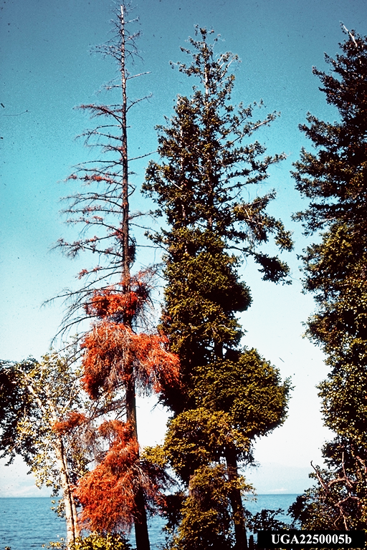
Arceuthobium douglasii
on Douglas-fir

Slide 22
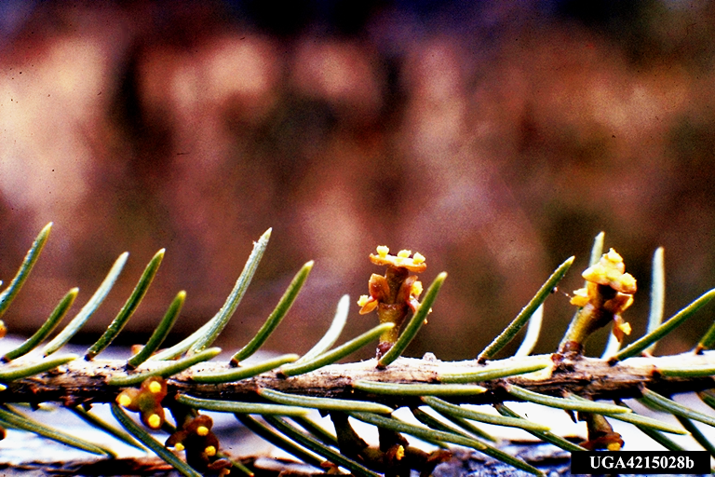
Male flowers

Slide 23
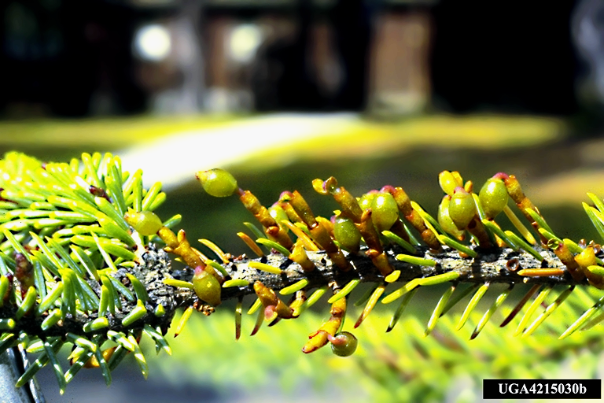
Mature female shoots - seeds

Slide 24
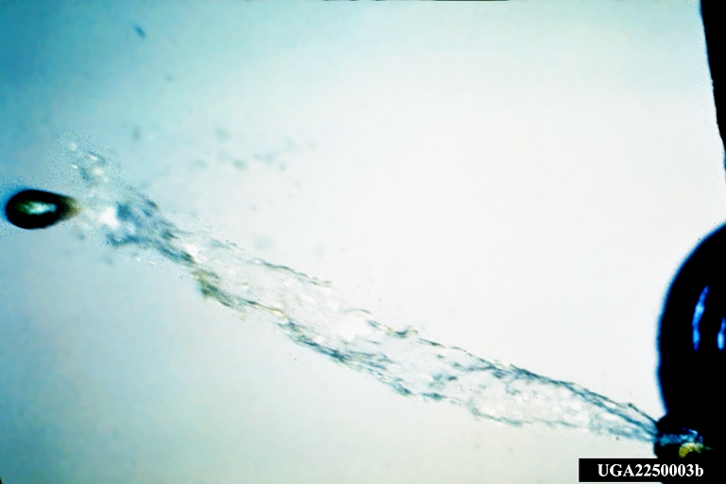
Explosive seed dispersal of Arceuthobium

Slide 25
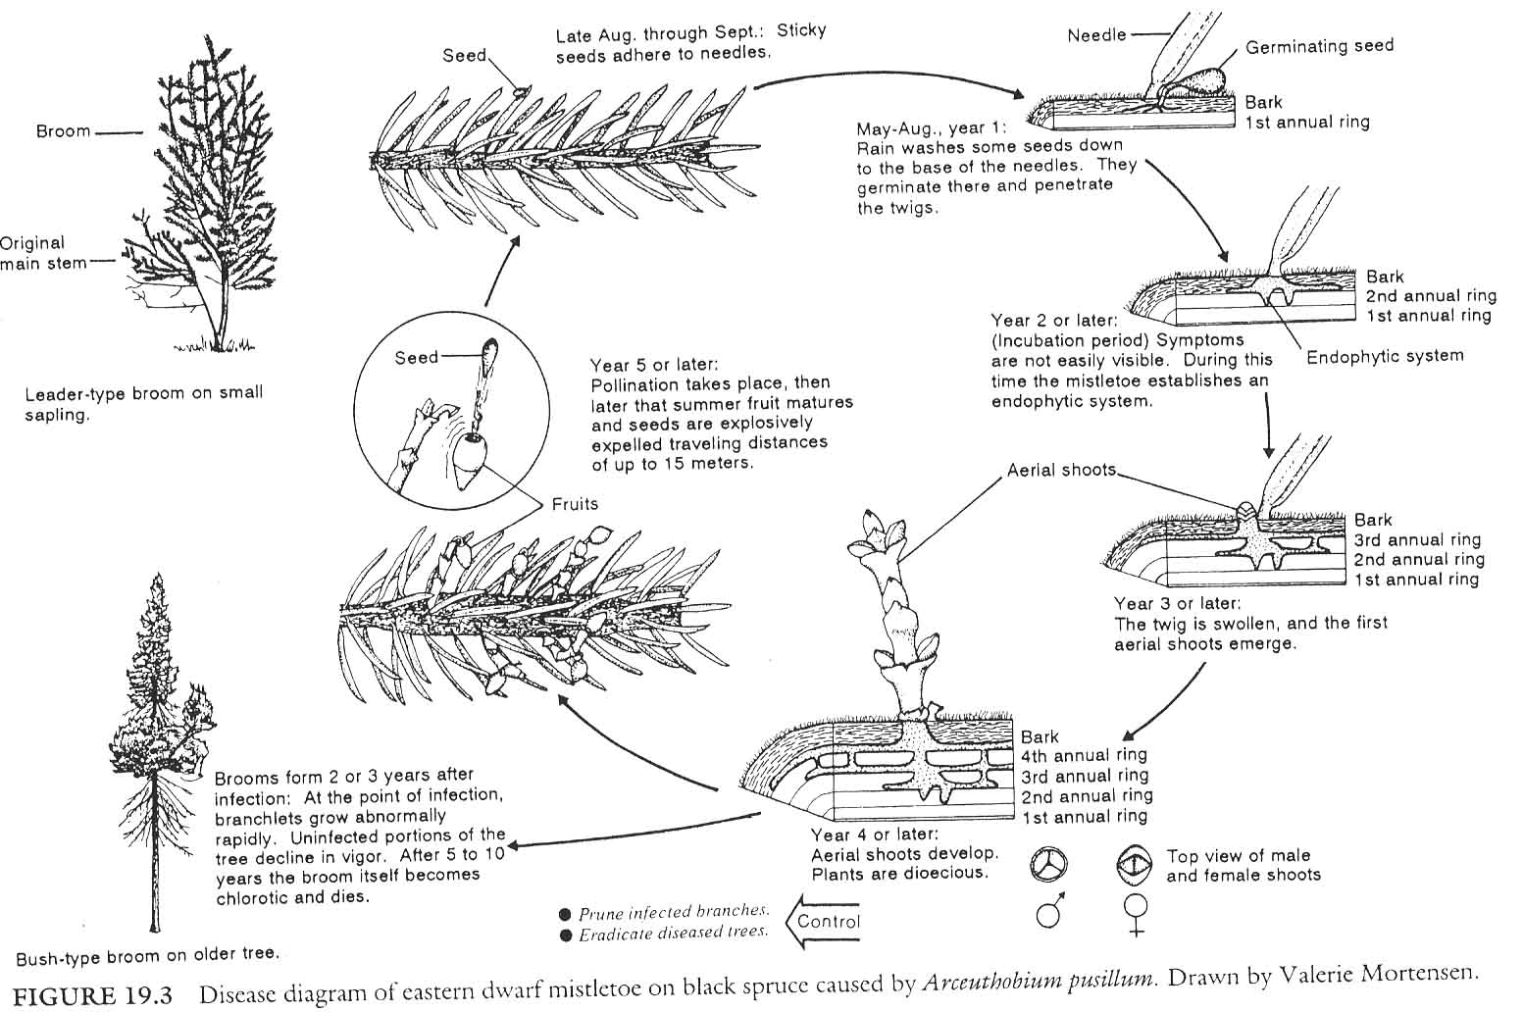

Slide 26
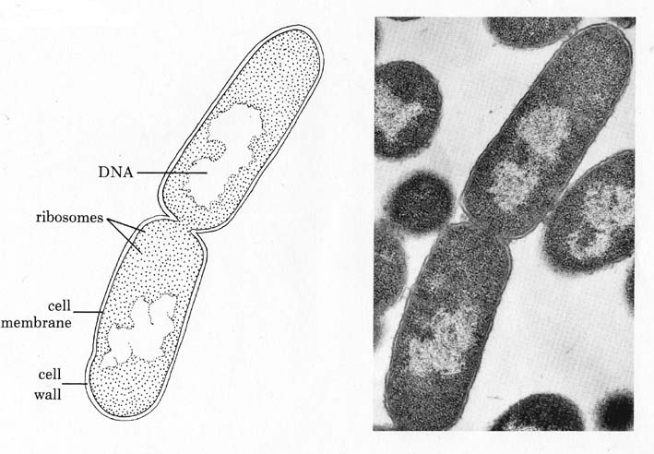
BACTERIA
Prokaryotes
Unicellular
Variously shaped
Do not produce spores
Reproduce by binary fission
*
Richiami sulle entità biotiche

Slide 27
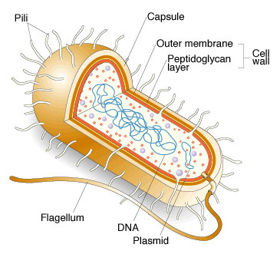

Slide 28
Genetic elements
Chromosome (single one, circular)
Plasmids
Primary mechanisms of variation
Mutations
Loss/acquisition of plasmids and transposons
Recombination through: transformation (incorporation in
Chromosome of plasmid DNA; conjugation (incorporation of
DNA from another bacterium); transduction (incorporation
through bacterial viruses called bacteriophages)

Slide 29
Phytoplasma
Prokaryotes lacking a cell wall (MLOs - Mollicutes)
Usually vascular pathogens
Generally vectored by insects

Slide 30
VIRUSES and VIROIDS
Submicroscopic parricles always intracellular when in the host, infectious and pathogenic
They comprise
Nucleic Acids (RNA or DNA) and a capsid protein
Viroids instead are simply constituted by a single RNA molecule, they do not code for or possess proteins

Slide 31
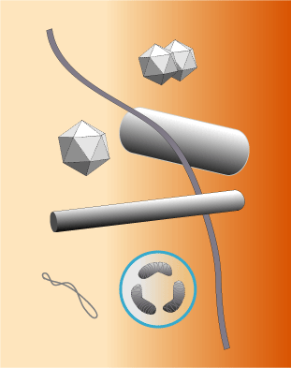
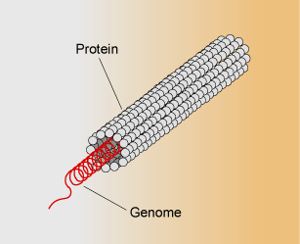
Nucleic acid: ssRNA, dsRNA, ssDNA, dsDNA
Protein capsid: protects virus during transport
*
*

Slide 32
VIRAL REPLICATION
The genome of the virus codes for:
1- capsid protein;
2- polymerase;
3- protein for intracellular movement;
4- proteins involved in transmission and relationship with vectors

Slide 33
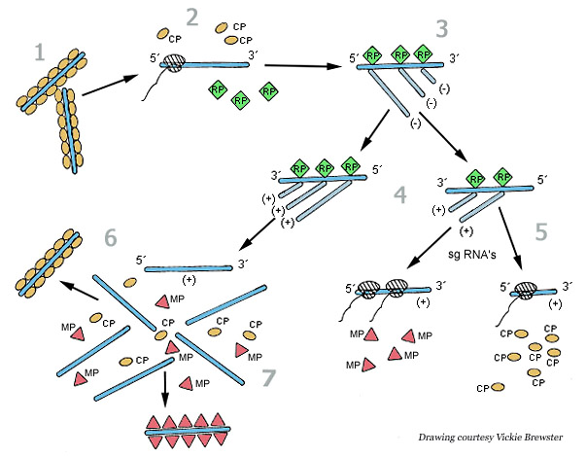
ssRNA+
Notes:
TMV enters a wounded plant cell to begin the replication cycle [1]. As the cost protein (CP) molecules are stripped away from the RNA [2], host ribosomes begin to translate the two replicase-associated proteins. The replicase proteins (RP) are used to generate a negative-sense (- sense) RNA template from the virus RNA [3]. This - sense RNA is, in turn, used to generate both full-length positive-sense (+ sense) TMV RNA [4] and the + sense subgenomic RNAs (sgRNAs) [5] that are used to express the movement protein (MP) and CP. The + sense TMV RNA is either encapsidated by the CP to form new TMV particles [6] or wrapped with MP [7] to allow it to move to an adjacent cell for another round of replication. For details on cell-to-cell and long distance movement, see Figure 10. (Courtesy Vickie Brewster)

Slide 34
Some examples of bacteria, phytoplasmas and viruses present in forests
Bacterial leaf scorch: Xylella fastidiosa
Crown Gall: Agrobacterium tumefaciens
Ash and elm yellows: Ca. Phytoplasma alni and P. ulmi
Bacterial wetwood (Enterobacter, Klebsiella, Erwinia and Pseudomonas)
Poplar mosaic virus, poplar potyvirus
Cherry leaf roll virus (elms, dogwood)
Tobacco Mosaic Virus (tanoak, oaks elders)

Slide 35
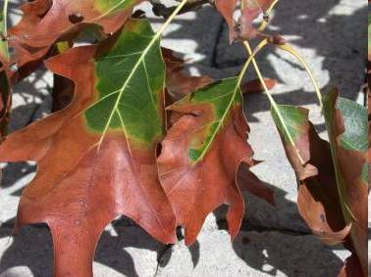
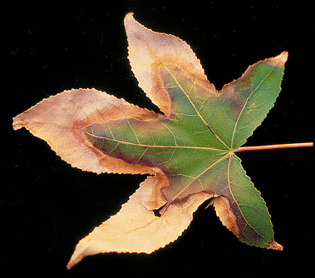
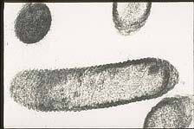
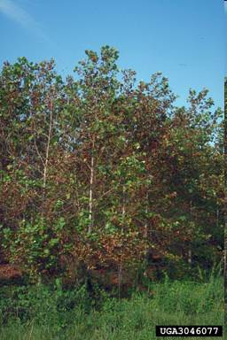
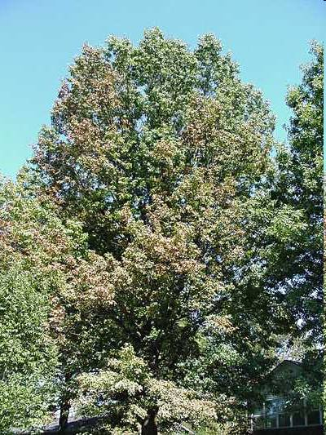
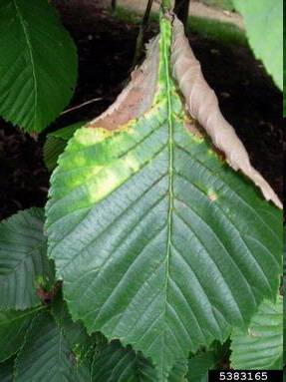
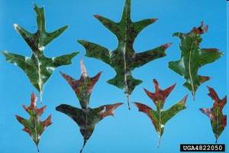
Bacterial Leaf Scorch
Xylella fastidiosa

Slide 36
Hosts
Scientific Common
Acer sp.
A. Rubrum Red maple
A. negundo Boxelder
A. saccharum Sugar maple
C. florida Flowering dogwood
C. occidentalis Hackberry
L. stryraciflua Sweet gum
Morus alba Whitemulberry
Platanus sp.
P. occidentalis American sycamore
P. x acerifolia London plane
Ulmus americana American elm
Scientific Common
Quercus sp.
Q. velutina Black oak
Q. incana Bluejack oak
Q. macrocarpa Bur oak
Q. prinus Chestnut oak
Q. laurifolia Laurel oak
Q. virginiana Live oak
Q. rubra Northern red oak
Q. palustris Pin oak
Q. stellata Post oak
Q. coccinea Scarlet oak
Q. imbricaria Shingle oak
Q. shumardii Shumard oak
Q. falcata Southern red oak
Q. bicolor Swamp white oak
Q. laevis Turkey oak
Q. nigra Water oak
Q. alba White oak
Q. phellos Willow oak

Slide 37
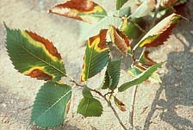
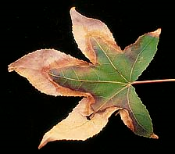
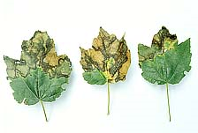
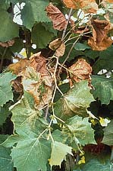
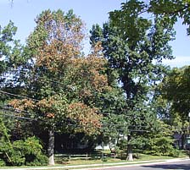
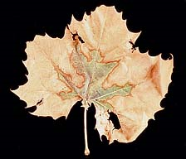
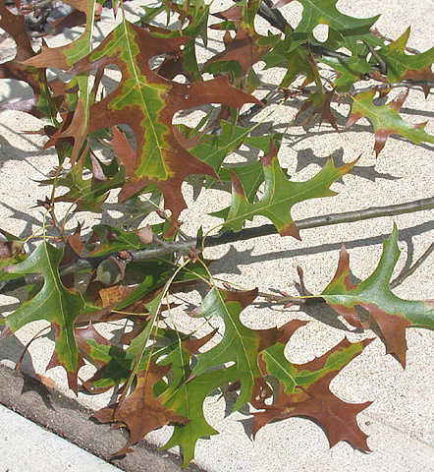
Symptoms
First appear in late summer /early fall
Leaf scorching
Limb death

Slide 38
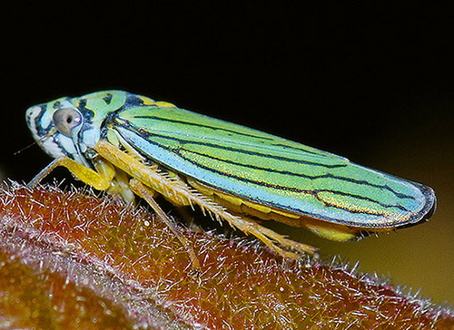
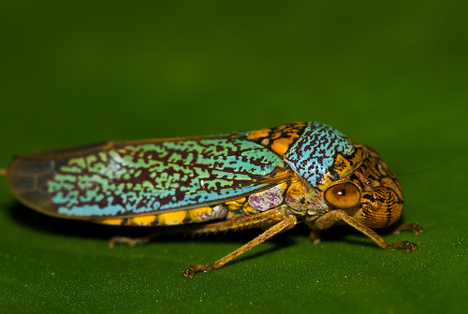

Vector
Not determined for each tree species yet
Most likely Graphocephala, Oncometopia and Homalodisca species.
Graphocephala atropunctata
Oncometopia orbona
Homalodisca vitripennis

Slide 40





A. tumefaciens
Elm yellows
Ash yellows
Bacterial wetwood
Cherry Leaf Roll virus

Slide 41



NEMATODES
*
*
*

Slide 42
Fungi
Eukaryotic organisms, heterotrophs, characterized by chitin and B-glucans in the cell wall, feeding through absorption, reproducing by spores and producing a vegetative structure made up of tubular structures,branched, irregular, and indefinite in growth (modified from B. Kendric 1992)

Slide 43

Fungal hyphae and mycelium

Slide 44



There are no differentiated structures in fungi, but hyphae can generate…
compatibile
compatibile
compatibile
mycelia
stroma
rhizomorphs

Slide 45



Slide 46


Ascomycetes (predominance of n in life cycle)
Ascus
Sexual spores (ascospores)
are generated within “sacks”
called asci
*

Slide 47


Ascomycota

Slide 48






Ascomata
apothecium
perithecium
cleistothecium
*

Slide 49

pseudothecium
*

Slide 50





Slide 51


Basidiomycetes (Div. Basidiomycota) n+n or rarely 2n is
predominant in life cycle
Sexual spores, basidiospores,
are carried naked on surface of “clubs”
called basidia
*
Richiami sulle entità biotiche

Slide 52

Basidiomycota

Slide 53



spores
basidia

Slide 54




Slide 55





Slide 56






anamorphic fungi no sexual stage
conidiomi
acervulo
*
*
conidiofori liberi
*
Marssonina betulae
*
Cryphonectria sp.
picnidio

Slide 57



Slide 58


Oomycetes (Div. Oomycota) Kingdom: straminopila
(prev. Chromista)

Slide 59
zooconidio di oomicete
Important group of forest pathogens, includes the genera
Pithyum and Phytophthora
Although apparently similar to the fungi, oomycetes are an
example of convergence, basically the same morphology was
selected because of their lifestyle similar to that of the fungi.
they all have a water dependant phase, they have cellulose in
the cell wall, and are mostly 2n
*

Slide 60
Types of disease: biotic vs. abiotic or..
Infectious: a disease that is caused by a pathogen which can spread from a diseased to a healthy host.
Non-infectious: a disease that is caused by an environmental or host factor. It is not spread between a diseased and healthy individual.

Slide 61
Types of diseases
Foliar diseases and blights
Stem diseases: cankers, wilts
Trunk rots
Root diseases
Seedling diseases
Fruit and flower disease

