Slide 1
Bases of Invasion Biology of Pathogens
Source: it can be either a pathogen in the native area, possibly with a cryptic phase, or not (weak pathogen or endophyte). In general the larger the populations, the easier they will become a source
Transport, survival: related to resting structures, distance, season
Establishment: related to presence of host (if host specific), to host-jumps, to survival as saprobe, to ecological similarity with source area, to lack of competitors/predators. This may be last stage
If transmission > mortality then organism becomes invasive, although at first unnoticed (lag phase) and populations transported long-distance become founder populations
Founder populations are all characterized by a strong genetic bottleneck, and at the same time must face completely new environments: purifying selection (loss of alleles that may be costly and not necessary); sexual reproduction especially if multiple introductions occurred from different sources; hybridization with native congeneric species and subsequent gene introgression (major evolutionary leap forward); plasticity, ability to have a variable phenotypic response to different environments…
ARE ALL MAJOR MECHANISMS LEADING TO INVASION

Slide 2
Predicting impacts of invasions (I)
I = k * i * t_{(hcpsv)}
- k = constant depending on the pathosystem
- i = number and source of introduction events
- t = transmission rate
h = density of sporulating hosts
c = permeability of landscape
p = favorability of climatic conditions
s = synchronicity between host susceptibility and pathogen life cycle
v = variation in susceptiility of hosts and virulence pathogen
Garbelotto & Pautasso, 2012

Slide 3
Transmission is an overlooked aspect, which includes, but is much more, than just pathogenicity
Population
Genetics
Genomics
Epigenetics
Plasticity
Niche partitioning
Trait-based
predictions
(which traits ?)
Competitive ability

Slide 4
Genetic structure of an invasive microbial species
Species has ancient lineages evolved in isolation (drift, selection, etc.)
Introduced population(s) only partial representation of native species
Specific “recently” emerged genotypes associated with specific phenotypes (single genes or more)
= introduced

Slide 5
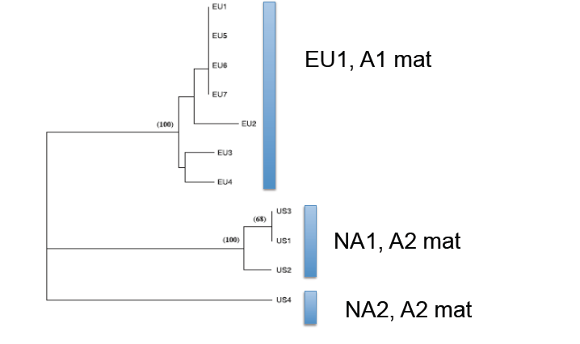
Species has ancient lineages evolved in isolation (e.g. P. ramorum)
Genetic divergence
Phenotypic diversity:
Mating type
Growth rate
Pathogenicity
Host-specificity

Slide 6
Mating type
Loci under selection may be linked to mating type
Recombination will accelerate evolutionary rate (see Prediction section)
Sexual structures may confer advantage

Slide 7
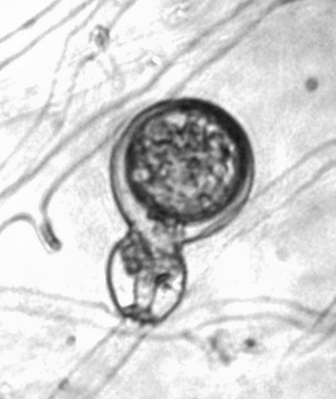
Sexual structures may confer advantage
Sexually produced oospores allow for
survival in harsher climatic conditions
Homothallic species such as P. nemorosa and P. pseudosyringae are less virulent than P. ramorum but are also introduced in California (Linzer et al. 2008) and have a much broader distribution, why?
History (introduced earlier ?)
Because homothallic they produce oospores

Slide 8
Growth rate…
NA2 NA1
15
10
Radial growth in vitro
5
NA2 > NA1
0
NA1
NA2
NA1
NA2
NA1
NA2
12C
20C
24C

Slide 9
Interaction of lineage, host, and temperature.
350
80
3.5
20 C
300
70
3.0
250
60
2.5
200
50
2.0
40
(Mean(Lesion area cm2)
Mean(Lesion area mm2)
Mean(Lesion area mm2)
150
30
1.5
100
20
1.0
50
10
0.5
0
NA1
NA2
NA1
NA2
NA1
NA2
0
NA1
NA2
NA1
NA2
NA1
NA2
0.0
NA1
NA2
12
20
24
12
20
24
Camellia setsugeken
NA1 > NA2 , P < 0.0001
Rhododendron sp.
NA1 < NA2, P = 0.05
Umbellularia californica
NA1 < NA2 , P = 0.008
At 20 C, Rhododendron and Umbellularia effective hosts more for NA2 and NA1,
but Camellia, only for NA1
At 12 C, Rhododendron not an effective host, Umbellularia yes, that may explain
why P. ramorum limited spread in Northern Europe on Rhododendron

Slide 10
Specific genotypes associated with specific phenotypes
Some specific genotypes carry specific phenotypes
Phytopthora cinnamomi: different genotypes associated with different commodities and transported around the world: are genotypes equivalent?

Slide 11
1- Huge oak mortality in Colima, Mexico (Tainter et al. 2000) 2- New problems in CA Christmas tree nurseries (2002). 3- Quasi-extinction of rare manzanita in CA (Swiecki et al. 2004)
All three recently reported (10 years)
All three associated with P. cinnamomi
All three associated with the same novel genotype of the pathogen

Slide 12
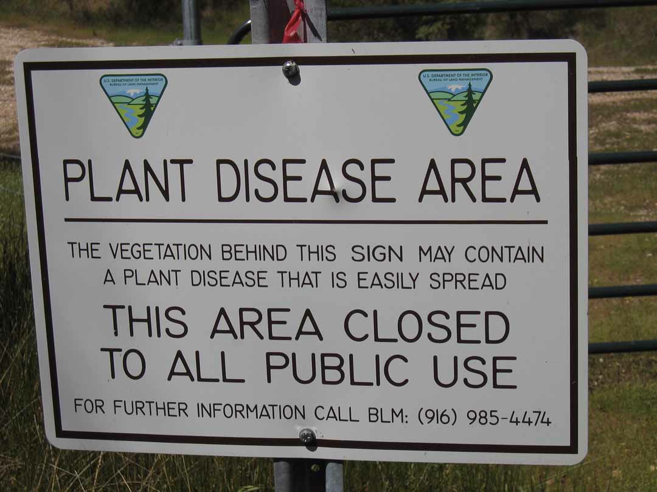
Widespread mortality of Ione manzanita caused by P. cinnamomi

Slide 13
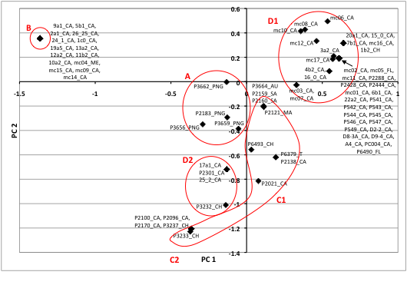
Newly discovered single genotype now found in different locations, on multiple hosts, and represents a new threat

Slide 14
Introduced population only partially represents phenotypes and genotypes of source
One or more mating types?
How low is genetic diversity and how is genetic diversity generated? (Pop size, Different substrates)
Does low genetic diversity correspond to low phenotypic variability (Plasticity)
If Host genotype x Pathogen genotype interaction exists, genotypic diversity will affect breeding programs

Slide 15
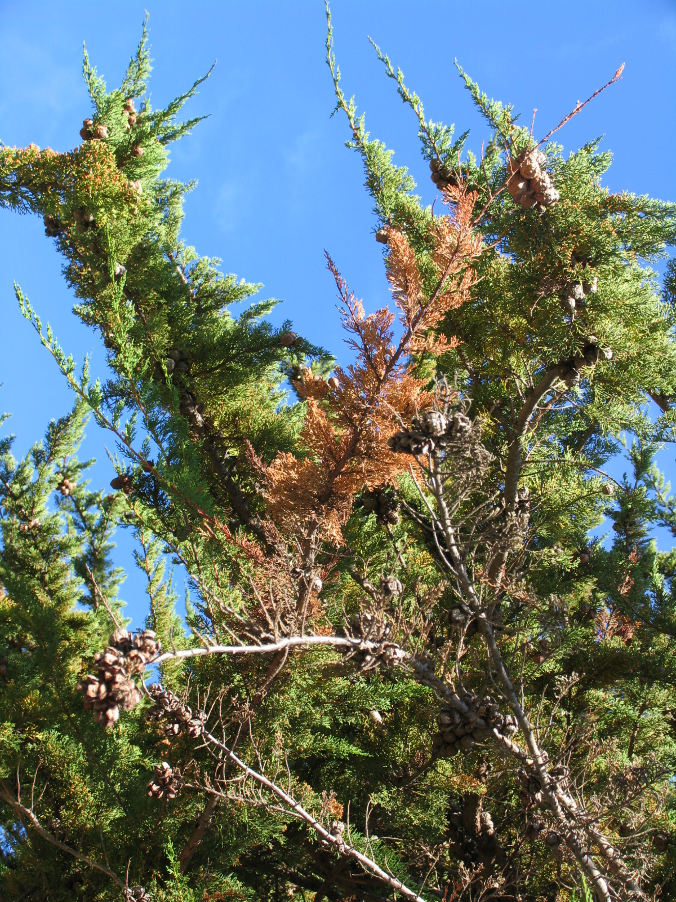
Cypress canker caused by Seiridium cardinale
Mortality in Mediterranean up to 95% locally
Introduced in 1930s from California, when Monterey Cypress became popular
No sex and little genetic variability (one B-tub lineage) observed in Mediterranean
Two B-tub lineages and sex in California where pops are in equilibrium
Very large pop sizes and diversity generated by mitotic recombination/mutation in Mediterranean

Slide 16
Significant bottleneck in Med
B-tub A
(CAL and MED)
B-tub B
(CAL and South H.)

Slide 17
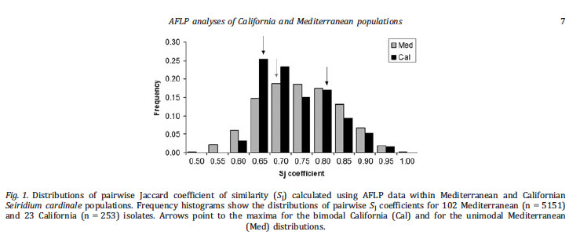
Pairwise Si (AFLPs) and Linkage Disequilibrium (SSRs) indicate lack of sex in Med and its presence in Cal

Slide 18
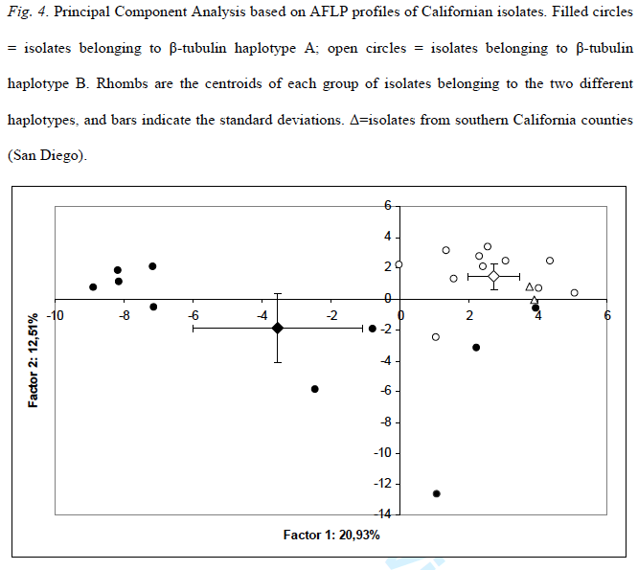
Does B-tub lineage mean more than diversity at one locus?
B-tub B
B-tub A

Slide 19
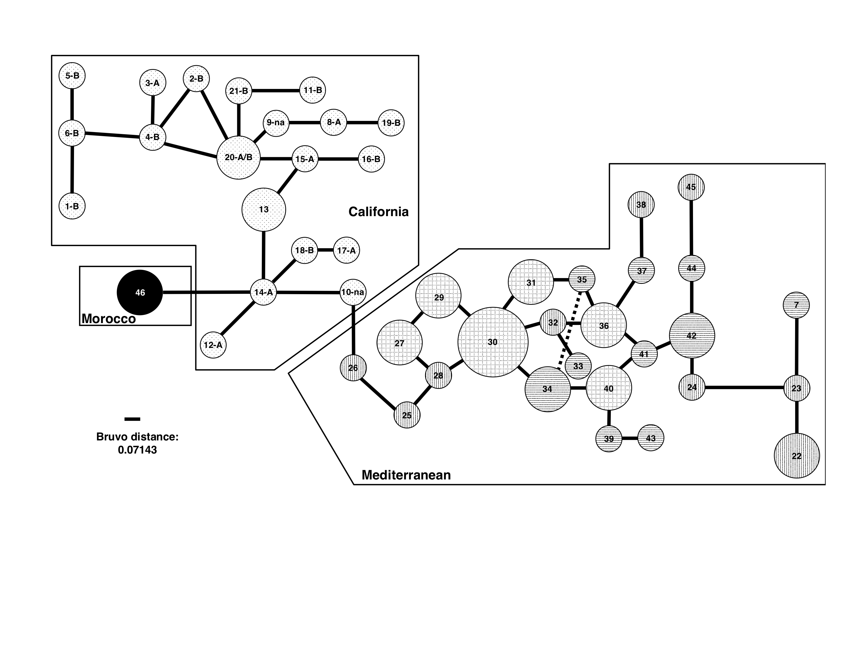
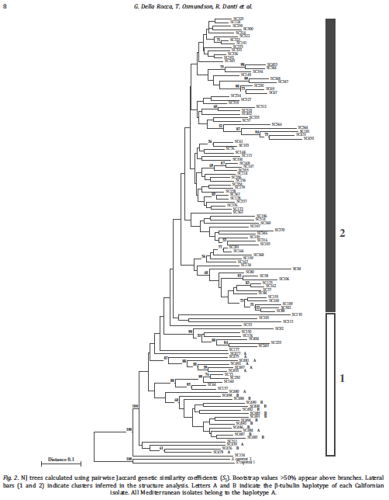
CAL has sex (Ia) and higher genetic diversity (Gd 0.98 vs. 0.88), is likely source, but MED pop has now differentiated in two, offering a wonderful system for trait-based hypotheses testing

Slide 20
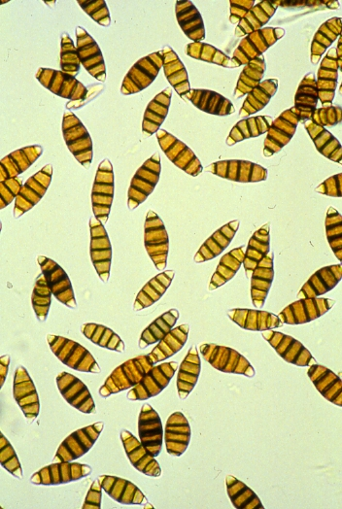
No selection towards increased growth and canker size, especially in
limiting conditions (High and Low T)
- Selection towards smaller spores, even if trade off is decrease in
germination
Plasticity increases with invasion and then decreases as species adapts, independent
of genetic diversity
Some CA genotypes much more virulent on Italian cypress:
future of resistance breeding in question

Slide 21
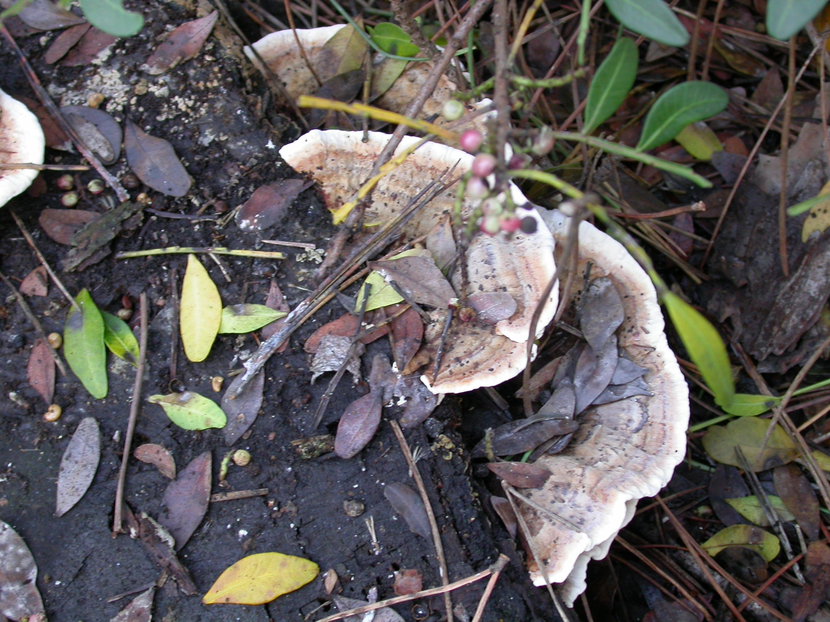
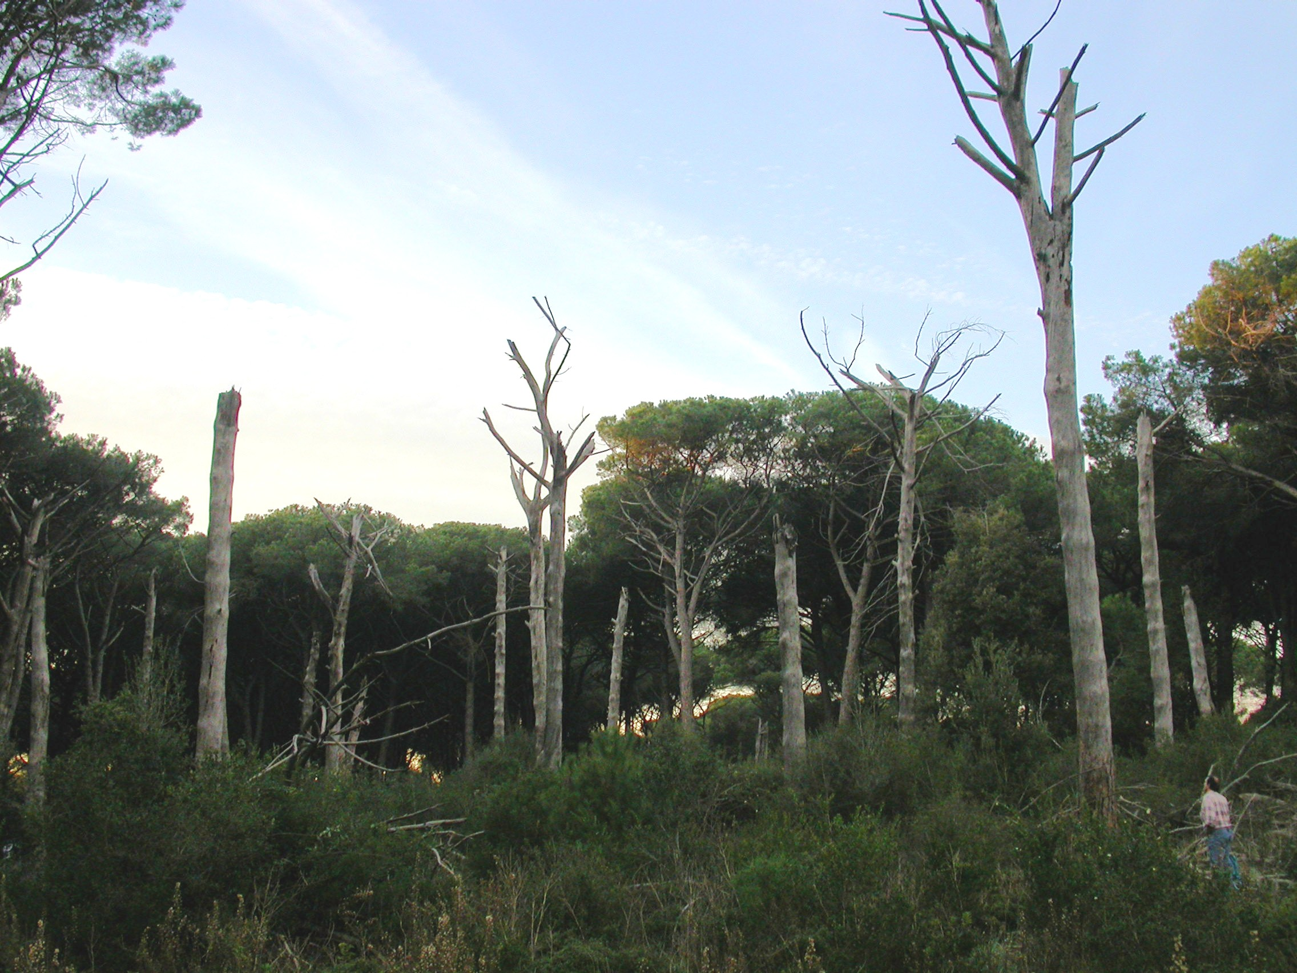
Introduction by US troops in 1945 of H. irregulare from North America into Italy shows ecology and transmission may be more important than pathogenicity
North American Heterobasidion
irregulare and pine mortality associated with it

Slide 22
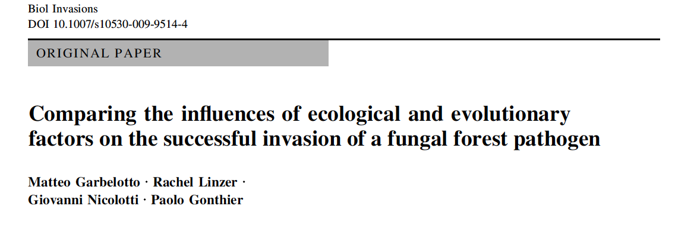
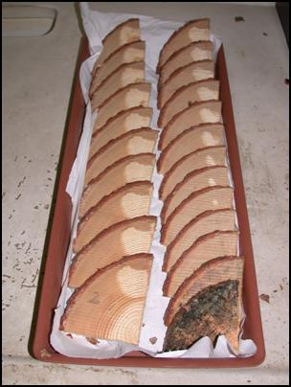
Pathogenicity same between native and exotic spp.
Sporulation much more significant in exotic sp.
Saprobic ability higher in exotic species and correlated to fruiting body production. True when co-inoculated
In Press: Biol. Invasions

Slide 23
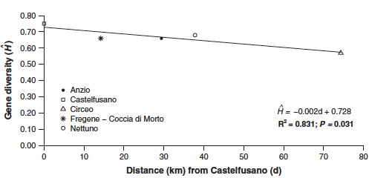
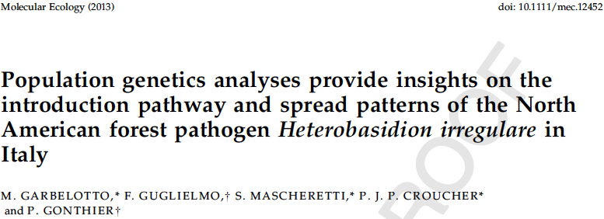
Due to bottleneck, genetic diversity of invasive H. irregulare alleles progressively decreases as distance from introduction point increases, how does invasive sp. maintain viable genome if introduction is single ?

Slide 24
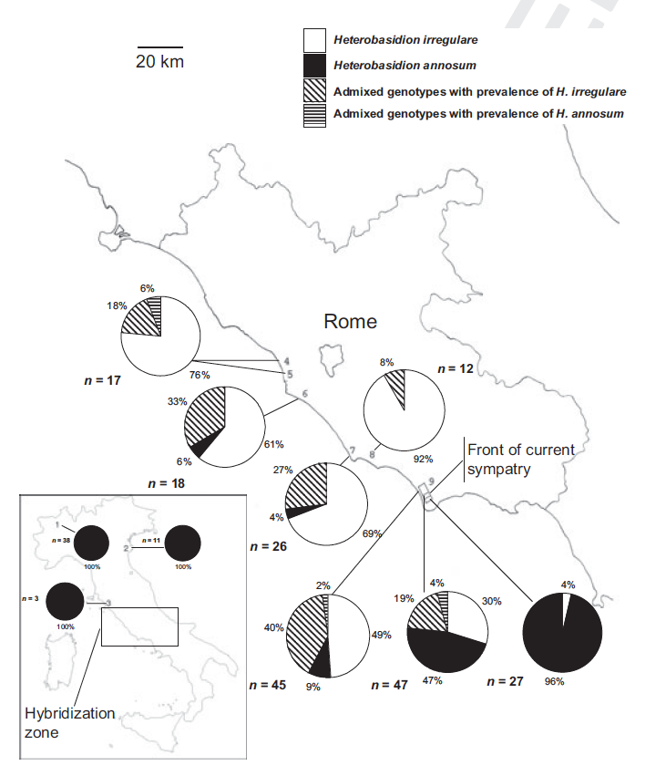
25% of genotypes had admixed genomes
All loci potentially introgressed in first phase of sympatry
About 20% of cases were recombinant novel alleles absent in either species: evolutionary acceleration

Slide 25
Roles of gene introgression
New combinations of alleles, possibly although rarely leading to phenotypes with ++ traits, that is super-strains. These are often capable to do “stuff” that either parents were incapable of. At times this may result in speciation with “hybrid” species limited to limiting environments
Generation of new alleles, rapid evolution
Massive genetic changes in invasive population, because invasive pop is in exponential growth, so any allele that is introgressed, rides the wave of this growth (allele surfing)
Changes in native species are limited but focused on alleles that are adaptive, so alleles that will make a difference will be selectively introgressed. End effect can be a measurable and inheritable change in the native pop

Slide 26
Pathogenicity insufficient to explain invasions: need to focus on ecology of transmission of invasive sp. in new niche or competitive ability in same niche as natives. Saprobic ability and sporulation may be driving invasion
Pop genetics and genomics need to be linked to functional traits such as spore size, host specificity, temp optima. Ancient lineages or novel genotypes may possess groups of traits that confer a phenotype ,even if recombination occurs. Multiple introductions from different sources need to be avoided, nomenclature issue
We should be careful in saying that low genetic variability corresponds to low phenotypic variability. Plasticity may play a huge role in invasion. Models needed to study how plasticity drives traits important for invasions
Hybridization will complicate predictions and accelerate adaptation (basic unpredictable nature of outcome when hybridization is ongoing)

Slide 27
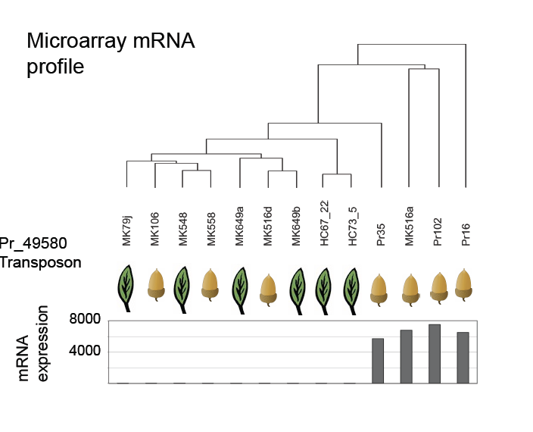
New evidence from P. ramorum suggests individual genotypes with a different history will behave differently permanently (nwt=not wild type, slow growth and early senescence).
13000 genes
Tn = upregulated
CRN= downregulated
Nwt only if from oaks
wt
nwt

Slide 28
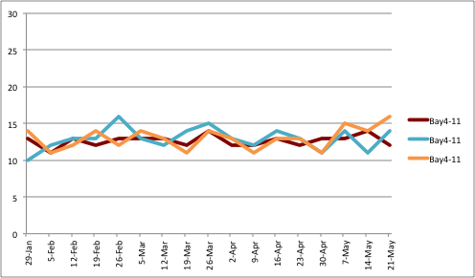
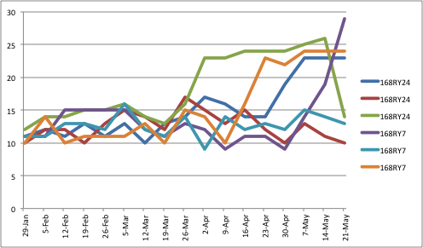
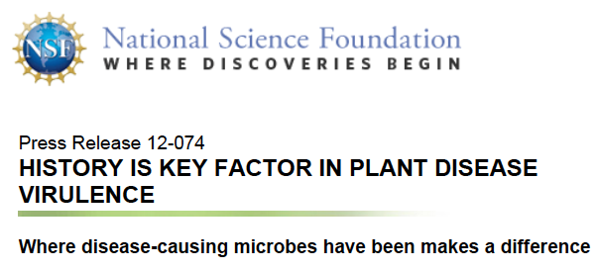
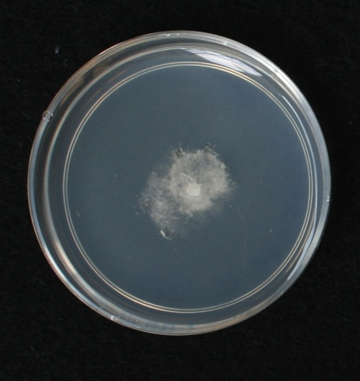
Time since re isolation of bay isolate
Inoc. on bay
We have been able to generate
nwt using same isolate and dual
inoculations
growth rate mm/week
Inoc. on oak
nwt
Notes:
1/15/2012 Inoculated, Racetubes_ND.xlsx

