Slide 1
“Emergent diseases”:
1: host
New host-pathogen combinations:
exotic hosts
hosts planted off site

Slide 2
Cypress canker by Seiridium cardinale
Pathogen was first described in California in the 20s. Later it was described in Italy where it started a serous epidemic of Italian cypress
Belief that pathogen is native to California: is that true and why is it then causing a significant disease in our state?

Slide 3
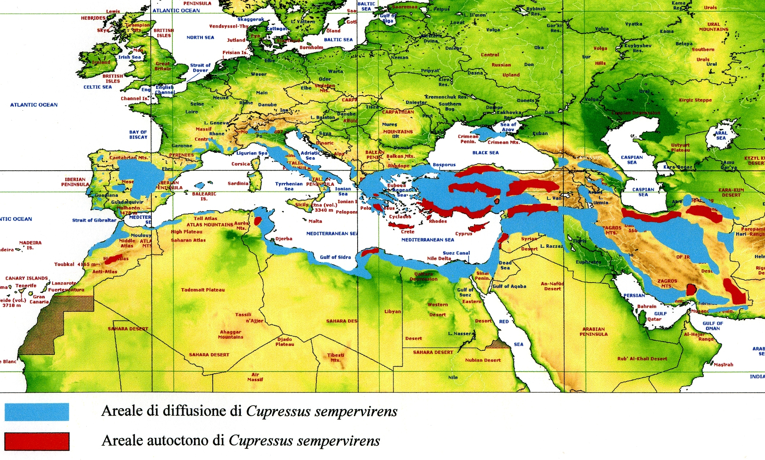
Natural geographic distribution of Cupressus sempervirens (red).
Anthropic distribution of Cupressus sempervirens (blue).

Slide 4
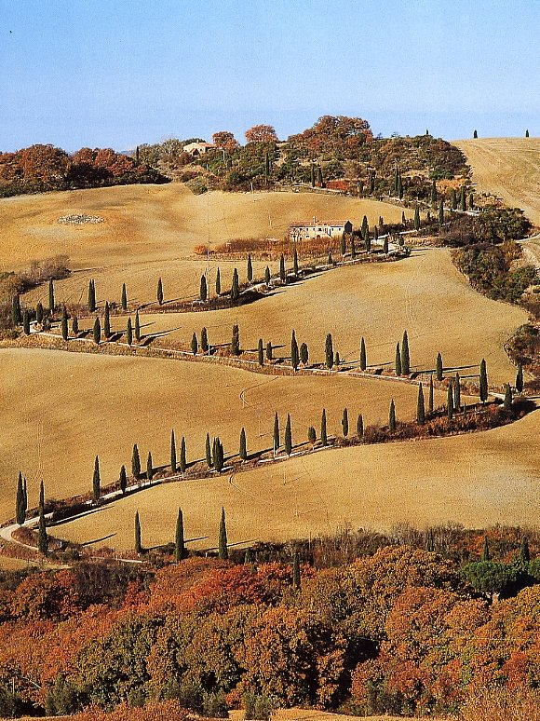
THE CYPRESS IN ITALY TODAY
The Cypress is planted along country roads...

Slide 5
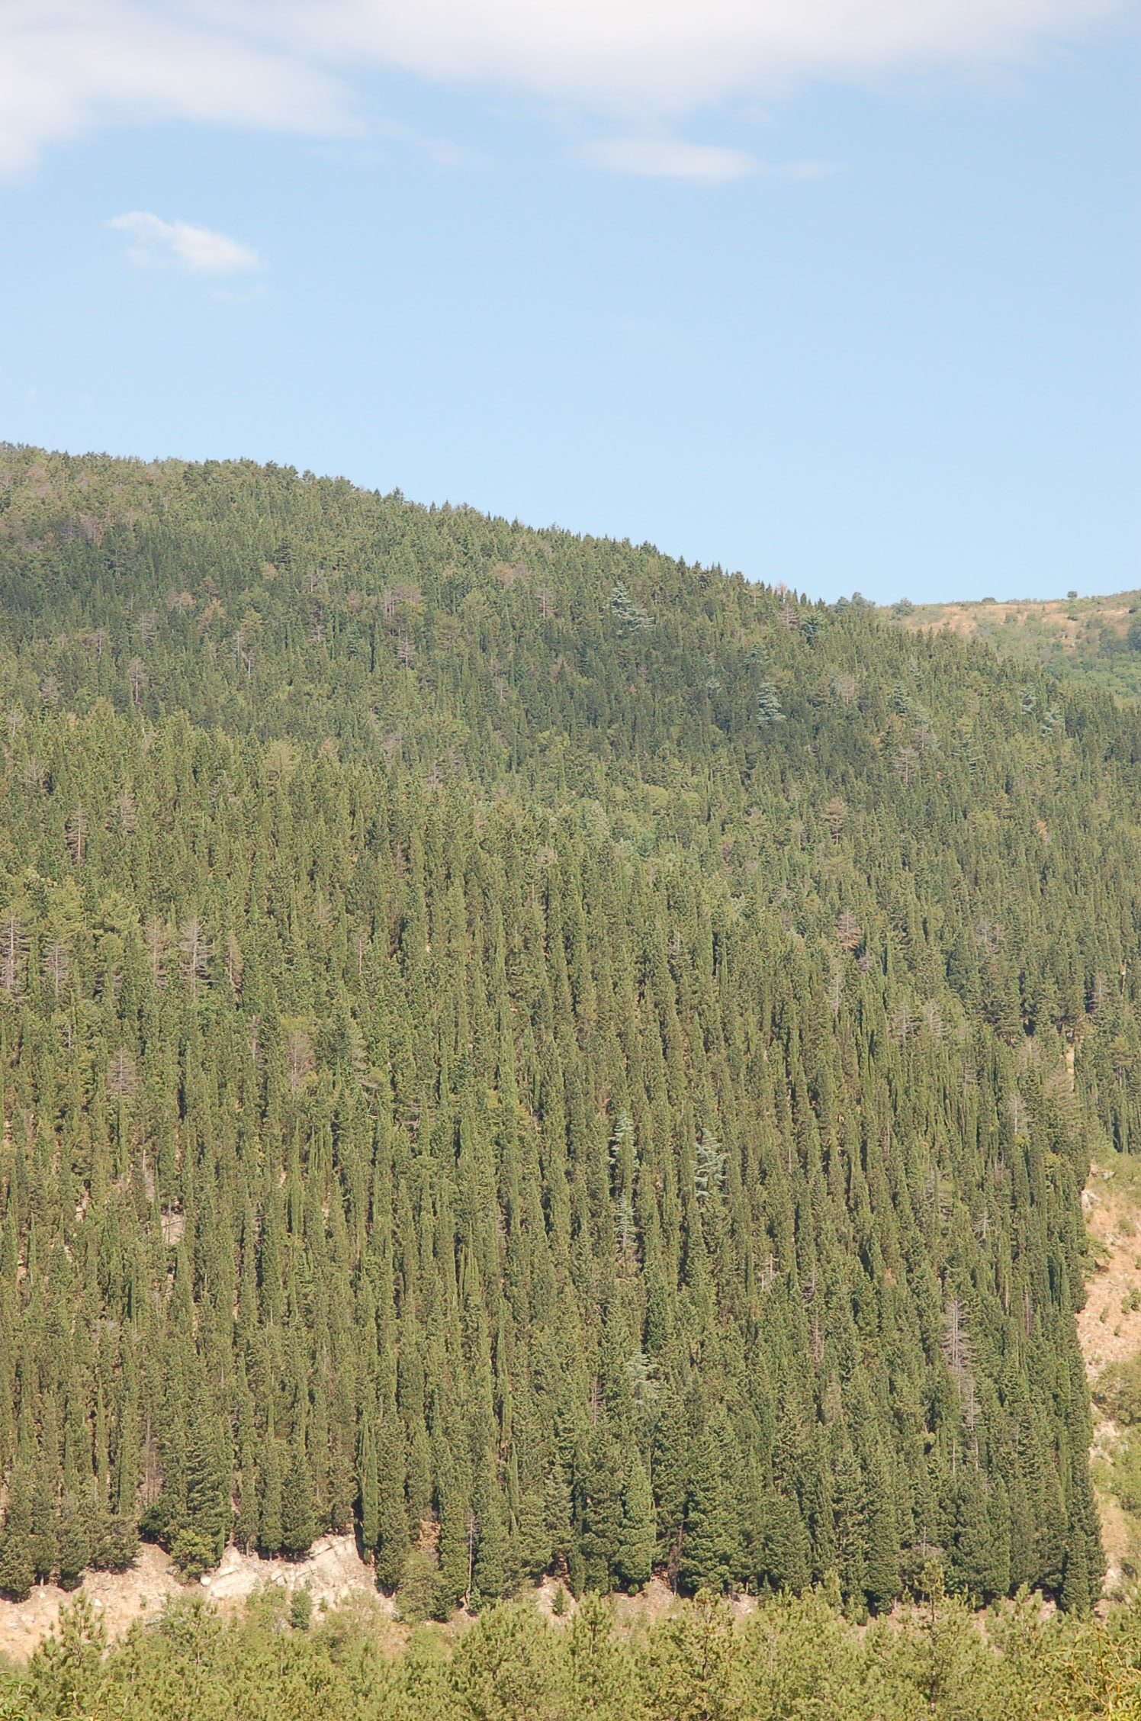
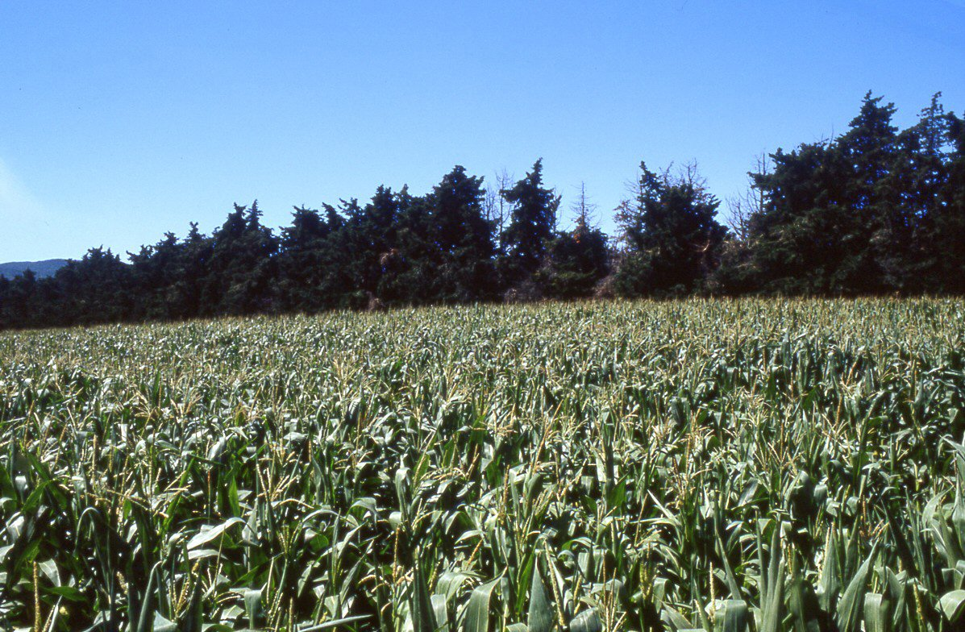
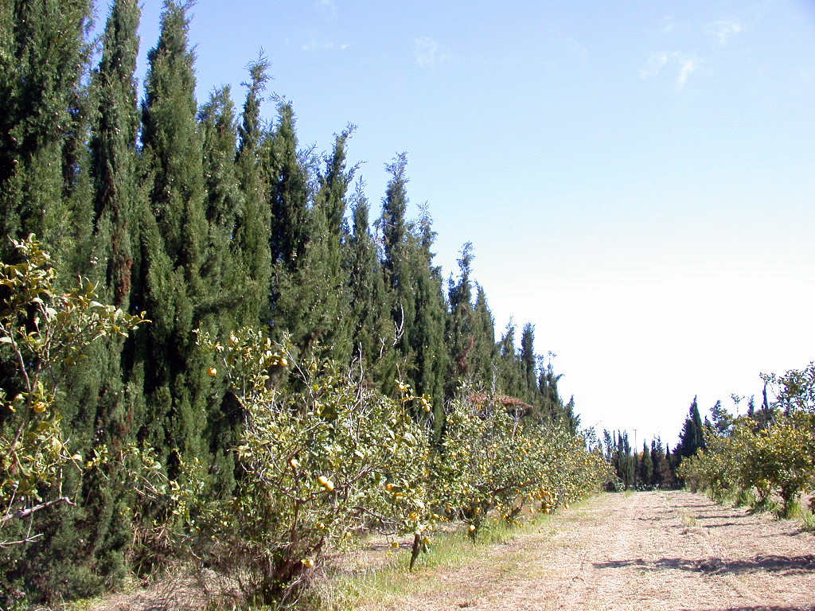
THE CYPRESS IN ITALY TODAY
The cypress in the rural life, as windbreak and tree for forestry.

Slide 6
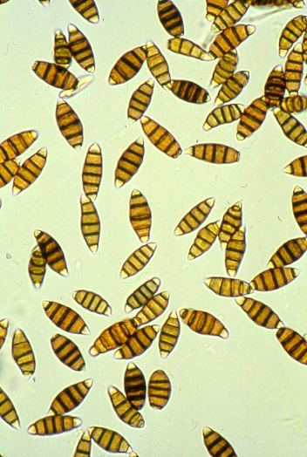
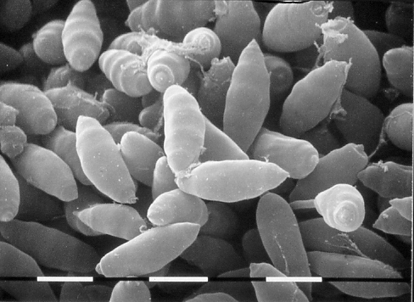
Conidia of Seiridium cardinale observed by optical microscope and SEM

Slide 7
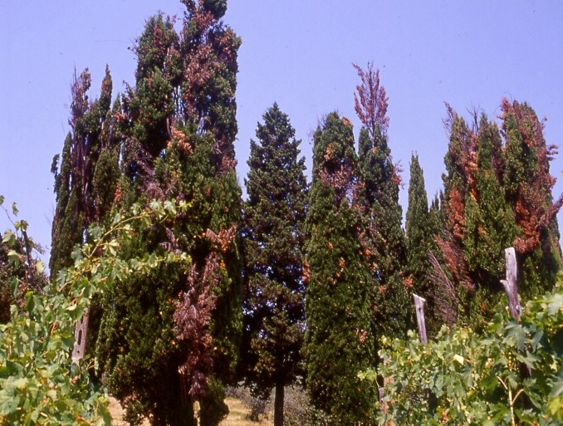
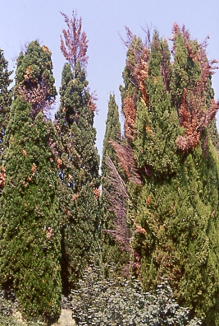
In some places of Tuscany the situation of Cypresses is dramatic…

Slide 8
Use of molecular genetics to resolve issue of origin of pathogen
Used a technique similar to the one used in human forensics
Native populations should comprise many different individuals genetically
Introduced populations should be genetically simpler because of bottleneck related to introduction events

Slide 9
RESULTS: CA vs. Europe
California population diverse genetically
California population has a genetic structure in agreement with sexual reproduction
European population reproducing clonally
European population show less diversity

Slide 10
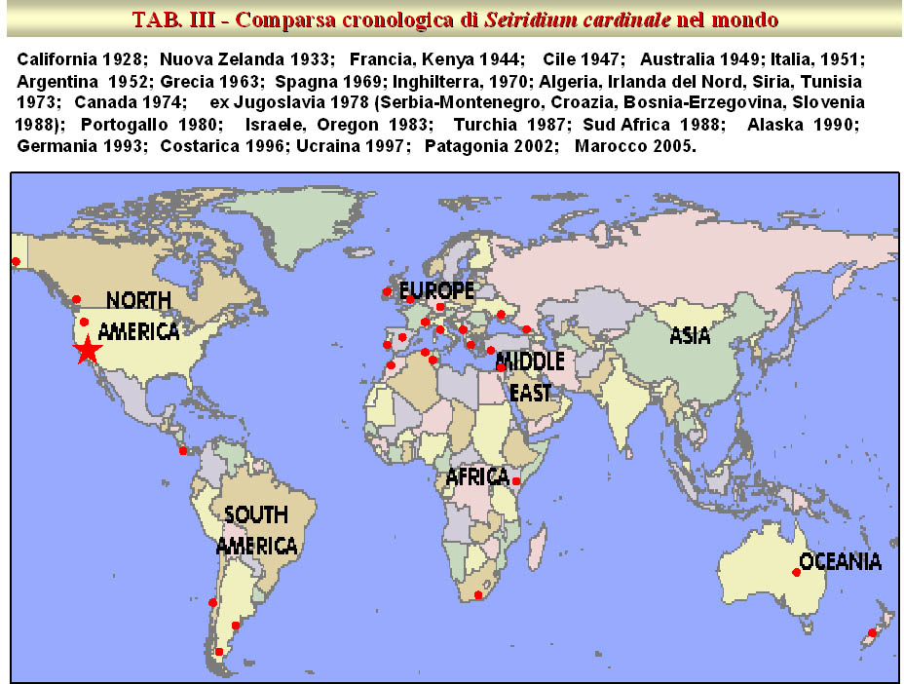
Spread of the disease.
Seiridium cardinale, a pandemic in progress…

Slide 11
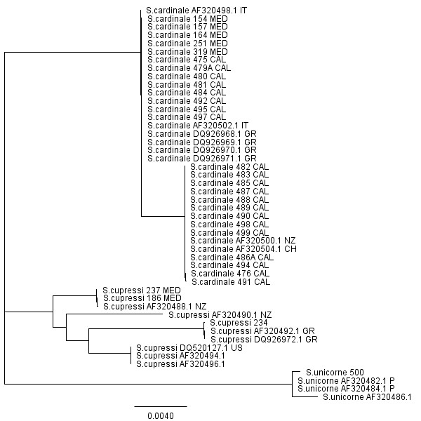
Seiridium NJ tree
99.3
IT=Italy
GR=Greece
NZ=New Zealand
US=USA
CH=Chile
73.9
61.5
70.2
65.5
60.8
66.3
98.6
66.1
66.5
66.5
100

Slide 12
5-B
3-A
2-B
21-B
11-B
6-B
9-na
8-A
19-B
4-B
20-A/B
15-A
16-B
45
1-B
18-B
17-A
13
38
35
37
44
14-A
10-na
31
46
29
7
32
36
42
12-A
30
27
30
41
26
33
28
24
23
34
40
25
Node scaling
Small: singleton MGs
Medium: 2-5 indivs with same MG
Large: 30 indivs with same MG
Dark blue = Italy only
Mid blue = Italy and other MED country
Light blue = Only MED country, excluding Italy
Black = Morocco
Red = California
A = clade A in NJ tree
B = clade B in NJ tree
na = no sequence available
39
43
22
Seiridium cardinale – Minimum spanning network

Slide 13
Results of coalescent analysis using MIGRATE-N
Populations
1 = Greece
2 = Italy
3 = Cal
Theta1 = 0.08826
Theta2 = 0.09727
Theta3 = 0.09735
M2-->1 = 347.450
M3-->1 = 6.392
M1-->2 = 23.160
M3-->2 = 6.886
M1-->3 = 5.142
M2-->3 = 6.180

Slide 14
It appears that a single introduction occurred in Europe and a single introduction occurred in Morocco.
Presence of identical genotypes at hundreds of miles both in CA and in the Mediterranean is best evidence that humans are moving it around
Strong unidirectional migration from Italy to Greece, suggesting Italy was a stepping stone
Was it moved during the war? In Italian nurseries symptoms shoed up before the war… guess when? When Monterey cypress started being imported into Italy from California

Slide 15
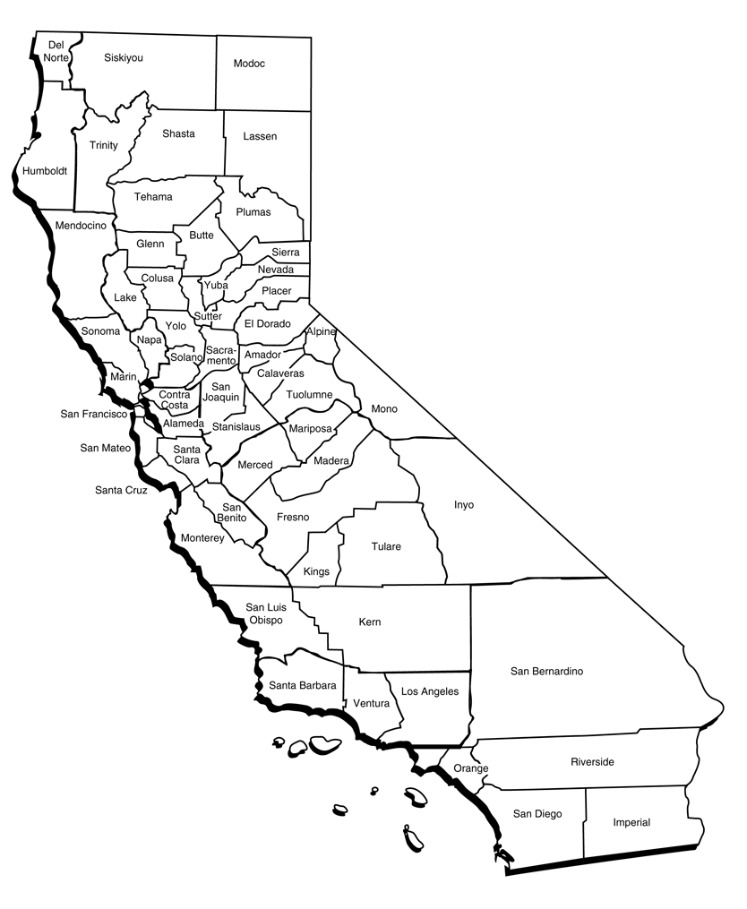
Fig. 1.
Distribution of Seiridium cardinale according to Wagener in 1939

Slide 16
Fig. 5.
Presence of pathogen confirmed in 2008
Symptoms observed without intense surveying in 2008

Slide 17
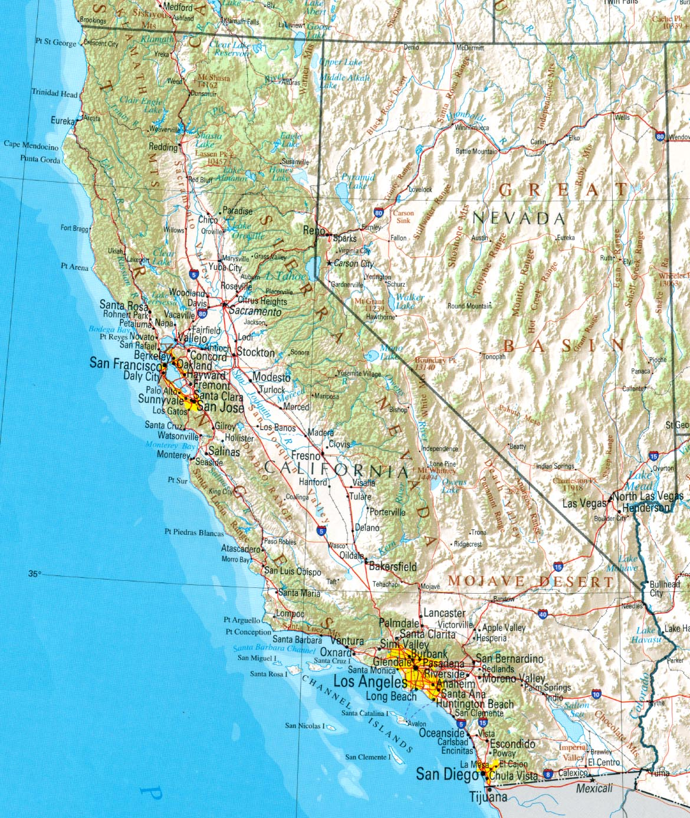
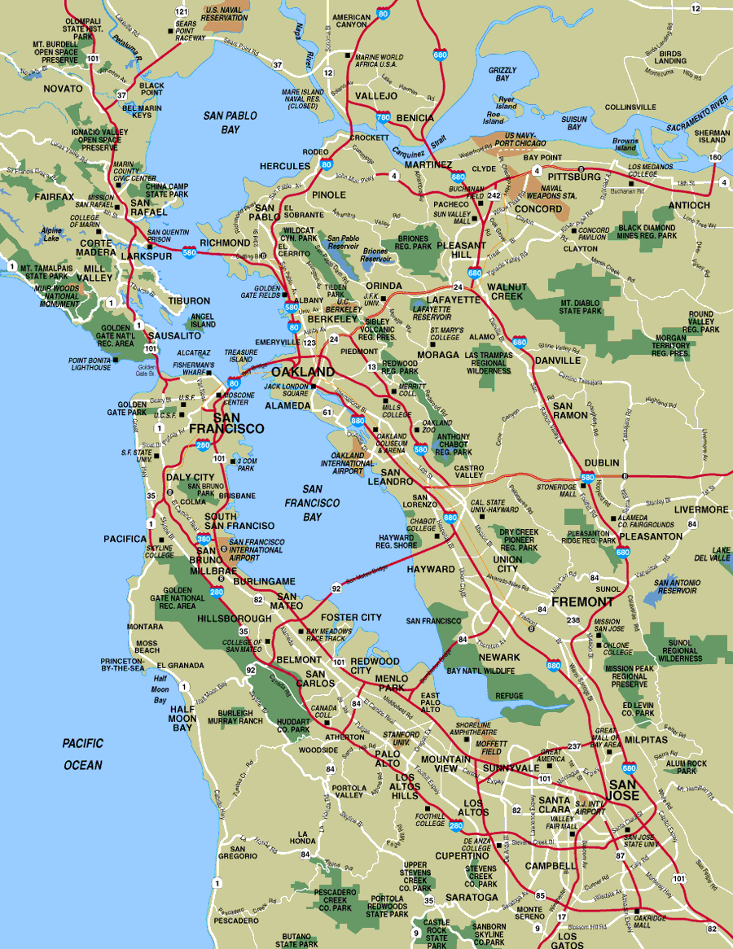
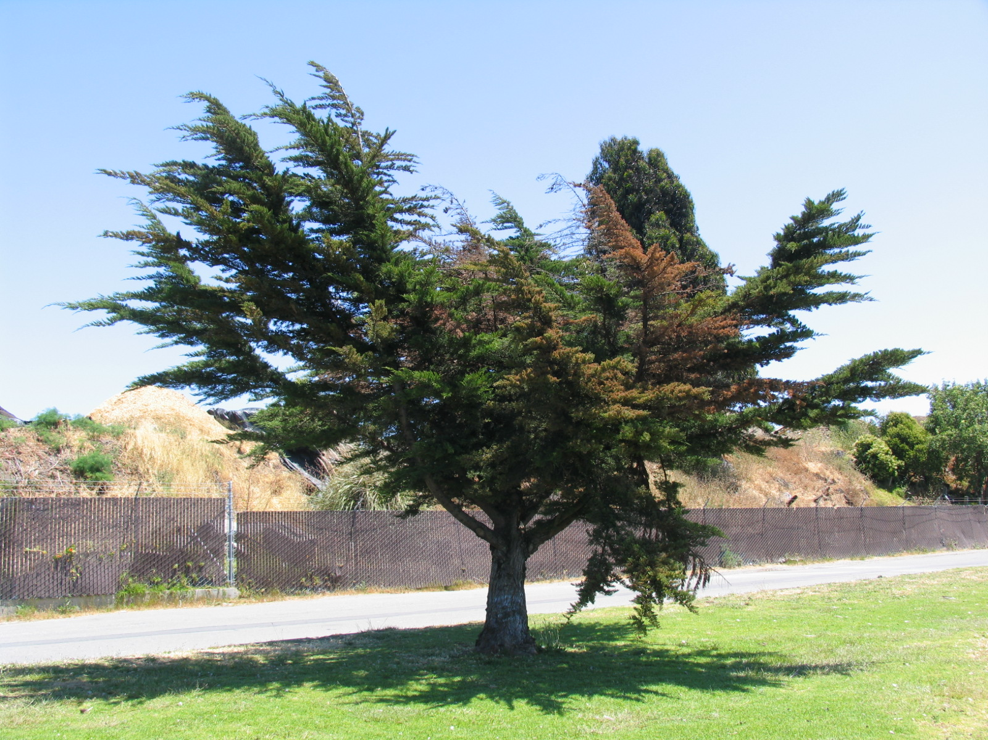
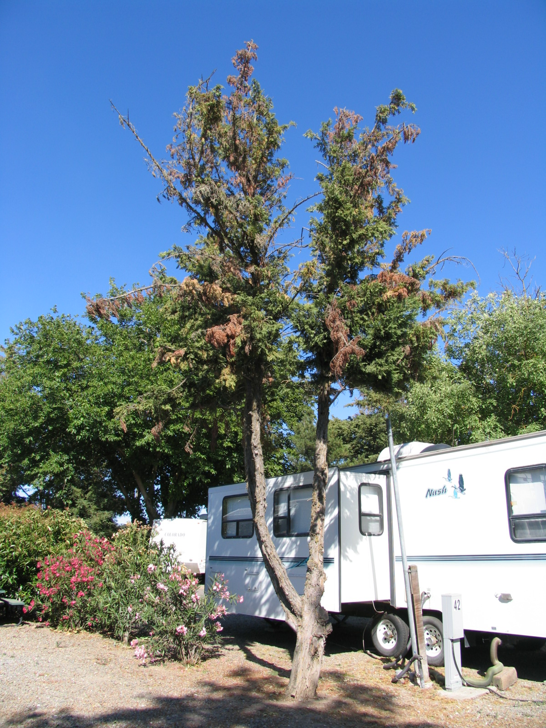
Fig. 2.
Distrinution of pathogen where intensively surveyed
Fig. 3
Symptoms caused by Seiridium cardinale on Cupressus macrocarpa (above) and xCupressocyparis leylandii (right)

Slide 18
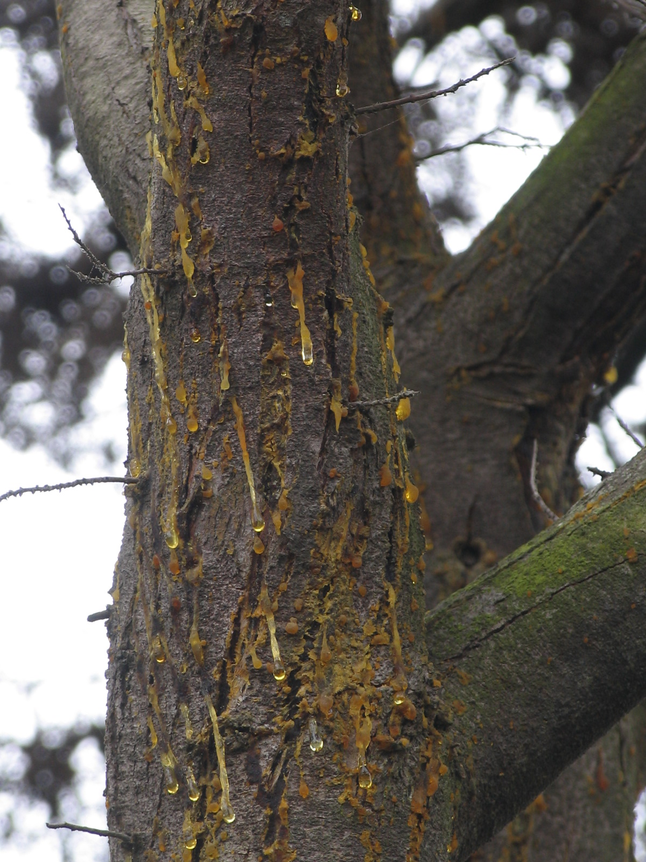
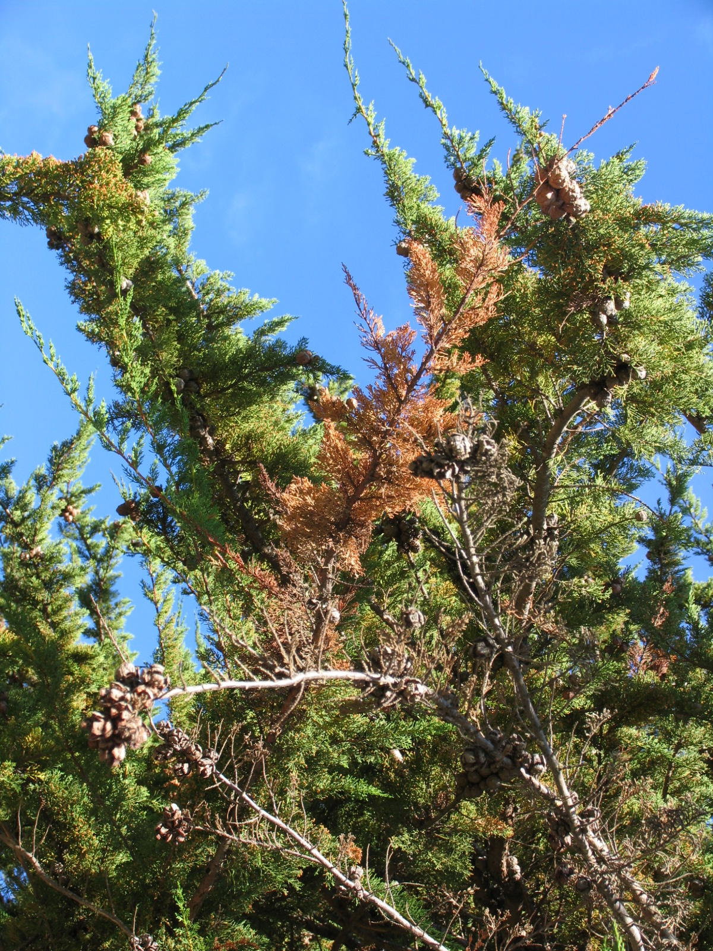
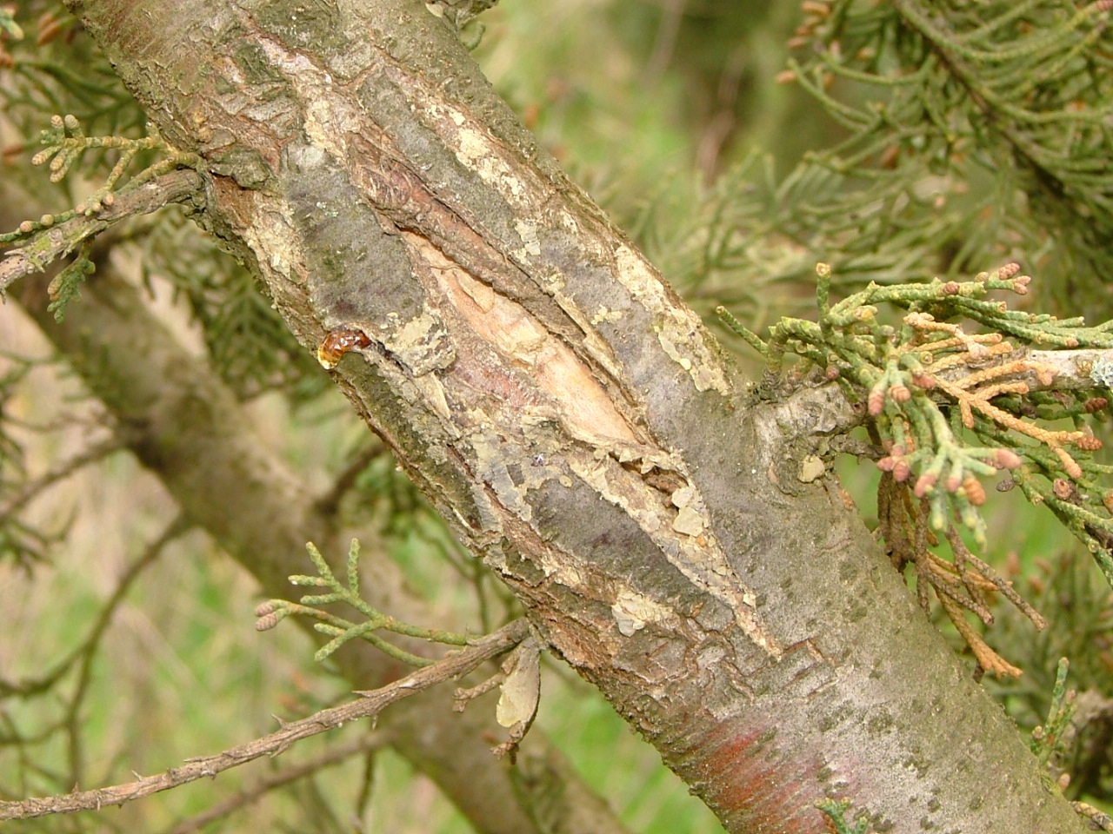
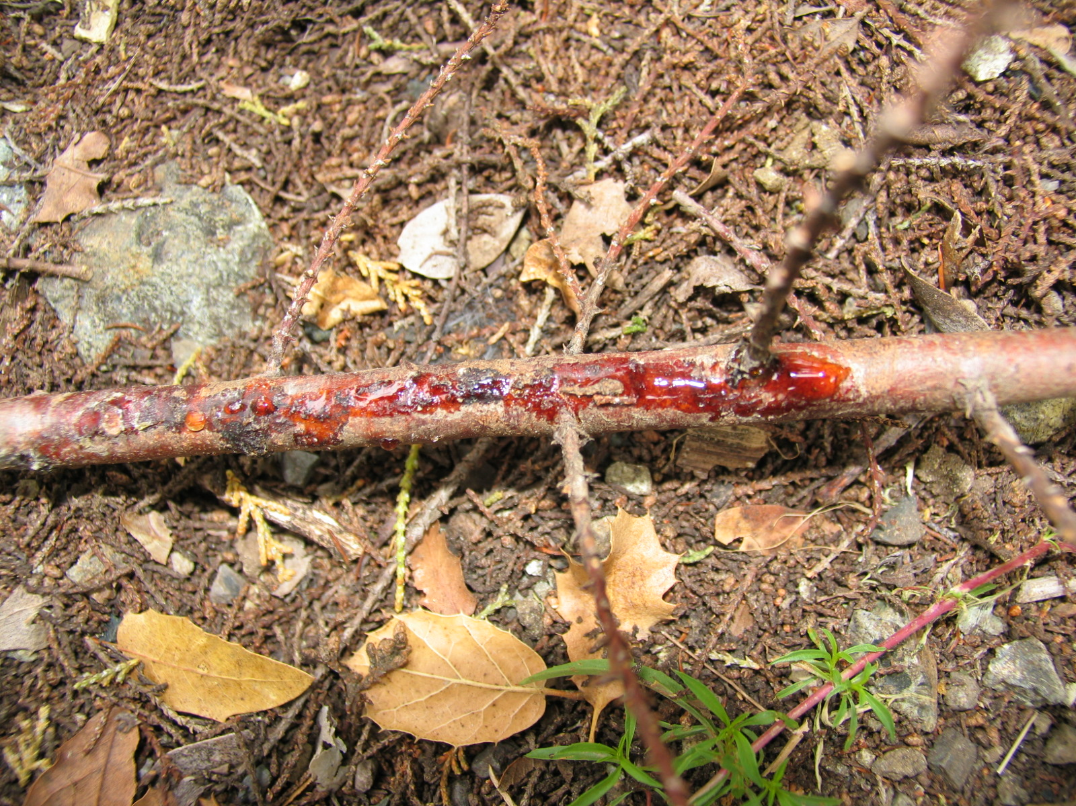
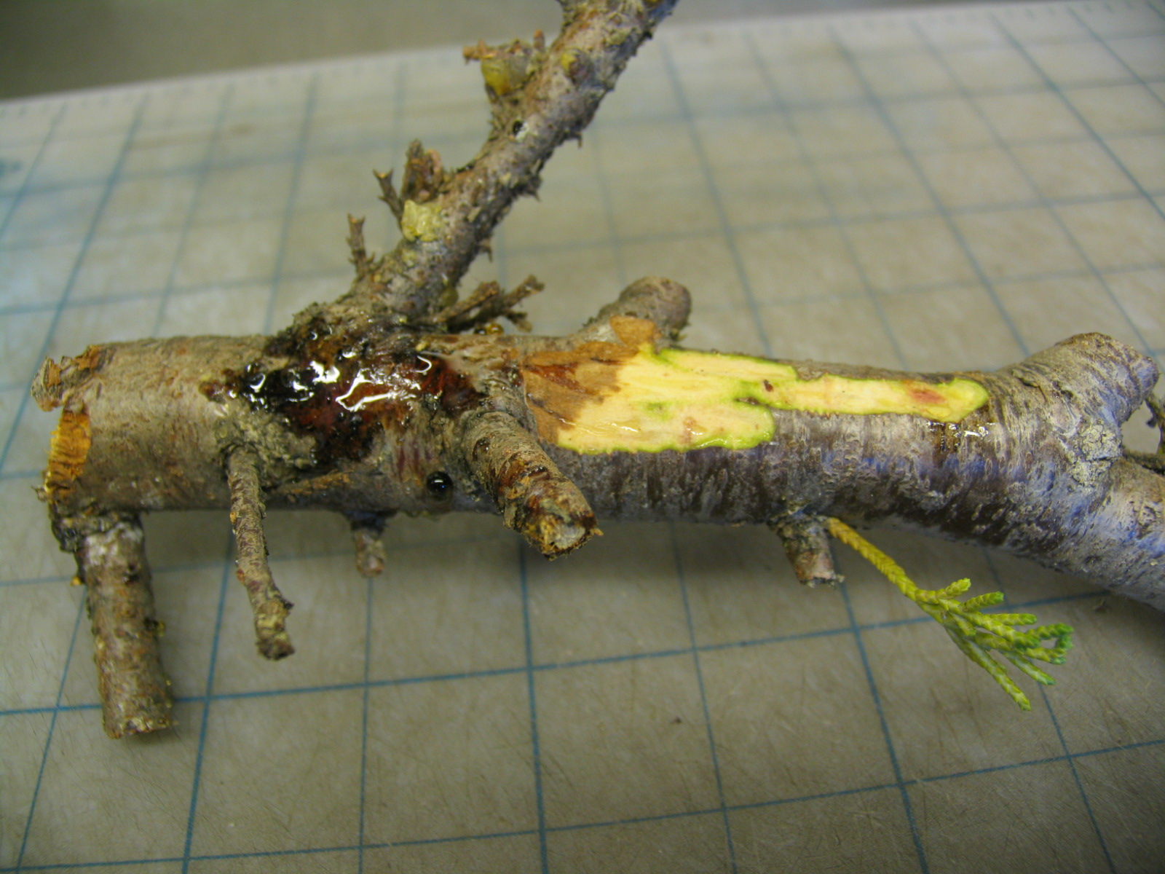
Fig. 4.
Close-ups of symptoms leading to mortality

Slide 19
Why a disease in CA?
If pathogen is native to California, why is it causing such a serious disease?
We observed that disease incidence is variable with:
  cypress species,
  location,
  abundance of planted cypresses

Slide 20
Range of susceptibility
Leyland cypress, Italian, monterey are listed as most susceptible
Arizona and McKnob are regarded as more resistant

Slide 21
Range of susceptibility
90% of Leyland are heavily infected
10% of monterey
LEYLAND CYPRESS IS AN ORNAMENTAL CROSS, NOT NATIVE

Slide 22
Range of susceptibility
Monterey is more susceptible in inland areas where it is NOT NATIVE: we believe that colder temperatures cause more wounds that lead to infection
More disease where there are more cypresses: classical DENSITY DEPENDANCE effect

Slide 23
CONCLUSIONS
Cypress canker is a serious disease in Europe because pathogen was introduced
Cypress canker is a serious disease in California because hosts were introduced either through planting off range (Monterey cypress) or because host is artificial creation (Leyland cypress); extinction of LEYLAND is most likely

Slide 24
Spread of the disease.
Seiridium cardinale, a pandemic in progress…

Slide 25
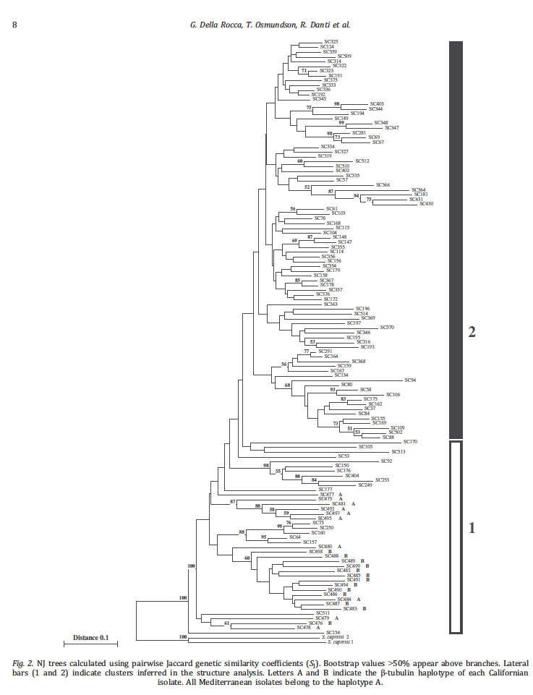
AFLP analysis identified 2 clusters in Europe, one that includes also California isolates, and one that does not, meaning it is exclusively European

Slide 26
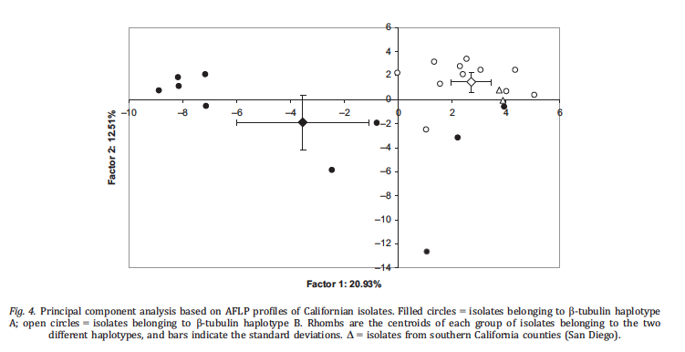
Beta tubulin seems to be linked to a significant evolutionary trait: when isolates were analyzed using 150 markers,the 2 b tubulin sequences grouped in 2 distinct areas

Slide 27
We now feel comfortable stating that
California population is the source
Mediterranean cluster 1 is the founder population
Mediterranean cluster 2 is an adaptation in the Mediterranean
We can ask interesting questions on why S, cardinale has been so successful as an invasive.
Size CA>Cluster1>Cluster2 TRANSMISSION
Plasticity CA<Cluster1>cluster 2 ADAPTATION
Virulence CA>CLuster1 and 2 CHANCE (1 isolate only was moved)

Slide 28
However, one of the best option overseas is the use of resistant cultivars
Seiridum cardinale is listed as present in Europe and in California so no regulations apply, however virulence of California isolates is greater and resistant cypresses to the strains now present in the Mediterrenean, may be susceptible to new strains, this nullifying 30 years of research necessary to develop such cultivars

Slide 29
“Emergent diseases”:
2: environmental changes
Forestry and intensive forest use:
timber production
tree felling and creation of stumps
fire exclusion and increase in density
oversimplified forest composition
changes in forest composition
changes in forest structure

Slide 30
Heterobasidion root disease
Heterobasidion (a bracket or shelf mushroom) infects trees through wounds and stumps, then it spreads through the roots to neighboring trees
With tree felling,stumps and wounds are created, suddenly exponentially increasing infection levels

Slide 31
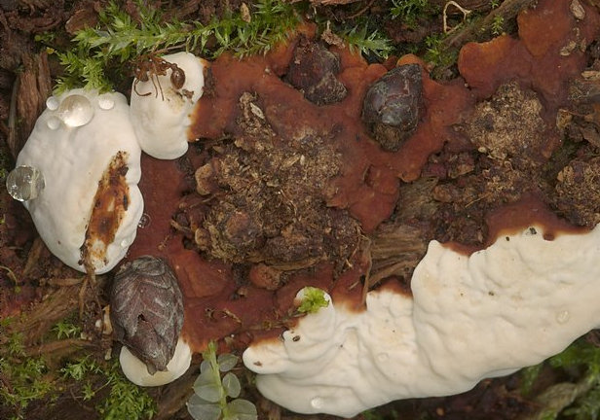
Heterobasidion shelf fruit-body

Slide 32
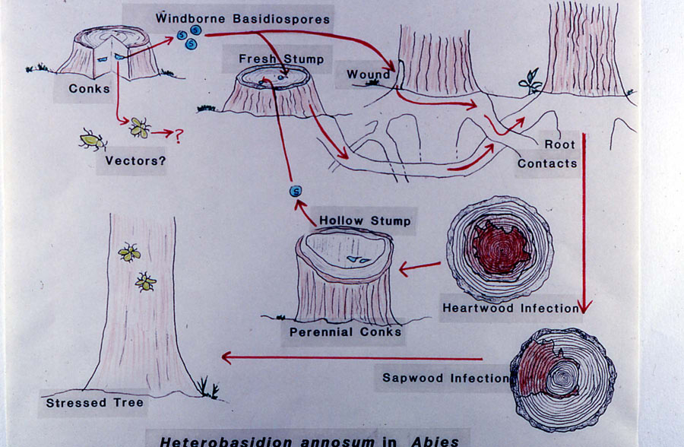

Slide 34
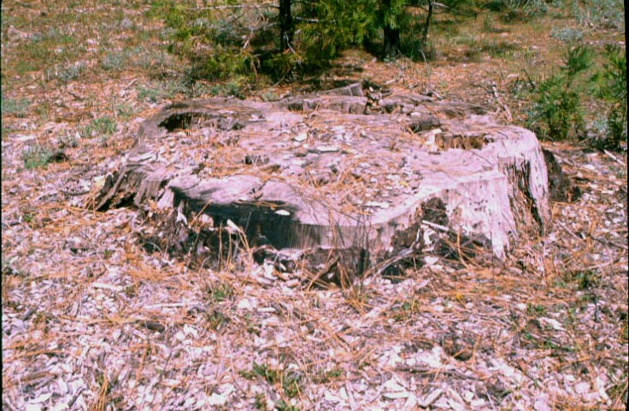
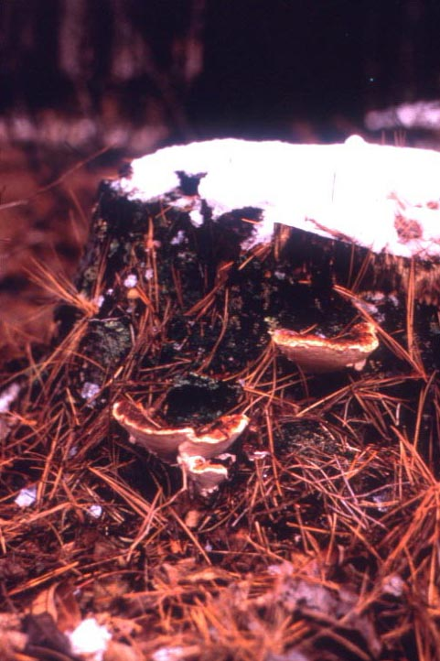
Stump creation and subsequent infection
by Heterobasidion annosum

Slide 35
Use of molecular genetics:
Differentiate Heterobasidion on fir/sequoias (H. occidentale) from that on pine/junipers (H.irregulare)
Show that airborne meiospores are responsible for most infection of Heterobasidion
Show that in pines most infections start on stumps and that in true firs most infections on wounds

Slide 36
True firs
Pines
Each spore is a genetically different individual:
In pines we found the same genetic individual in stumps and
adjacent trees indicating direct contagion between the two
In true firs and true firs/sequoias we find same individual
in adjacent standing trees indicating infection not linked
to stumps but to wounds on standing trees

Slide 37
CONCLUSIONS:
Logging activities increase Heterobasidion infection because of stump creation in pines and because of wounding in true firs sequoias
We have shown that in pine stumps H. irregulare and H. occidentale can both be present and create a new hybrid entity
We have shown that in the past these hybridization events have lead to sharing of genes among these two species (Horizontal gene transfers)

Slide 38
Once Heterobasidion is established at high frequency
Significant loss in timber value
Dangerous situations (campsites)
Mortality of valuable species such as sequoia
With insects and pollution it makes trees more susceptible to mortality
Can make fires more destructive

Slide 39
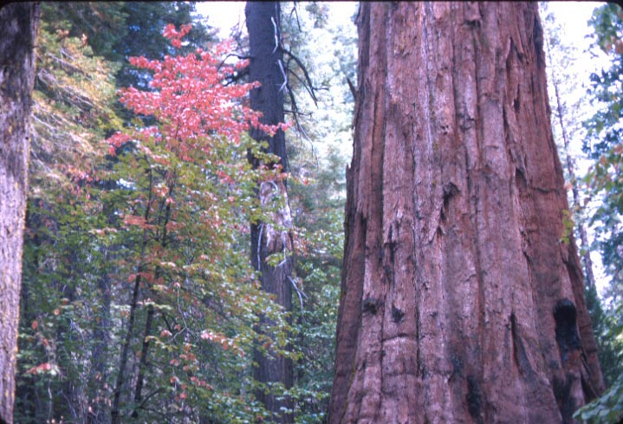
Sequoia National Park

Slide 40
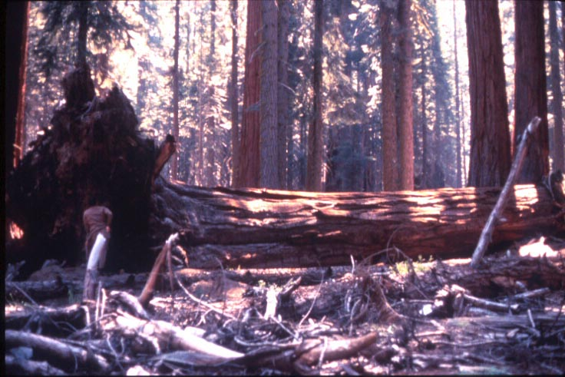
Annosus root disease in giant sequoia

Slide 41
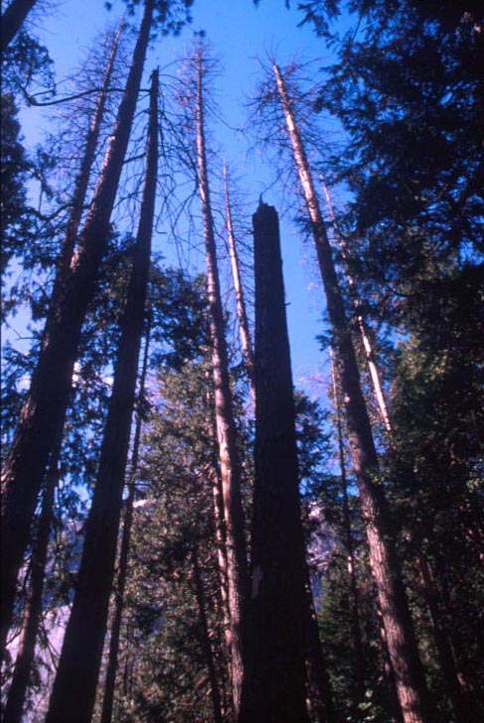
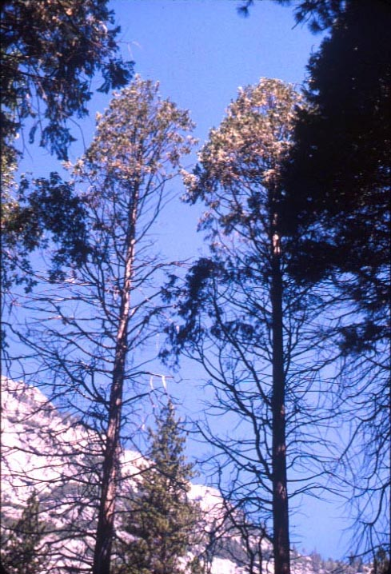
Ponderosa pine
Incense cedar

Slide 42
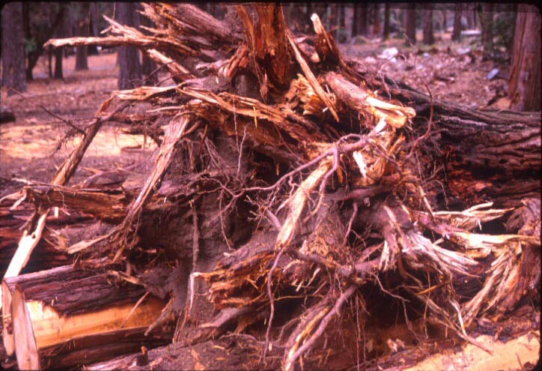

Slide 43
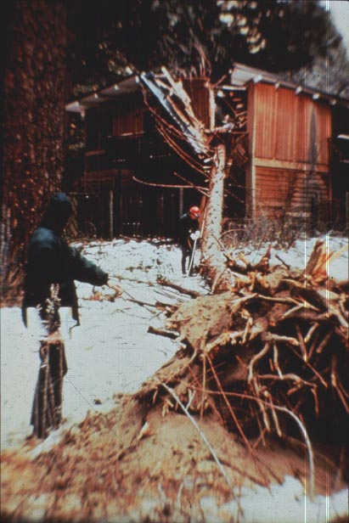
Yosemite Lodge complex
1972
cabin crushed by tree with rotted roots
since 1973
7 fatalities
19 serious injuries
Over $1M property damage

Slide 44
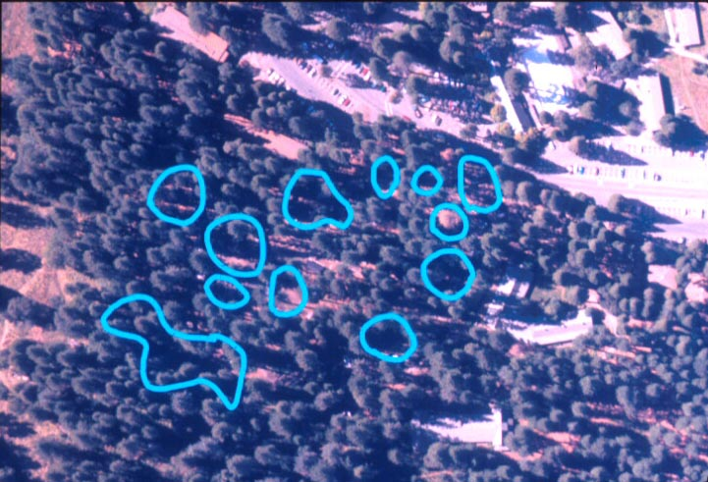
Yosemite Lodge 1975 Root disease centers outlined

Slide 45
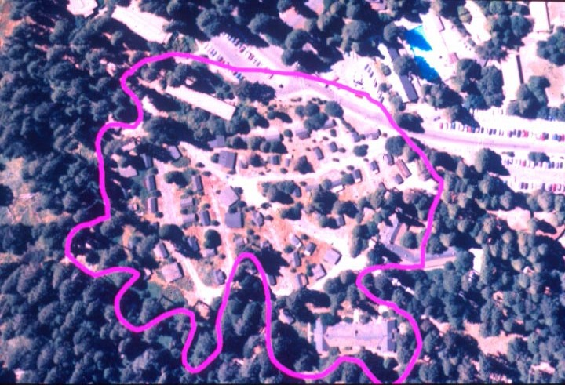
Yosemite Lodge 1997 Root disease centers outlined

Slide 46
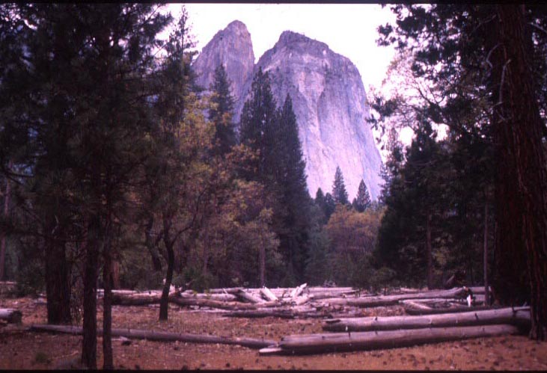
Many gaps with very little regeneration and have not closed in

Slide 47
Change in gap area 1972-1999

Slide 48
Armillaria root diseases
Armillaria, the honey mushroom, normally infects the roots of trees. It can be a saprobe and a pathogen and is common amongst oaks
If woodland composition shifts to pine/oak, pines become the target of attacks and gaps in canopy enlarge over time. Stress (e.g. flooding) exacerbates susceptibility

Slide 49
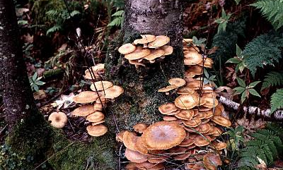
Clusters of Armillaria

Slide 50
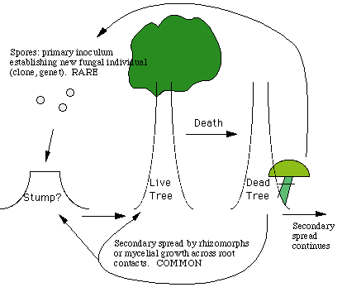
How Does it Infect?
Two means of dispersal to other trees:
Mycelium can grow through direct root contacts and grafts with uninfected trees.
Rhizomorphs can grow through soil to contact uninfected trees.
OAK or PINE
DEAD OAK
SOURCE: http://www.forestpathology.org/dis_arm.html

Slide 51
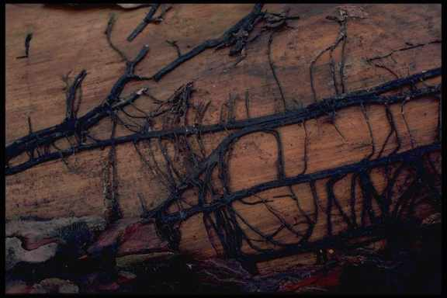
What are Rhizomorphs?
…“conglomerations of
differentiated parallel
hyphae with a protective
melanized black rind
on the outside.”
Rhizomorphs are able to transport food and nutrients long distances which allows the fungus to grow through nutrient poor areas located between large food sources such as stumps.
SOURCE: http://www.nifg.org.uk/armillaria.htm
SOURCE: http://botit.botany.wisc.edu/toms_fungi/apr2002.html

Slide 52

Humongous Fungus
It’s One of
U-HAUL’s “Bizarre Roadside Attractions”
http://botit.botany.wisc.edu/toms_fungi/apr2002.html

Slide 53
CONCLUSIONS
Human activities shifting from oak woodlands to mixed oak-pine lead to large mortality gaps in pines around oaks if honey mushroom is present
CHANGING SPECIES COMPOSITION LEADS TO SEVERE DISEASE

Slide 54
Many gaps with very little regeneration and have not closed in

Slide 55
How can people transport pathogens
By transporting plants and plant parts
  Crops, and seeds
  Raw food
  Ornamental plants
  Untreated lumber
  Soil
  Insects vectoring fungi
  Military activity

Slide 56



Invasion of an exotic root pathogen
of forest trees:
the case of Heterobasidion annosum
P. Gonthier¹, R. Linzer², G. Nicolotti¹ & M. Garbelotto²
¹ Di.Va.P.R.A., University of Torino, Italy
² E.S.P.M., University of California at Berkeley, USA
Eighth International Mycological Congress, Cairns, Australia, 20-25 August 2006

Slide 57
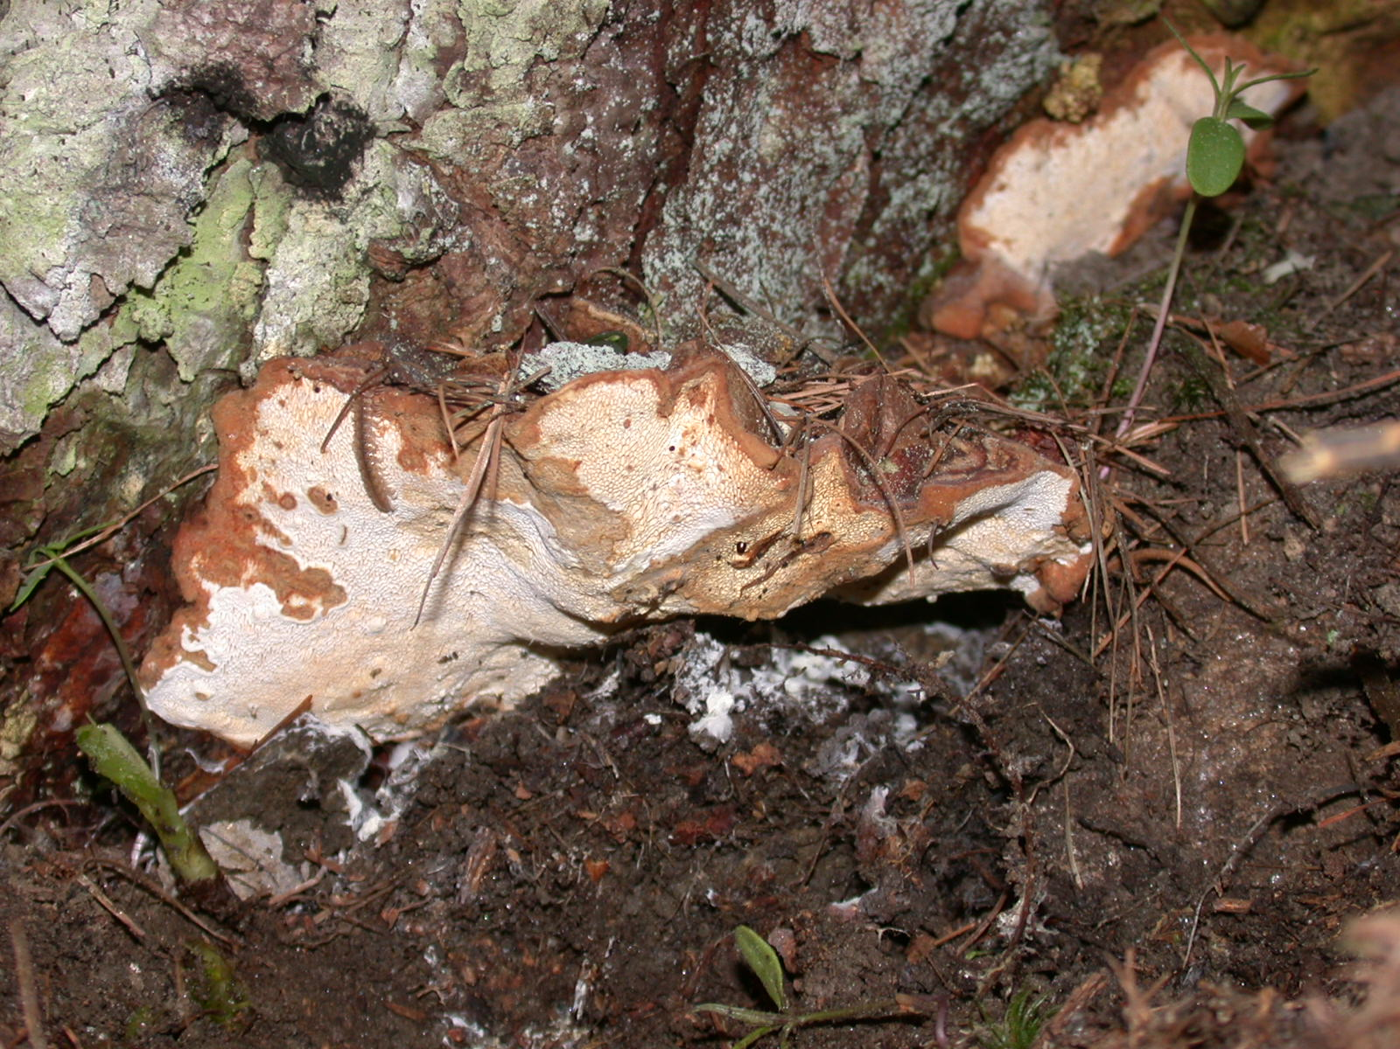
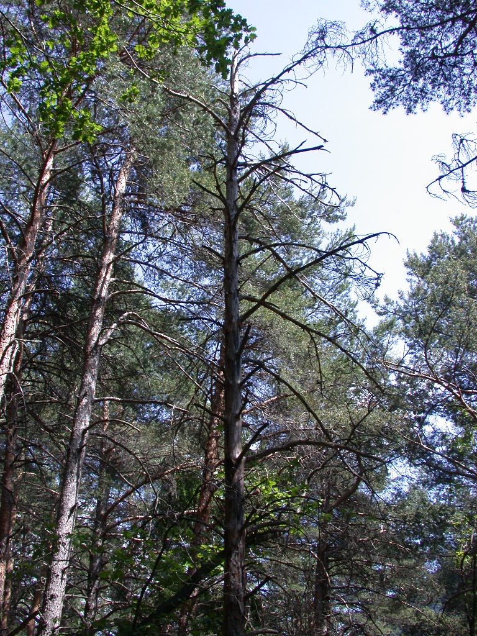
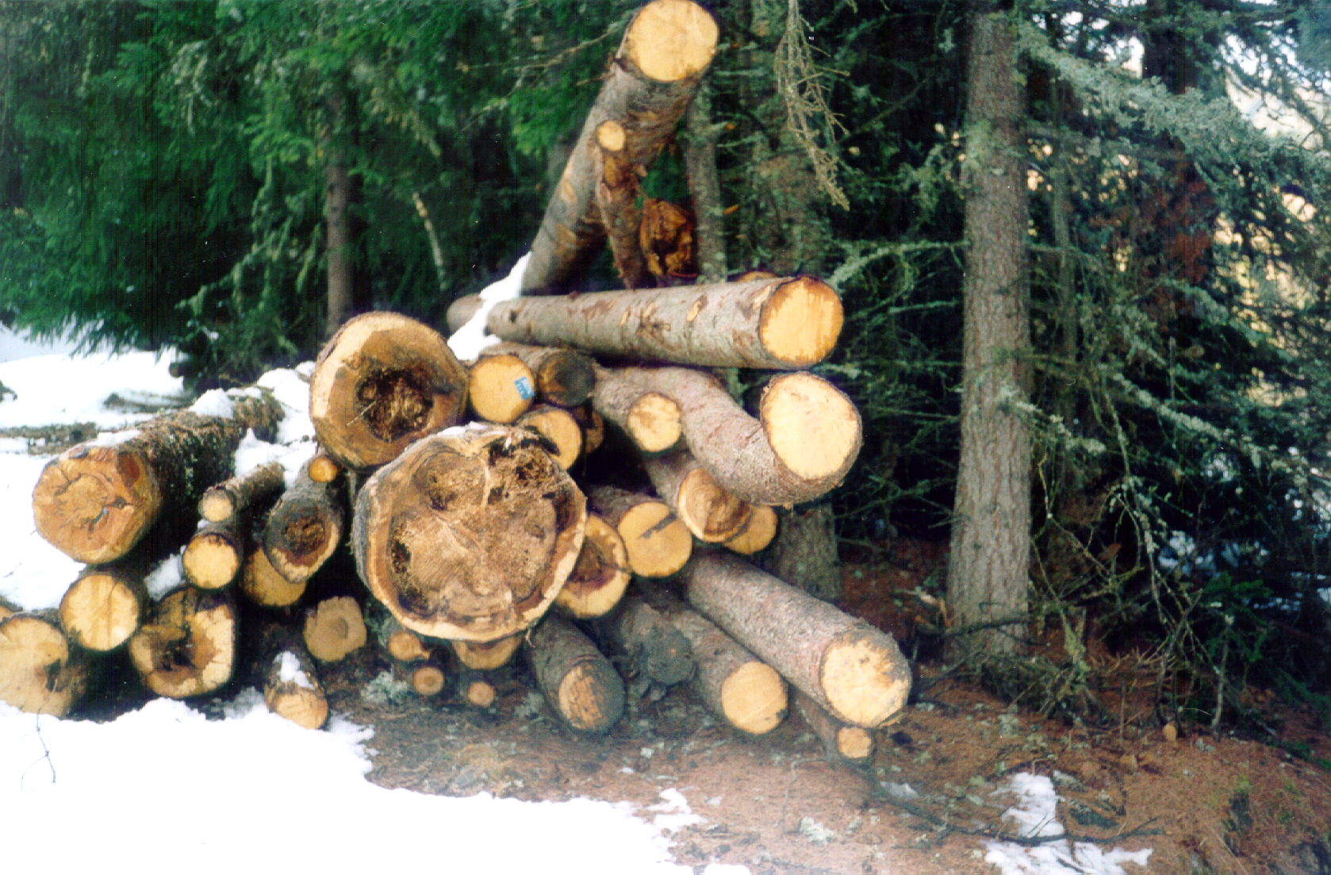
The Heterobasidion annosum (Fr.) Bref. species complex
Notes:
These are my current projects.

Slide 58
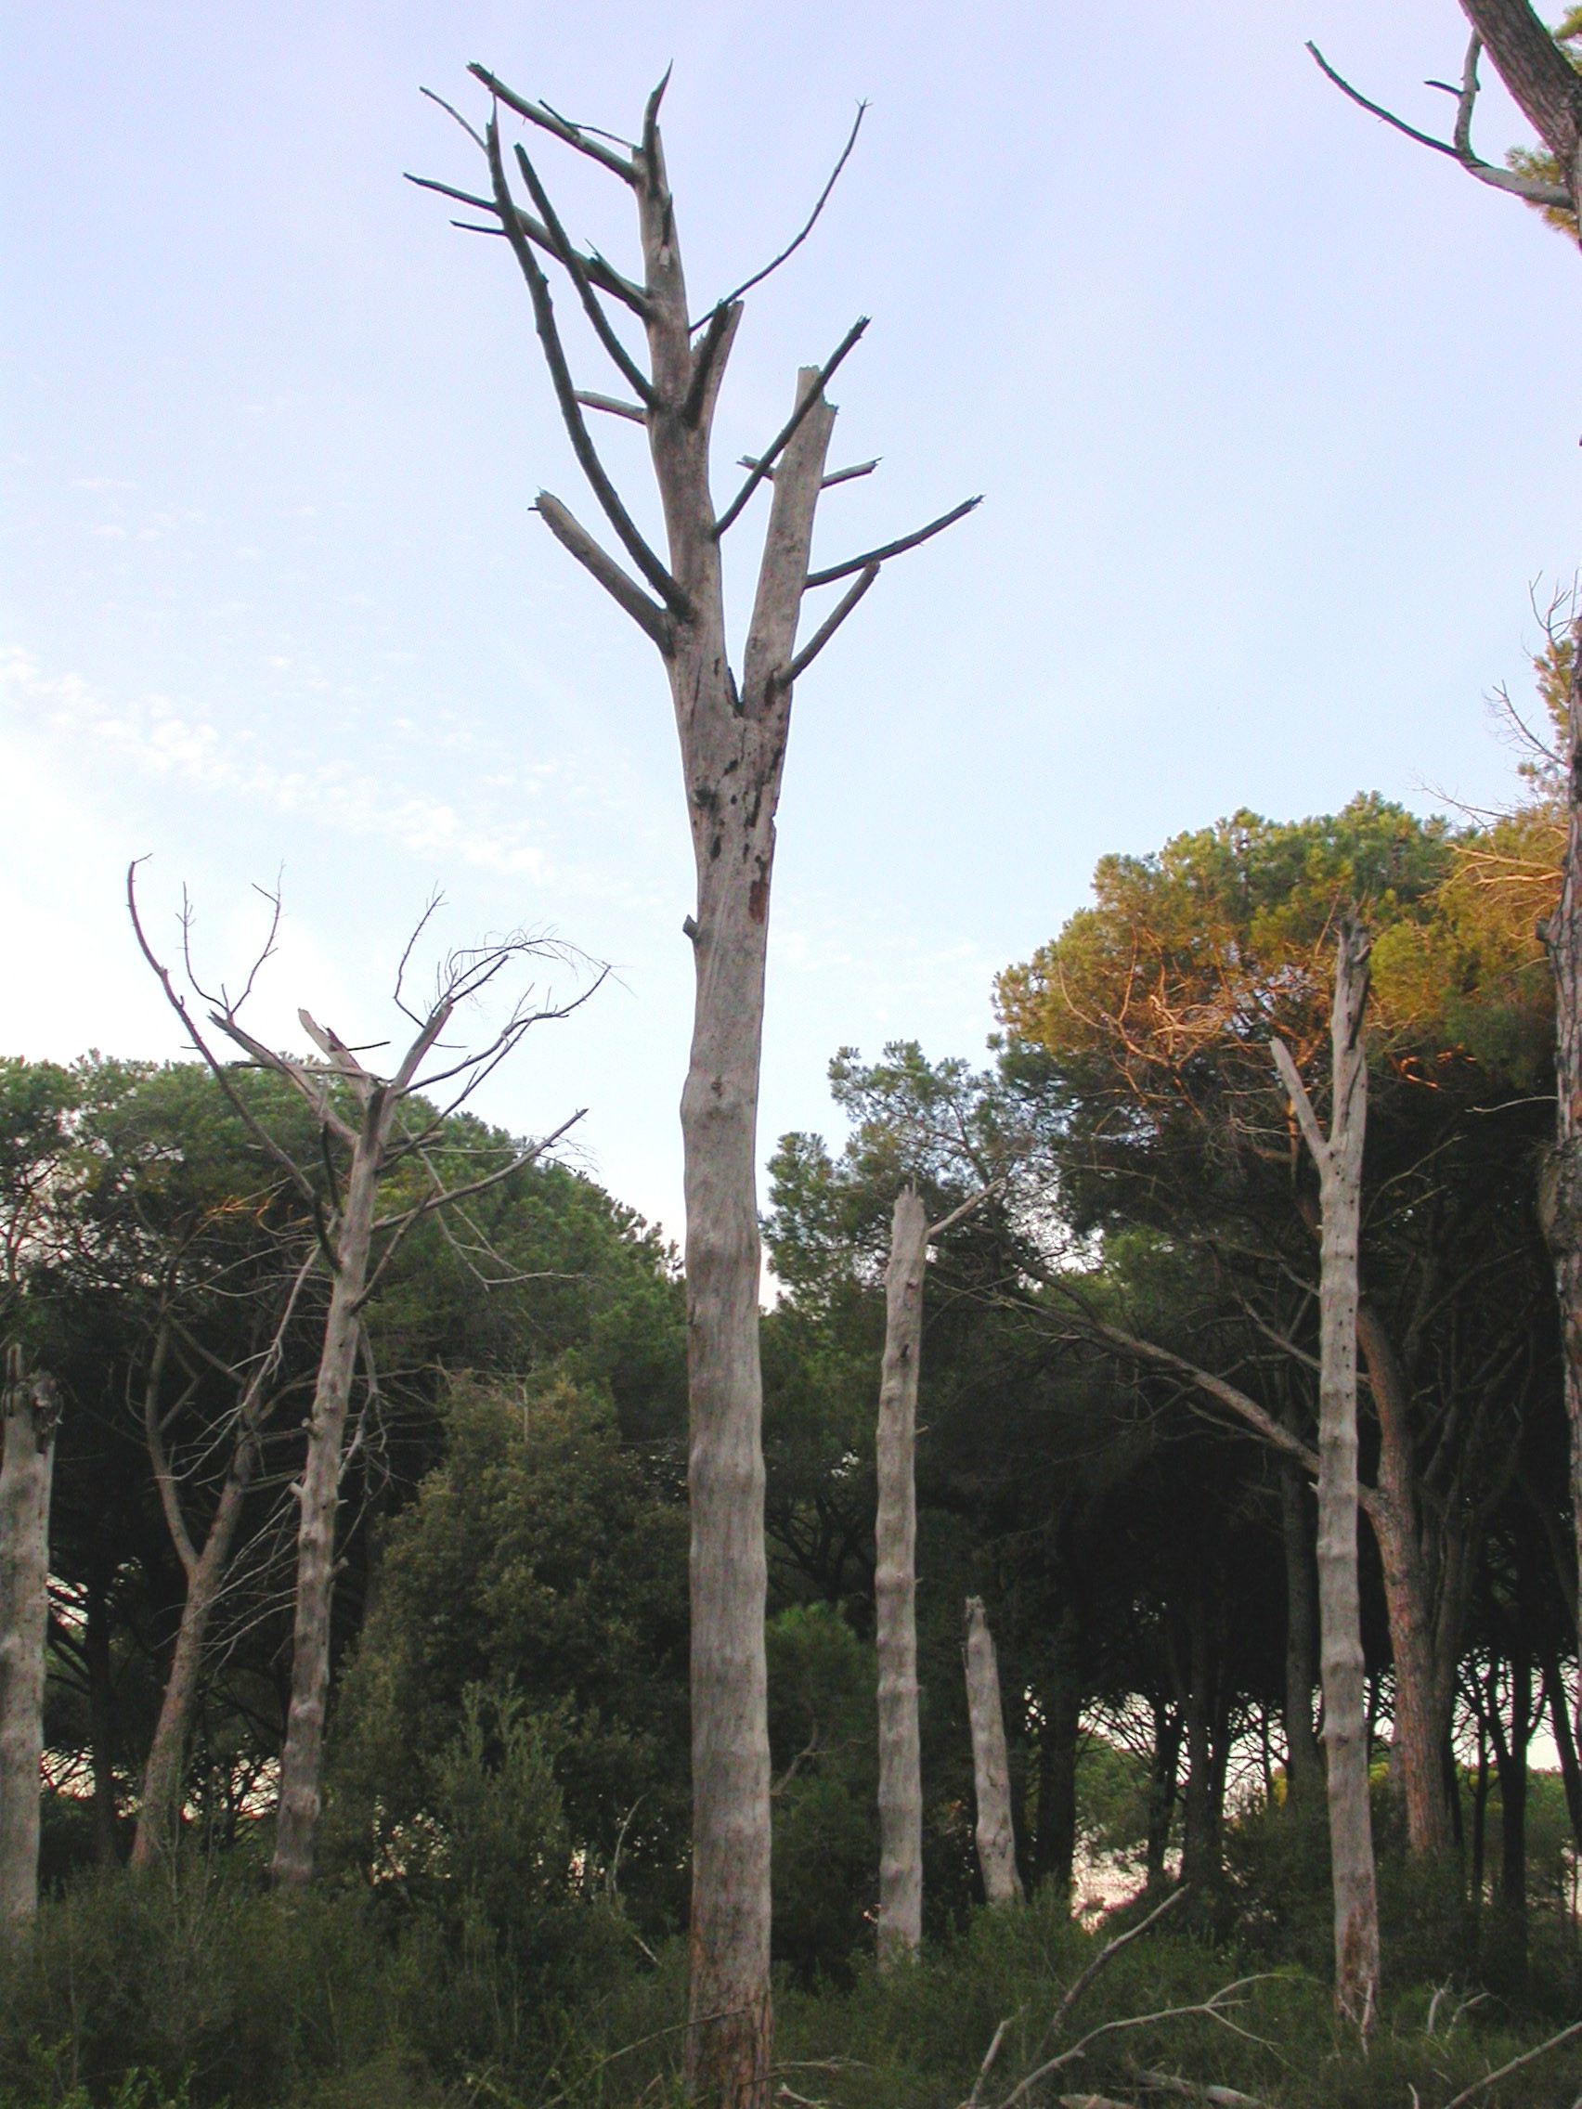
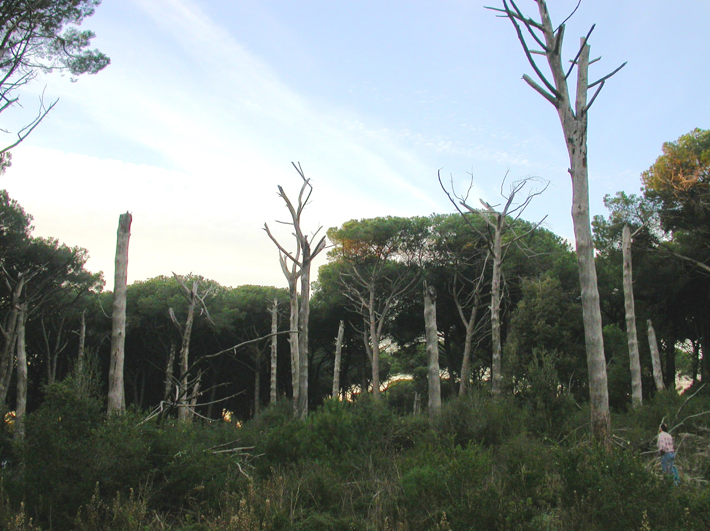
Italian Stone Pine (Pinus pinea L.) mortality centers in Castelporziano (Rome)
2002
Notes:
These are my current projects.

Slide 59
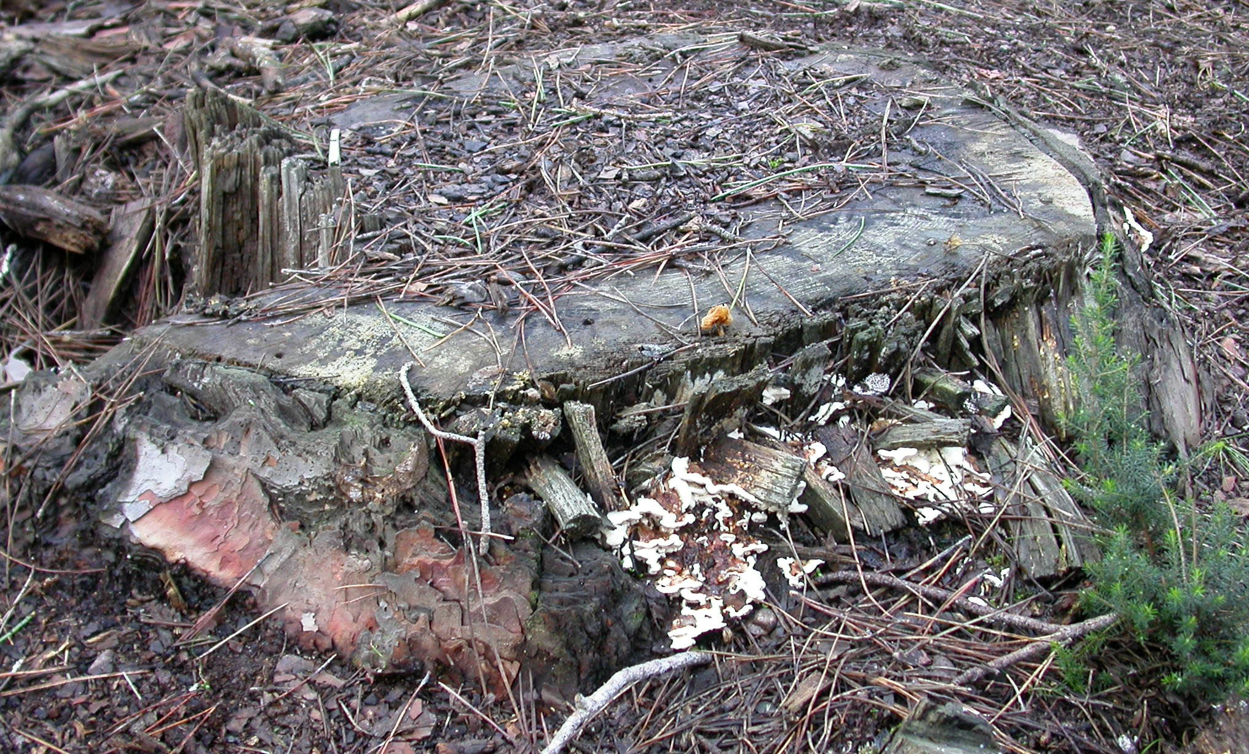
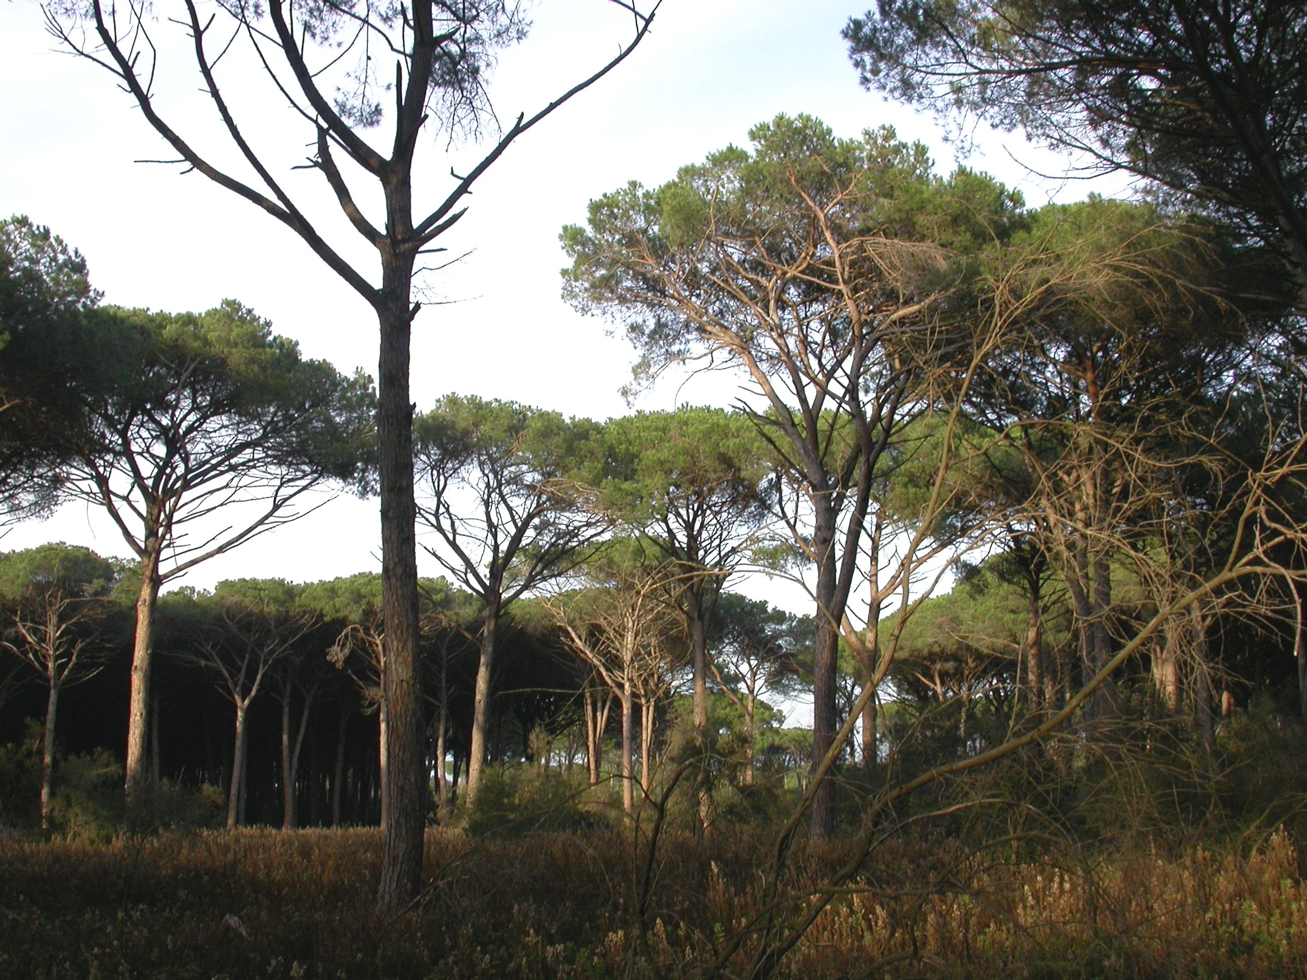
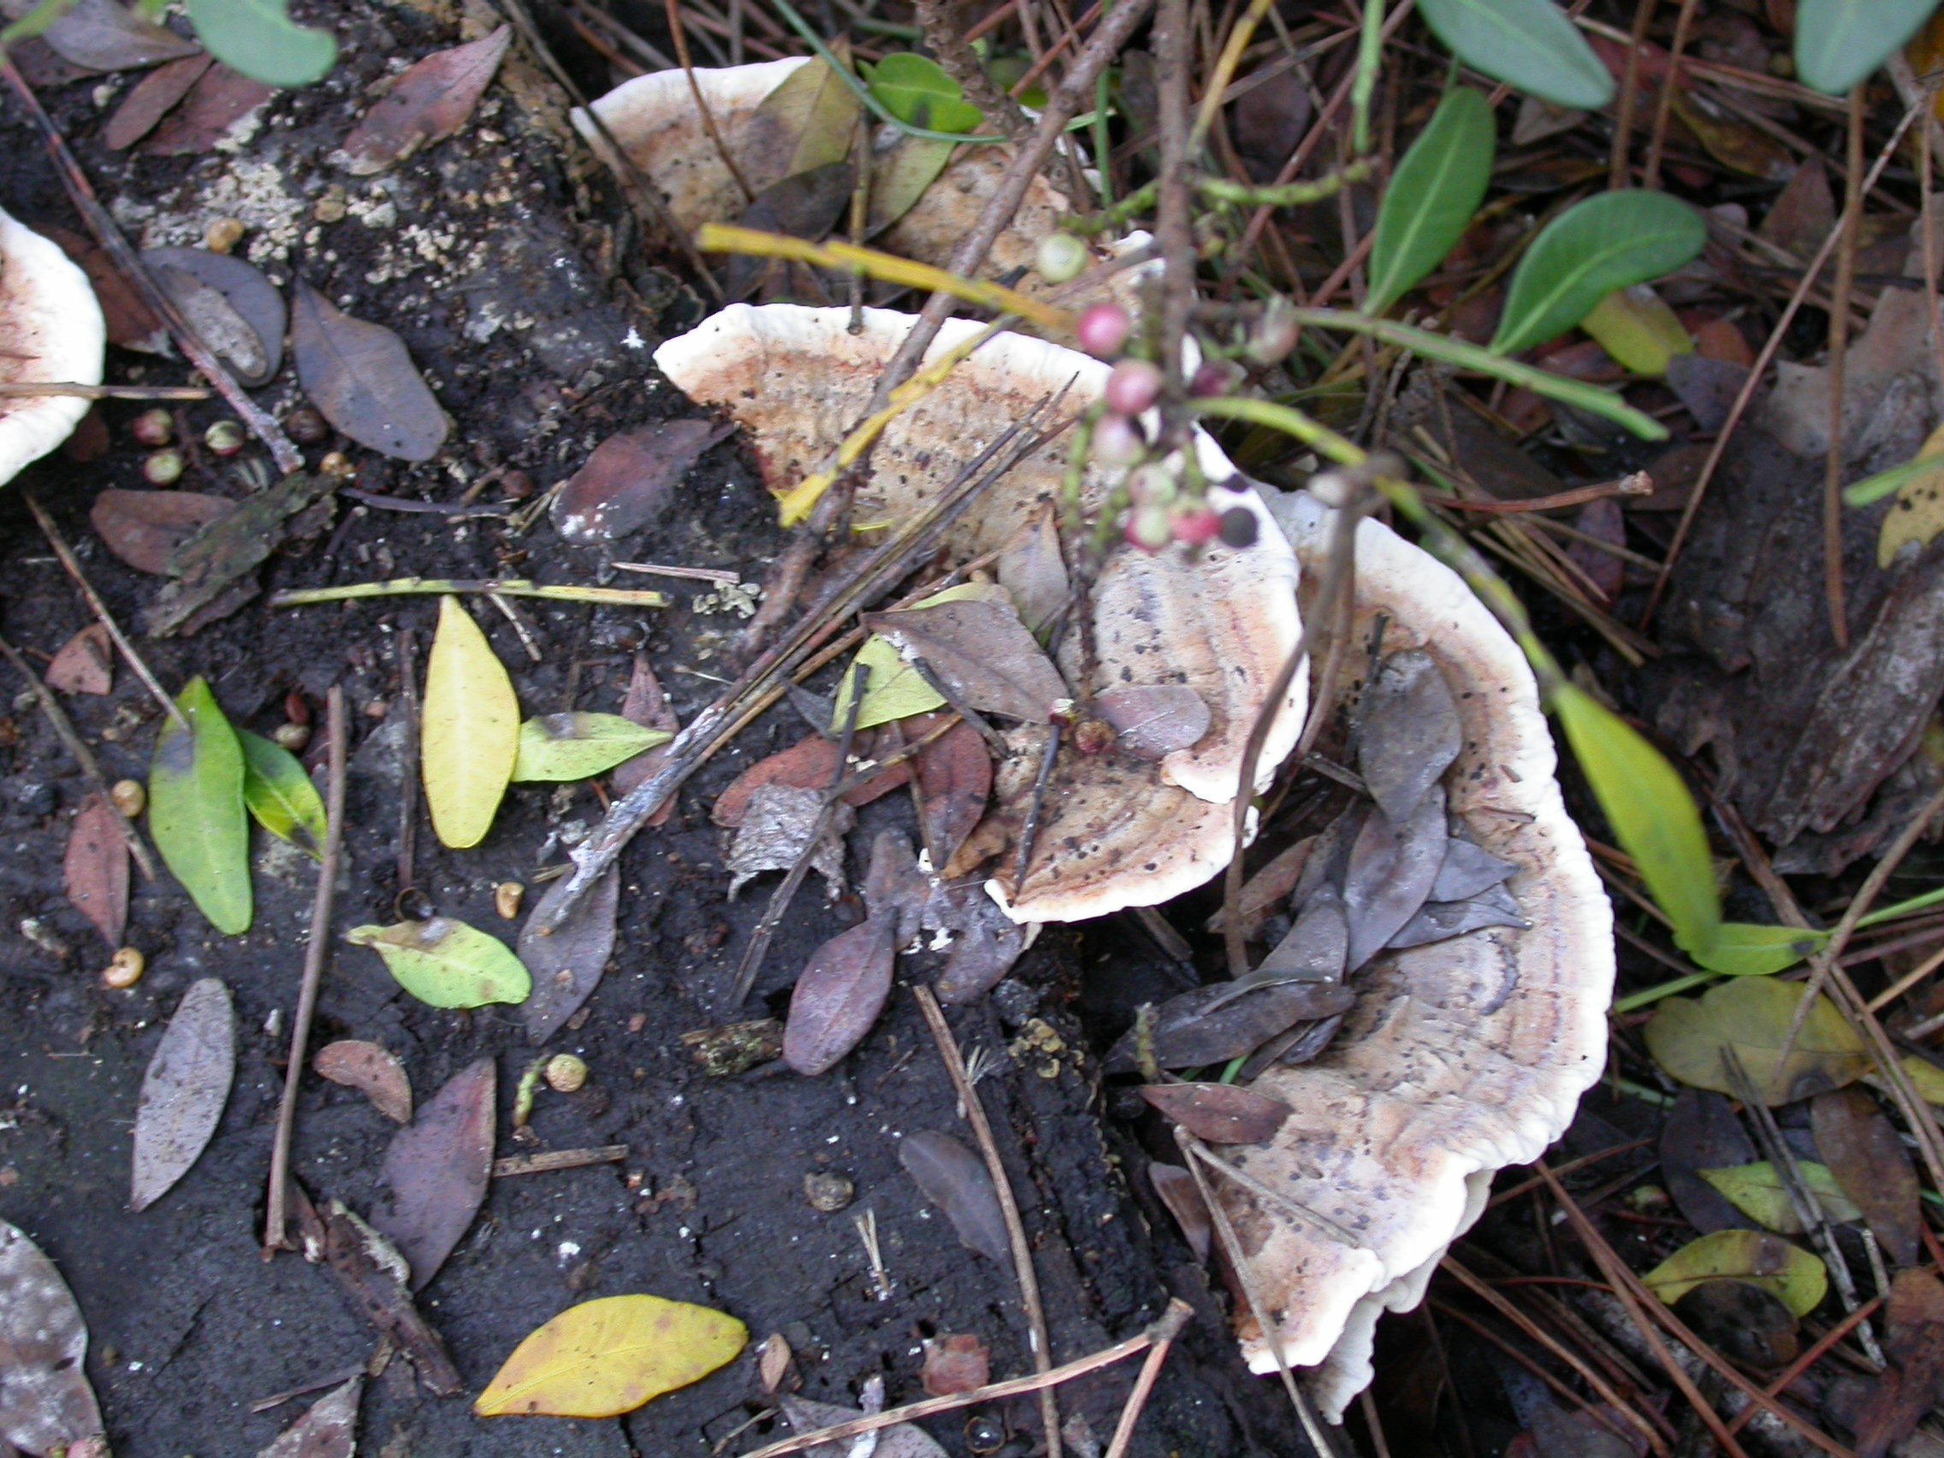
Basidiomata of Heterobasidion sp. on
pine stumps within Castelporziano’s
pine mortality centers
2002
Notes:
These are my current projects.

Slide 60
Phylogram of Bayesian analysis of partitioned, multilocus dataset: GPD, EFA and ATP.
Gonthier et al., 2004
Warner et al., 2005
Linzer et al., in prep.
How it was discovered that the Castelporziano’s Heterobasidion population was exotic
H. insulare
H. insulare
98307
P12p
00 070 1
02 023 1
1.0
02 030 5
02 031 1
203005
203006
791200 1 2
95092
B13 4
0.51
Cal1
H. annosum
Cal2
E14 2
E18 11 3
E3 1
L1b
sensu stricto
L58 1
T5
0.50
0.67
98297
B20 1
0.86
00 071 1
00 073 2
1.0
417P
810928 1 1
11063B
B3 22
11115A
1116 1
12023B 2
1A
24086C
1.0
323
427
365
9319
4 2 1
H. annosum
9321
98001
98012
ENA P ISG
98027
98034
98042
98040
Conk3
REU120
cl5
cl3
cl6
2 1 3
98018
344 6
390
390 5
1.0
BBb
BBh
a2sd
a5sd
1.0
c1sd
1.0
c3sd
c4sd
H. annosum
c6sd
c7sd
305 4
1.0
340 3
310 7
WNA P ISG
0.88
0.99
327 5
354 1
382 5
0.51
351 1
398 2
98008
0.68
98015
0.52
94190
9320
94189
0.50
98002
98005
98028
0.59
98035
98003
1.0
98006
98029
H. annosum
0.50
98041
1.0
98007
98011
98016
ENA P ISG
0.51
98017
98036
cp0
98038
1.0
cp15
cp18
cp2
1.0
cp7
cp3
1.0
cp9
1.0
stop1
Conk1
1.0
1010
H. abietinum
1.0
1.0
365F
1041
H. parviporum
1.0
181
230 3
433
H. annosum
WNA S ISG
0.1
BBe
Notes:
These are my current projects.

Slide 61

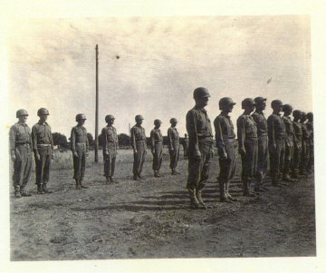
How was Heterobasidion introduced from Eastern North America?
  The Estate of Castelporziano has been closed to the public since 1562, and…
  is comprised of an exclusively native Italian flora (Manes et al., 1997)
June 5th - July 10th, 1944
training and resting camp
337th Regiment Review Castelporziano
Notes:
These are my current projects.

Slide 62
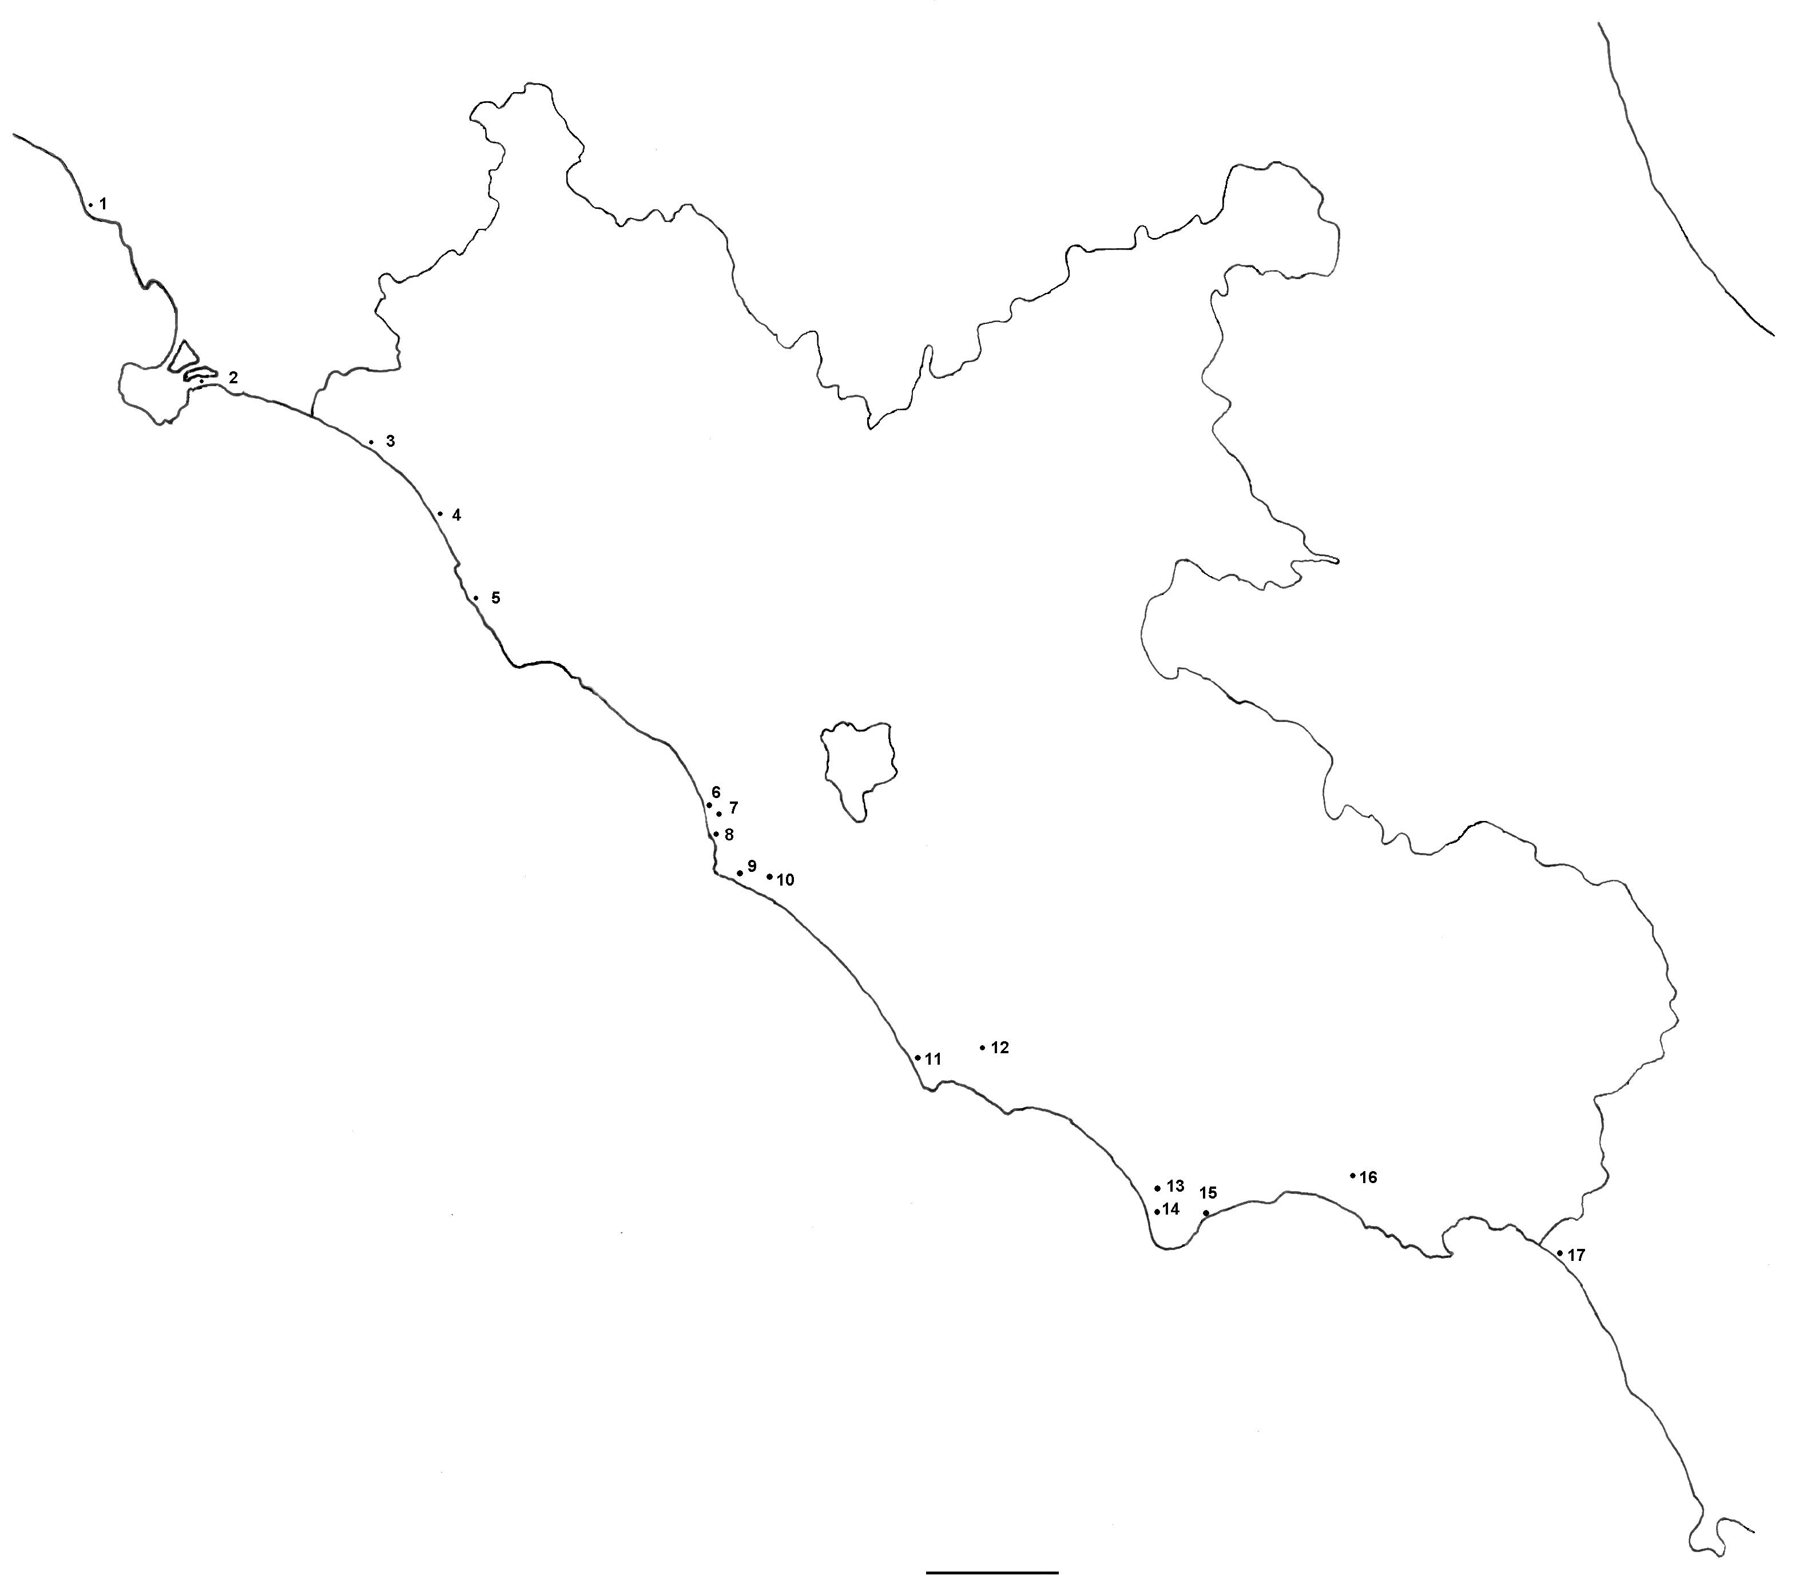
Current distribution of the exotic pathogen
20 km
wood disks (%)
Heterobasidion free
with EU Heterobasidion spores
with NA Heterobasidion spores
with both EU and NA Heterobasidion spores
Notes:
These are my current projects.

Slide 63
Why exotic outcompetes native
It is equally pathogenic (can’t always blame lack of coevolution)
It produces a lot more spores (transmission)
It is a better saprobe (establishment)
It can colonize oak stands

Slide 64
Hybridization: why care?
Hybrid pathogens can change hosts
Hybridization allows for gene introgression and can increase virulence
We have documented that about 17% of alleles are completely new due to recombination: what will these alleles be able to do

