Slide 1
BCC Bio 10 - Spring 2020
Section #4 – Lecture #4.1

Slide 2
Chapter 8
0
Cellular Reproduction:
Cells from Cells

Slide 3
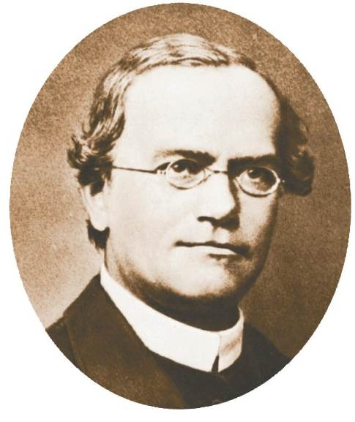
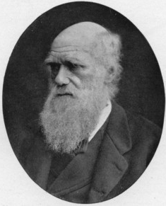
Inheritance
vs
Genetics
Gregor Mendel
“It’s Medeltastic!”
Charles Darwin
aka “Chucky D”
Notes:
Figure 8.1a Three functions of cell division. (Part 1)

Slide 4
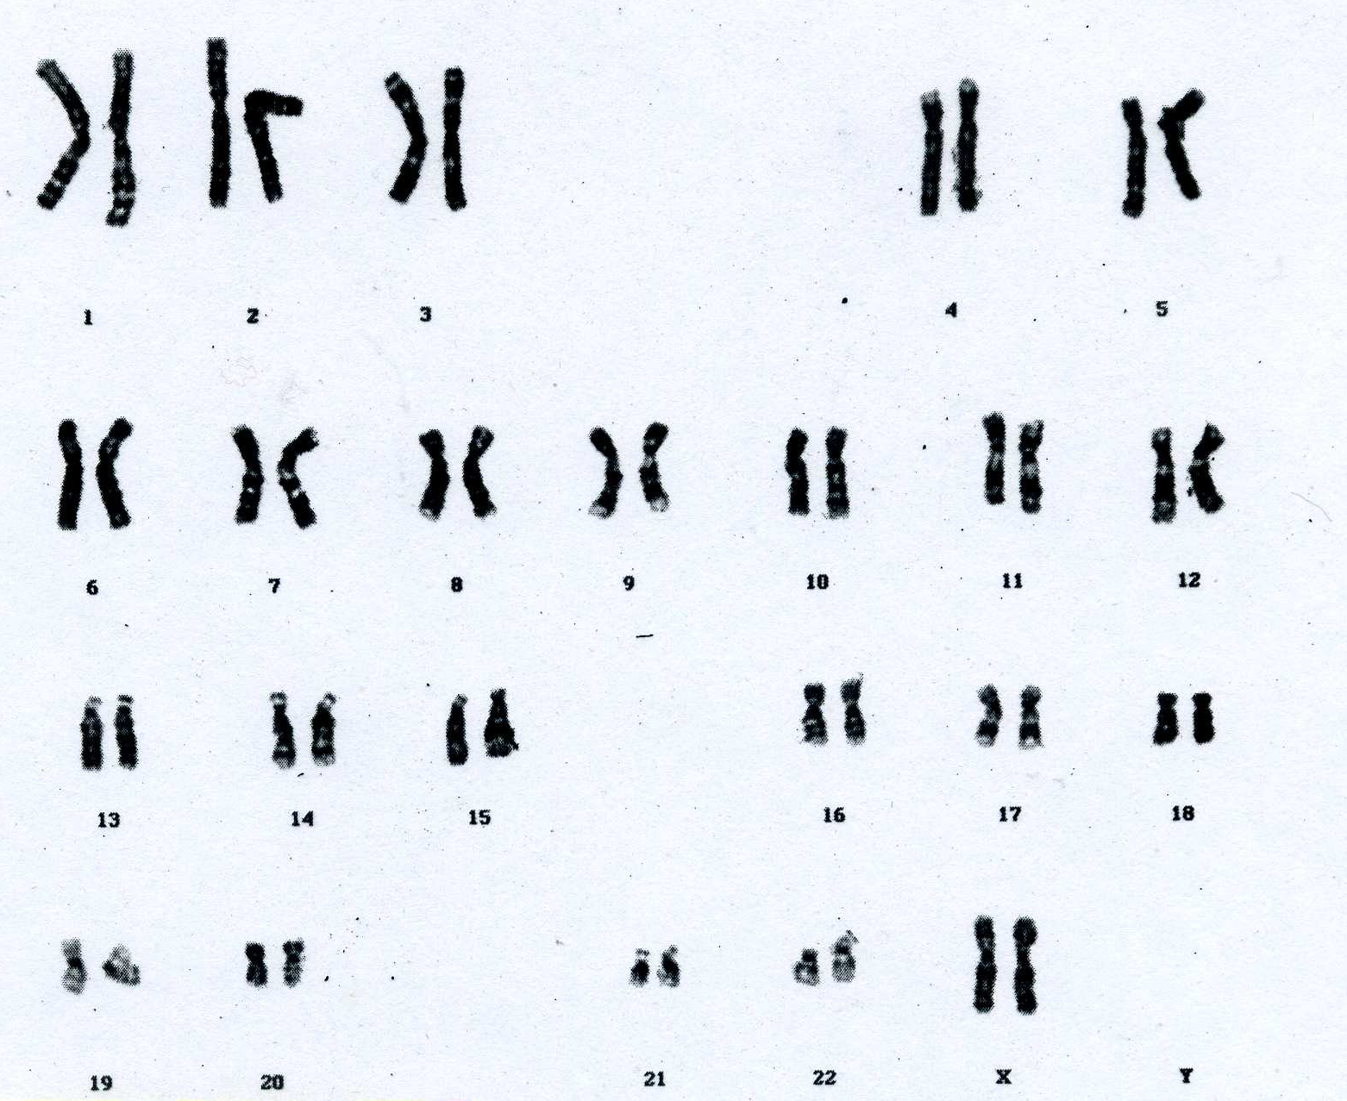
Human Chromosomes

Slide 5
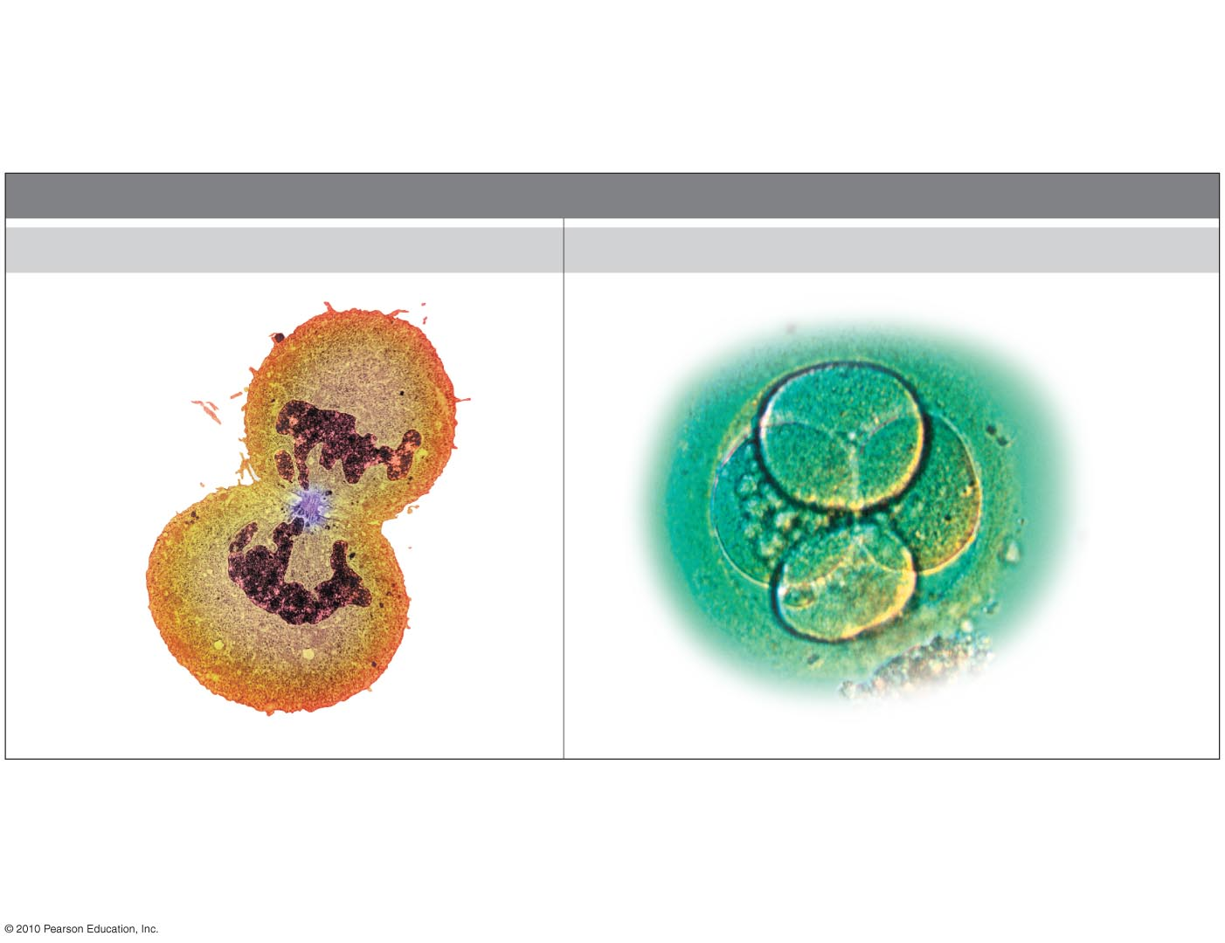
Mitosis vs Meiosis
FUNCTIONS OF CELL DIVISION
Cell Replacement
Growth via Cell Division
Colorized TEM
LM
Human kidney cell
Early human embryo
Figure 8.1a
Notes:
Figure 8.1a Three functions of cell division. (Part 1)

Slide 6
Mitosis
Asexual Reproduction
Meiosis
Sexual Reproduction
Mom
Dad
Baby
“Cloning”

Slide 7
Discussion Questions:
1. Which will probably have a bigger impact on an organism: a mistake made in mitosis or meiosis?
2. Are all “mutations” bad?
Notes:
Figure 8.1a Three functions of cell division. (Part 1)

Slide 8
Pair of homologous
chromosomes
LM
Centromere
Sister
chromatids
One duplicated
chromosome
XX
Notes:
Figure 8.11 Pairs of homologous chromosomes in a male karyotype.

Slide 9
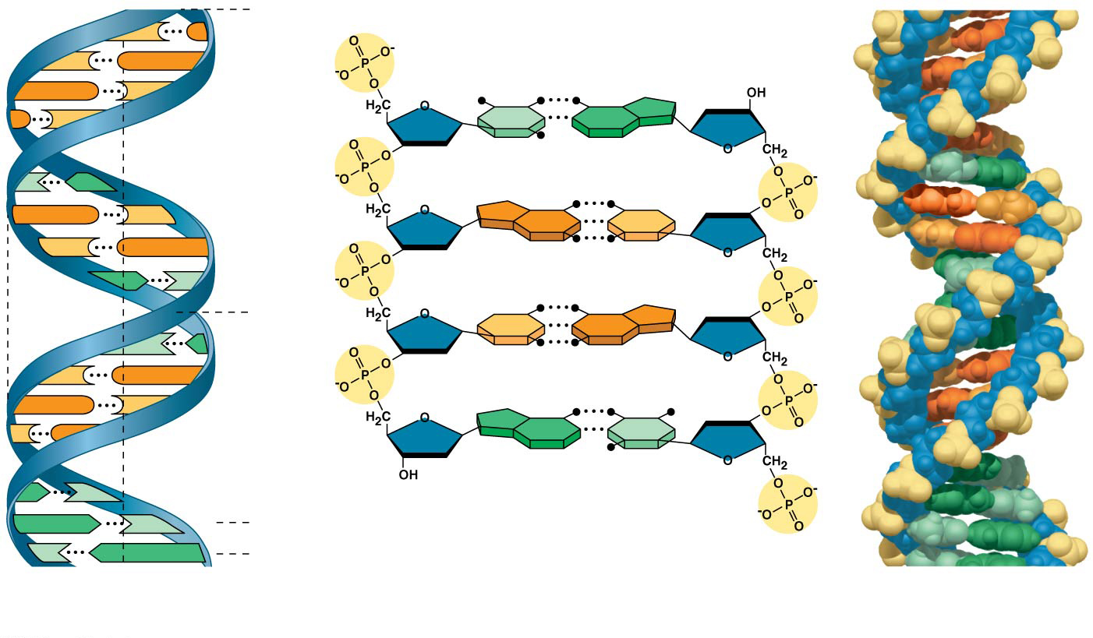
The DNA molecule
5′ end
C
G
C
G
Hydrogen bond
3′ end
G
C
G
C
T
A
3.4 nm
T
A
G
C
G
C
C
G
A
T
1 nm
C
G
T
A
C
G
G
C
C
G
A
T
A
T
3′ end
A
T
0.34 nm
T
A
5′ end
(a) Key features of DNA structure
(b) Partial chemical structure
(c) Space-filling model
Notes:
Figure 16.7 The structure of the double helix

Slide 10
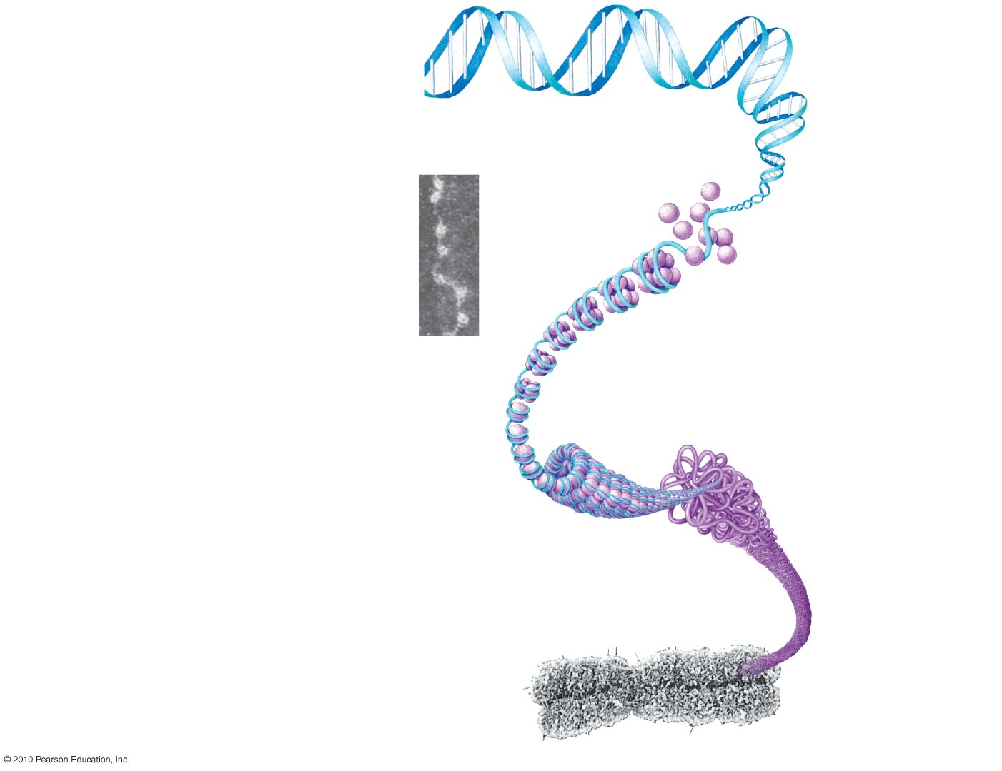
DNA double helix
Histones
“Beads on
a string”
TEM
Nucleosome
Tight helical fiber
Looped domains
Duplicated chromosomes
(sister chromatids)
TEM
Centromere
Figure 8.4
Notes:
Figure 8.4 DNA packing in a eukaryotic chromosome.

Slide 11
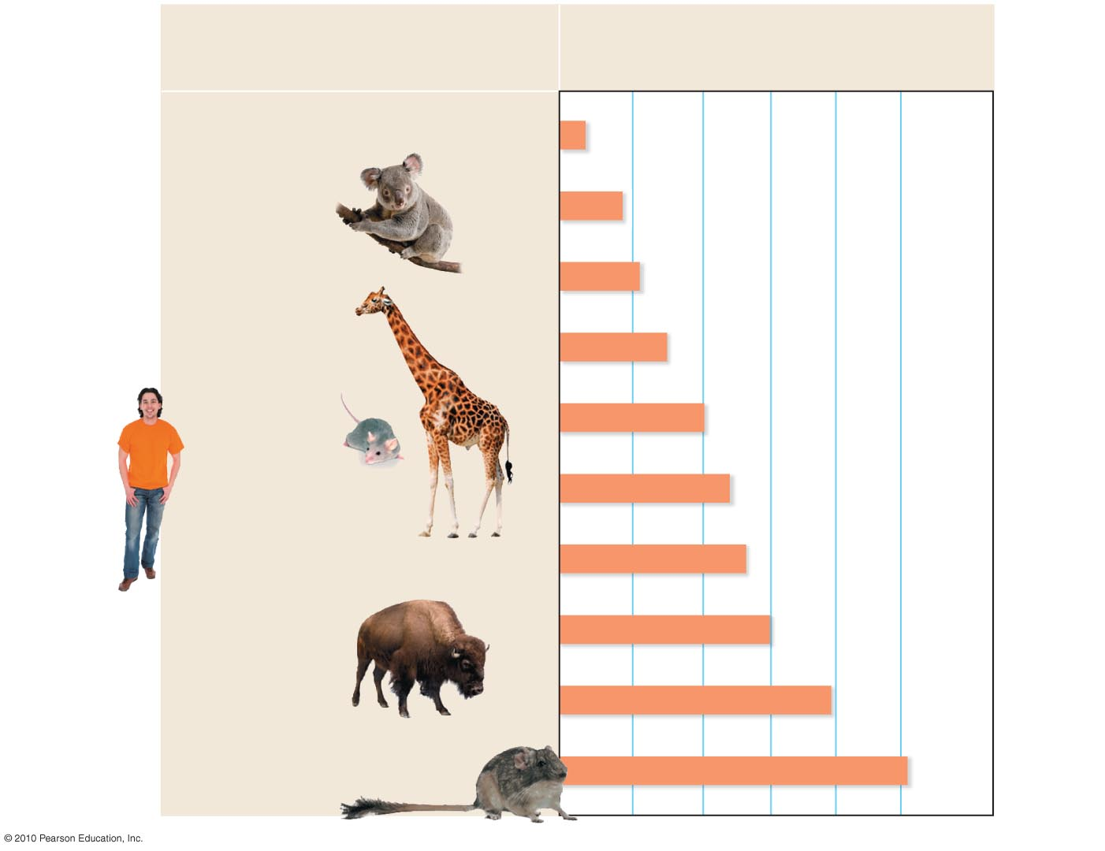
Number of chromosomes
in body cells
Species
Indian muntjac deer
6
Koala
16
Opossum
22
Giraffe
30
Mouse
40
Human
46
Duck-billed platypus
54
Buffalo
60
Dog
78
Red viscacha rat
102
Notes:
Figure 8.2 The number of chromosomes in the cells of selected mammals.

Slide 12
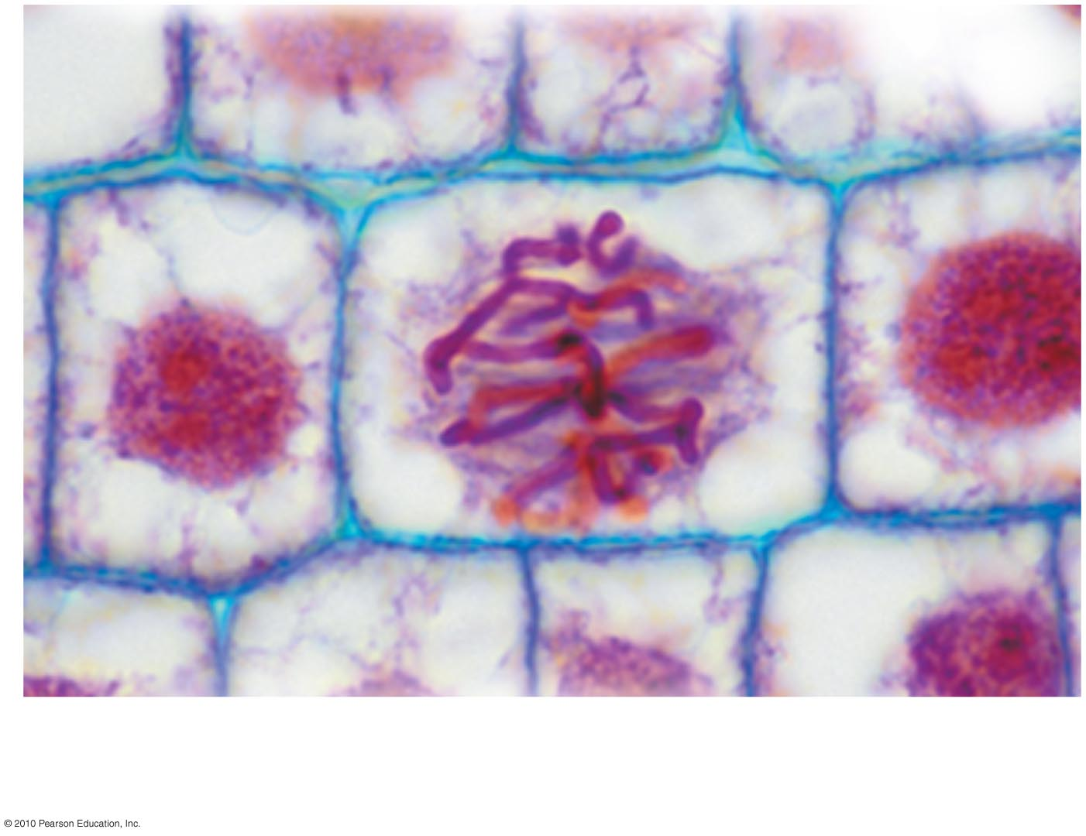
LM
Chromosomes
Figure 8.3
Notes:
Figure 8.3 A plant cell just before division (colored by stains).

Slide 13
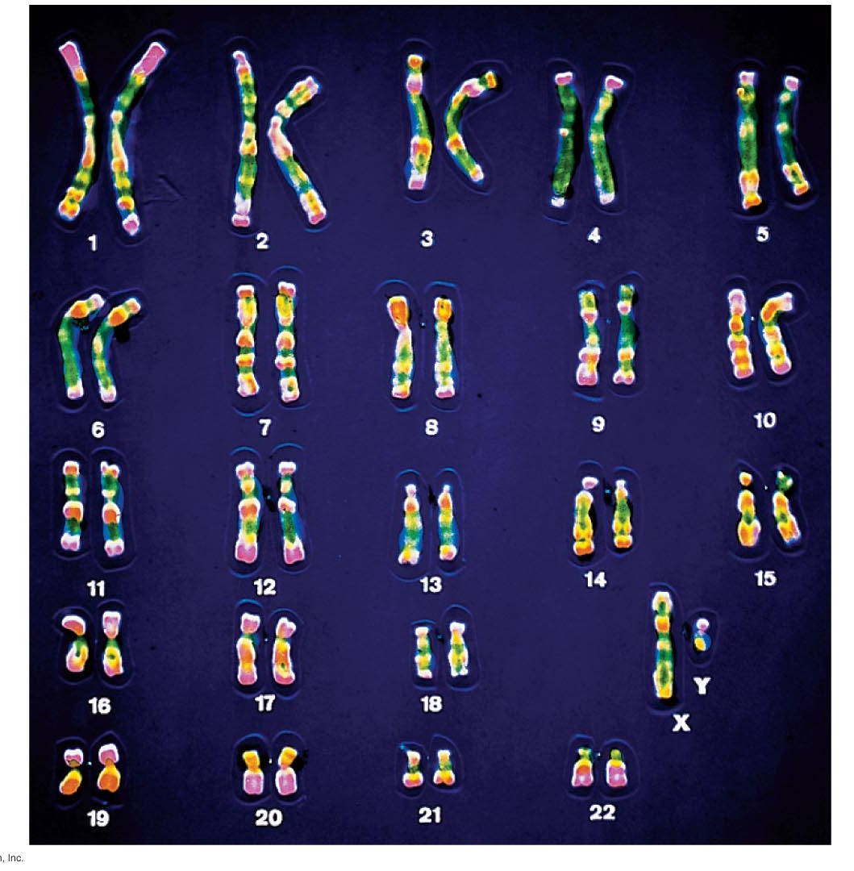
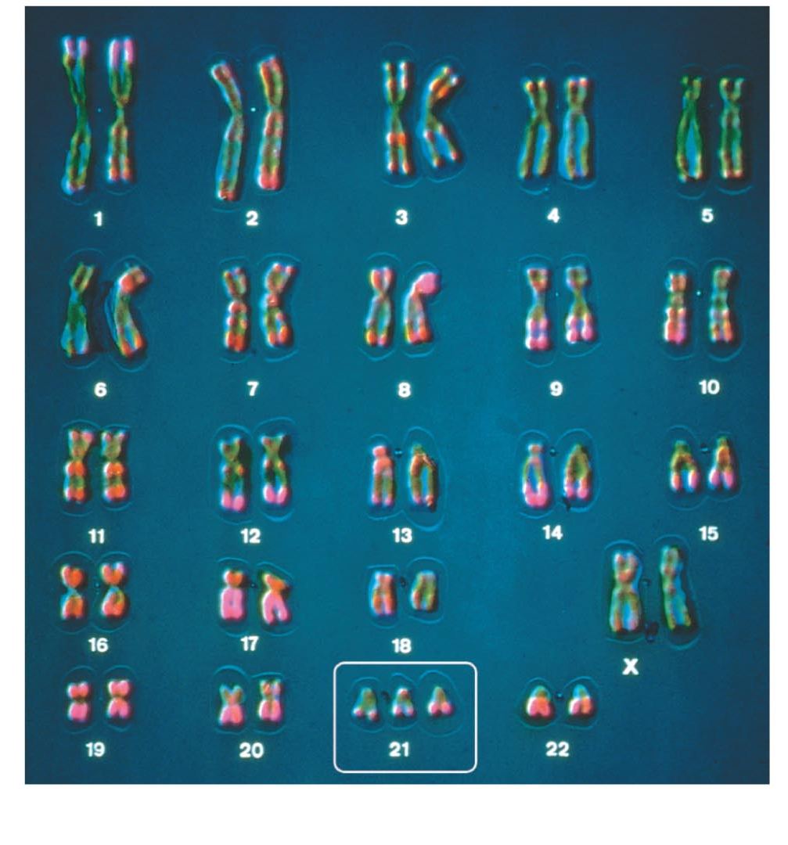
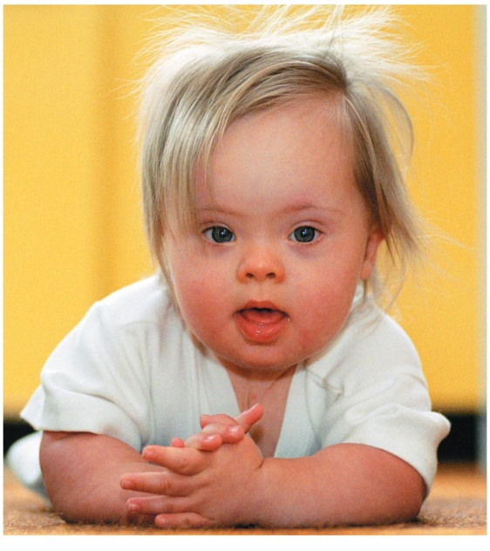
LM
Chromosome non-disjunction
Down Syndrome – Trisome 21
Notes:
Figure 8.11a Pairs of homologous chromosomes in a male karyotype.

Slide 14
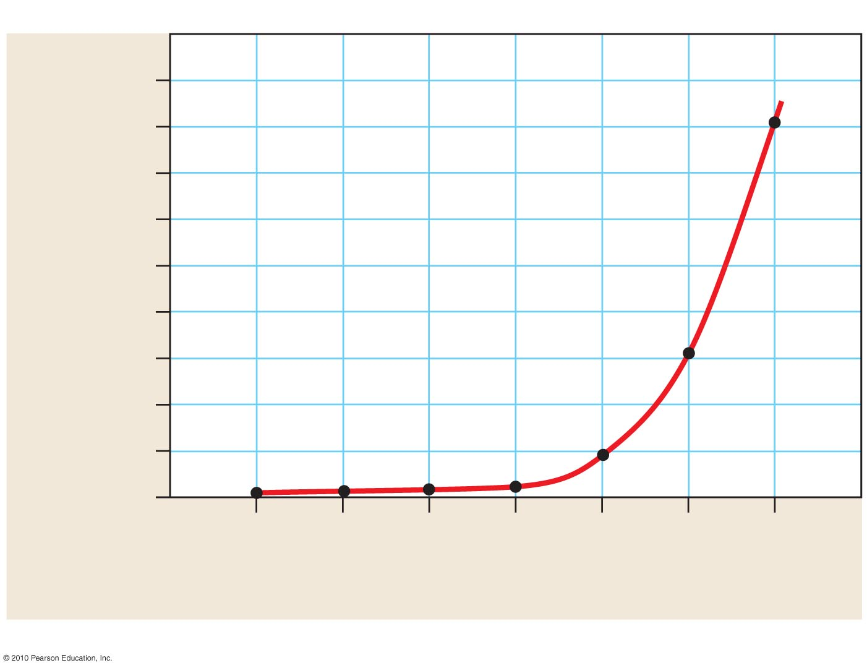
90
80
70
60
Infants with Down syndrome
(per 1,000 births)
50
40
30
20
10
0
20
25
30
35
40
45
50
Age of mother
Notes:
Figure 8.23 Maternal age and Down syndrome.

Slide 15
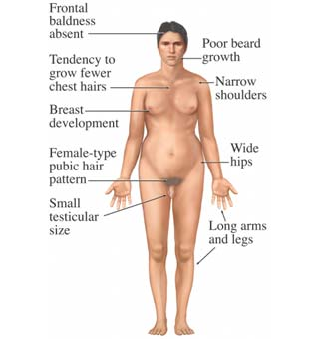
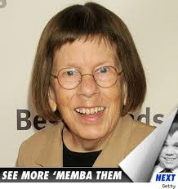
Non-disjunction in the sex chromosomes
Turner - X0
Klinefelter - XXY
Notes:
Figure 8.11a Pairs of homologous chromosomes in a male karyotype.

Slide 16
Notes:
Figure 8.1a Three functions of cell division. (Part 1)

Slide 17
BCC Bio 10 - Spring 2020
Section #4 – Lecture #4.2

Slide 18
Chapter 9
0
Inheritance

Slide 19
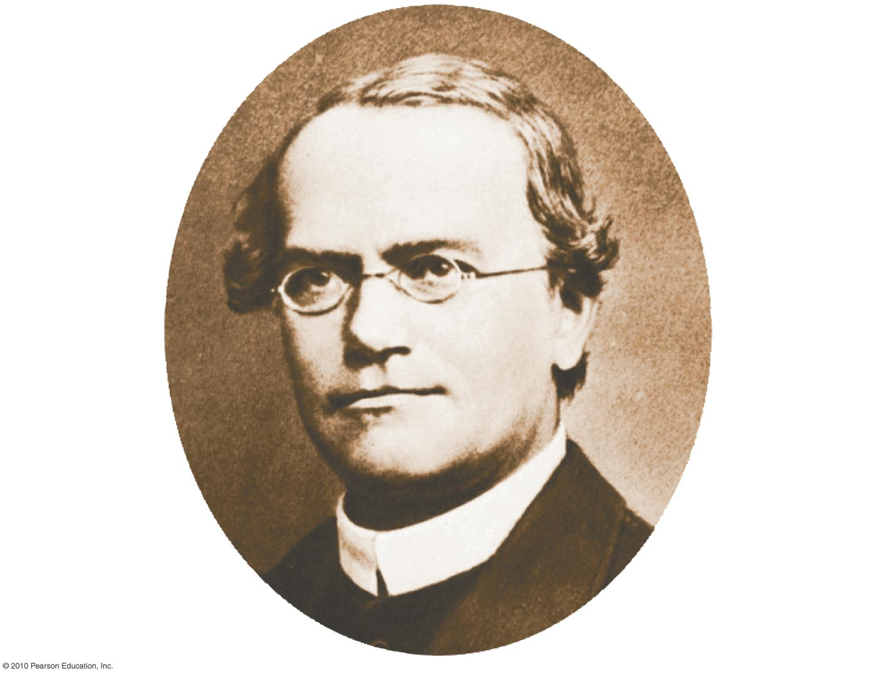
Gregor Mendel
Notes:
Figure 9.1 Gregor Mendel.

Slide 20
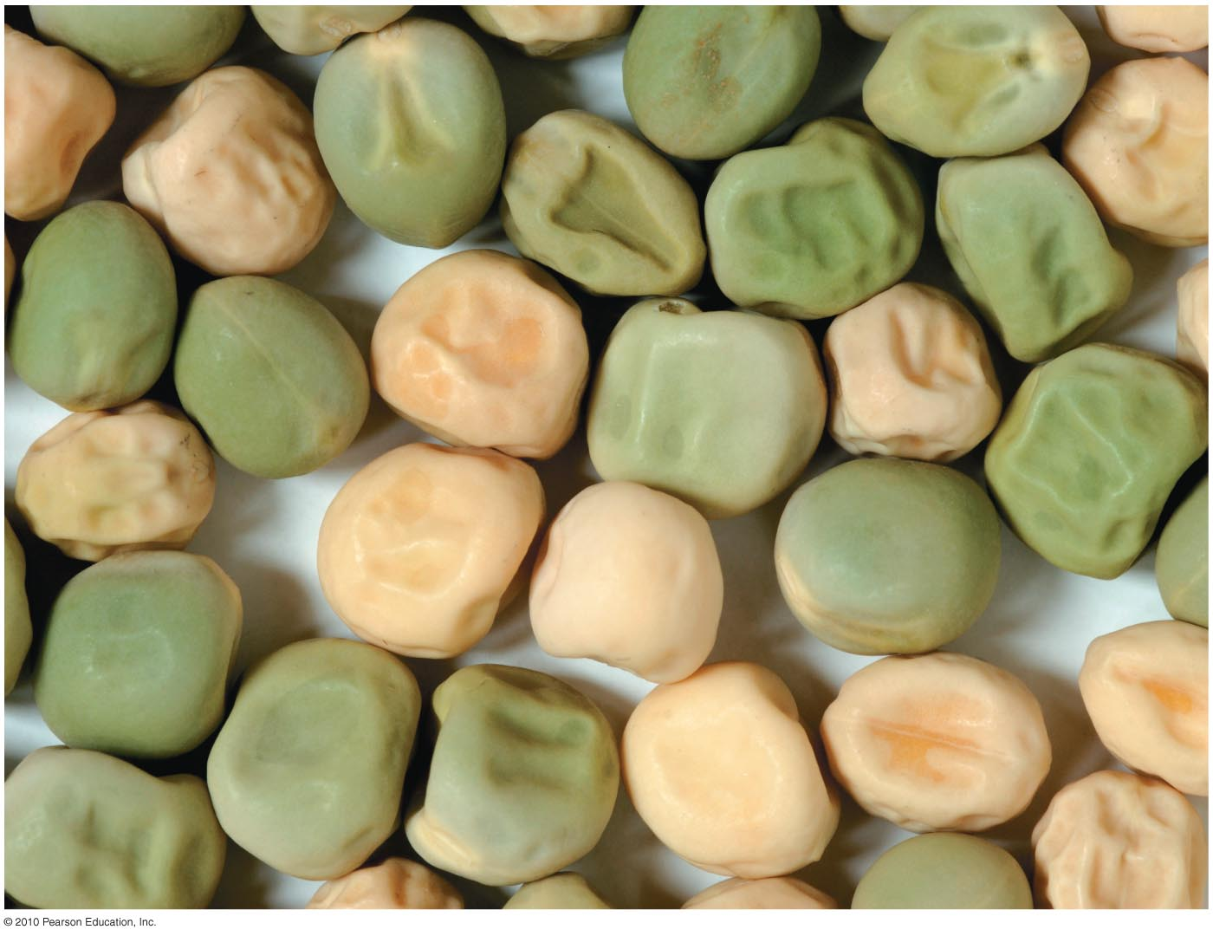
Figure 9.8
Notes:
Figure 9.8 Photo of peas

Slide 21
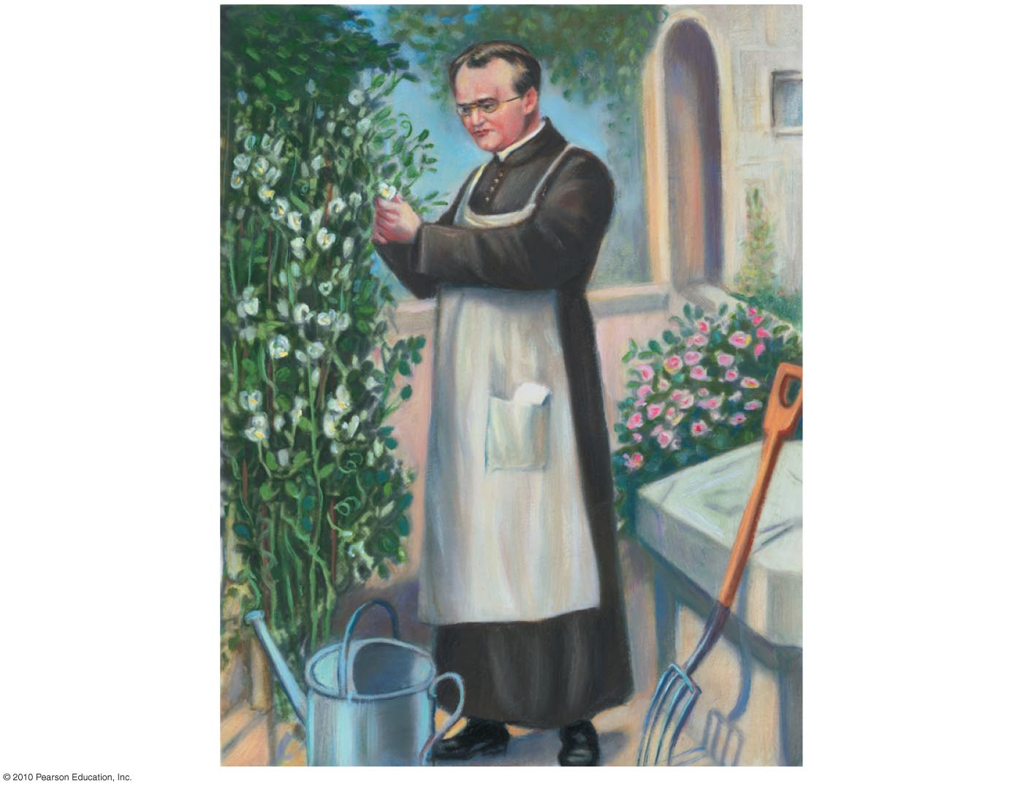
Figure 9.5
Notes:
Figure 9.5 Photo of Mendel in garden.

Slide 22
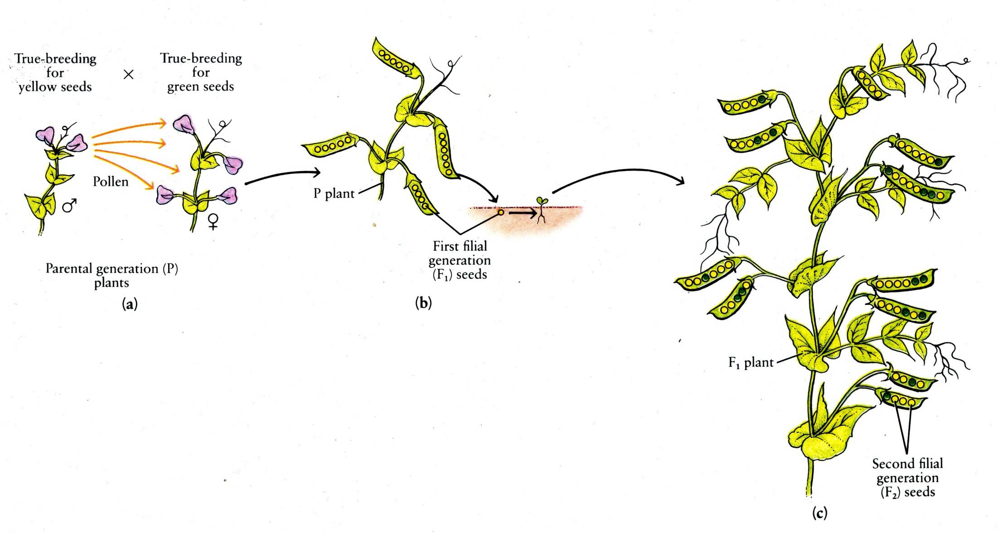
Mendel’s Pea Plants
Notes:
Figure 8.1a Three functions of cell division. (Part 1)

Slide 23
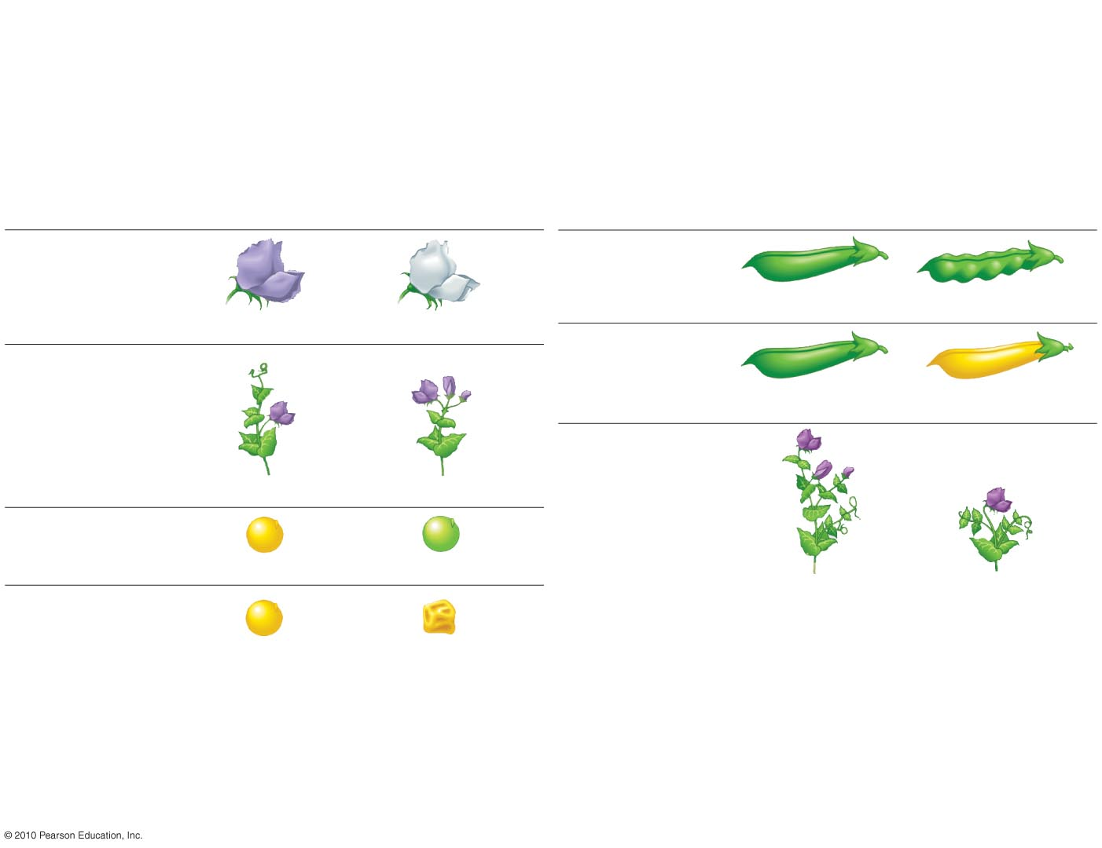
Characteristics of Pea Plants
Dominant
Recessive
Dominant
Recessive
Flower color
Pod shape
Inflated
Constricted
Purple
White
Pod color
Flower position
Green
Yellow
Stem length
Axial
Terminal
Seed color
Yellow
Green
Seed shape
Tall
Dwarf
Round
Wrinkled
Figure 9.4
Notes:
Figure 9.4 The seven characters of pea plants studied by Mendel.

Slide 24
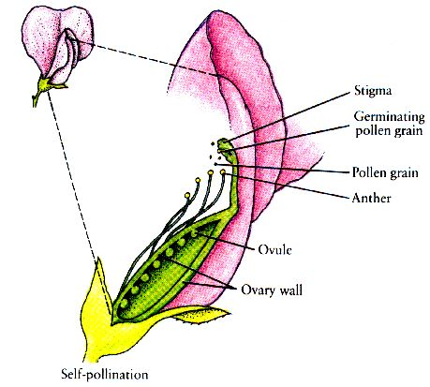
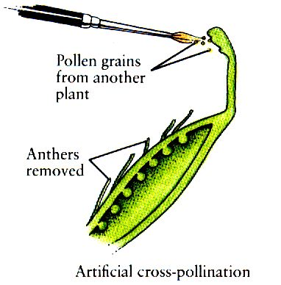
Test Crossing Experiments
in Pea Plants
Notes:
Figure 8.1a Three functions of cell division. (Part 1)

Slide 25
Dominant traits: phenotypic effect of allele is the same for both homologous and heterologous genotypes (TT and Tt are both tall)
Recessive traits: phenotypic effect of allele is masked by the dominant heterologous genotype (only tt is short)
Generations
P - parental generation
F₁ - first generation of offspring
F₂ - second generation of offspring
F_{n} - subsequent generations of offspring
Alleles: two forms of a gene
homozygous: two alleles are the same for a trait (YY or yy)
heterozygous: two alleles are not the same for a trait (Yy)
Phenotype: outward appearance and observable characteristics of an organism
Genotype: the actual genetic makeup of an organism
Notes:
Figure 8.1a Three functions of cell division. (Part 1)

Slide 26
Flower color
W = purple
w = white
Genotype
Phenotype
WW
Purple
Ww
Purple
ww
White
Height of pea plants
T = tall
t = short
Genotype
Phenotype
TT
Tall
Tt
Tall
tt
Short
Notes:
Figure 8.1a Three functions of cell division. (Part 1)

Slide 27
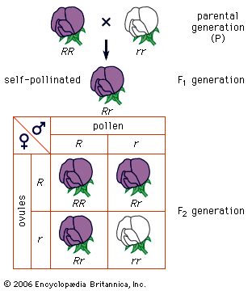
Mendel’s First Law: Principle of Segregation
WW
ww
Ww
W
w
W
WW
Ww
w
Ww
ww
Notes:
Figure 8.1a Three functions of cell division. (Part 1)

Slide 28
Mendelian Genetics - Punnett Squares
P generation
WW = Purple
ww = White
F₁
W
W
w
Ww | Ww
Ww | Ww
F₂
F₃
W
w
W
W
w
WW | Ww
Ww | ww
WW | WW
WW | WW
W
W
All Purple
w
W
3:1
Purple:White
All Purple
F₃
F₃
w
w
W
w
ww | ww
ww | ww
W
WW | Ww
Ww | ww
w
w
w
3:1
Purple:White
All White
Notes:
Figure 8.1a Three functions of cell division. (Part 1)

Slide 29
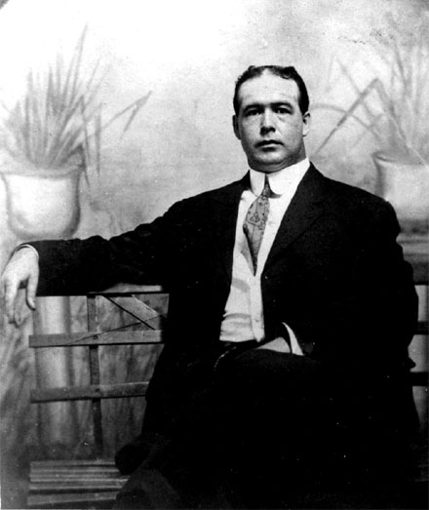
Walter Sutton – Figured out the role of the chromosomes
“Mendel said traits come in pairs and chromosomes come in pairs,
So maybe the traits are on the chromosomes….no wait that’s too easy.”
Notes:
Figure 8.1a Three functions of cell division. (Part 1)

Slide 30
Notes:
Figure 8.1a Three functions of cell division. (Part 1)

Slide 31
BCC Bio 10 - Spring 2020
Section #4 – Lecture #4.3

Slide 32
Chapter 9
0
Genetics

Slide 33
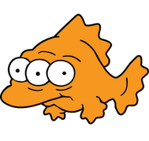
What is a Mutation?
Notes:
Figure 8.1a Three functions of cell division. (Part 1)

Slide 34
Mendel’s First Law: Principle of Segregation
WW
ww
Ww
W
w
W
WW
Ww
w
Ww
ww
Notes:
Figure 8.1a Three functions of cell division. (Part 1)

Slide 35
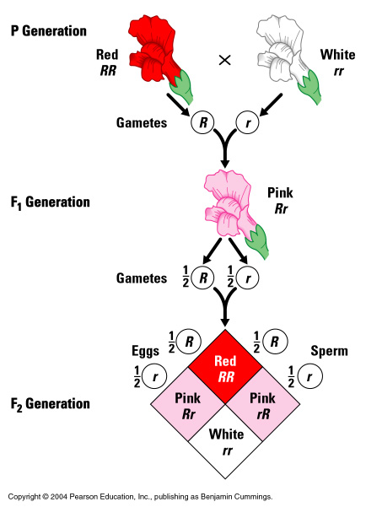
Incomplete dominance – Snap dragons
Notes:
Figure 8.1a Three functions of cell division. (Part 1)

Slide 36
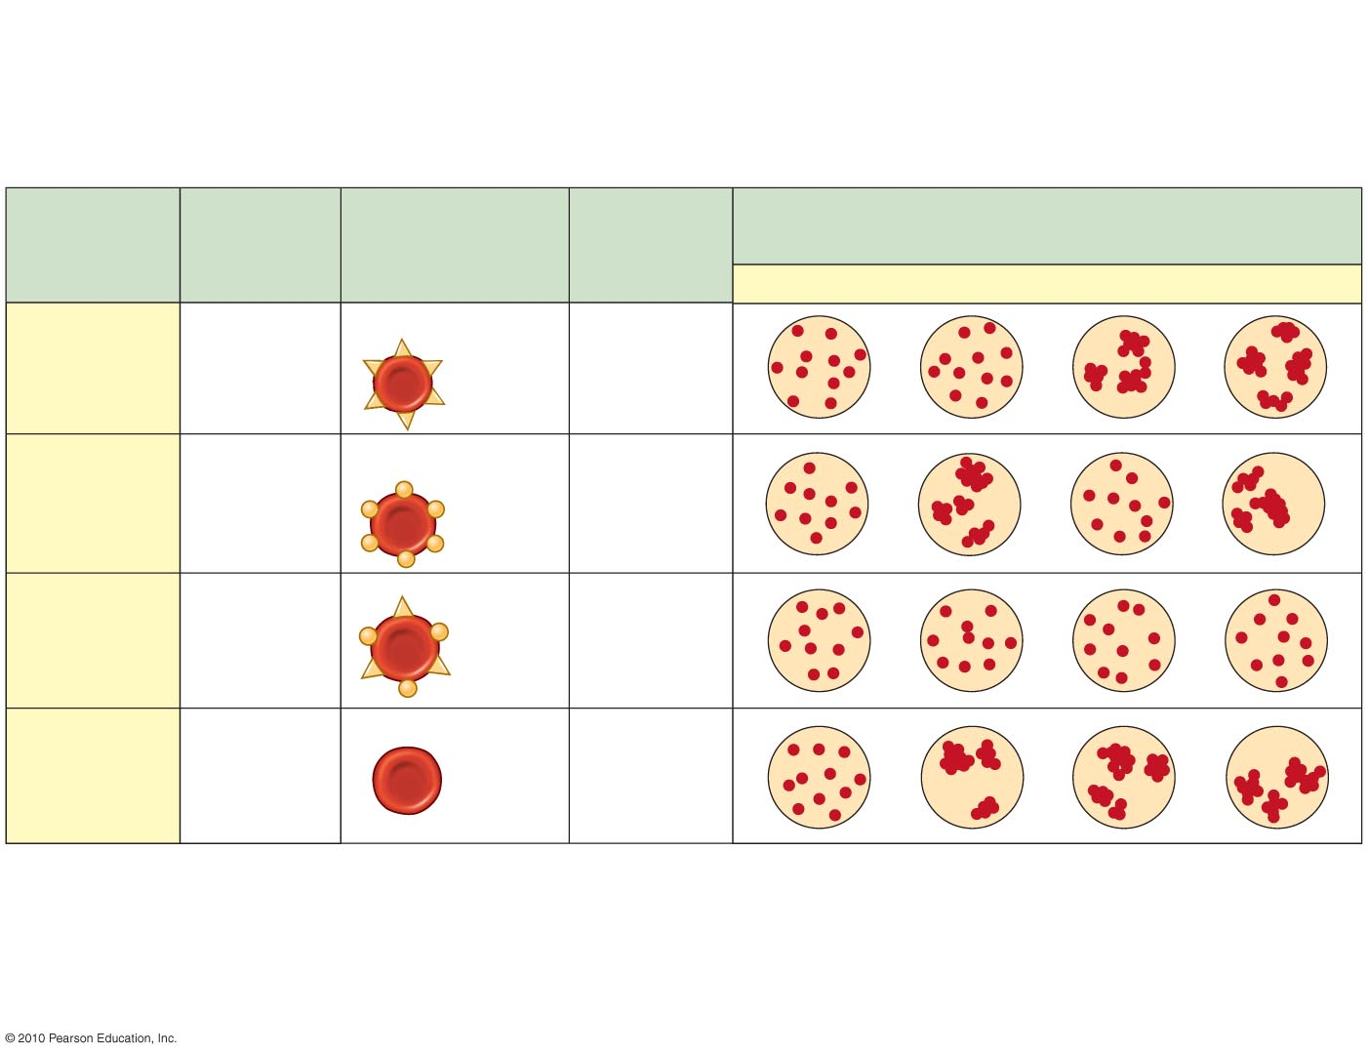
Codominance – Blood Types
Blood
Group
(Phenotype)
Antibodies
Present in
Blood
Reactions When Blood from Groups Below Is
Mixed with Antibodies from Groups at Left
Genotypes
Red Blood Cells
O
A
B
AB
I^{A}I^{A}
or
I^{A}i
Carbohydrate A
A
Anti-B
Carbohydrate B
I^{B}I^{B}
or
I^{B}i
B
Anti-A
AB
I^{A}I^{B}
—
O
ii
Anti-A
Anti-B
Figure 9.20
Notes:
Figure 9.20 Multiple alleles for the ABO blood groups.

Slide 37
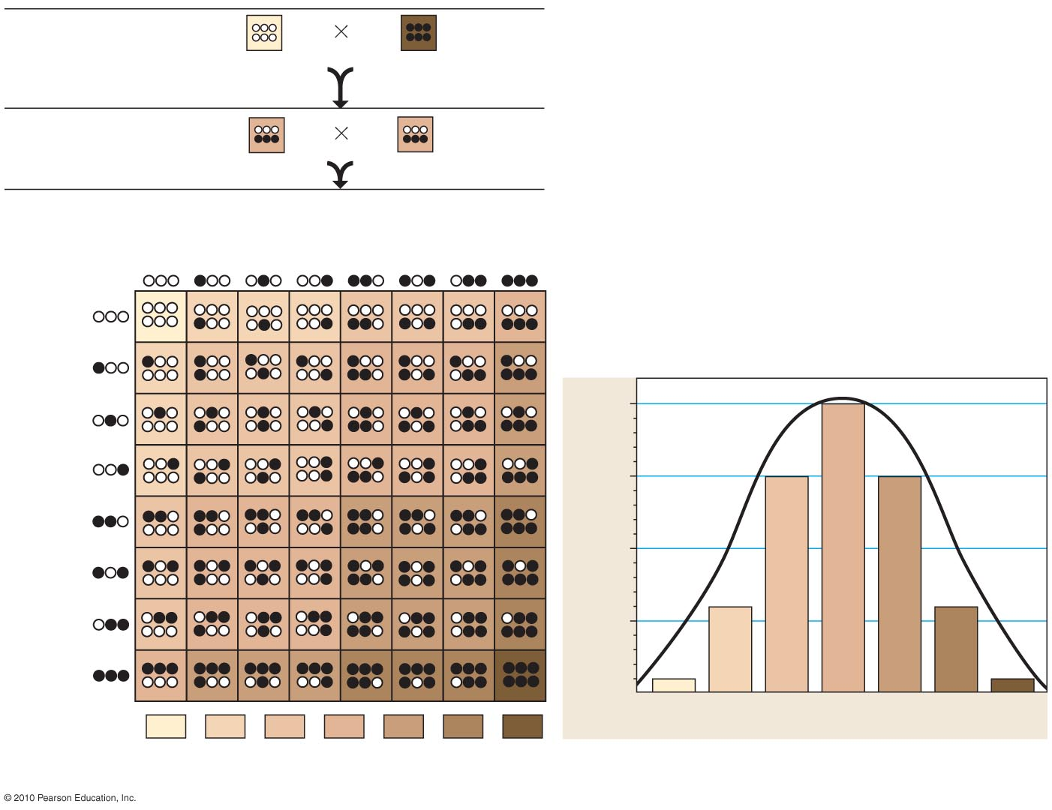
P Generation
Polygenic
Inheritance
aabbcc
(very light)
AABBCC
(very dark)
F₁ Generation
AaBbCc
AaBbCc
F₂ Generation
Sperm
1
1
1
1
1
1
1
1
8
8
8
8
8
8
8
8
1
8
1
8
20
1
64
8
1
15
Eggs
8
64
1
8
Fraction of population
1
8
6
1
64
8
1
1
8
64
Skin pigmentation
1
6
15
20
15
6
1
64
64
64
64
64
64
64
Figure 9.22
Notes:
Figure 9.22 A model for polygenic inheritance of skin color.

Slide 38
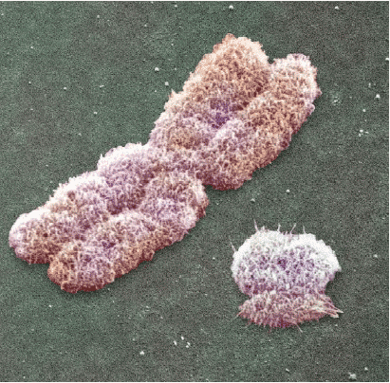
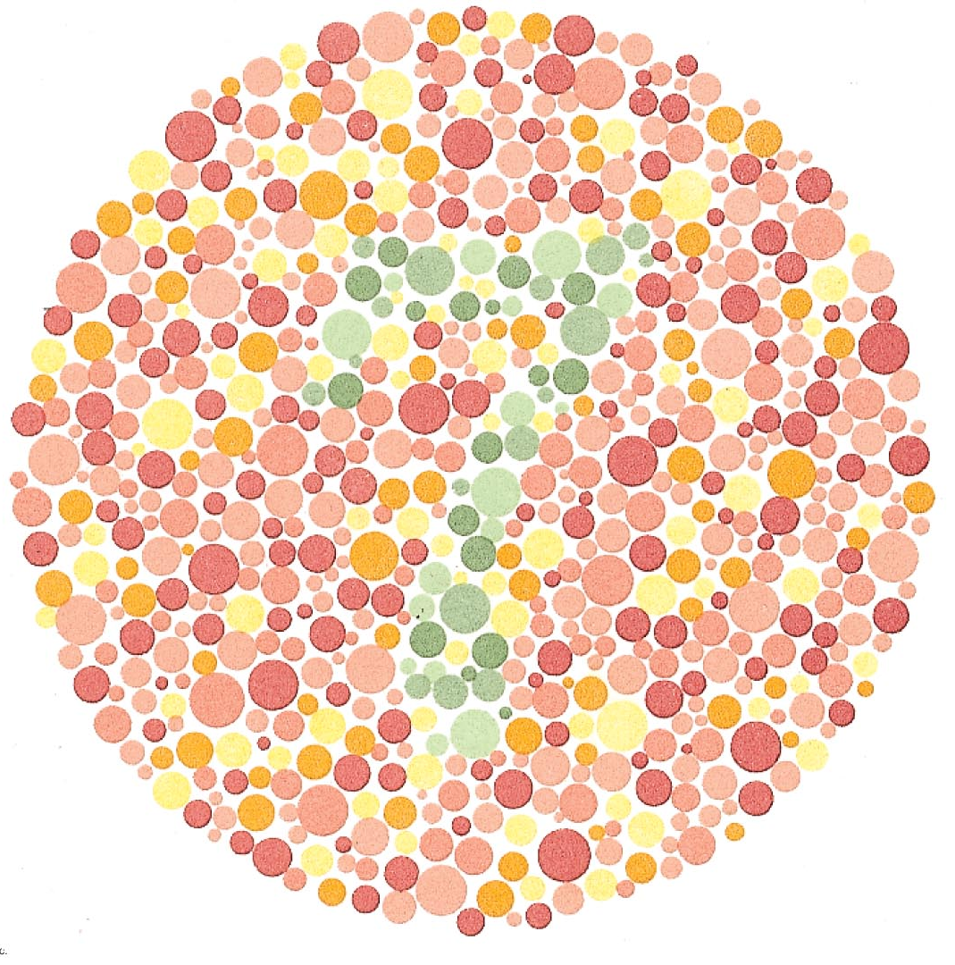
Sex Linked
Characteristics
Notes:
Figure 9.30 A test for red-green colorblindness.

Slide 39
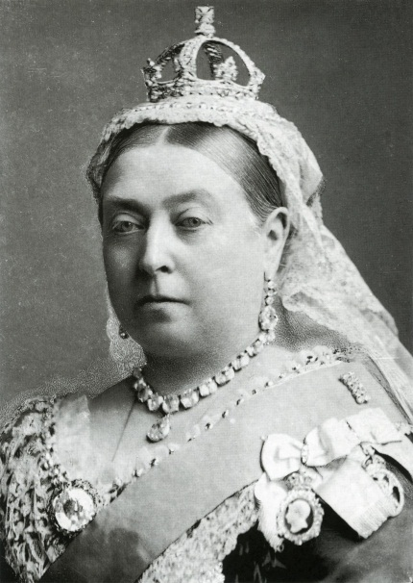
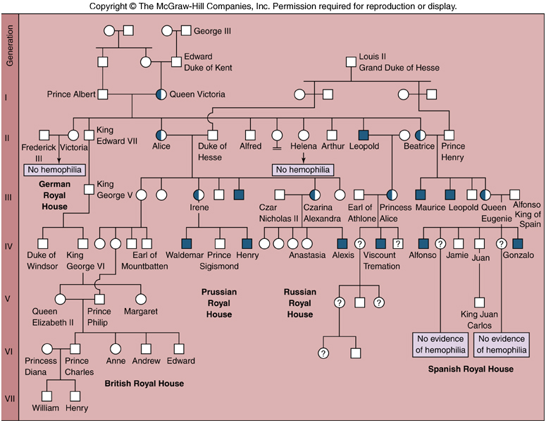
Sex Linked Characteristics
Notes:
Figure 8.1a Three functions of cell division. (Part 1)

Slide 40
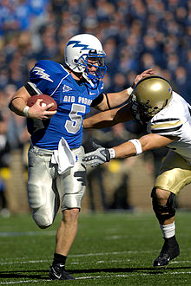
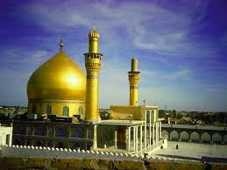
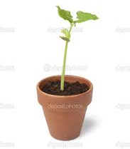
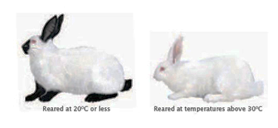
Genes and the Environment
Notes:
Figure 8.1a Three functions of cell division. (Part 1)

Slide 41
Notes:
Figure 8.1a Three functions of cell division. (Part 1)

