Slide 1
Chapter 13
0
How Populations Evolve

Slide 2
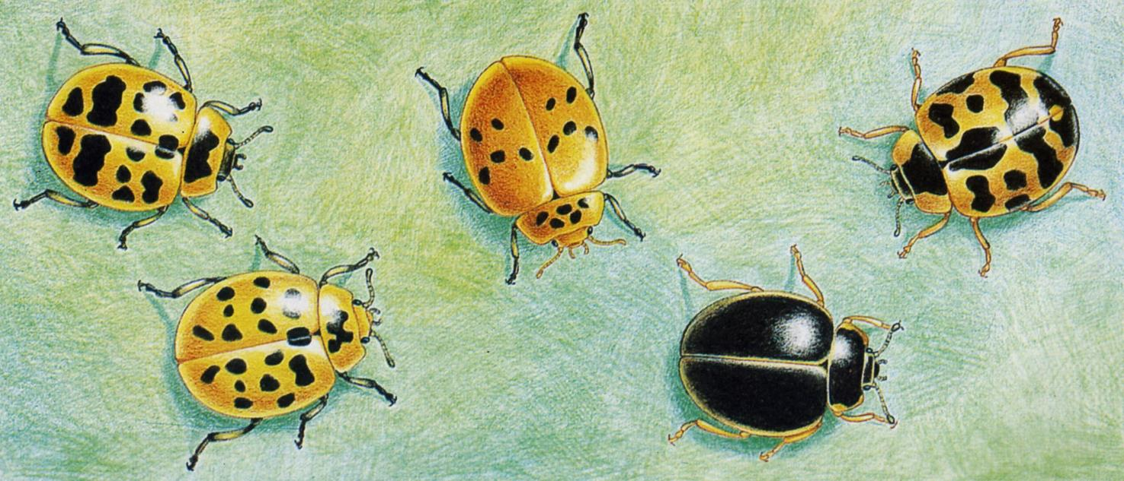
Polymorphisms
Notes:
Figure 8.1a Three functions of cell division. (Part 1)

Slide 3
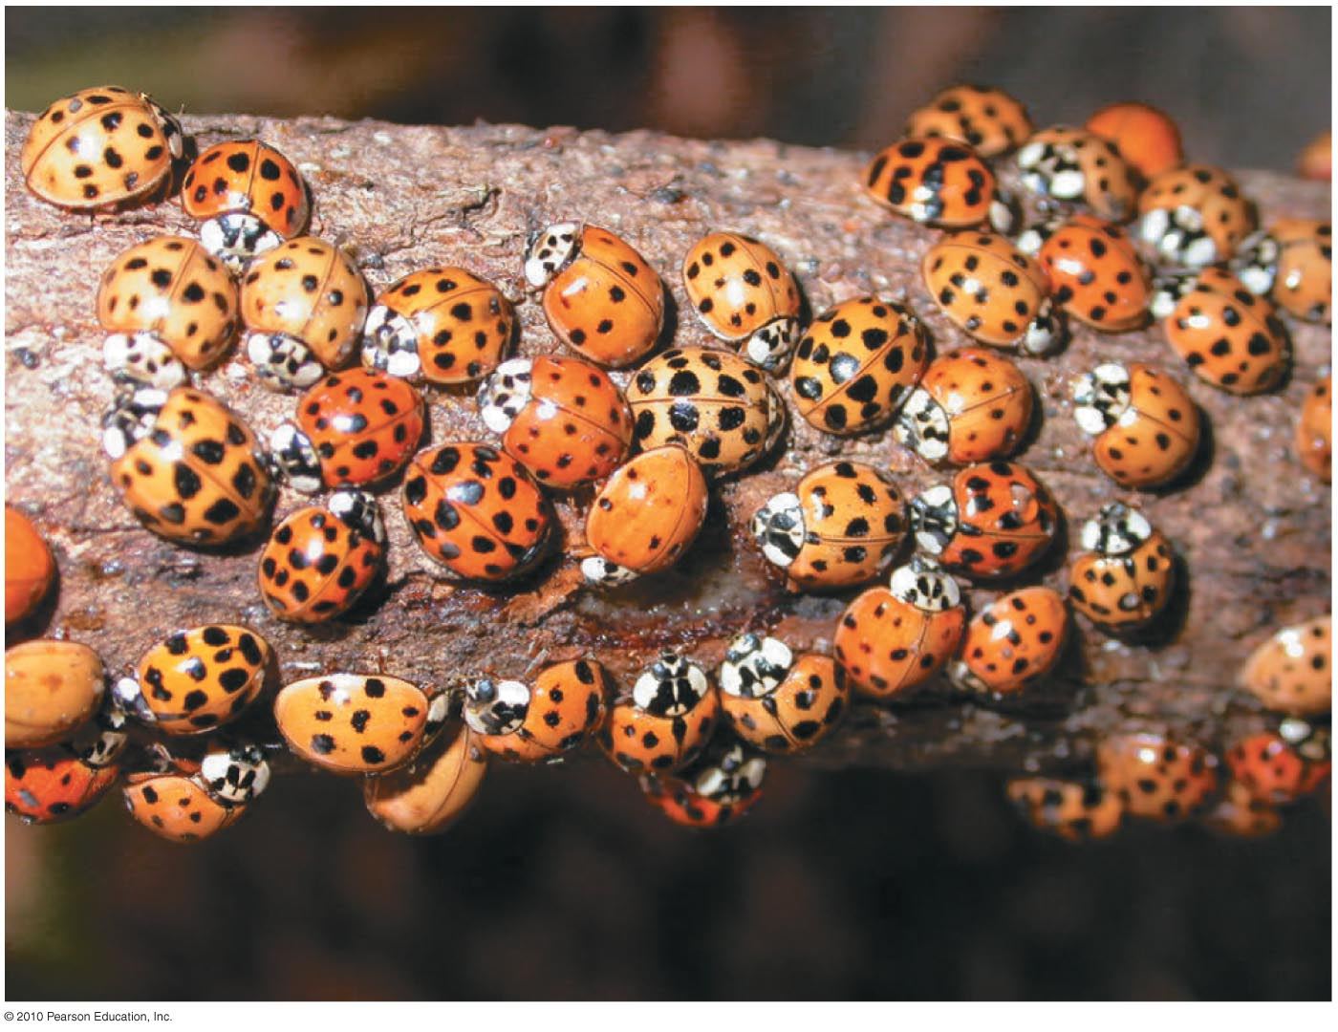
Figure 13.13
Notes:
Figure 13.13 Color variations within a single species of Asian lady beetles

Slide 4
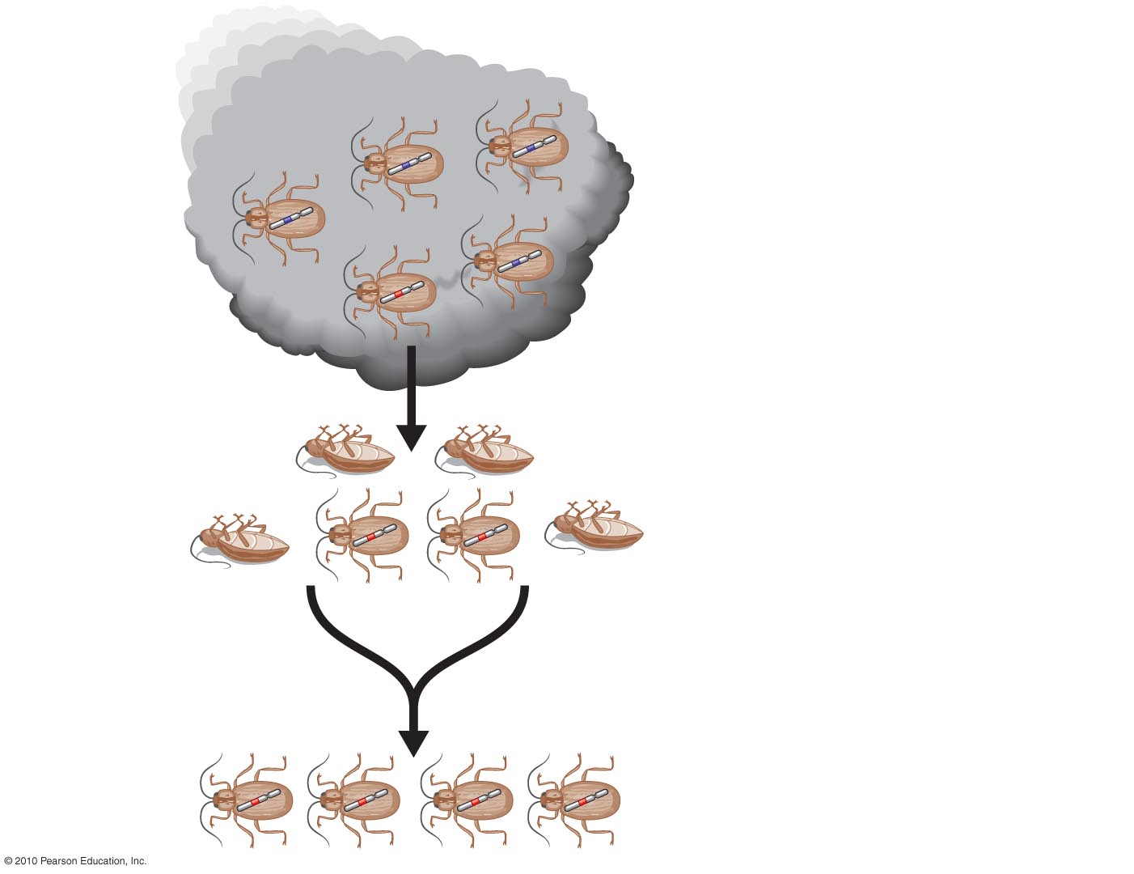
Insecticide application
Selection Pressure
Chromosome with gene
conferring resistance
to pesticide
Survivors
Reproduction
Figure 13.14-3
Notes:
Figure 13.14 Evolution of pesticide resistance in insect populations (Step 3)

Slide 5
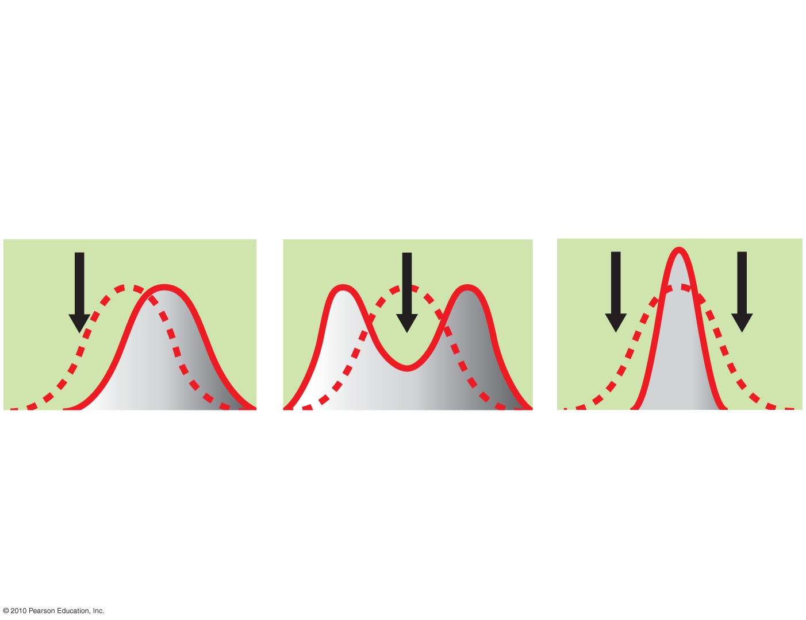
Different Types of Selection
Evolved
population
Original
population
Pressure of
natural selection
Directional selection
Disruptive selection
Stabilizing selection
Figure 13.UN5
Notes:
Figure 13.UN5 Summary: outcomes of natural selection

Slide 6
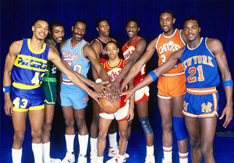
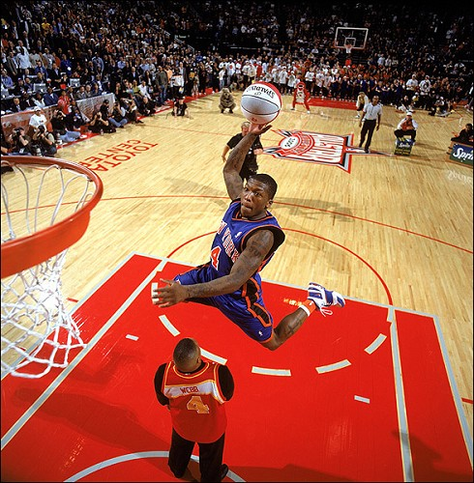
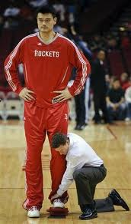
Selection Pressure
Notes:
Figure 8.1a Three functions of cell division. (Part 1)

Slide 7
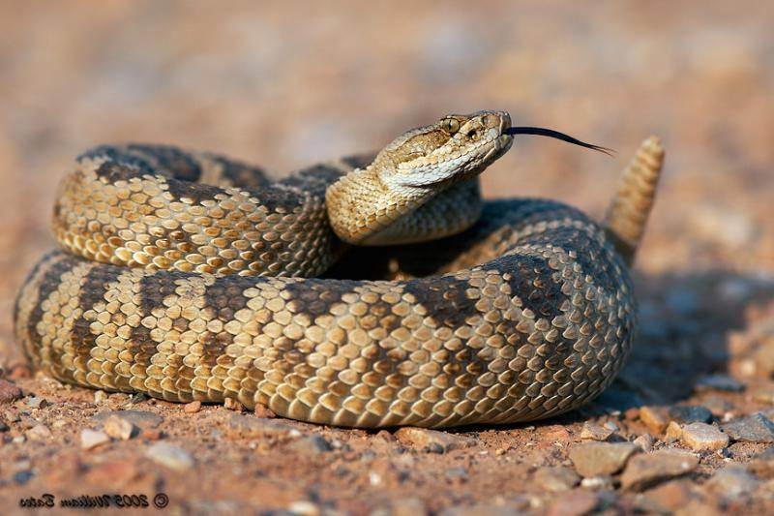
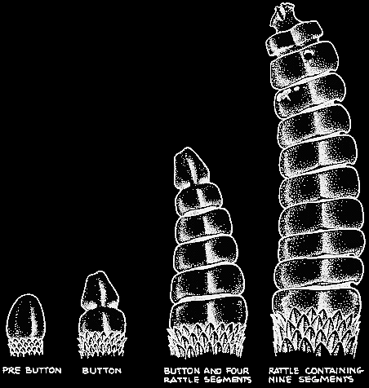
Selection Pressures
Notes:
Figure 8.1a Three functions of cell division. (Part 1)

Slide 8
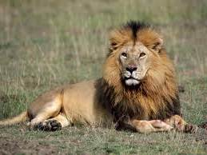
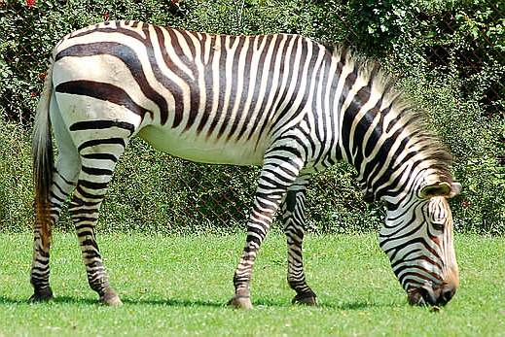
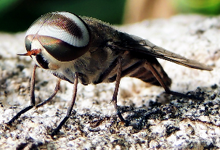
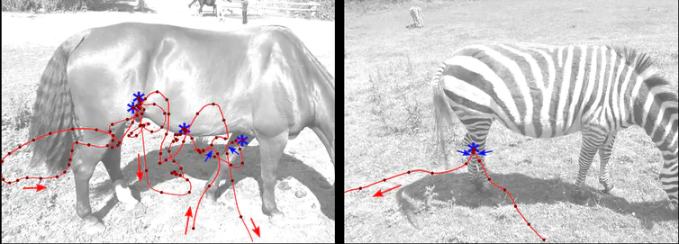
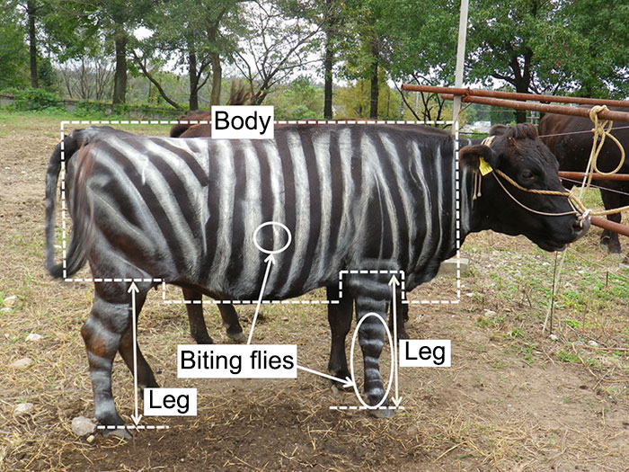
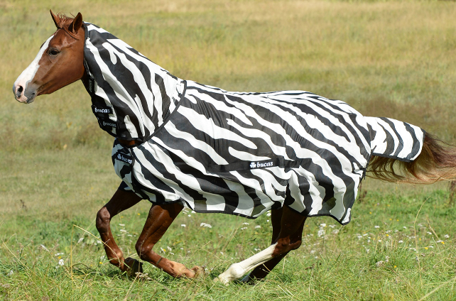
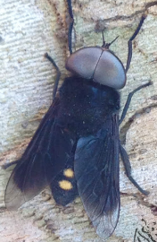
Selection
Pressures
Notes:
Figure 8.1a Three functions of cell division. (Part 1)

Slide 9
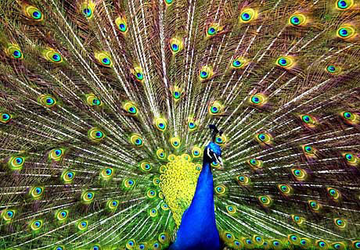
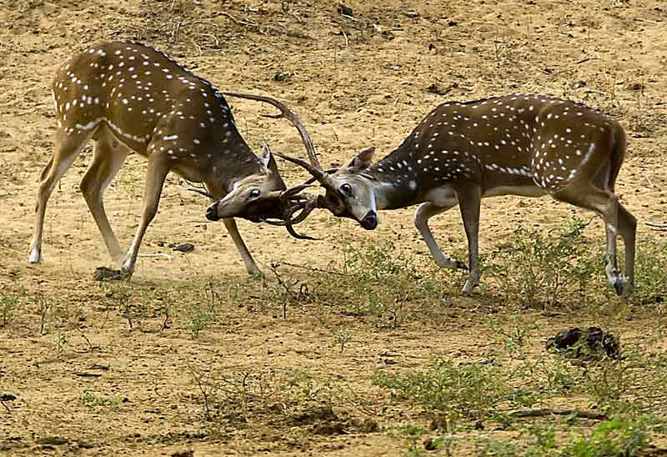
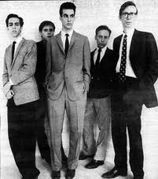
Evolution of Complex
Behaviors Through
Selection
Notes:
Figure 8.1a Three functions of cell division. (Part 1)

Slide 10
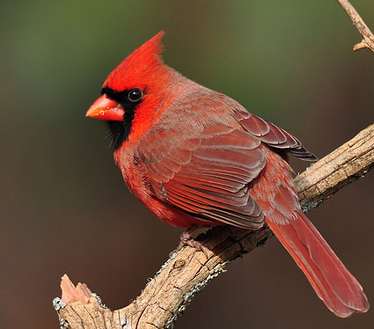
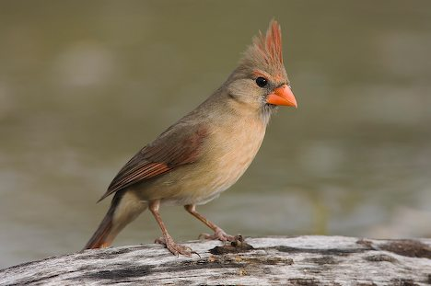
Sexual Dimorphism in the
Northern Cardinal
Female
Male
Notes:
Figure 8.1a Three functions of cell division. (Part 1)

Slide 11
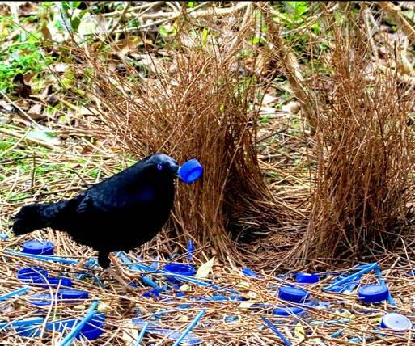
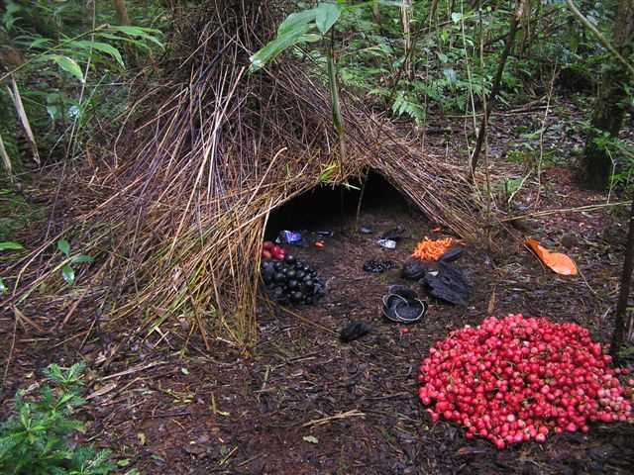
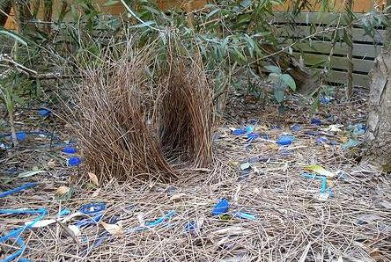
Bower Birds
Notes:
Figure 8.1a Three functions of cell division. (Part 1)

Slide 12
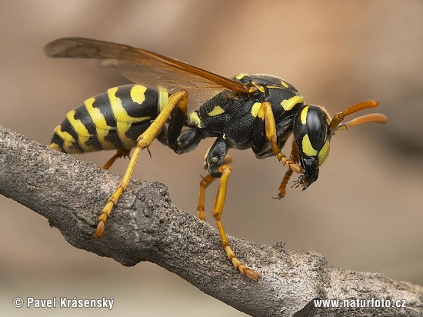
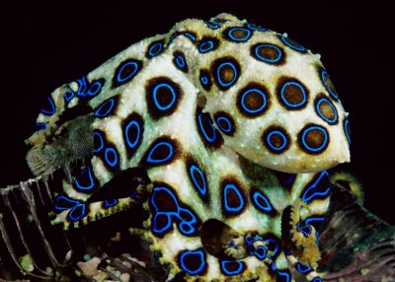
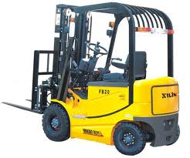
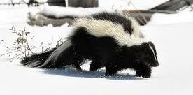
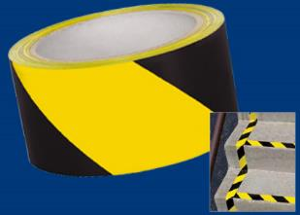
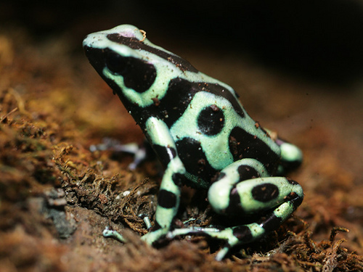
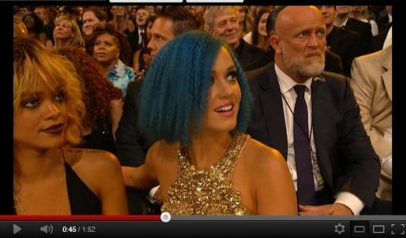
Warning Coloration
Notes:
Figure 8.1a Three functions of cell division. (Part 1)

Slide 13
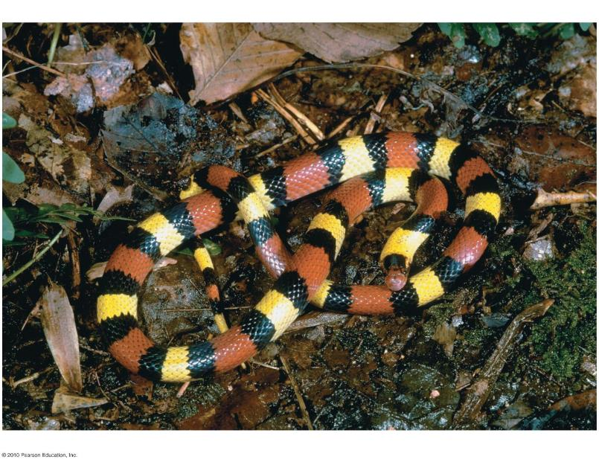
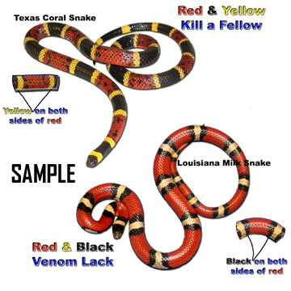
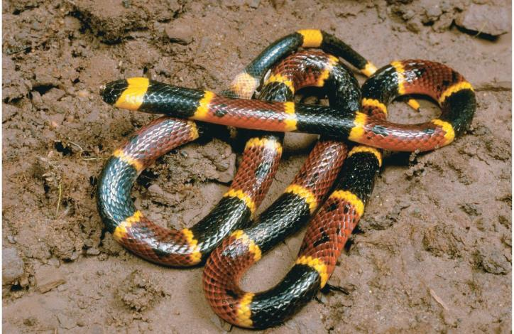
Mimicry
Figure 20.12a
Notes:
Figure 20.12a Mimicry in snakes

Slide 14
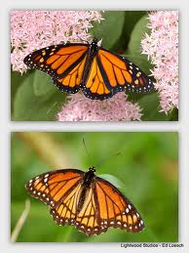
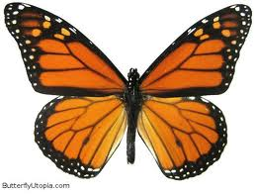
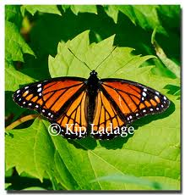
Mimicry
Notes:
Figure 8.1a Three functions of cell division. (Part 1)

Slide 15
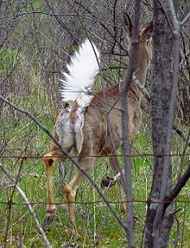
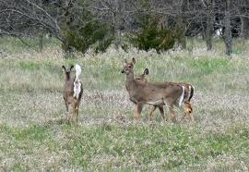
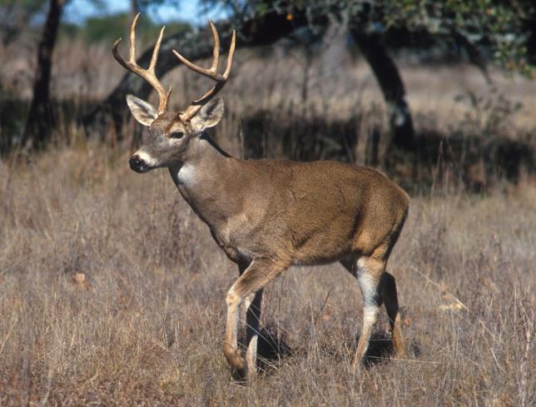
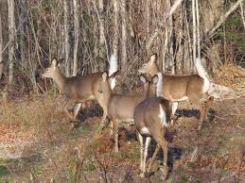
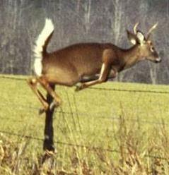
Releasing
Cues
Notes:
Figure 8.1a Three functions of cell division. (Part 1)

Slide 16
Notes:
Figure 8.1a Three functions of cell division. (Part 1)

Slide 17
Organization of all the Organisms

Slide 18
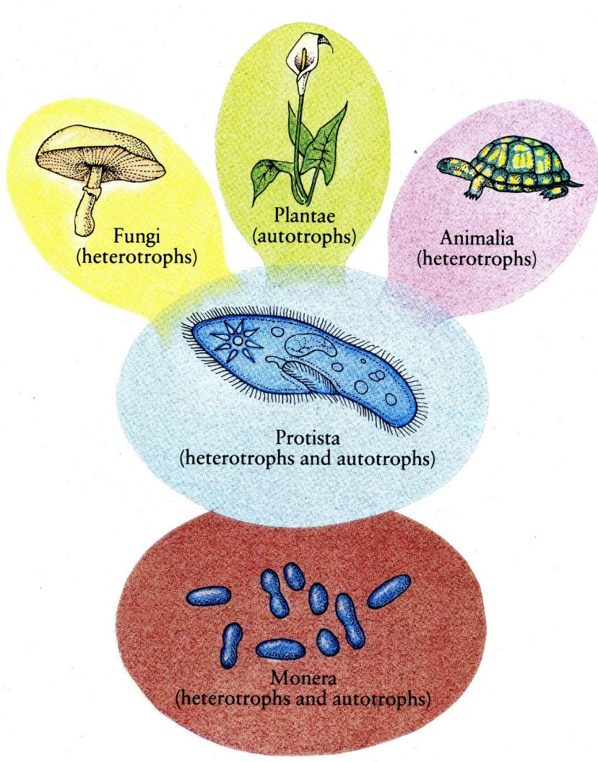

Slide 19
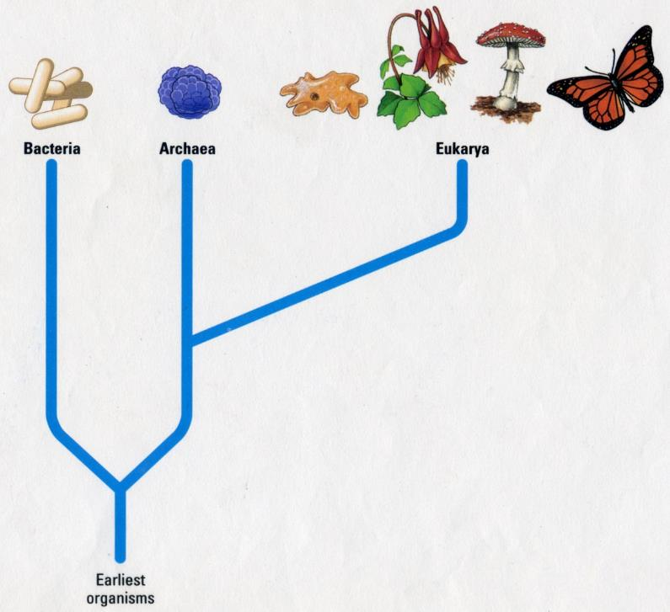
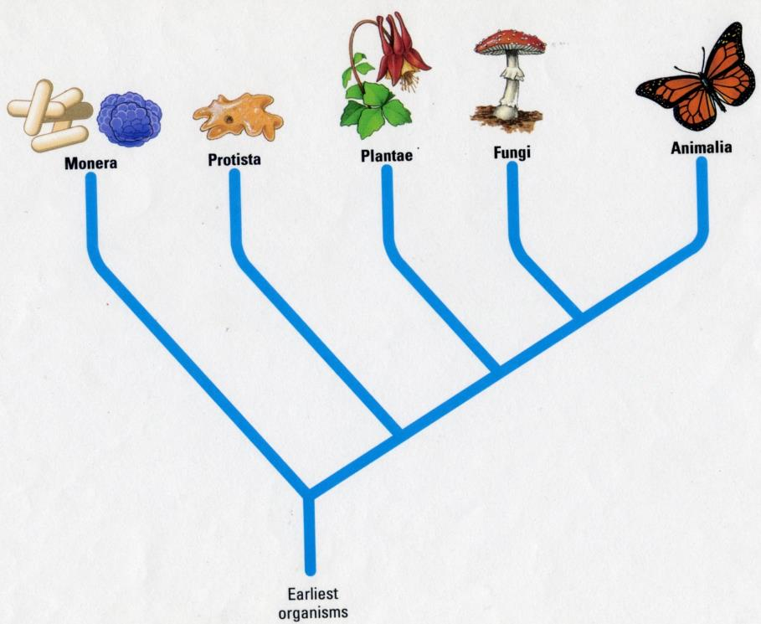
Organizational
Schemes
3 Domains
5 Kingdoms
Notes:
Figure 8.1a Three functions of cell division. (Part 1)

Slide 20
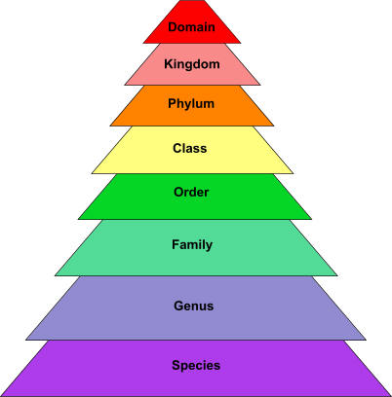
Organizational
Scheme
Notes:
Figure 8.1a Three functions of cell division. (Part 1)

Slide 21
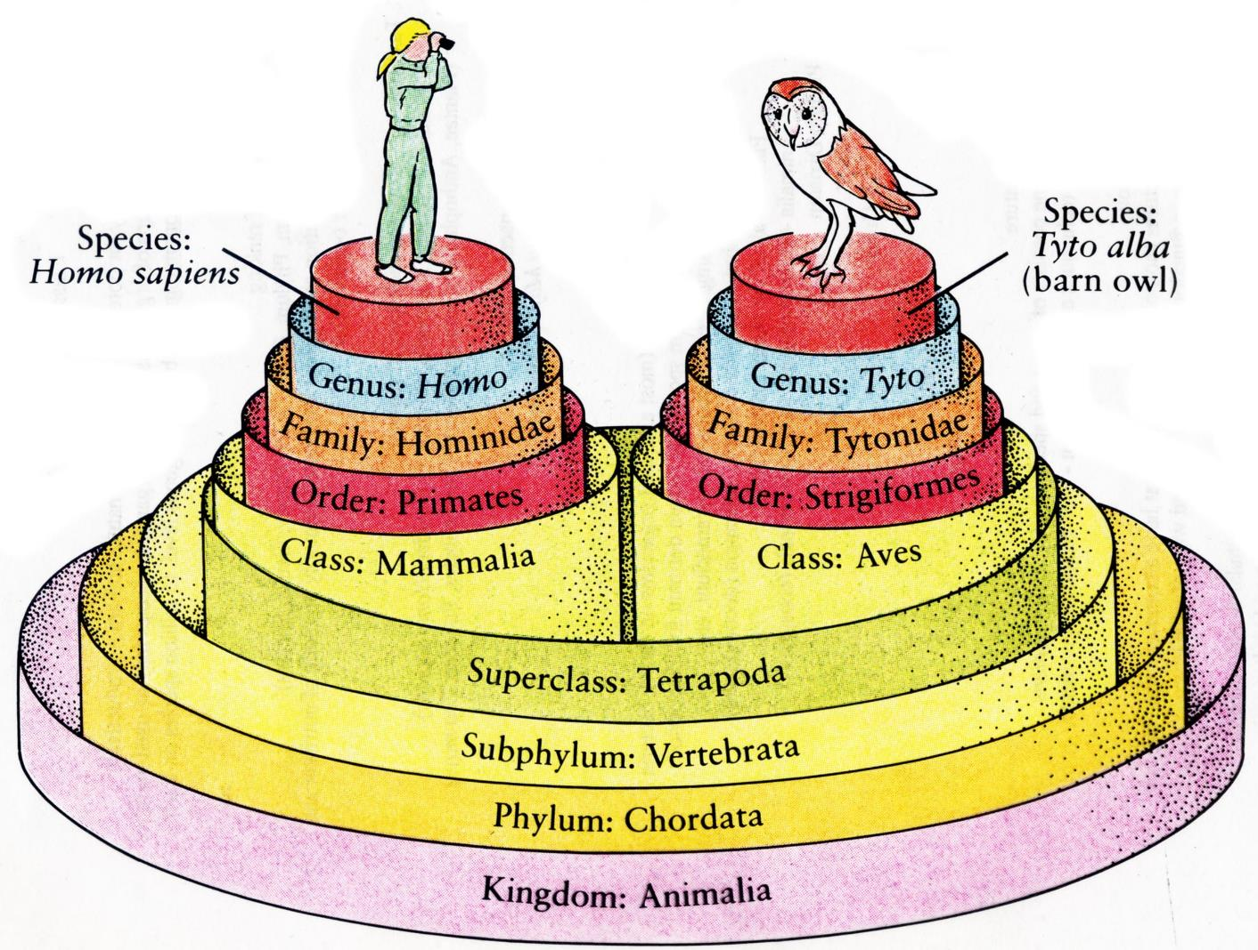
Notes:
Figure 8.1a Three functions of cell division. (Part 1)

Slide 22
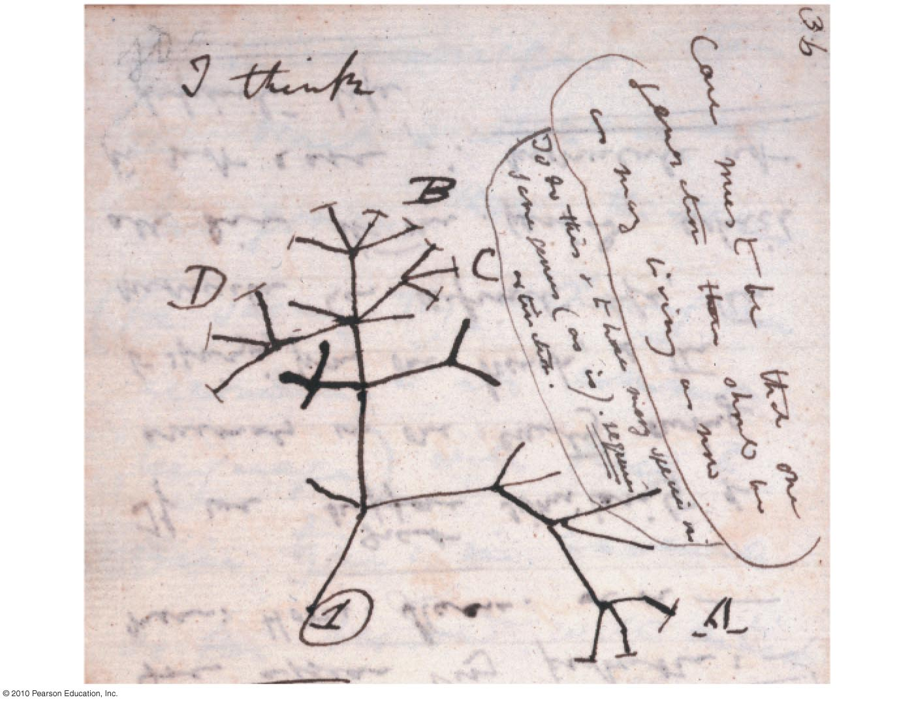
Figure 13.2c
Notes:
Figure 13.2c Page from Darwin's notes

Slide 23
Darwin in 1840
Great
Britain
Asia
Europe
North
America
ATLANTIC
OCEAN
HMS Beagle
Africa
Galápagos
Islands
PACIFIC
OCEAN
Pinta
Marchena
Genovesa
South
America
Equator
Santiago
Equator
Pinzón
Daphne Islands
Australia
Fernandina
Cape of
Good Hope
Isabela
Santa
Cruz
Santa
Fe
PACIFIC
OCEAN
Andes
San
Cristobal
0
40 km
Florenza
Española
Cape Horn
Tasmania
0
40 miles
New
Zealand
Tierra del Fuego
Figure 13.3
Notes:
Figure 13.3 The voyage of the Beagle

Slide 24
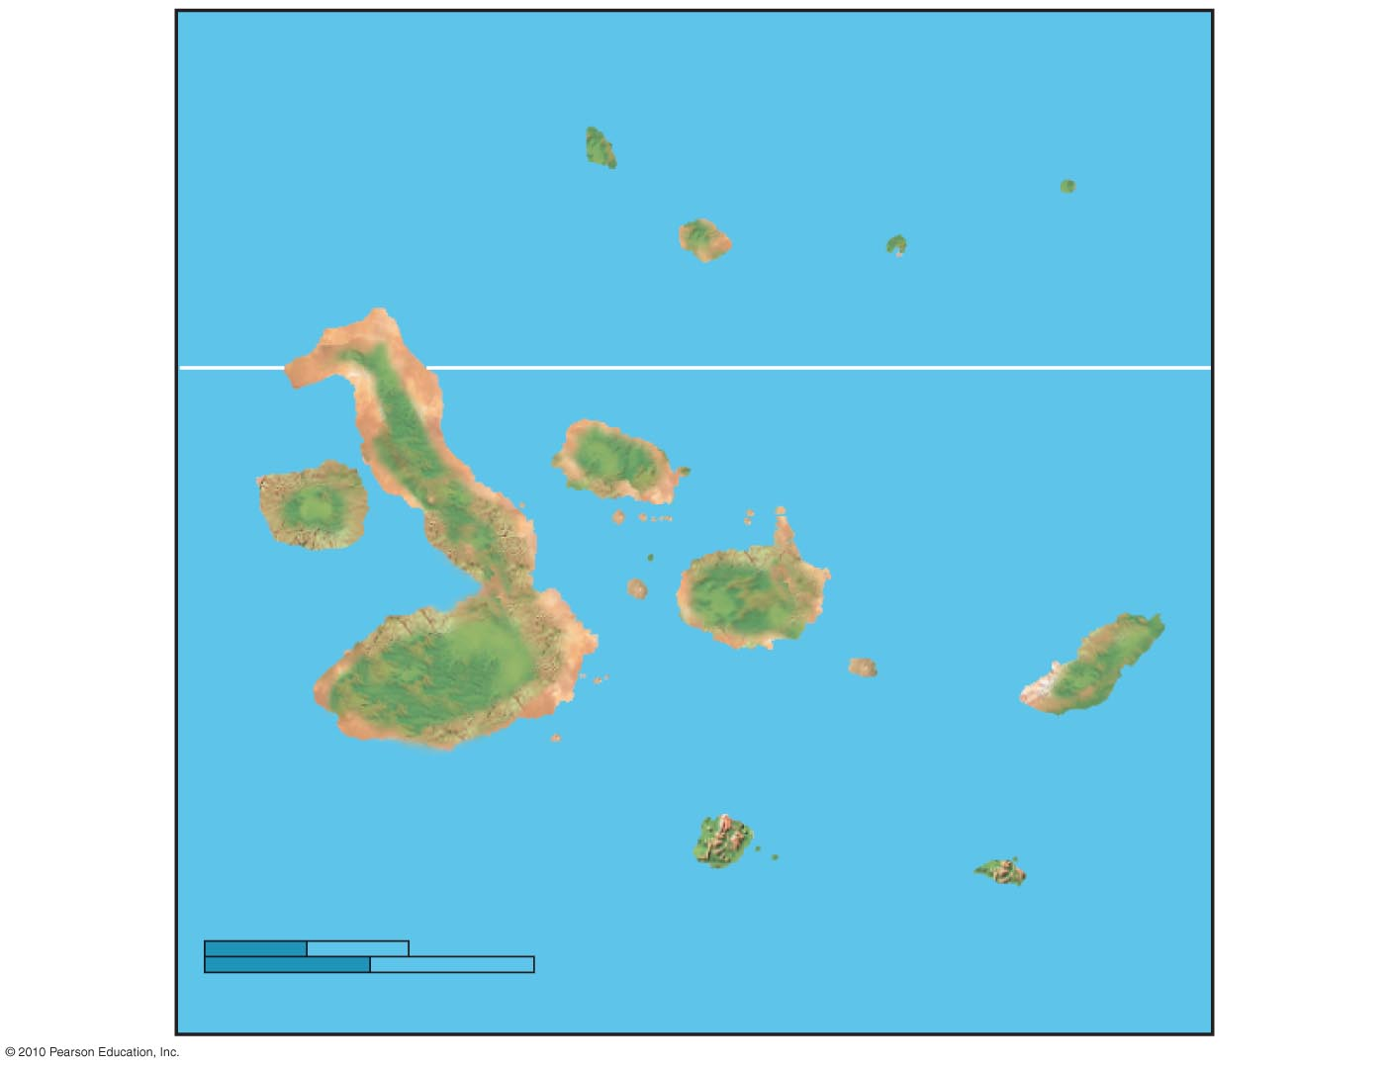
Galápagos
Islands
PACIFIC
OCEAN
Pinta
Genovesa
Marchena
Equator
Santiago
Daphne Islands
Pinzón
Fernandina
Isabela
Santa
Cruz
Santa
Fe
San
Cristobal
0
40 km
Florenza
Española
0
40 miles
Figure 13.3c
Notes:
Figure 13.3c The Galápagos Islands

Slide 25
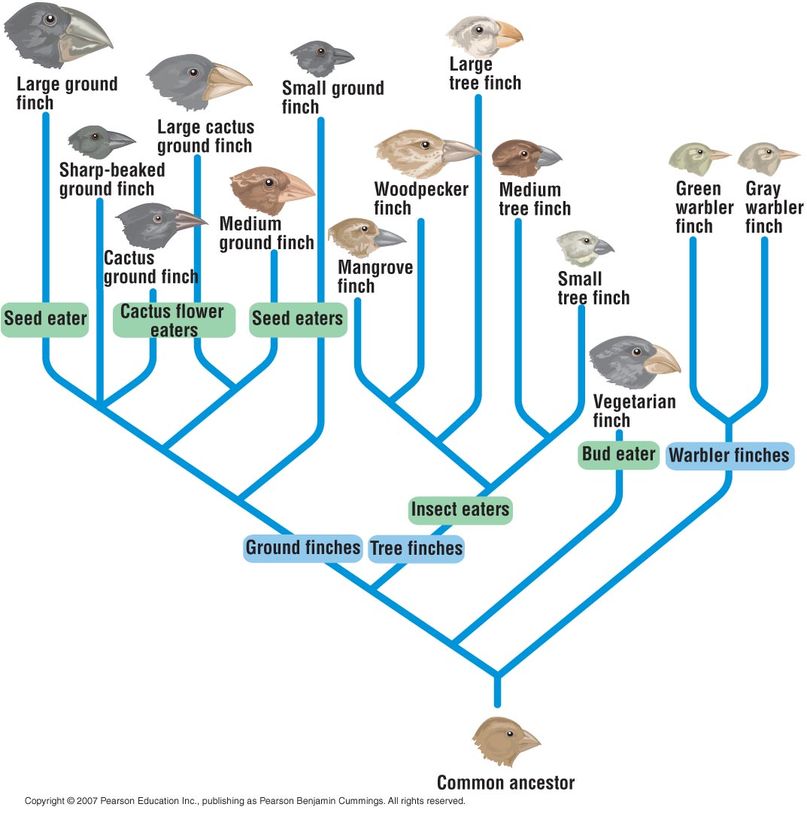
Notes:
Figure 8.1a Three functions of cell division. (Part 1)

Slide 26
Notes:
Figure 8.1a Three functions of cell division. (Part 1)

Slide 27
Notes:
Figure 8.1a Three functions of cell division. (Part 1)

Slide 28
Notes:
Figure 8.1a Three functions of cell division. (Part 1)

Slide 29
Divergent Evolution of Mammalian Arms
Notes:
Figure 8.1a Three functions of cell division. (Part 1)

Slide 30
Humans and Other Apes
Notes:
Figure 8.1a Three functions of cell division. (Part 1)

Slide 31
Human Hands
Notes:
Figure 8.1a Three functions of cell division. (Part 1)

Slide 32
Human
Eyes
&
Ears
Notes:
Figure 8.1a Three functions of cell division. (Part 1)

Slide 33
Human Hair and Pigmentation
Notes:
Figure 8.1a Three functions of cell division. (Part 1)

Slide 34
Figure 13.8
Notes:
Figure 13.8 Homologous structures: anatomical signs of descent with modification

Slide 35
Chapter 14
0
How Biological Diversity Evolves

Slide 37
Colorized SEM
Figure 15.8b
Notes:
Figure 15.8b Three common shapes of prokaryotic cells

Slide 38
Colorized SEM
Figure 15.8a
Notes:
Figure 15.8a Three common shapes of prokaryotic cells

Slide 39
Prokaryotes
Colorized SEM
Figure 15.7
Notes:
Figure 15.7 Bacteria on the head of a pin

Slide 40
Plants Evolved
From Green Algae

Slide 41
Fungi
Notes:
Figure 16.22d A gallery of diverse fungi

Slide 42
Fungi
Notes:
Figure 16.22d A gallery of diverse fungi

Slide 43
Notes:
Figure 16.22b A gallery of diverse fungi

Slide 44
Penicillium
Zone of inhibited growth
Staphylococcus
Antibiotics
Notes:
Figure 16.27 Fungal production of an antibiotic

Slide 45
Plant
Adaptations
Leaves
Gametangia
Stomata
Cuticle
Lignin
Shoot
Vascular tissues
Roots
Figure 16.UN07
Notes:
Figure 16.UN07 Summary: Terrestrial Adaptations of Plants

Slide 46
Scale
Seed Adaptations
Ovule-producing
cones; the scales
contain female
gametophytes
Pollen-producing
cones; they
produce male
gametophytes
Ponderosa pine
Figure 16.15
Notes:
Figure 16.15 A pine tree, the sporophyte, bearing two types of cones containing gametophytes

Slide 47
Seed Adaptations
Notes:
Figure 16.22d A gallery of diverse fungi

Slide 48
Radial vs Bilateral Symmetry
Notes:
Figure 8.1a Three functions of cell division. (Part 1)

Slide 49
Amniotic Egg
Notes:
Figure 8.1a Three functions of cell division. (Part 1)

Slide 50
Yes, insects are awesome
Longhorn beetle
Figure 17.23f
Notes:
Figure 17.23f Insect diversity: longhorn beetle

Slide 51
A Trinidad tree mantid that
mimics dead leaves
A flower mantid in Malaysia
A leaf mantid in
Costa Rica
Figure 13.1
Notes:
Figure 13.1 Camouflage as an example of evolutionary adaptation

Slide 52
Stick Insects
Notes:
Figure 8.1a Three functions of cell division. (Part 1)

Slide 53
Butterflies and Moths
Notes:
Figure 8.1a Three functions of cell division. (Part 1)

Slide 54
Metamorphosis
In Insects
Notes:
Figure 8.1a Three functions of cell division. (Part 1)

Slide 55
Figure 13.8
Notes:
Figure 13.8 Homologous structures: anatomical signs of descent with modification

Slide 56
Chapter 18
0
An Introduction to Ecology and the Biosphere

Slide 57
Food Chains and Food Webs
Notes:
Figure 8.1a Three functions of cell division. (Part 1)

Slide 58
Food Webs
Notes:
Figure 8.1a Three functions of cell division. (Part 1)

Slide 59
Quaternary,
Food Webs
tertiary,
and secondary
consumers
Tertiary
and
secondary
consumers
Secondary
and
primary
consumers
Primary
consumers
Producers
(plants)
Figure 20.18
Notes:
Figure 20.18 A simplified food web for a Sonoran desert community

Slide 60
CO₂ in atmosphere
Burning
Cellular respiration
Photosynthesis
Higher-level
consumers
Plants, algae,
cyanobacteria
Wood
and fossil
fuels
Primary
consumers
Decomposition
Wastes; death
Plant litter;
death
Decomposers
(soil microbes)
Detritus
Figure 20.32
Notes:
Figure 20.32 The carbon cycle

Slide 61
Nitrogen Cycle
Nitrogen (N₂) in atmosphere
Plant
Animal
Organic
compounds
Organic
compounds
Assimilation
by plants
Nitrogen
fixation
Death; wastes
Denitrifying
bacteria
Nitrogen-fixing
bacteria in
root nodules
Nitrates
In soil
(NO₃–)
Detritus
Decomposers
Free-living
nitrogen-fixing
bacteria
Nitrifying
bacteria
Decomposition
Nitrogen fixation
Ammonium (NH₄⁺)
in soil
Figure 20.34
Notes:
Figure 20.34 The nitrogen cycle

Slide 62
Bioaccumulation
Notes:
Figure 8.1a Three functions of cell division. (Part 1)

Slide 64
Notes:
Figure 8.1a Three functions of cell division. (Part 1)

