Slide 1
SOD Blitzes: additional information
1-Determining Your GPS Coordinates
2-What if I see no symptoms
3-Tagging trees and tagged trees
www.sodblitz.org

Slide 2
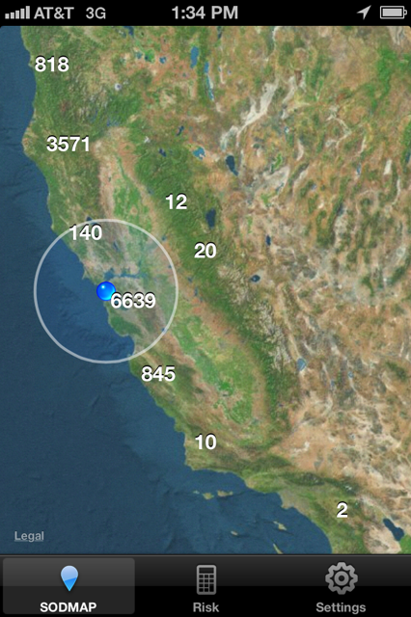
We use our app SODmap Mobile to determine GPS coordinates

Slide 3
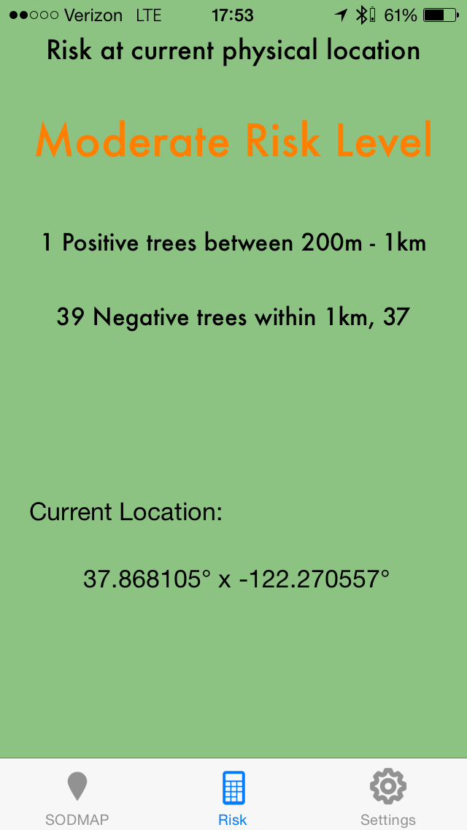
We recommend using the free app SODmap Mobile to map your trees with your iPhone or Android device!
Available on iTunes and Google Play
Tapping the Risk button will give you the
Lat, Long, and Risk at your current site.
When you reach the next site tap
SODMAP and then RISK again to reset
and get the new Lat and Long

Slide 4
If a GPS/smartphone is not available:
On the small collecting envelope or datasheet, write down as much as you can to help you remember where each sample was collected (address, side of street, landmarks)
At home, download and turn on Google Earth
Redo your collecting walk on the computer
Put the mouse on the estimated location of a tree you sampled
At the bottom of the page, you will see Lat. and Long.

Slide 5
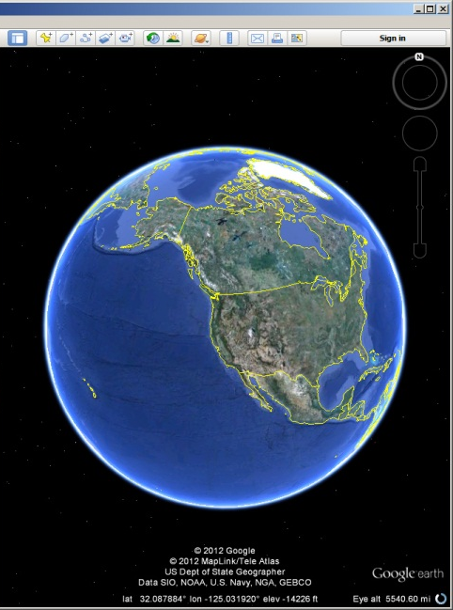
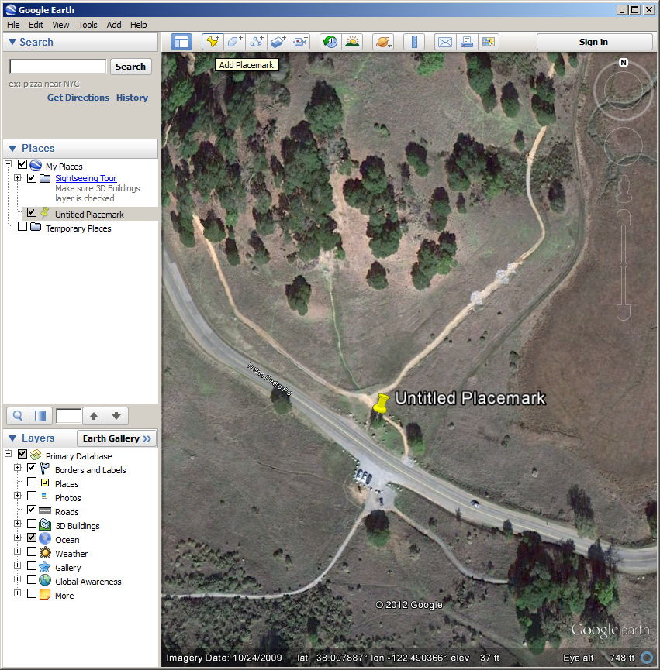
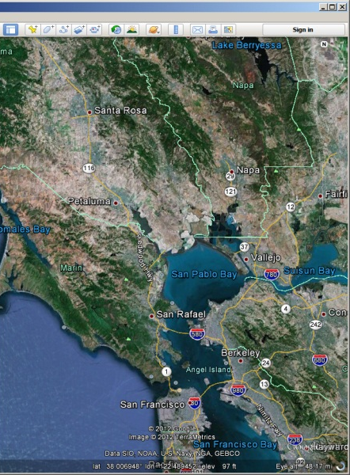
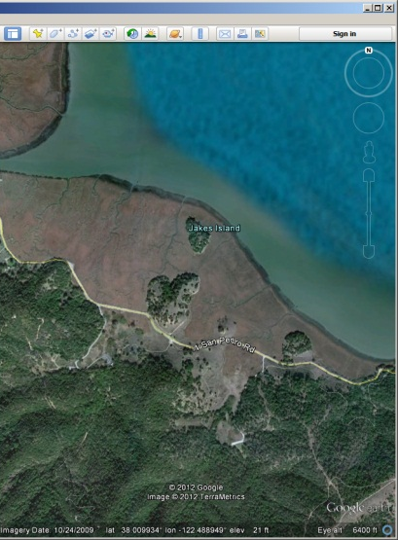
Google
Earth

Slide 6
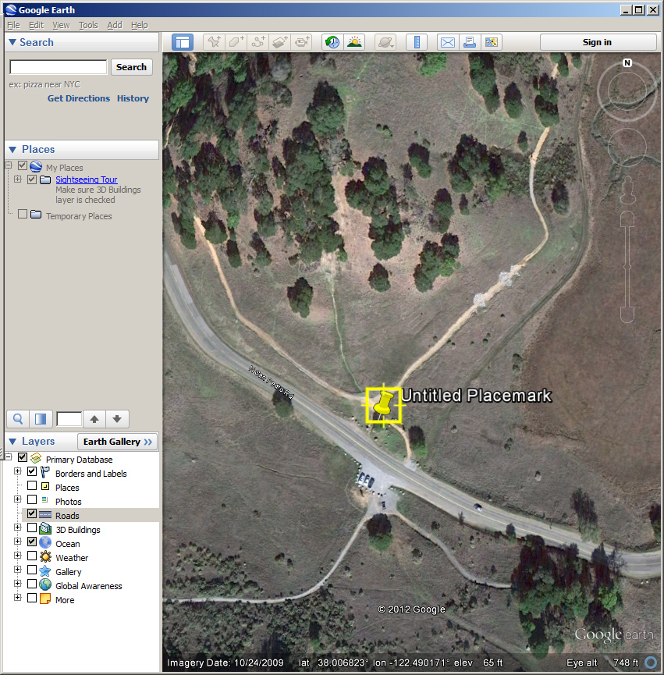
Record
GPS
Coordinates
(all numbers)

Slide 7
Record the coordinates on the SOD Blitz datasheet
Do NOT round off numbers for Lat. and Long.

Slide 8
What if I see no symptoms?
In some areas, SOD may have not arrived yet or may be rare
If you survey an area with bay laurels or tanoaks and do not see any symptoms for a significant stretch ( 10 minutes or 200 yards ), it may be important to include this information for the database. It will warn us that that area was surveyed and at the time of survey there were no obvious symptoms. This information will be included in the SOD Blitz map as a green icon. When a viewer taps the icon a pop up will say it is an “observational negative”
Next slide to find out how to include observational negatives in a SOD Blitz survey

Slide 9
Observational negatives
Select a tree in the middle of an area where you have not observed any symptoms
Check the lower branches of the selected tree on four sides of the tree (spend 20 seconds per side)
If indeed no symptoms are observed do NOT collect any healthy leaves, instead fill in a pink form ( fill pink forms completely the same way you would fill a white form)
Do not place pink form in small envelop but simply place it inside the collection packet
Normally only two observational negatives are included per collection packet, but if your area has little SOD, you can turn a white form into a pink on by writing PINK onto it with your pencil

Slide 10
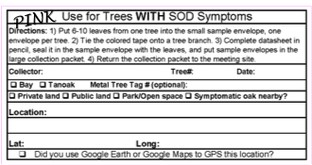
Forms to be used for observational negatives

Slide 11
Tagging trees
We have aluminum tags and nails that will make a tree you sample a permanent sampling tree. GPS coordinates are only required the first time you sample
If you are going to sample a tree through the years (infection status changes with time) it may be useful to tag a tree. Ask for tags at the end of the training
If possible we ask that tags are placed at breast height on the main stem of the tree on its Northern side. Remember to bring a hammer or a mallet. The aluminum nails will not damage the tree, however make sure tagging is Ok with owners

Slide 12
If you encounter a tree that already has the “right” (blue and round) tag, then you can simply put tag number and do not need to determine coordinates for that tree (see next slide)
WHAT IF A TREE IS ALREADY TAGGED?

Slide 13
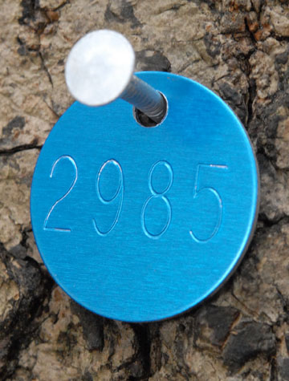
If trees have metal tags, record number on datasheet
Tags are usually found on the north side of the tree at breast height
2985

Slide 14
Final remarks
Make sure you keep samples cool and dry
Make sure you complete form on outside of the packet with estimated number of symptomatic and healthy trees you surveyed (including thsoe you collected)
Make sure you do not bring any plant material with you outside what you placed in collection packet
Make sure you know where the collection bin is to return your samples
Make sure you return samples before the cut off time
Make sure you fill in and include the evaluation form

