Slide 1
Nonlinear shifts in infectious rust disease due to climate change
Joan Dudney, Claire E. Willing, Adrian J. Das, Andrew M. Latimer, Jonathan C. B. Nesmith & John J. Battles
2021 | in Nature Communications
Taylar Bankston, Louis Cimmino, Nicole Lau
April 18 2024
Notes:
first author received her phd in ESPM at Berkeley and is now a postdoc at UCSB.

Slide 2
INTRODUCTION
Knowledge gap: Climate change and host-pathogen-environment interactions are complex and stochastic. As a result, long-term studies investigating range shifts between changing climate effects and emergent pathogens are few and far between.
Research questions and hypothesis: Two questions were asked: 1) whether climate change shifted disease prevalence nonlinearly in Sequoia and Kings Canyon National Park (SEKI) and 2) whether the disease’s range was influenced by varying drought and host-pathogen interactions.
Why SEKI? The two broad reasons are due to environmental and disease factors:
Environmental | high elevational gradient involving climate extremes (humidity, temp); five co-occurring white pine species; old individuals in stands = low genetic resistance; NP = no recent land use change
Disease | historical absence; SEKI is at expansion front
Notes:
“The authors of this paper focused on how the changing climate might affect the prevalence of white pine blister rust in white pine species across an elevational gradient in Sequoia and kings national parks. Prior lab- and field-based studies have shown that diseases respond to temperature and moisture changes, and Though studies predict that range shifts may occur, little research has been completed on the subject. Climate change and host-pathogen-environment interactions are complex and stochastic. As a result, long-term studies investigating range shifts between changing climate effects and emergent pathogens are few and far between.”
The authors asked two questions in this study: One being “Does climate change shift disease prevalence nonlinearly (meaning does the disease develop across space and time in an unpredictable way), and two, is blister rust occurence influenced by drought-pathogen interactions.

Slide 3
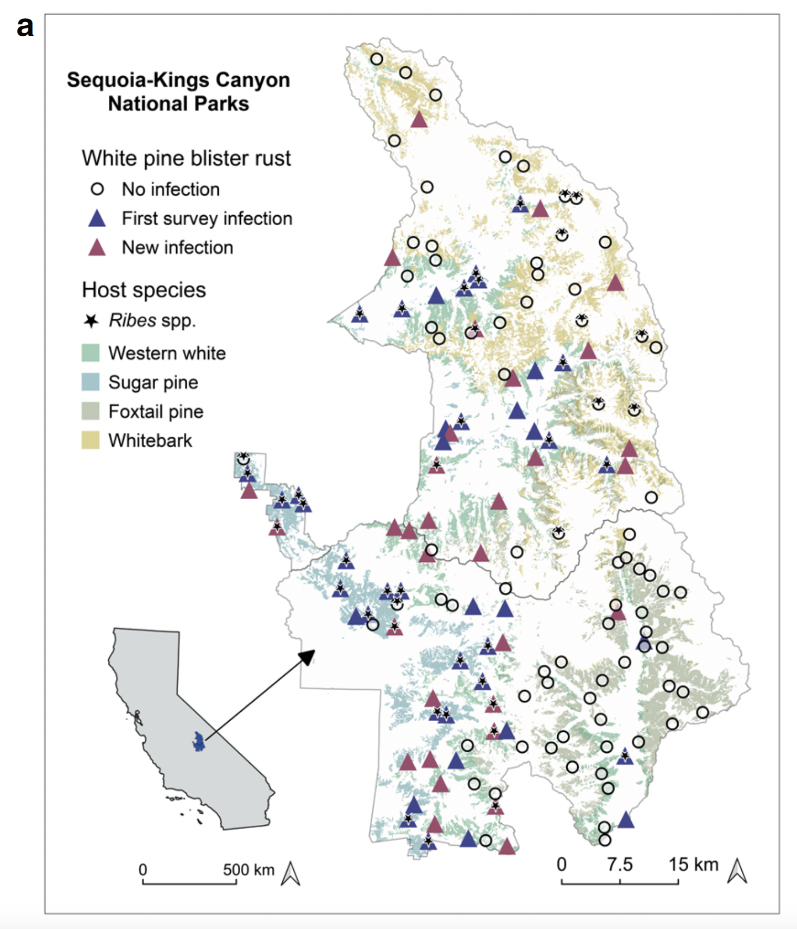
MATERIALS & METHODS
Used tree and plot-level data from two surveys conducted in SEKI between two time frames which spanned 147 plots containing a total of 7,809 white pine stems, and measured DBH, blister rust occurrence, and mortality
To compare how climate changed over time, Dudley et al. averaged the climate variables across two time periods of equal length: 1) the time period between the first and second surveys and the previous 21 years before the first surveys.
Used complementary analyses to quantify the impacts of climate change on blister rust prevalence using generalized linear mixed models
Notes:
To isolate the climate-disease relationship of blister rust, the authors used tree and plot-level data from two surveys conducted in SEKI between two times frames: 1995–1999 and 2013–2017, that spanned 147 plots containing a total of ~7,800 white pine stems, and collected data including DBH, blister rust occurrence, and mortality
To compare how climate changed over time, they averaged the climate variables from PRISM across two time periods of equal length: 1) the time period between the first and second surveys (1996–2016) and the previous 21 years before the first surveys (1975–1995)
They then used complementary analyses to quantify the impacts of climate change on blister rust prevalence
*CLICK ANIMATION IN* heres a map of the plots that were spread throughout SEKI.

Slide 4
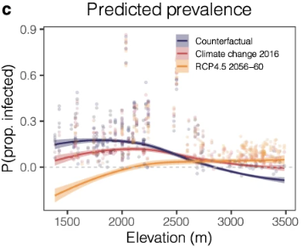
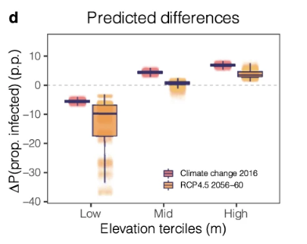
RESULTS
Climate change expanded the geographic area suitable for blister rust infection, resulting in a decrease in blister rust prevalence at low elevations and an increase at high elevations.
Between the first and second surveys, mean climatic conditions became hotter and drier. Authors found a nonlinear relationship between disease prevalence and Vapor Pressure Deficit (VPD)
Climate change contributed to a decline in mean infection risk due to complex, spatially varying host–pathogen–drought interactions.
Notes:
The authors found that climate change expanded the geographic area suitable for blister rust infection in SEKI, resulting in a decrease in blister rust prevalence at low elevations and an increase at high elevations, meaning the disease range shifted upslope.
Climate change contributed to a decline in mean infection risk due to complex, spatially varying host–pathogen–drought interactions. Blister rust shifts were controlled by abiotic-biotic interactions that varied in strength and direction across an aridity gradient. Between the first and second surveys (1996–2016), mean climatic conditions became hotter and drier compared to the previous 21 years. The authors found a Nonlinear relationship between disease prevalence and Vapor Pressure Deficit (VPD)
*CLICK ANIMATION* This is a graph from the paper that predicts disease prevalence as Vapor Pressure Deficit increases: the x axis is elevation, and the y axis is proportion infected, the blue line represents what is to be expected with no climate change, the red line represents current climate change and orange line represents future climate change predictions (2020-2060). The main thing to point out here is how opposite the trend lines are between “no climate change” and future predicted climate and disease prevalence…
And from that graph authors made a graph of predicted differences for current and future climate change: There is a predicted 5% decrease in blister rust at the low elevation and an increase of ~7% at the mid and high.

Slide 5
DISCUSSION
As the range for blister rust expands upward in elevation, new populations with higher vulnerability to the pathogen are likely to be exposed.
And while disease risk is predicted to decline in lower-elevation forests, that may not result in population rebounds for those regions. Rather, we may see ecosystem type shifts.
The direct effects of climate change are likely to be mediated by indirect effects (hence, the non-linear relationship).
Host-pathogen interactions
Drought events and the aridity gradient
Warming temperatures
Results show that climate change ≠ increased pathogen susceptibility at the host range edge.
^Highlights the importance of host availability for projecting pathogen distributions.
Opportunities for further research:
Investigating host-pathogen-drought interactions to understand indirect effects of climate change on plant disease risk.
Identifying how host infection surfaces respond to climate change across aridity gradients.
Notes:
The authors discuss that while we can expect new host populations to become infected at higher elevations, low-elevation host populations may actually decrease in infection rates, although are not necessarily likely to experience population rebounds.
Furthermore, the authors highlight that there are a number of indirect effects of climate change that ultimately influence the behavior of pathogens across various gradients, such as elevation and aridity. Those effects include host-pathogen interactions, drought events, and temperature increases, and demonstrate that host availability (not range edge movement) is the most prominent factor for projecting pathogen distributions.
The authors illuminate some areas for further research as well, primarily including the exploration of those interactions, as well as host physiology.
Thanks for listening!

Slide 6
Ecological, evolutionary, and societal
impacts of invasions by emergent forest
pathogens
Kestrel Grevatt
Amanjot Bains
Edoardo Scali

Slide 7
INTRODUCTION
ss
Emergent diseases includes invasive pathogens that:
Are introduced by humans or
Have a rapidly expanding range due to climate change or habitat transformation
This chapter intended to summarize the broad and less directly obvious effects of emergent tree pathogens
Ecological
Evolutionary (both of hosts and pathogens)
Societal
Many emergent tree diseases have impacts across all three categories

Slide 8
Ecological effects of the emergence or introduction of tree pathogens
ss
Biodiversity overall | SOD - tanoak and oak both keystone species, but tanoak more likely to be completely removed Chestnut blight, ash dieback - trophic web of host dependent organisms lost, but functional recovery possible due to ecologically similar tree species
Wildlife diversity and populations | SOD - bird population smaller but more diverse, pollinator population decreased Dutch elm disease - shift in available habitat due to tree mortality increased woodpecker and understory bird populations
Mycorrhizal networks | Altered endophytic communities and general decline in mycorrhizal networks and microbial interactions, but relationships are dynamic and complex
Food webs and nutrient cycling | Shifts in forest composition and growth rates, reduced carbon sequestration, increase in litter composition and soil nitrates
Wildfire resilience | Increase in coarse woody debris (CWD) and reduced moisture content of stem and foliage of diseased trees results in increased flame length, ROS, surface fire intensity, and hot spots/torching in wildfire scenario Unpredictability of this demonstrated by coast-redwood (4x increased mortality risk when impacted by SOD)

Slide 9
Evolutionary effects of the emergence or introduction of tree pathogens
ss
Direct effects on the pathogens
Bottleneck effect, Introduction of single or multiple mating type
Effects on emerging and native pathogens mediated by interspecific hybridization and genic introgression
Outcomes of interspecific hybridization: 1) Phytophthora alni; 2) H. irregulare×H. occidentale; 3) establishment of H. irregulare in Lazio (Italy); 4) Dutch Elm Disease poathogen’s interspecific hybridization.
Effects on the hosts of emerging pathogens
Removal of susceptible genotype; positive selection of resistant genotypes with impact in breeding of resistant individuals; correlation between tree size and disease incidence; association of host traits with disease severity or incidece.

Slide 10
Societal effects of the emergence or introduction of tree pathogens
ss
Historical instances
Heterobasidion spp. causing annual damage of ~800 million Euros to European timber industry.
Economic effects
Loss of revenue from timber, tree products, & ecosystem services. Damage to local economies because of tree mortality, reduced growth rates, and inferior quality of tree products.
Direct impacts
Chestnut blight: billion trees killed, US timber industry destabilized, social changes - urbanization & migration out of rural areas
Non timber forest resources: Decline in mushroom foraging, honey production, etc. dependent on healthy trees
Cultural/ aesthetic impacts: loss of iconic tree species altering landscapes/ recreational areas. Removal of culturally significant trees leading to disconnect with heritage and traditions.
Indirect impacts
Spread of tree pathogens to cultivated crops (affecting industries like avocado orchards)
Conclusion Need for comprehensive/ collaborative approaches to address challenges posed by emergent tree diseases.
Policies/ regulation to reduce frequency/impact of invasive tree diseases which need to be science based, culturally sensitive, fair, historically informed. Costs to control tree diseases should be considered as an additional economic impact - tree removal, pathogen eradication, disease management efforts. Accepting control strategies can be easier in affected communities but social acceptance is needed for stakeholders. VERY COMPLEX!

Slide 11
How Do Plant Diseases Caused by Xylella fastidiosa Emerge?
Rodrigo P. P. Almeida (2015)
Trish Le
Katia Diaz
Victoria Dy
Jennifer Hernandez

Slide 12
INTRODUCTION
Xylella fastidiosa causes bacterial leaf scorch on a wide range of host plants and is vectored by xylem-sap feeding insects and the movement of infected living plants
It is distributed in the Americas with invasion to Europe and has resulted in Pierce’s disease and oleander leaf scorch (California)
Subspecies are capable of recombining and adapting to new plant hosts through IHR and genetic exchange
Notes:
Trish
might change third point if its better for discussion, or keep to reiterate

Slide 13
MATERIALS & METHODS
olive trees identified to have a disease, have coDiRo, but also identified X, fastidiosa
Electron Microscope observations on thin sectioned olive leaves showed element accumulations
serological and molecular assays to detect bacterium
transmission tests with field collected insects to identify the vector and their role
surveys conforming the spread of X. Fastidiosa

Slide 14
RESULTS
olive isolate of X. fastidiosa is related to the subspecies pauca, but is distinct from the other pauca strains that have been characterized so far
among the few vector species identified, the most common was Philaenus spumarius., the meadow spittlebug. Testing showed that P. spumarius transmits X. fastidiosa strain CoDiRo to olive and other host plants, not only periwinkle plants.
the surveys have shown that olive, oleander, almond, cherry, Polygala myrtifolia, Westringia fruticosa, Acacia saligna, Spartium junceum, Myrtus communis, Rosmarinus officinalis, Rhamnus alatemus, and Vinca minor are susceptible hosts under natural field infections

Slide 15
DISCUSSION
Xyllela fastidiosa can have very complex dynamics
In general, this bacteria works by colonizing the xylem vessels of the plant which disrupts water & nutrient flow. This leads to symptoms like leaf scorching, stunted growth, and eventually plant death
Differences in severity of the bacterium on different hosts have led researchers to conclude that because it’s unclear what proportion of contacts between fastidiosa and host plants lead to disease, it’s been suggested that x. fastidiosa might primarily function as an endophyte rather than a pathogen
Human Activity has prompted the spread of X. fastidiosa
The main way of spread has been when an exotic genotype is introduced into an environment that turns out to be suitable for sustaining the bacteria in that plant community
The bacteria has been dispersed widely when infected plants/ plant materials are moved from where the pathogen occured
Evolutionary Adaptations
The genetic variability within X. fastidiosa enables it to adapt to new hosts and environments through genetic exchange and recombination
Scientists found that the bacteria’s genes changed when it infected these new plants and shows that human actions can lead to the bacteria infecting plants it couldn’t before which is important to understanding how to control the spread of the disease
Notes:
The interactions between x.fastidiosa depends on several factors that are influenced by more and more factors. Things like the host, insect vector, environmental conditions, genetic variability can all contribute to how severe or mild the effects of the bacterium are.
Overall, this bacteria works by colonizing the xylem vessels of plants, disrupting the flow of water and nutrients. This can lead to symptoms like leaf scorching, wilting, leaf drop, stunted growth, and eventually, the death of infected plants.
Differences in severity of the bacterium on different kinds of hosts have led research to conclude that because it's unclear what proportion of contacts between X. fastidiosa and host plants in natural ecosystems lead to disease. a suggestion has been made that X. fastidiosa might primarily function as an endophyte rather than a pathogen
Human Activity
The primary pathway leading to X. fastidiosa spread involves the introduction of exotic genotypes into environments conducive to the maintenance of the bacterium in plant communities.The bacteria has been dispersed widely when infected plants/ plant materials are moved from where the pathogen occured
Rapid Olive Decline in Italy:
Outbreak in Apulia region of Italy in 2013
Strain that was not previously in South America was detected in Costa Rica affected oleander
Introduction of the strain into Italy represents invasion into new region infecting novel hosts of olive and olender
Pierce's Disease of Grapevines:
thought to have originated from Gulf Coast Plain but turns out the genotype that causes Pierce’s disease in grapevines is from Central America
It’s hypothesized that a single genotype was introduced to the US through an infected coffee plant
Spread widely in grape-growing regions in the US
Pierce’s reported in Taiwan which might’ve been from an inadvertent introduction via an infected plant
Evolutionary Adaptations
The genetic variability within X. fastidiosa enables it to adapt to new hosts and environments through genetic exchange and recombination.
The passage discusses the introduction of exotic genotypes of X. fastidiosa into new regions, which can lead to the emergence of diseases involving novel plant hosts. For example, the case of mulberry leaf scorch highlights how X. fastidiosa invaded a new host, mulberry trees, leading to disease emergence in previously unaffected areas.
This disease was initially observed in Washington DC in the early 1980s and later spread along the eastern seaboard to southern New York. The disease eventually appeared on the west coast in California. Genetic analysis revealed a chimeric genome resulting from genetic exchanges between different subspecies of X. fastidiosa, leading to the proposal of a new subspecies, subsp. morus.
Scientists found that the bacteria's genes changed when it infected these new plants. This shows how human actions can lead to the bacteria infecting plants it couldn't before, which is important to understand to control the spread of the disease.
Victoria

Slide 16
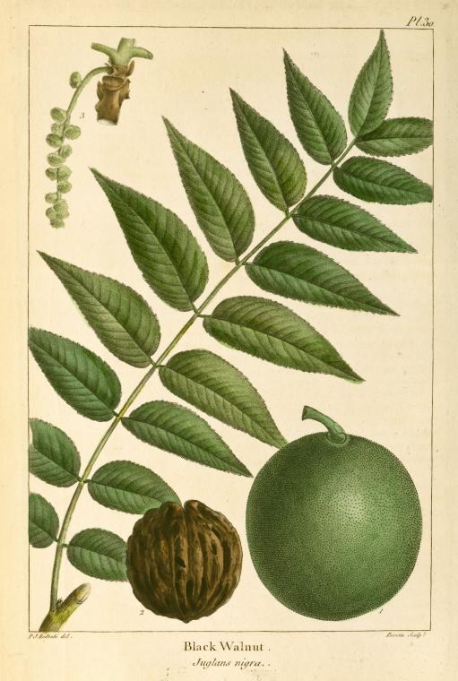
Regional Differences in the Structure of Juglans nigra Phytobiome Reflect Geographical Differences in Thousand Cankers Disease Severity
Onufrak et al., 2020
Lee Farese, Zoe Fung, and Analise Gutierrez
ESPM 290: Emergent Diseases Threatening CA Ecosystems

Slide 17
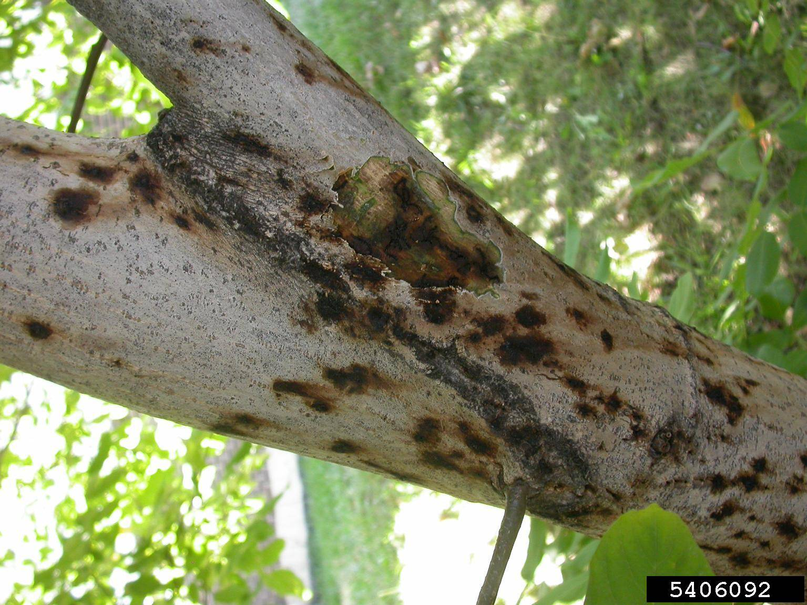
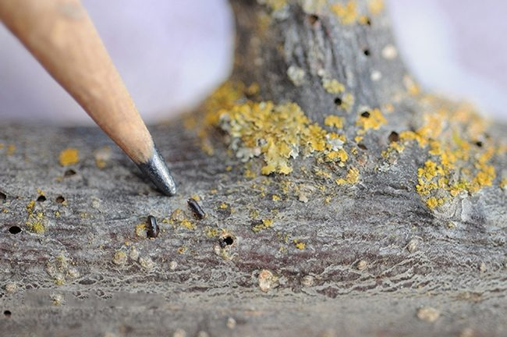
Introduction
Black walnut (Juglans nigra) - deciduous hardwood native to the Eastern U.S., & widely introduced in the West
Important timber & food crop tree
Thousand cankers disease (TCD) - caused by fungus Geosmithia morbida and vectored by the walnut twig beetle (WTB), Pityophthorus juglandis
Likely originated in Southwest & Mexico
TCD incidence is highest in Western States
Hypothesis: regional differences in the phytobiome of J. nigra between native and introduced ranges may explain differences in TCD incidence and severity
Notes:
TCD causes yellowing foliage, branch mortality, small circular bark cankers, and bark cracking

Slide 18
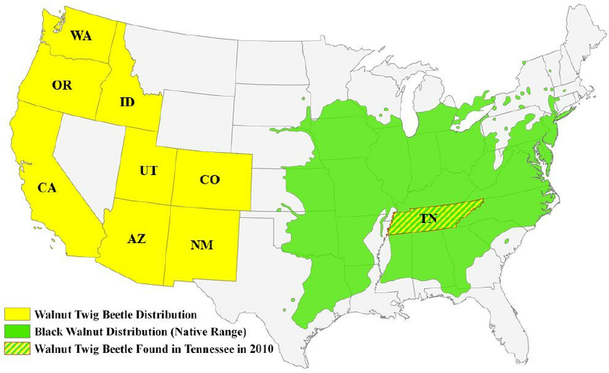
Materials & methods
Study areas:
Tippecanoe County, IN
Northern native range
Polk & Knox Counties, TN
Southern Native range
Walla Walla County, WA
Introduced range
Stem Microbiome sampled via drill shavings
Soil microbial communities sampled via leaf litter, debris samples & soil cores
Sequenced DNA of sample to determine community composition, diversity, & richness

Slide 19
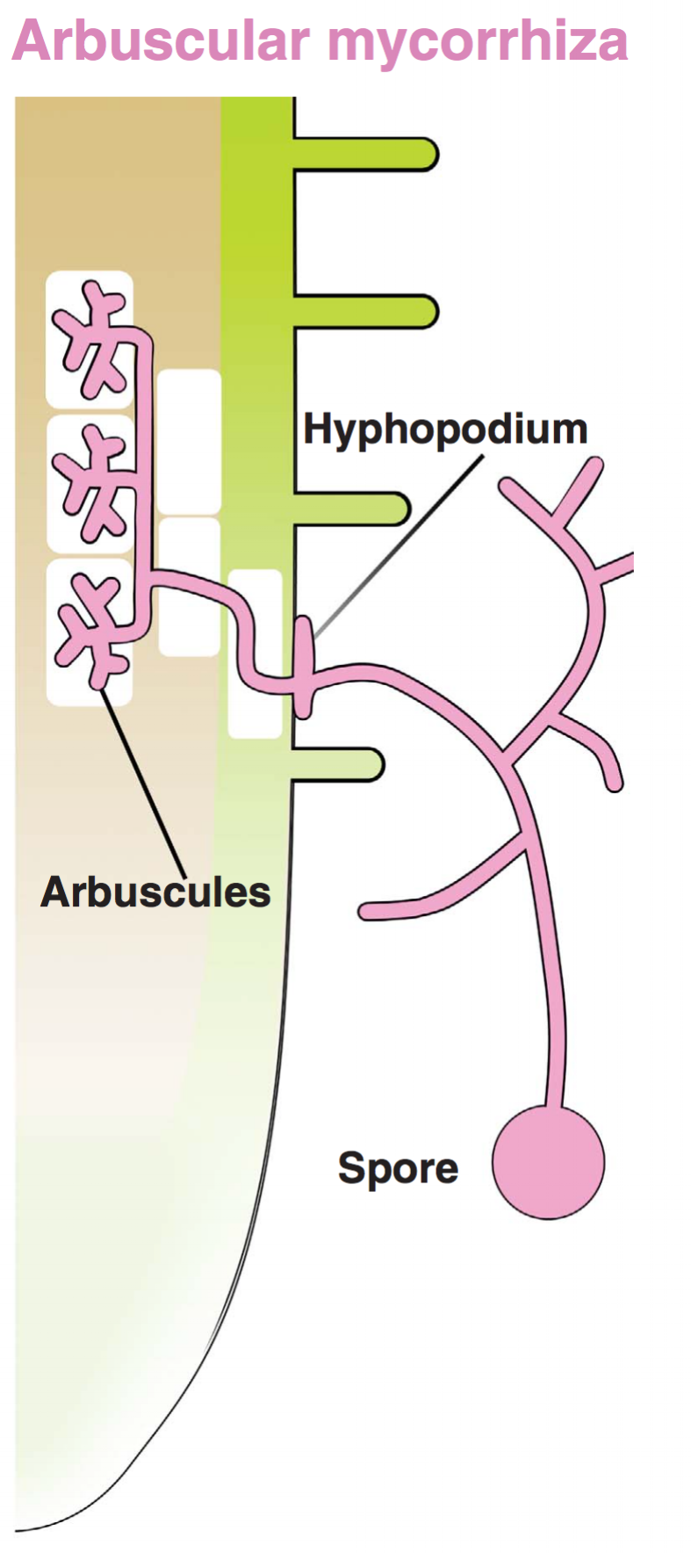
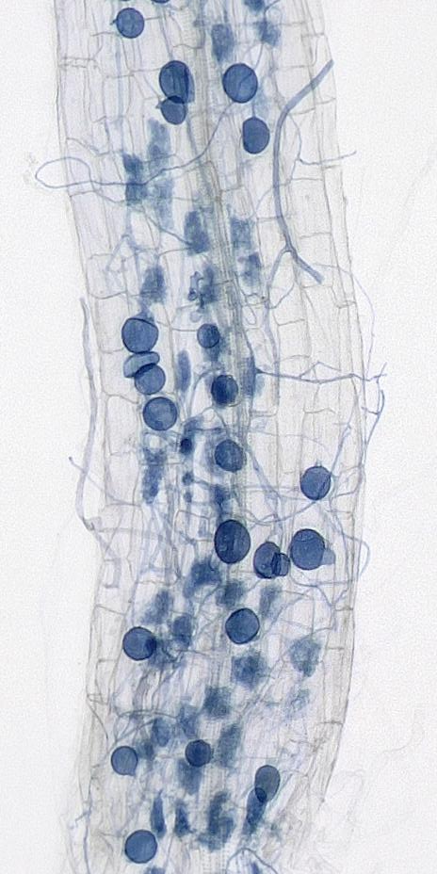
Results
Mycorrhizal richness significantly higher in IN & TN than in WA
Plant pathogen and mycoparasite communities significantly different between native and introduced ranges
Significantly different soil physicochemical properties between the three states

Slide 20
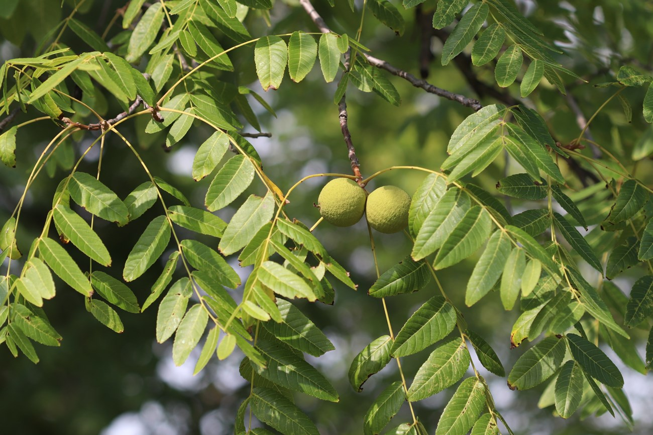
Discussion
Higher levels of diversity in IN & TN stem phytobiomes could potentially limit success, severity, & spread of G. morbida in J. nigra native range
Greater mycorrhizal richness in native range may suppress TCD
J. nigra has likely encountered novel pathogens (including secondary pathogens), or lacks mutualists, in its introduced range
Plant tissue microbial communities are more influenced by host biology and competition with other microbes, while soil microbial communities are more influenced by dispersal and soil physicochemical properties
More research is needed to understand whether low diversity is cause or result of TCD infection, understand the impact of land-use history & habitat differences

Slide 21
Fast and Reliable Molecular Methods to Detect Fungal Pathogens in Woody Plants
Minya Pertel
Nadia Mayer
Steven Zhang

Slide 22
INTRODUCTION
Plant diseases caused by pathogenic microorganisms are a serious threat to plant productivity, food security, and natural ecosystems. New plant pathogens are being introduced in large due to an increase in international plant trade and widespread sale of ornamentals. Though biosecurity protocols are in place for plant protection in many places, this detection is often difficult, time-consuming, expensive, and difficult to identify, especially in pre-symptomatic stages.
This growing need to identify pathogens quickly leads us to goals of reducing the amount of time required for diagnoses. Plant pathologists seek better strategies of identification – ones that are more rapid and more sensitive, such as molecular techniques. This review focuses on fast and reliable molecular methods to detect the presence of woody plant pathogens at early stages of disease development, prior to the development of symptoms in the host.
The study provides an overview of new molecular-based techniques that are reliable, rapid, and accurate. These techniques are capable of intercepting woody plant pathogens before symptoms occur in the host, thus mitigating the impact of these pathogens on both invasive and native organisms.

Slide 23
MATERIALS & METHODS
Classical diagnostic methods for fungal pathogens involve symptom observation and isolation for identification due to the various microorganisms also found in plant tissues. Advances led to using specific antibodies in ELISA ( enzyme linked immunosorbent assay) and lateral flow devices, however this technique has risk for false positives and lower sensitivity.
Preferences have shifted to molecular approaches such as qPCR, due to their rapidity and high sensitivity when directly sequencing ribosomal RNA genes for accurate identification, rather than analyzing genetic differences among populations. This bypassed the need for culturing when diagnosing fungal pathogens and identifying species.
Current development and validation of molecular methods involve a process starting with purpose definition, target pathogen identification, and selection of the sampling matrix. The RNA ITS sequence is often used as a ‘barcode’ sequence for fungi due to its ability to distinguish between species. Validation includes assessment of assay development, analytical and diagnostic performance, reproducibility, along with evaluation of calibration, analytic specificity, sensitivity, and robustness.

Slide 24
RESULTS
The results section presented in the review demonstrate that molecular diagnostics, especially like qPCR, significantly reduce the time required for pathogen detection from days to just a few hours, without compromising accuracy.
Case studies within the paper illustrate successful applications of these methods across various geographical regions and plant species, such results proves their effectiveness in diverse environmental conditions and against a range of fungal pathogens.
The paper shows quantitative comparisons between traditional methods and molecular techniques. There’s also enough statistical evidence of the molecular technique’s superior performance in early and accurate pathogen identification.

Slide 25
DISCUSSION
The discussion highlights the transformative potential of molecular diagnostics in managing plant health. The article suggests that technologies represent a major advancement over traditional visual and culture-based methods.
The paper also discusses the challenges of integrating these new technologies into existing plant health management frameworks, such as the need for training, standardization of protocols, and ensuring accessibility to these tools for wide adoption.
Future perspectives are considered, where ongoing research could further improve the specificity, cost-effectiveness, and user-friendliness of molecular diagnostics, particularly through the development of portable field-testing kits.

Slide 26
Emerging Fungal Threats to animal, plant and ecosystem health
Name 1 Elijah Brown
Name 2 Spencer Benlien
Name 3: Hayden Salfen

Slide 27
INTRODUCTION:
Fungal Disease Often Leads To Host Extinction
Past decades have shown an increase in virulent infectious. Many of these fungal diseases have killed off many wild species.
Fungal pathogens can also cause extirpation since it makes species highly vulnerable to env conditions. Needing relocation
Causes widespread loss of crops, amphibians, and bats. (Central America saw loss of 40% of amphibians due to fungal pathogens)
Human Activities Have Stimulated The Evolution Of Fungal Pathogens
Practices such as ag (monocultures and chemicals) and also deforestation/ habitat destruction = fungal Pathogens.
Climate Warming from anthropogenic practices has also been associated with the rise of fungal pathogens.
Migrating Fungal EID’S In Animals And Plants
Though trade and human migration many fungal pathogens (through animal/plant hosts) can be spread to plants and even animals in different countries
Global Monitoring on int trade and integration of theoretical/practical epidemiology can help combat the spread of migrating fungal pathogens.

Slide 28
MATERIALS & METHODS:
Disease alerts: recording patterns of EIDs (pathogens that are increasing in incidence, geographic or host range, and virulence) by disease monitoring programs like ProMED and HealthMap
1) active reporting of disease outbreaks
2) capturing diverse online data sources
Peer-reviewed Literature: used primary research literature for reports in which EIDs have caused host extinction events at regional or global scale
Literature searched and compilation of previous meta-analysis of infection-related species extinction show that fungi comprise the highest threat for both animal-host (72%) and plant-host (64%) species
Observation: the data found from disease alerts, literature, and patterns in human fungal EIDs, supports the answer to their question that fungi pose a greater threat to plant and animal biodiversity relative to other taxonomic classes of pathogen and hosts, and the threat is increasing

Slide 29
Results:
Disease Monitoring and Trends
Analysis of disease alerts from ProMED and HealthMap has shown an increase in reports of fungal diseases. These platforms have captured real-time data that reveal trends in the spread and severity of fungal diseases across different regions and host species.
Impact on Host Populations
A thorough review of peer-reviewed literature has documented multiple instances where fungal diseases have led directly to host extinctions, particularly in plant populations. These findings were gathered to assess the extent of the threat posed by fungal pathogens relative to other disease agents.
Comparative Threat Analysis
The collected data indicate that fungi pose a greater threat to biodiversity than many other pathogens. This analysis supports the study's assertion that fungal pathogens are among the primary drivers of biodiversity loss, affecting a significant percentage of plant-host species globally.

Slide 30
DISCUSSION:
Implications for Biodiversity and Ecosystem Health:
Serious threats to global biodiversity and ecosystem health from increasing virulence and incidence of fungal diseases. These pathogens, responsible for host extinctions, significantly disrupt ecological balances, affecting ecosystem functions and services. This highlights the importance of understanding how these pathogens alter ecological dynamics and their long-term consequences for natural and agricultural systems.
Globalization and Disease Spread:
The research indicates that global trade and transport facilitate the rapid spread of fungal pathogens across borders, pointing to a significant vulnerability in current global biosecurity measures. Strengthening these measures, including improved monitoring at points of entry and stricter quarantine regulations, is essential to reduce the risk of further spread.
Future Directions and Mitigation Strategies:
The pressing threat posed by fungal diseases to plant health necessitates the development of integrated management strategies. The study suggests focusing research on developing resistant crop varieties, advancing biological control methods, and enhancing predictive models to better anticipate outbreaks. It also calls for stronger international collaboration among research communities, policymakers, and stakeholders to formulate effective responses.

Slide 31
Evolutionary Ecology of Plant Diseases in Natural Ecosystems
Author: Gregory S. Gilbert
Zoey Morales
Natalia Lelan-Cox
Anna Magruder

Slide 32
INTRODUCTION
[Host Mortality, Growth, and Reproduction]
Pathogens affect host population dynamics by directly influencing the survival, growth, and fecundity of individual plants. They can hinder reproduction by killing plants before they can reproduce, or by reducing reproductive output through effects on growth and fecundity. Examples abound in agricultural systems, and similar effects are observed in wild host plants. Gilbert categorizes wild plant diseases based on their impact on host survival, growth, or fecundity, and presents a comprehensive overview of various disease types.
[Population dynamics, species interactions, diversity]
Ecological dynamics of plant diseases can be examined through three main themes: (1) density-dependency, (2) cross-generational effects, (3) pathogenic effects on competition, succession, and diversity
[Rapid Evolution and Local Adaptation]
Plant-Pathogen interactions involving ecological and evolutionary aspects in natural ecosystems is a complex process involving rapid evolution and local adaptation. The overall process of how host plants and pathogens evolve in response to one another can be accounted for in three main factors: (1) generation time, (2) genetic variability, and (3) spatial dispersal patterns.

Slide 33
[Host Mortality, Growth, and Reproduction]
Foliar Diseases: Foliar pathogens, including fungi, bacteria, and viruses, reduce leaf area and photosynthetic activity, affecting seedling survival and hindering growth and reproduction in larger plants, though rarely directly causing mortality
[Population dynamics] Density dependence has direct + indirect effects on host-pathogen encounter rates. Negative density dependence can exist in certain situations such as if an alternate host is necessary or the pathogen has short term effects.
[Rapid Evolution and Local Adaptation]
Red Queen Hypothesis: Used to understand the continuous adaptation race between hosts and pathogens. Wild hosts can evolve resistance to pathogens which results in the coevolutionary arms race.
Spatial Scale: Used to help determine the outcome of host plants and pathogens and is central to the ecological and evolutionary dynamics of plant-pathogen interactions.

Slide 34
[Host Mortality, Growth, and Reproduction]
Seed and Seedling diseases: Fungal infections commonly afflict fresh seeds, influenced by interactions with frugivorous animals, while damping-off diseases caused by Oomycetes significantly impact seedling survival, particularly in environments with varied conditions.
[Population dynamics] Compensatory effects need to be taken into account when examining pathogen population dynamics. A reduction in the number of plants does not have a negative effect on the population if it does not result in an overall reduction of seed production.
[Rapid Evolution and Local Adaptation]
As a specific host becomes more prevalent, its pathogens may increase in numbers and as a result hosts can evolve resistance to their pathogens. Continuous adaptation is important for plant hosts and pathogens in order to maintain their survival and reproductive success.

Slide 35
Conclusion
[Host Mortality, Growth, and Reproduction]
Other Disease Types and Their Impacts: Systemic infections, parasitic plants, cankers, wilts, diebacks, root and butt rots, and floral diseases all contribute to shaping plant populations. These diseases can cause severe effects, from reduced growth and reproduction to significant tree mortality, highlighting the diverse and substantial impacts pathogens have on natural ecosystems.
[Population Dynamics] Competitive exclusion would lead to low diversity in theory. Negative interactions within species (often involving pathogens) contribute to cohabitation and increased diversity (Janzen-Connell Hypothesis).
[Rapid Evolution and Local Adaptation]
Understanding pathogen dispersal and host specificity in various environments provides insight on plant pathogen interactions and their process of evolution. By utilizing the spatial scale of these rapid evolutionary changes and focusing more on improving these materials/methods will allow for better management of disease impacts and outcomes that their interactions will have.

Slide 36
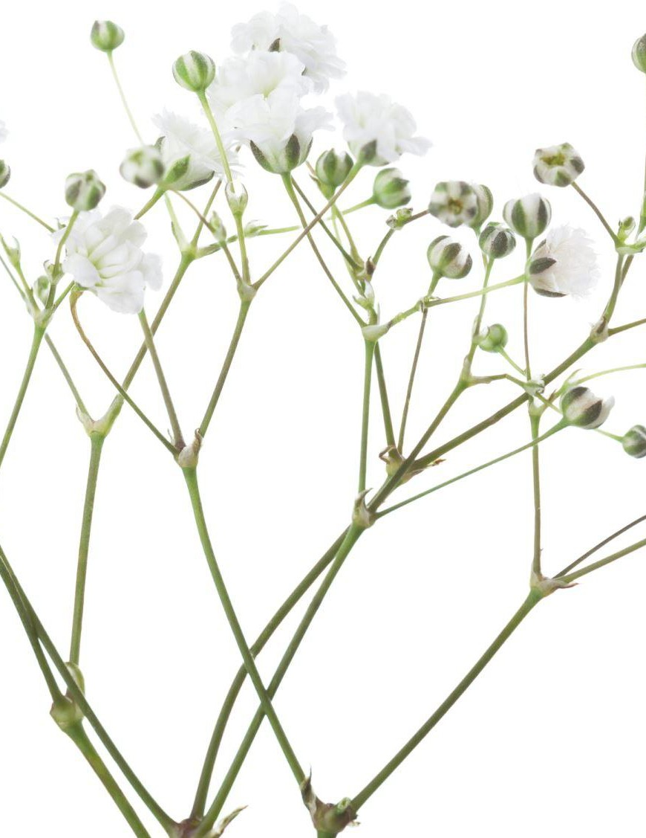
A Framework to Evaluate Climate Effects on Forest Tree Diseases
Authors: Paul E. Hennon, Susan J. Frankel, Alex J. Woods, et al.
Daniel Conway Heyichen Xu James Jiang

Slide 37
INTRODUCTION
Although several studies impacts of climate change on forests, this focuses on how a changing climate affects forest tree diseases, a foundation and language to help guide discussion, and introducing a method to critically evaluate possible climatic controls of disease.
Objectives:(a) concepts for demonstrating causality in climate- and climate change-driven forest diseases and (b) methods for evaluating the extent and certainty of any climate involvement. .
Modified Disease Triangle:Type 1 and Type 2 climate-pathogen diseases

Slide 38
MATERIALS & METHODS
A framework is proposed to evaluate the potential roles of climate, climate change, and related environmental factors in forest tree diseases, suggesting constructing hypotheses linking climate to specific diseases and evaluating various factors to determine the strength of this connection.
Climate-spatial
Fine scale - local, stand
Mid-scale - watershed to regional
Broad scale - range-wide
Climate-temporal
Near-term - weather, seasonal
Mid-term - decadal oscillation
Long-term - regime shift

Slide 39
RESULTS
Forest trees
Assess the vulnerability of tree species to climate stress compared to others nearby.
Consider tree age, genetics, and provenance tests for insights into disease susceptibility.
Species with narrow climatic ranges are more vulnerable to climate change.
Climate affects tree phenology, influencing disease occurrence.
Pathogens
Weather and climate affect a pathogen's life cycle and ability to infect trees.
Short-term weather factors influence a pathogen's reproduction and infection.
Chronic infection pathogens may show a climate relationship over long periods.
Certainty for climate involvement
Climate change impacts forest health and can contribute to increased stress and mortality in trees, as well as affecting pathogen populations.
Certainty of climate involvement in disease development is assessed on a gradient from none to confident, based on the strength of associations between climate factors and disease outbreaks.
Confirmed climate involvement requires robust evidence, including consistent associations between climate patterns and disease outbreaks, with no credible alternative explanations, and established mechanisms linking climate to tree stress or pathogen population increase.

Slide 40
DISCUSSION
Establish links between fluctuations in climate and forest diseases
Two primary types of climate-induced forest tree disease, one where climate favours pathogens to increase disease, and another where climate directly stresses trees
The framework improves communication with stakeholders and aids in understanding the role of biotic agents, host genetics, climate, and other environmental factors in forest disease expression.

Slide 41
Tree Diseases as a Cause and Consequence of Interacting Forest Disturbances
Samuel Bobick
Jessica Katz
Brooke Ramirez
Malena Twomey

Slide 42
INTRODUCTION
Landscape ecology: study of ecological changes that occur over large spatial scales; can be applied to heterogeneous ecosystems (a landscape) or regions (a collection of landscapes).
Historically, forest pathology has tended to examine disease in isolation from other dynamics and processes
In this paper, the authors suggest a nexus of the forest pathology and landscape ecology that can improve understanding of landscape dynamics and disease emergence at broad spatial extents.

Slide 43
MATERIALS & METHODS
This paper is a review article; it does not present new research (i.e., no materials or methods per se) but instead synthesizes the "strengths of research needs" of the forest pathology and landscape ecology fields as they relate to understanding disease-disturbance impacts at the landscape scale.
In their discussion of forest pathology, the authors review the disease triangle as a conceptual framework for understanding disease emergence. They then describe several examples of mechanisms (and cite the supporting literature) through which disturbances might influence the three elements of the disease triangle.
In their discussion of landscape ecology, the authors discuss how this field approaches the study of interacting disturbances and summarize the (relatively few) studies that have focused on two-way disease-disturbance interactions (here, they also draw on literature focused on insect-disturbance interactions).

Slide 44
RESULTS
This article was a review did not have any results but it did have a conclusion which is summarized below:
Forest diseases and their impacts are influenced and/ or modified by “Landscape-scale disturbances” which include land use by humans, wind events, and fires. Although diseases are impacted by such disturbances these same disturbances can be likely magnified and affected by the diseases present in that area.
The disease triangle model has shown to be useful for both understanding disease-disturbance interactions but its main use was to evaluate the opposite which is how environmental factors influence disease emergence. The use of the triangle model to understand disease-disturbance interactions is helpful because it allows for the furtherance of research on disease influence on disturbance processes.
Collaboration has always been important in research and has proven so as collaboration between forest pathologists and landscape ecologists has fostered the development and testing of predictions on diseases-disturbance interactions. This joint effort has allowed for better, more informed, land management decisions, policies, and actions to be taken

Slide 45
Discussion
Studies of these disease-disturbance interaction have been limited, as the authors discussed with the sudden oak death system. Management has generally included the removal of at risk trees and an increase in prescribed burns.
It is still unclear how forest management has influenced disease dynamics outlined in this article. With the context of a changing climate, what are some considerations for further studies in this area? In particular, two-way disease-disturbance relations?
The authors outline difficulties in scaling up research from smaller, ecological studies to larger landscape scale research. How do ecological processes and patterns differ when examined at the landscape scale compared to smaller scales? How can understanding dynamics at the landscape scale inform conservation and management practices in heterogeneous environments?

Slide 46
Sudden Oak Death: Interactions of the Exotic Oomycete Phytophthora ramorum with Naïve North American Hosts
Connie Ryan
Ashlyn Olah

Slide 47
INTRODUCTION
Phytophthora ramorum, the causal agent of sudden oak death (SOD), is spread through the movement of infectious zoospores contained in sporangia. P. ramorum is spread aerially through rain droplets and can survive in harsher conditions than other species in the Phytophthora genus.
The origin of P. ramorum is unknown, but believed to be of eastern Asian origin. P. ramorum has 4 genetically and phenotypically different lineages which undertook independent evolution in geographically isolated areas. Each of these lineages almost exclusively carries out one mating type.
Introduced into forest ecosystems through ornamental plants in the wildland-urban interface. P. ramorum causes lethal cankers, leaf and branch dieback, and leaf blotches or spots on different hosts. The main host of SOD is bay laurel.
Notes:
probably something about how it’s spread, origin (or lack thereof…. idk how old this paper is), hosts, etc.
Phytophthora ramorum, the causal agent of sudden oak death (SOD), is spread through the movement of infectious sporangia. P. ramorum is spread through rain droplets and can survive in harsher conditions than other species in the Phytophthora genus.
Introduction into forest ecosystems through ornamental plants in the wildland-urban interface (WUI). P. ramorum causes lethal cankers, leaf and branch dieback, and leaf blotches or spots on different hosts. These are the main symptoms associated with SOD.
The origin of P. ramorum is unknown, but believed to be of eastern Asian origin. P. ramorum has 4 genetically and phenotypically different lineages which undertook independent evolution in geographically isolated areas. Each of these lineages almost exclusively carries out one mating type.
P. ramorum causes lethal cankers, leaf and branch dieback, and leaf blotches or spots on different hosts.

Slide 48
MATERIALS & METHODS
Spatial autocorrelation: Analysis was conducted to determine how far the infectious sporangia can move, which was assumed to be 10 meters due to capture in rain traps. However, spatial autocorrelation suggests that it can move up to 3-5 km from the host. This is also confirmed by field observations.
Laboratory disease trials: P. ramorum was tested in laboratory settings to identify the key elements of infection, including optimal air temperature for infection and zoospore density needed for infection. Findings were also observed in field settings.
Genetic analysis: Conducted to determine the evolutionary dynamics of the pathogen. This helps determine where the pathogen has spread, adaptations it may have developed, and survival characteristics.
Notes:
laboratory settings, sampling in CA and beyond, etc
Genetic analysis: Conducted to determine the evolutionary dynamics of the pathogen. This helps determine where the pathogen has spread, adaptations it may have developed, and survival characteristics.
Spatial autocorrelation: Analysis was conducted to determine how far the infectious sporangia can move, which was assumed to be 10 meters. However, spatial autocorrelation suggests that it can move up to 3-5 km from the host. This is also confirmed by field observations.
Laboratory disease trials: P. ramorum was tested in laboratory settings to identify the key elements of infection, including optimal air temperature for infection and zoospore density needed for infection. Findings were also observed in field settings.

Slide 49
RESULTS
Spread: Primarily vectored through bay laurel (leaves) and tanoak; oaks are ‘sink’ and non-infectious; sporulation and infection requires wet conditions (rain) & peaks in warm (late-spring) rains. Phenological synchronization of oak susceptibility and bay laurel spore production facilitates spread. Oak infection occurs primarily in ‘wave’ years.
Laboratory: Infection highest 18-20ºC; infection of bay laurel & tanoak possible with low spore count, but oak infection requires 10,000 spore/mL minimum.
Genetic analysis: Primarily only NA1 lineage is found in CA, and limited evidence of hybrid viability moderates risk of sexual reproduction; California populations from 1 progenitor that spread nursery to wildland with 3 genotypes that descended and spread clonally across CA.

Slide 50
DISCUSSION
Spread: Mild coastal climate facilitates survival through hot dry summers; spread may be environmentally limited by areas with hot, dry summers.
Laboratory: Spread highly dependent on rain occurring later in spring in warmer temperatures. High inoculum load to infect oaks causes periodic infection waves every 4-5 yrs, while bay laurel & tanoak spread yearly.
Genetic Analysis: Evidence of adaptation from original CA nursery genotype to 3 main genotypes responsible for spread. Introduction of other lineages risks sexual reproduction and rapid evolution.
Notes:
not sure about these

